Slide 2
Teacher’s identity
Farzana Yasmin
Assistant Teacher
Rongarchar Government Primary School
Sunamgonj sadar
Sunamgonj.

Slide 3
Lesson identity
Class – Four
Unit – 40
Lessons – 1-2
A garment worker’s day
Activity – A
Part – 1

Slide 4
Learning outcomes:
Listening
1.1.1 recognize sound differences in the context.
1.2.1 recognize which syllable in a word is stressed.
1.3.1 recognize which words in a sentence are stressed.
4.3.1 enjoy and understand simple stories.
Speaking
1.1.1 say words, phrases and sentences with proper sounds and stress.
Reading
1.5.1 read words, phrases and sentences in the text with proper pronunciation, stress and intonation.
1.7.1 read short paragraphs, dialogues and simple letters.
5.1.1 read silently with understanding paragraphs, stories and other text materials.

Slide 5
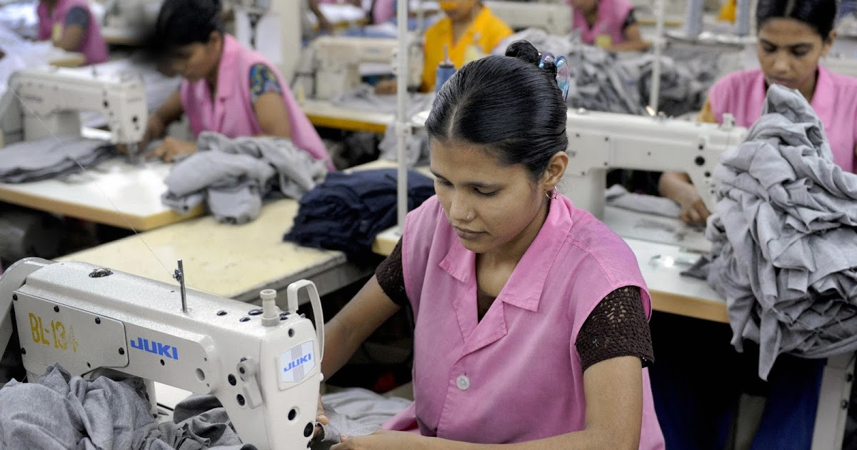
A garment worker’s day

Slide 6
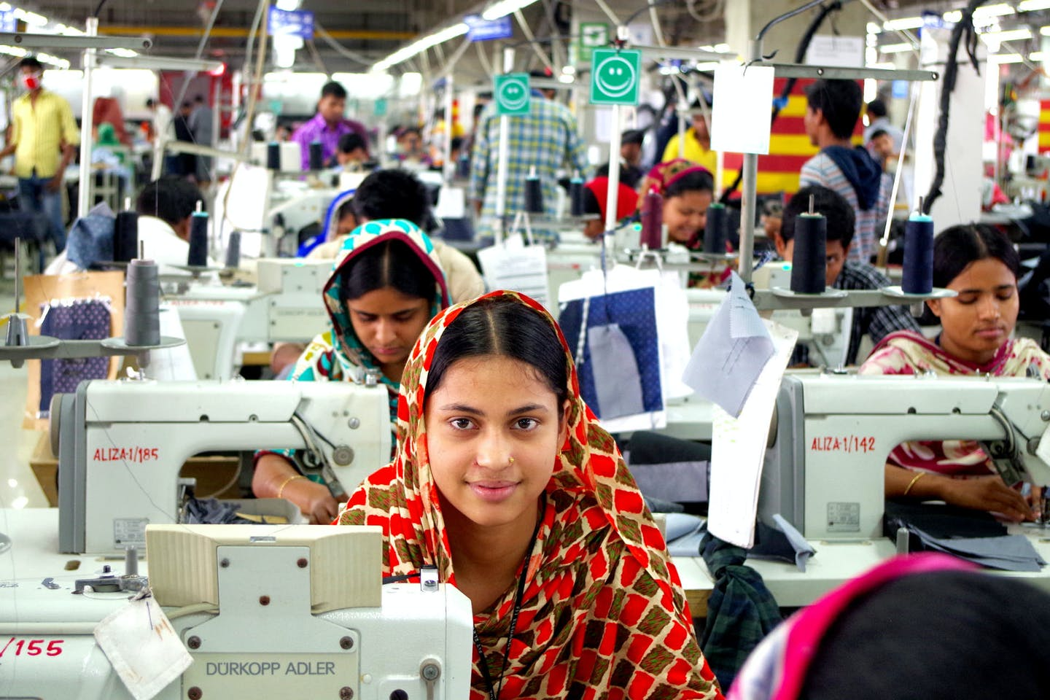
Reshma is a garment worker in Dhaka. She’s 18 years old.

Slide 7
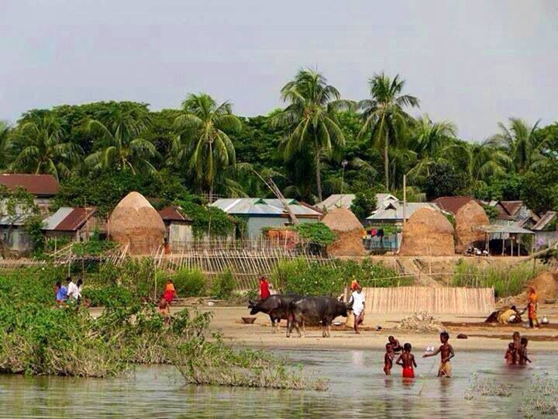
Her family came to Dhaka from a village eight years ago.

Slide 8
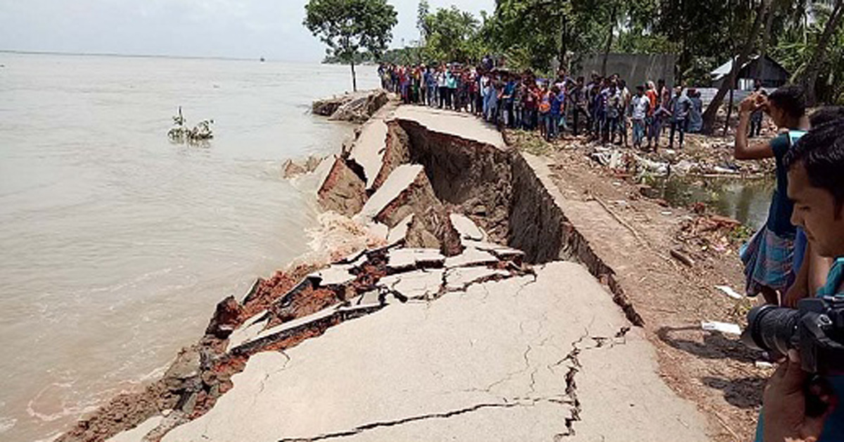
There was river erosion in her village.

Slide 9
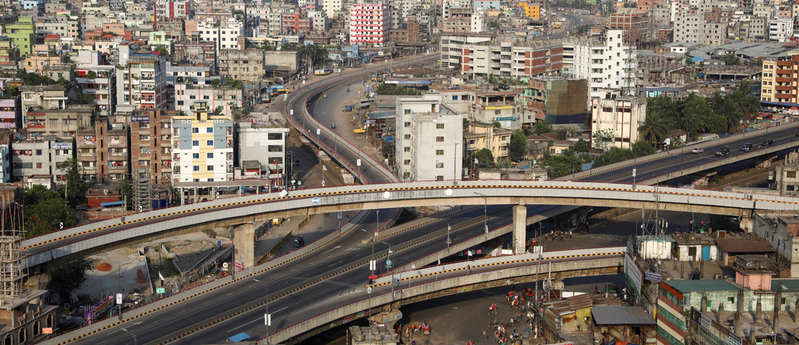
They lost their home. So the family came to Dhaka.

Slide 10
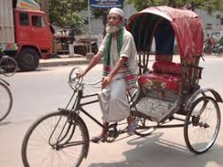
Reshma’s father worked as a rickshaw driver

Slide 11
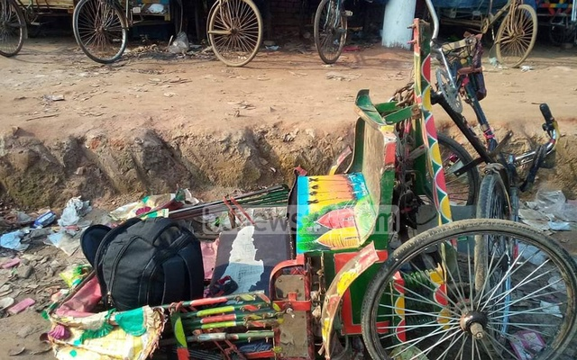
But he died in an accident.

Slide 12
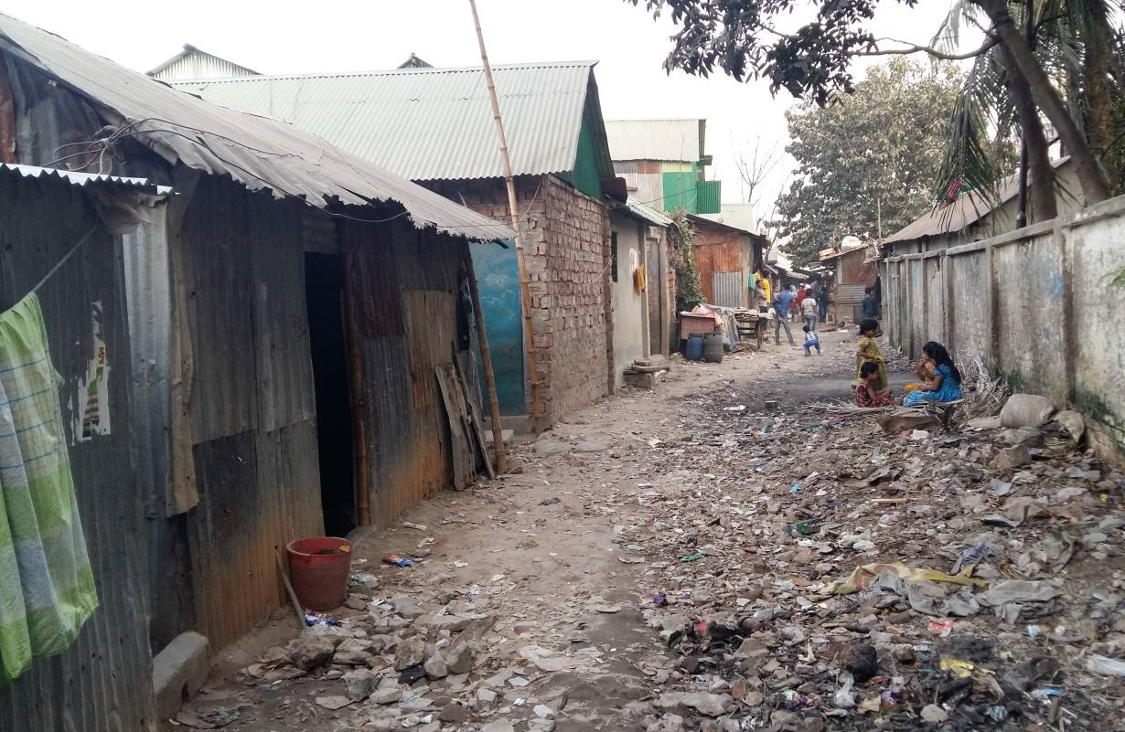
Reshma’s uncle Ratan helped the family. He found a small house for them at kalyanpur.

Slide 13
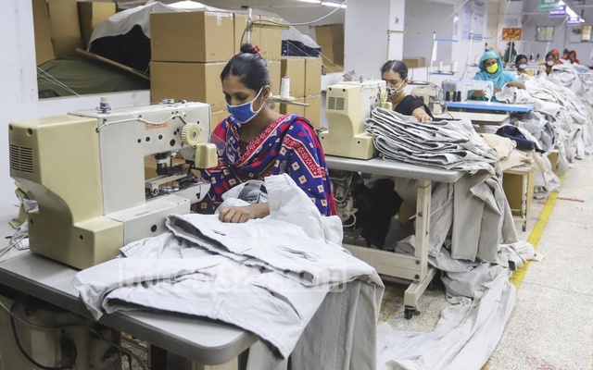
He took Reshma to a garment factory in Mirpur. She work’s there now.

Slide 14
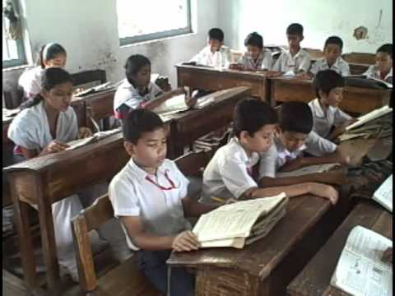
Her younger brother Babul goes to school. He’s in class 5.

Slide 15
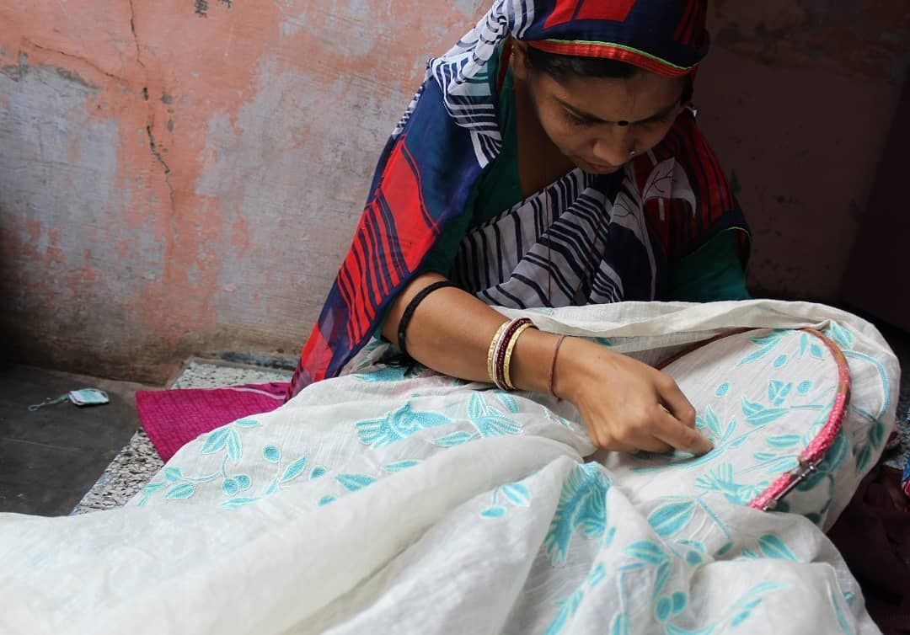
Her mother stitches “Nakshi kathas” at home and sells them.

Slide 16
Peer Work
Discuss with your partner and find out the new words.

Slide 17
New Words
Garment worker: A person who makes clothes.

Slide 18
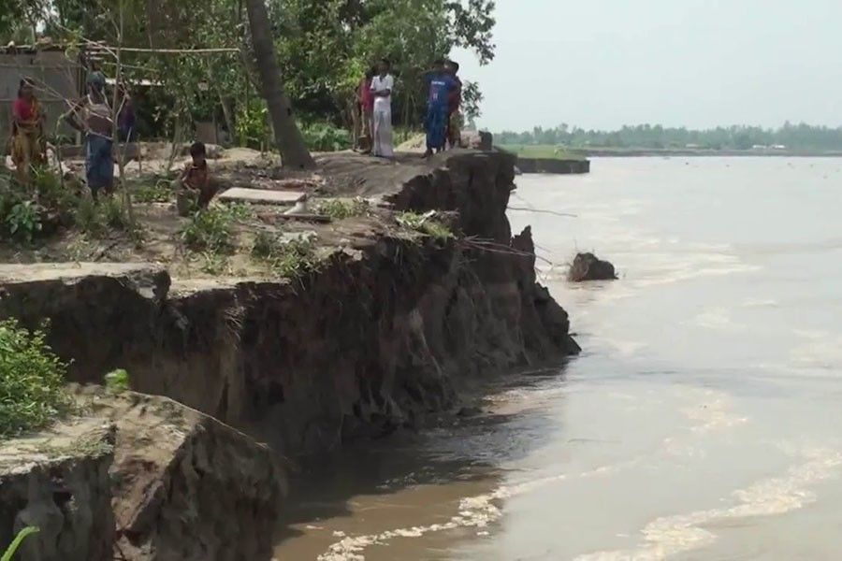
New Words
River erosion: The process by which the surface of the earth is worn away by the action of water.

Slide 19
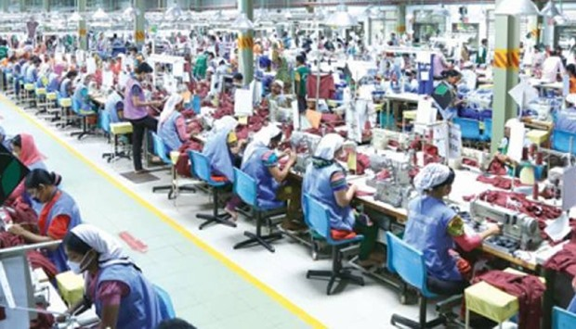
New Words
Garment factory: makers and sellers of fashionable clothing.

Slide 20
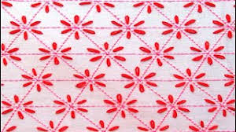
New Words
Nakshi katha: The popular hand embroidery art from Bangladesh.

Slide 21
Checking learning
If I do any mistake you will say “Stop”
Reshma is a garment worker in Dhaka. She’s 18 years old. She’s 19 years old. Her family came to Sylhet from a village eight years ago. There was river erosion in her town. They lost their house. So she came to Dhaka. Reshma’s father worked as a car driver, but he died in an accident.

