Slide 2
Teacher’s identity
Farzana Yasmin
Assistant Teacher
Rongarchar Government Primary School
Sunamgonj sadar
Sunamgonj.

Slide 3
Lesson identity
Class – Four
Unit – 40
Lessons – 1-2
A garment worker’s day
Activity – A
Part – 2

Slide 4
Learning outcomes:
Listening
1.1.1 recognize sound differences in the context.
1.2.1 recognize which syllable in a word is stressed.
1.3.1 recognize which words in a sentence are stressed.
4.3.1 enjoy and understand simple stories.
Speaking
1.1.1 say words, phrases and sentences with proper sounds and stress.
Reading
1.5.1 read words, phrases and sentences in the text with proper pronunciation, stress and intonation.
1.7.1 read short paragraphs, dialogues and simple letters.
5.1.1 read silently with understanding paragraphs, stories and other text materials.

Slide 5
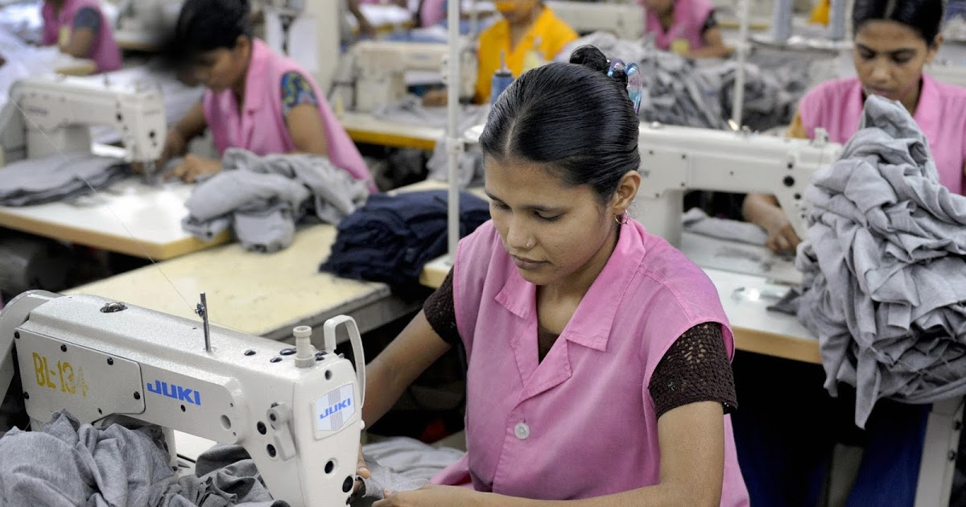
A garment worker’s day ( Part-2 )

Slide 6
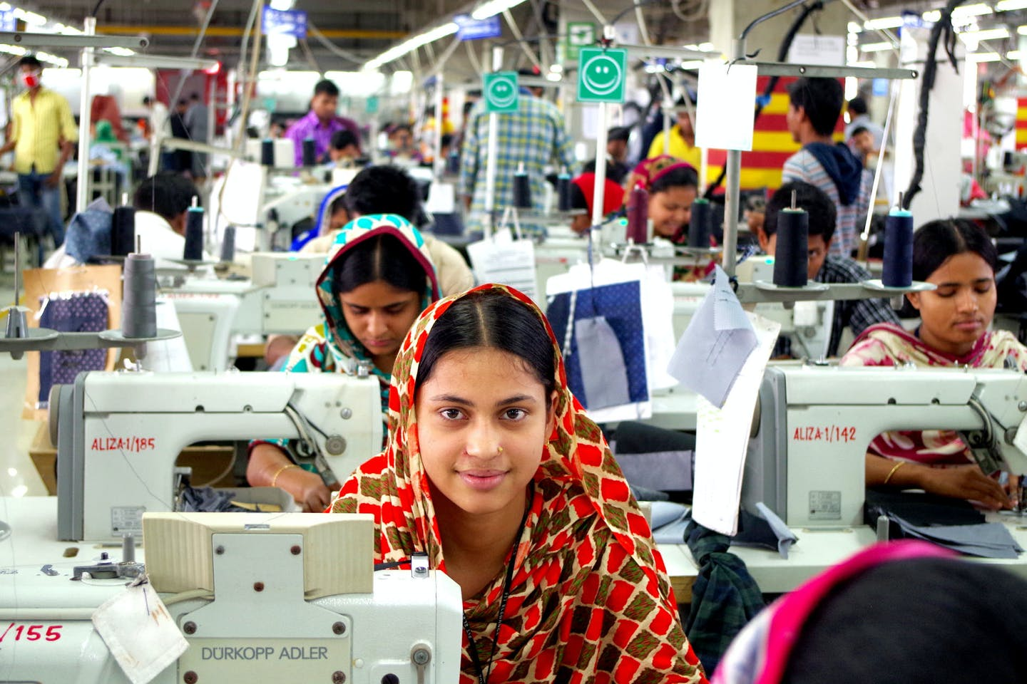
The garment factory is two kilometres from Reshma’s house

Slide 7
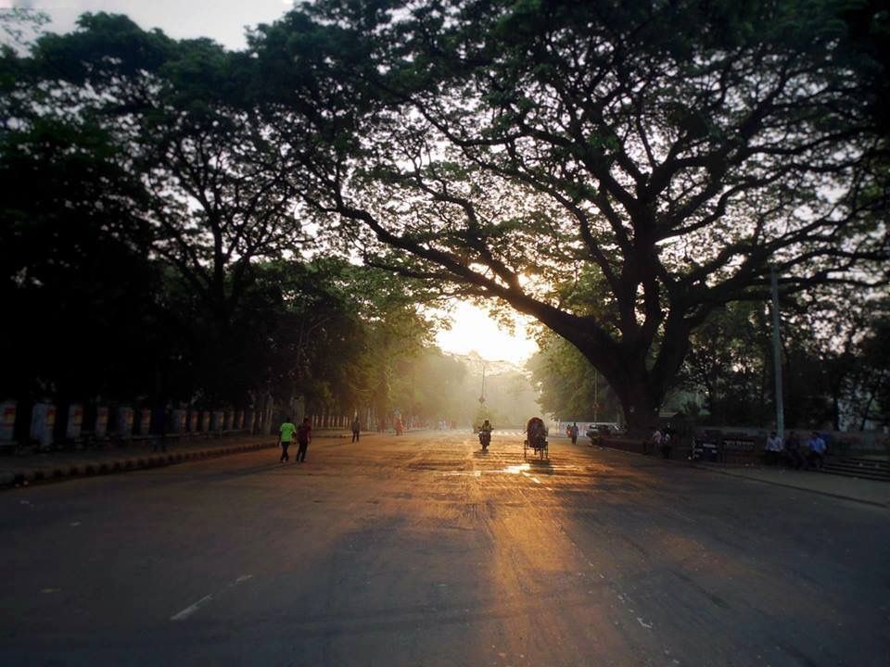
In the morning, she walks to work.

Slide 8
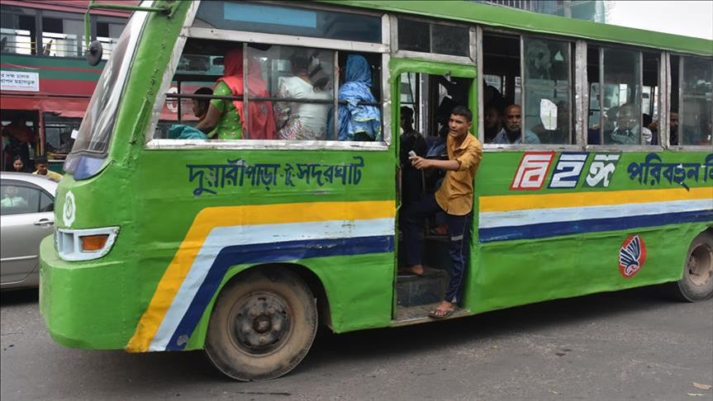
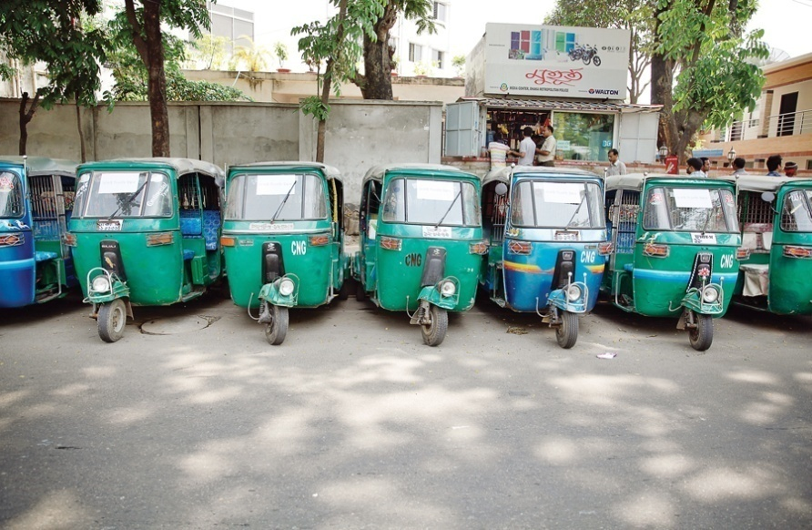
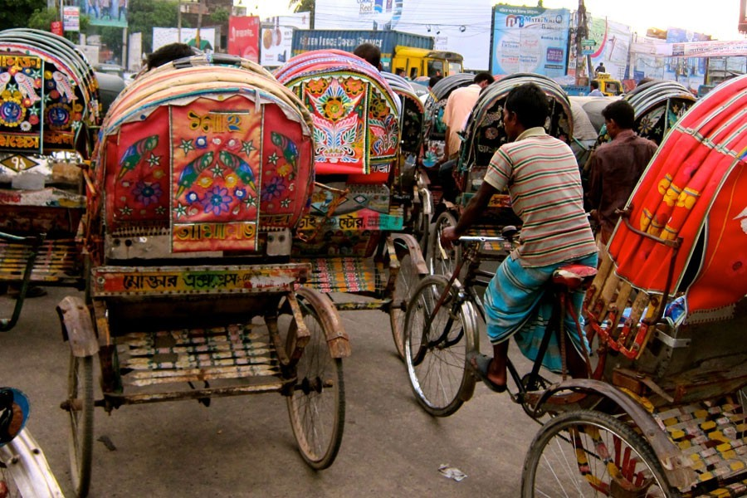
Some of her friends go by bus, rickshaw or scooter.

Slide 9
She works from 8 a.m. to 4 p.m.

Slide 10
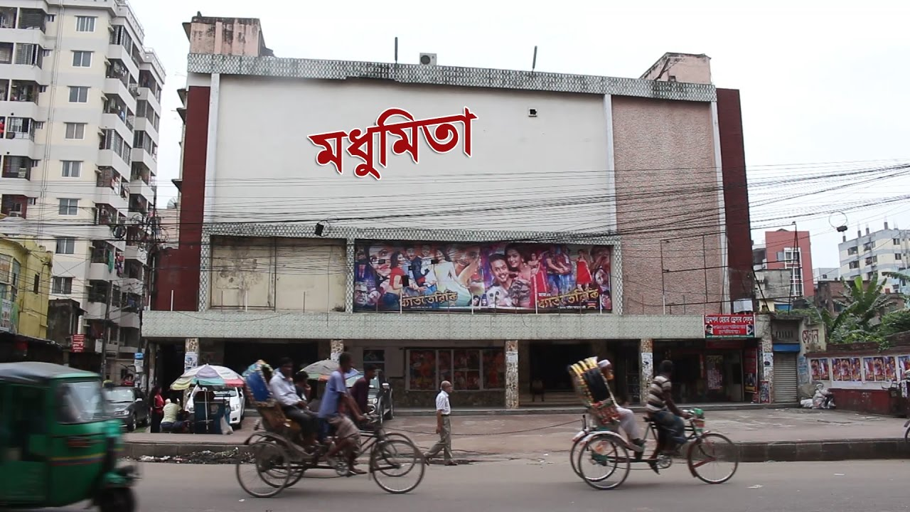
Reshma likes to go to the cinema, but she doesn’t have much free time or money for this.

Slide 11
She often works extra hours until 6 p.m. so she can make more money

Slide 12
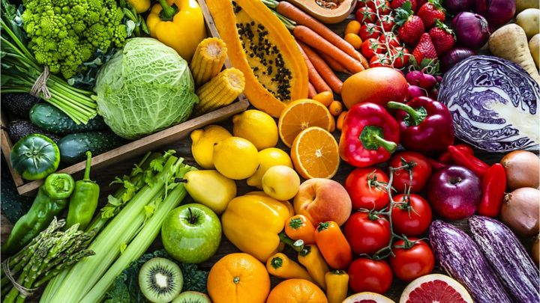
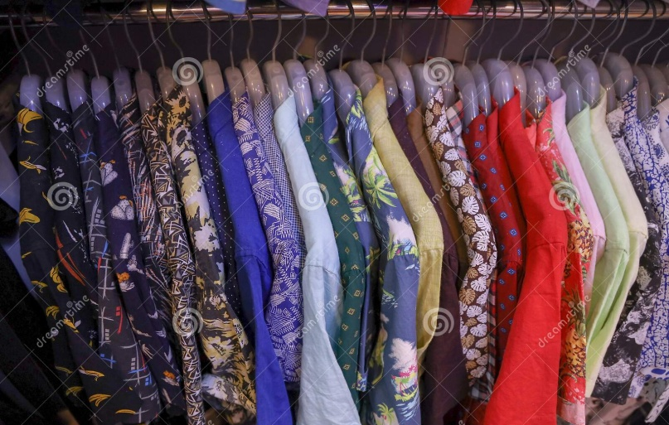
Her family need this money for food and other things.

Slide 13
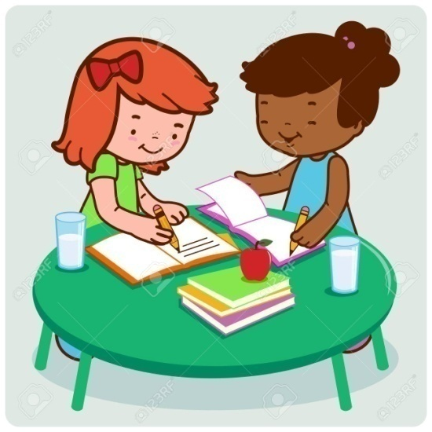
Peer Work
Discuss with your partner and find out the new words.

Slide 14
Checking learning
If I do any mistake you will say “Stop”
The garment factory is three kilometers from Reshma’s house. In the afternoon, she walks to work. Some of her neibours go by bus, rickshaw or scooter. She works from 9 a.m. to 4 p.m. Reshma likes to go to the village, but she doesn’t have much free time or money for this. She often works extra hours until 9 p.m. so she can make more money. Her family needs this money for cinema and other things.

