Slide 1
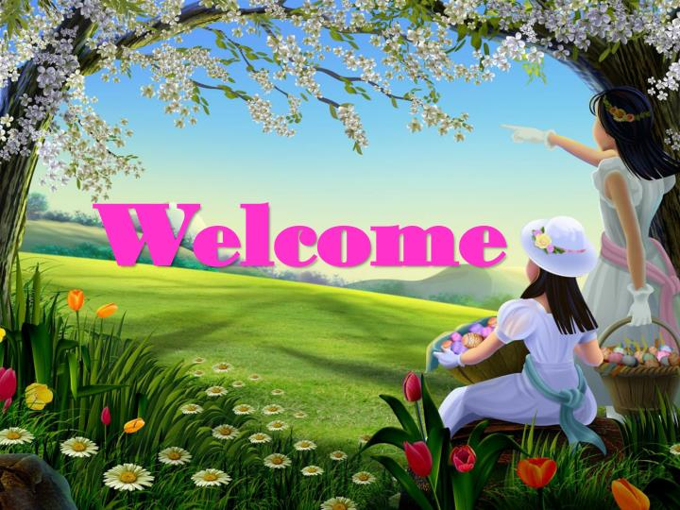

Slide 2
Teacher’s identity
Farzana Yasmin
Assistant Teacher
Rongarchar Government Primary School
Sunamgonj sadar
Sunamgonj.

Slide 3
Lesson identity
Class – Four
Unit – 34
Lessons – 1-2
SM Sultan
Activity – A
Part – 2

Slide 4
Learning outcomes:
Listening
4.2.1 enjoy and understand simple stories.
Speaking
1.1.1 say words, phrases and sentences with proper sounds and stress.
Reading
1.4.1 read words, phrase and sentences in the text with proper pronunciation, stress and intonation.
1.5.1 read words, phrases and sentences in the text with proper pronunciation, stress and intonation.
1.7.1 read short paragraphs, dialogues and simple letters.
5.1.1 read silently with understanding paragraphs, stories and other text materials.

Slide 5
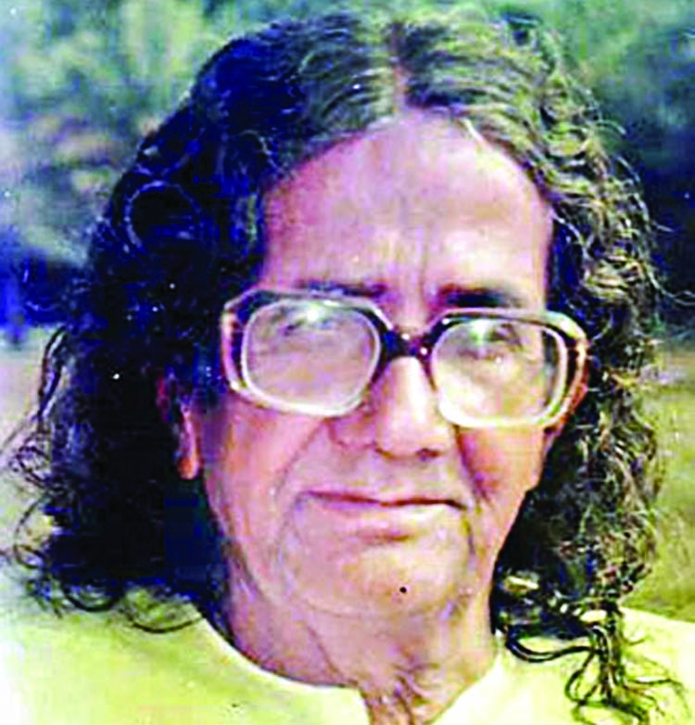
SM Sultan( Part-1 )

Slide 6
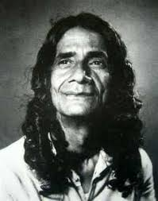
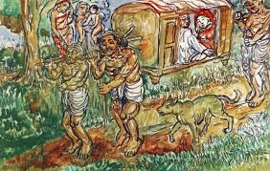
People around the world know about Sultan and his paintings.

Slide 7
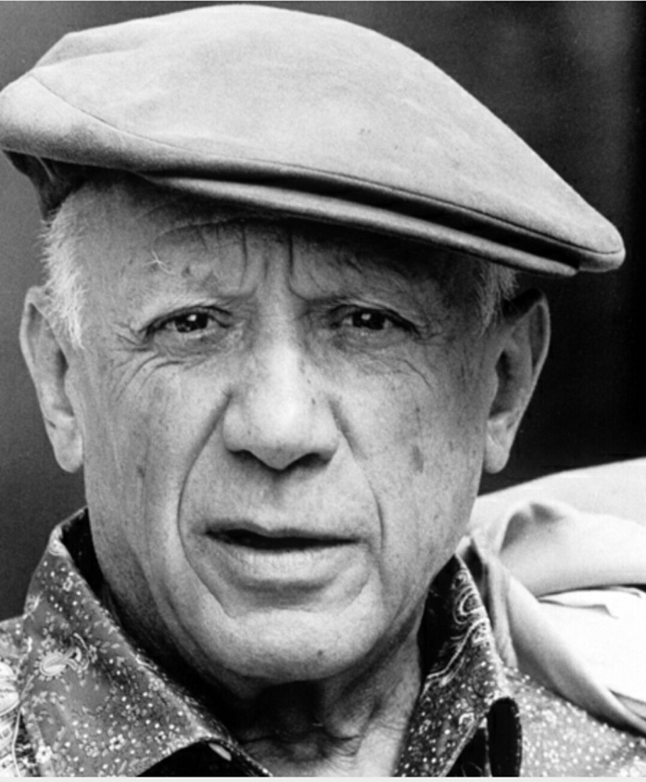
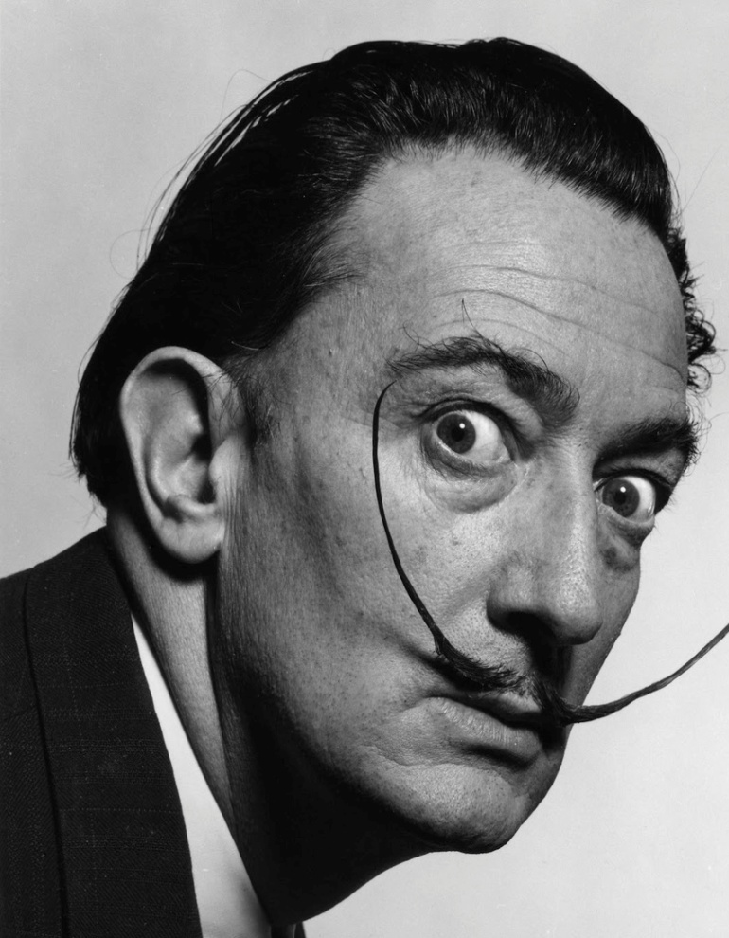
He exhibited his paintings along with the famous painters, Pablo Picasso and Salvador Dali.

Slide 8
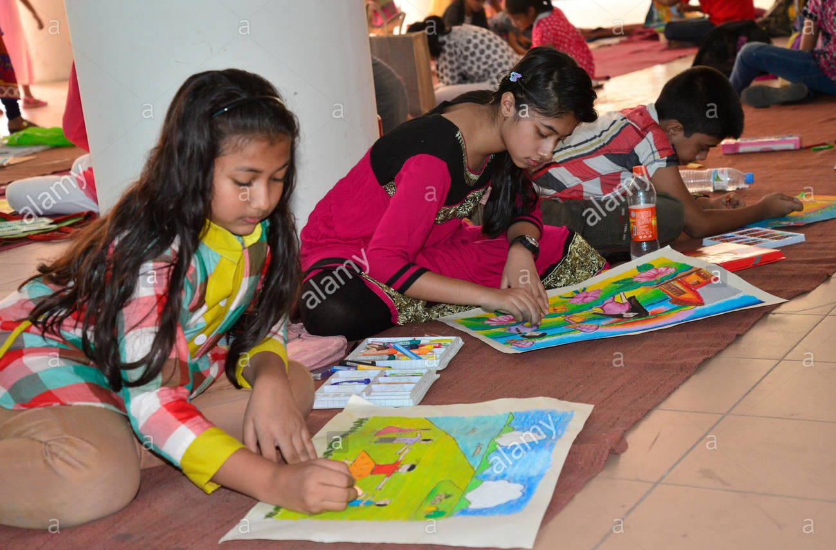
Sultan loved children.

Slide 9
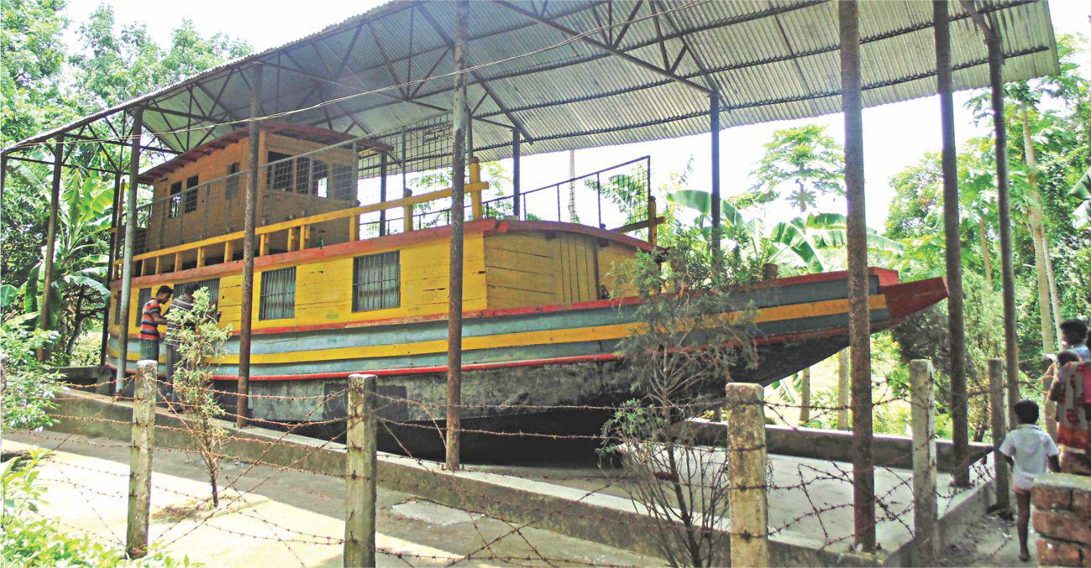
He established ‘Nandankanon’ and ‘Shishuswargo’ for children.

Slide 10
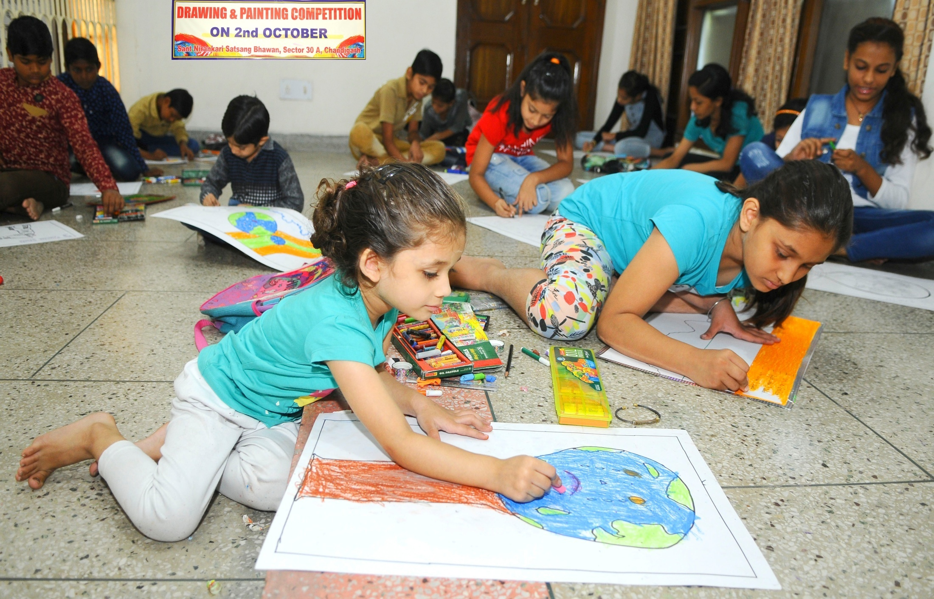
Here they could get some education and learn painting.

Slide 11
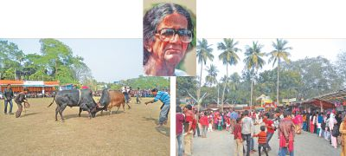
Every year, there is a Sultan Mela in Narail.

Slide 12
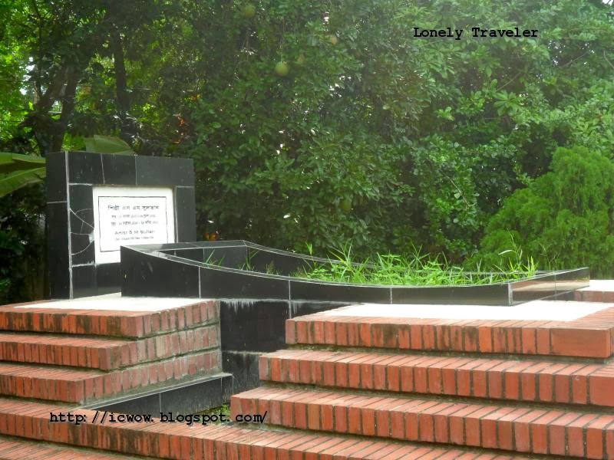
He died in 1994 at a hospital in Jashore

Slide 13
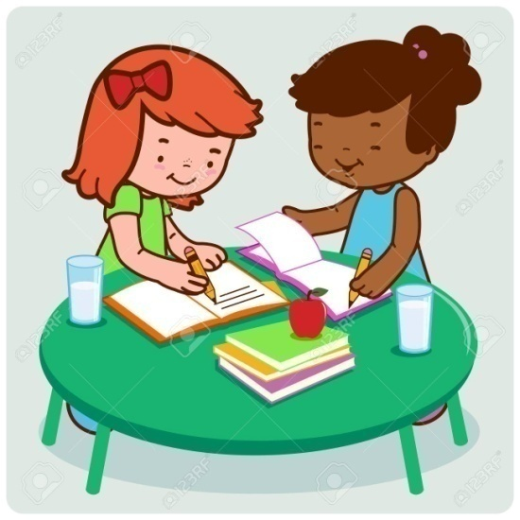
Peer Work
Discuss with your partner and find out the new words.

Slide 14
Checking learning
If I do any mistake you will say “Stop”
People around the world don’t know about Sultan and his paintings.
He exhibited his paintings along with the well known painters, pablo Picasso and Salvadar Dali.
Sultan loved birds. He established ‘Nandankanon’ and ‘Shishuswargo’ for old men. Here they could get some food and learn painting. Every year, there is a Sultan Drama in Narail. He died in 1994 at a hospital in Narail.

