Slide 1
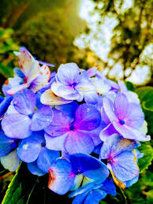
WELCOME TO MY CLASS

Slide 2
IDENTITY
A.H.M.MOSTAFIZUR RAHMAN
HEAD TEACHER
UTTAR KRISHNAPUR GPS
PHULBARI. DINAJPUR
CLASS-5
SUBJECT: ENGLISH
Unit-9 Lesson 5-6,page-37, Unit-10(p-41) U-12 ( p-49) U-14(p-57)

Slide 3
LEARNING OUTCOME
Students will be able to-
7.1.1 recognizes punctuation marks and read accordingly

Slide 4
HEADING
PUNCTUATION MARK & CAPITALS

Slide 5
CAPITAL LETTERS
We use capital letters.....
At the beginning of every sentence
For names of people, places, days and months
INDIVIDUAL WORK
Give the examples with individual

Slide 6
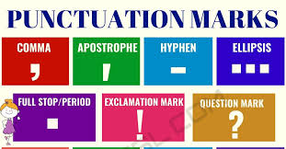
PUNCTUATION
There are 14 punctuation marks that are commonly used in English grammar. They are the period, question mark, exclamation point, comma, semicolon, colon, dash, hyphen, parentheses, brackets, braces, apostrophe, quotation marks, and ellipsis. Following their correct usage will make your writing easier to read and more appealing.

Slide 7
FULL STOP ( . )
We use a full stop ( . ) At the end of a sentence that.....
Tells something
Gives a command
Makes a statement
PAIR WORK
Give the examples with pair

Slide 8
QUESTION MARK ( ? )
We use question mark ( ? ) at the end of a sentence that......
Ask for information
GROUP WORK
Give the examples with group

Slide 9
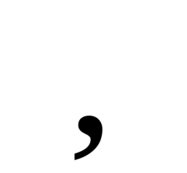
COMMA
We use commas ( , )-----
To separate three or more words in a list. Such as-
Mili, Nayan and Saleh are my friends. They are kind, polite and caring.
To separate words that introduces a sentence. Such as-
Well, how are you? Oh, I am fine. Yes, I know Laila. No, I don’t know Yousuf.
To separate the name of a person addressed in sentence.
Tamim, listen to this song. Neel, can you please turn on radio?

Slide 10
EXCLAMATION MARK ( ! )
We use exclamation marks.....
To show strong feelings. That’s great! Thank you so much!
To show surprise. Such as Wow! Oh!
After strong commands. Stop that! Don’t touch that!

Slide 11
QUOTATION MARK ( “ ” )
We use quotation marks to show what someone said.
We put quotation marks at the beginning and the end of the person’s words.
Use a comma before or after quotation marks.
Start the first word inside the quotation marks with a capital letter.
The hare said. “I am the fastest animal.” “I am the slowest animal,” said the tortoise.

Slide 12
EVALUATION
Answer the following question….
a) Where we use exclamation mark?
b) Where we use full stop? Write three examples.
c) Draw the following punctuation mark
comma, full stop, question mark, exclamation mark, quotation mark,

Slide 13
HOME WORK
Put punctuation mark following the passage
The hare said I am the fastest animal I am the slowest animal said the tortoise.

Slide 14
THANKS TO ALL

