Slide 1
Welcome

Slide 2
IDENTITY
Teacher
Lesson
Hirendra Debnath
MA(English),Bed
Assistant Teacher(English)
Puran Bazar Girls’ High School
01789-916684
Hirendra Debnath
hirendra0501@gmail.com
English For Today
Classes : IX-X

Slide 3
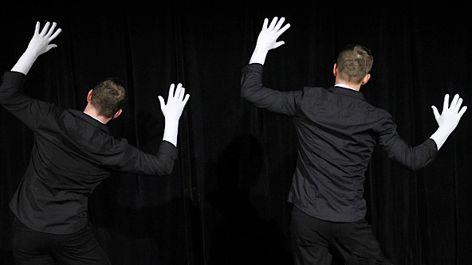
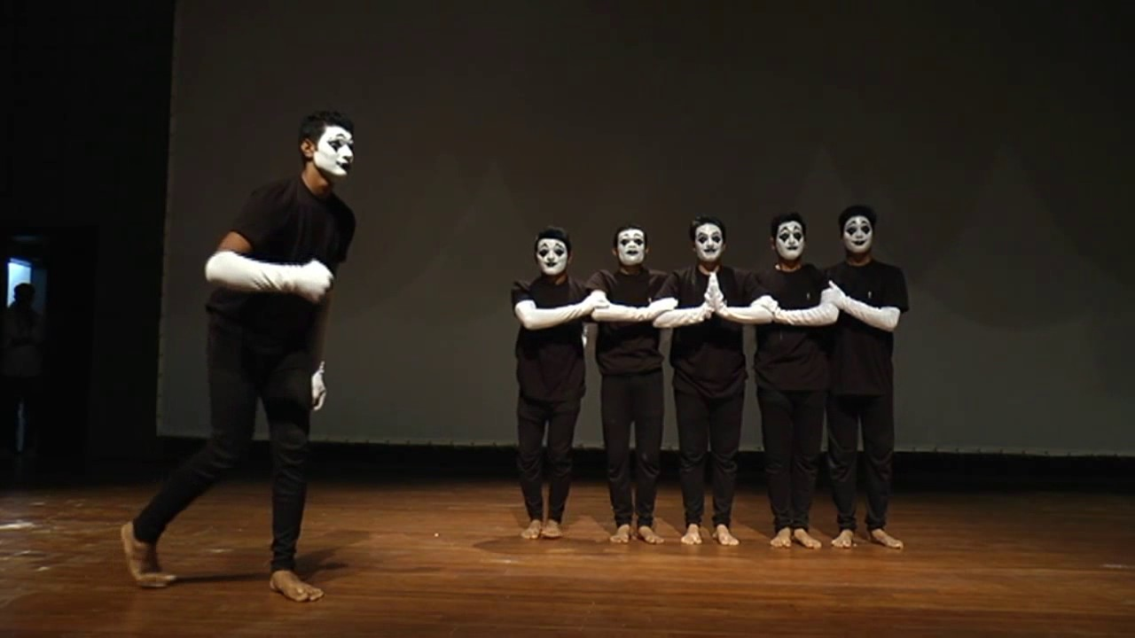
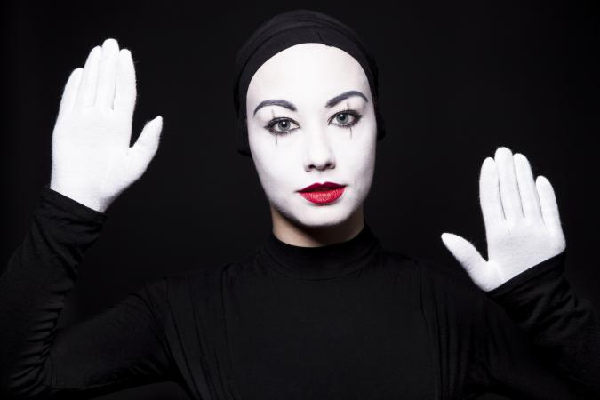
Mime
Look at the picture?
What are they doing?
They are showing something.
What is the name of this art?

Slide 4
So, can you guess what our today’s lesson might be?

Slide 5
Our today’s lesson is-
The Art of Silence
Unit-7, Lesson-2
Notes:
Lesson declaration.

Slide 6
Learning outcomes
After the end of this lesson, students will be able to --- ---
1. read and understand texts ;
2. ask and answer questions;
3. write a paragraph.

Slide 7
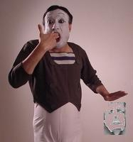
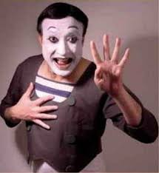
A: Look at the pictures of Partha Pratim Majumder. Work in pairs and discuss the following questions.
1. What is Partha Pratim Majumder doing in the pictures?
2. Describe his facial expressions.
3. Describe his physical features i.e. his age, how he looks, what he is wearing, his hair style, etc.

Slide 8
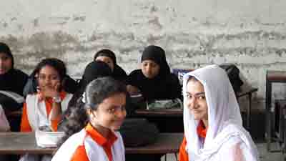
A discussion between two students is given below.
S2: In the first picture, he keeps his two fingers into his mouth in a way as if he were going to shoot himself. In the second picture, he seems to be showing any number.
S2: He seems to be middle aged but fit. He has taken make-up on his face. He is wearing a special kind of dress generally used in mime. He has well-brushed medium size hair.
S1: Please, describe his physical features i.e. his age, how he looks, what he is wearing, his hair style, etc.
S1: What is Partha Patim Majumder doing in the two pictures?
S2: He is performing mime.
S1: Please, describe his facial expressions.

Slide 9
Keywords

Slide 10
Gesture (N)
Vocabulary
Meaning:
A movement of body parts to show a particular meaning.
Syn.= Signal, sign; ant.= speech

Slide 11
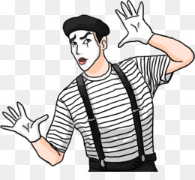
Mime (N)
Meaning:
Acting a story without speaking, using movements and expressions

Slide 12
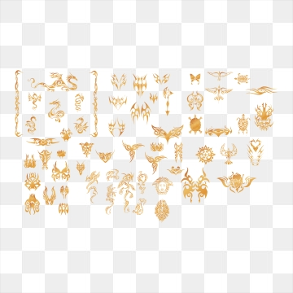
Depict (V)
Meaning:
To represent someone or something in a picture or story
Syn.= portray, figure, exhibit

Slide 13
Evolve (V)
Meaning: to develop gradually
Syn.= develop, advance, N = evolution

Slide 14
Determined
Firm
Master
Become expert in
Forerunner
Pioneer
Keen
Enthusiastic
Solo
Single, solitary

Slide 15
Maestro
Master artist
Enthusiastic
Eager, keen
Air
Broadcast, transmit
Genre
Category, class
Contribution
Performance

Slide 16
Disappear
Vanish, fade
Performance
Show, production
Fascinate
Captivate

Slide 17
What is mime?

Slide 18
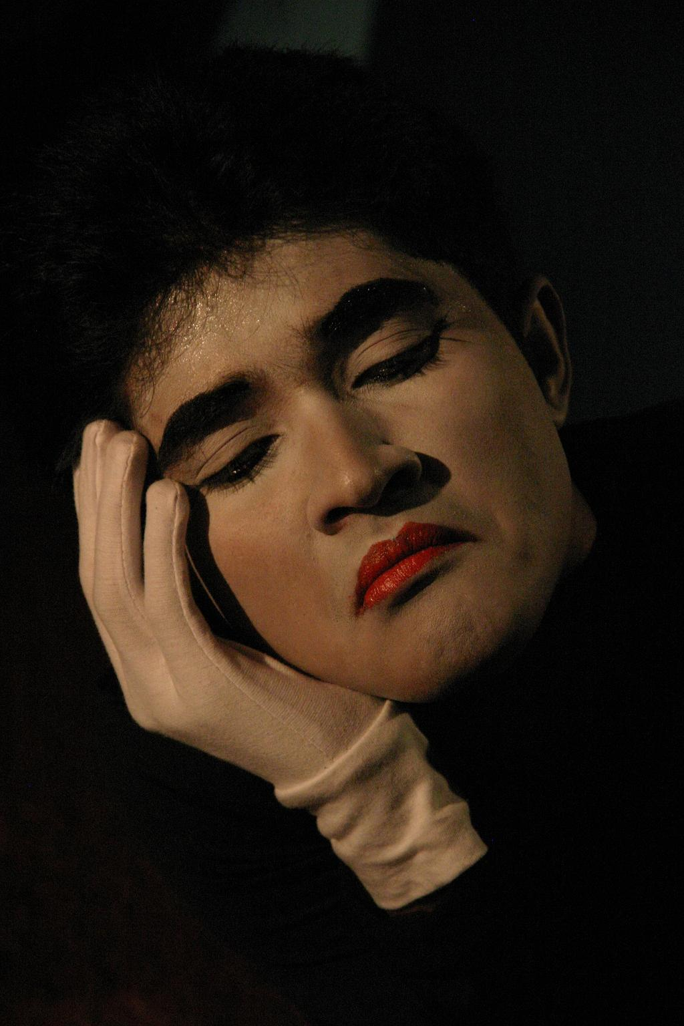
Mime is an art of talking without using vocal sound. The mime artists tell us a story by showing their gesture. We can understand their happiness, sorrow, anger, envy by seeing their expression.

Slide 19
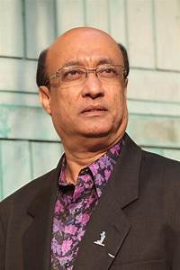
Let us know something about Partha Pratim Majumdar
Pioneer in the field of mime in Bangladesh.
Got scholarship from French govt. in 1981.
Got training in mime from two legendry maestros.
They were Etiene Decroux and Marcel Marceau

Slide 20
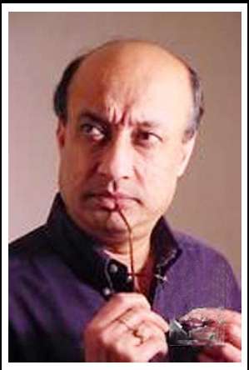
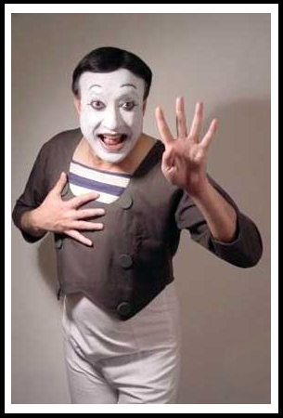
Staged solo performance in England, Belgium,
Germany, Spain, Italy, The USA & TV Channels.
Won “Moliere Award” in 2009 which is the highest
Distinction in the French Theatre.
Honoured by the Bangladesh Govt. with “Ekushey Padak” in 2010.
Honoured by the French Govt. with “Knight in the order of Arts and Letters” in 2011.

Slide 21
Teacher’s model reading
Keep silent and listen attentively

Slide 22
Before the beginning of human language, communication took place between humans through signs and gestures. As humans began to use their vocal chords, these silent gestures were no longer used as the primary means of communication. But these did not completely disappear. They evolved as a form of art, which came to be known as ‘mime’.

Slide 23
In a Bangladeshi village a little boy came to know about mime as he watched a performance in his village. He was so fascinated by the show that he was determined to master this art. The name of that little boy was Partha Pratim Majumder.

Slide 24
Majumder is undoubtedly a forerunner in the field of mime in Bangladesh. He started as a musician and his keen sense of rhythm helped him to let his limbs move and express his thoughts through gestures. Partha Pratim Majumder is the first Bangladeshi to take up mime as a profession. He performed in a number of television shows in Bangladesh and gained popularity. In his mime, Majumder depicted the day-to-day life of the people-their sadness, tears as well as their happiness and laughter.

Slide 25
Majumder’s turning point of life came in 1979, when he was asked to give a solo performance in Bangladesh Shilpakala Academy. The then French ambassador to Bangladesh Mr. Loic Moreau happened to be among the audience. Mr. Moreau noticed the talent in Majumder. In 1981, the French Government offered him a scholarship so that he could get professional training in mime. This was the first time that a student was granted a French scholarship in mime. Majumder started his training under the legendry maestro, Etiene Decroux. Through Decroux, he met another celebrated mime artist named Marcel Marceau. Marceau has transformed modern mime by taking it to an unimaginable height.

Slide 26
Marceau was very impressed by the young Bangladeshi talent and offered him a place in his school for mime, named ‘Ecole Internationale de Mimodrame de Paris Marcel Marceau’. This school of mime is the biggest and the best in the world.
During his three year training period, Majumder practiced 16-18 hours daily till each and every bone in his body would feel like breaking.
After his time with Marceau, there was no looking back for Majumder. He staged solo performances in England, Belgium, Germany, Spain, Italy and the USA. French, Canadian and American TV channels enthusiastically aired his shows.

Slide 27
In 2009, a French play featuring Majumder won the “Moliere Award” which is the highest distinction in the French Theatre.
As a pioneer of the art of mime in Bangladesh and for popularizing the artistic genre, Bangladesh Government honoured the artiste with the “Ekushey Padok” in 2010.
The Government of France has also honoured him for his contribution to the art of mime throughout the world with one of the highest cultural awards of France titled “Chevalier de L’odre des Arts et des Letters” (Knight in the order of Arts and Letters) in the year 2011.

Slide 28
Choose the best answer
1. Before the use of speech, communication took place through __ language.
written (b) sign (c) spoken (d) art
2. In what form have the silent gestures evolved into?
Drama (b) cinema (c) mime (d) dance
3. In older times the actors who performed mime used to put white paint on their __.
limbs (b) body (c) face (d) hair
4. The word ‘fascinated’ in the text means ___.
enchanted (b) encouraged (c) silenced (d) upset

Slide 29
C: Read the text in B again. Say if the following statements are true or false? If false, give the correct information.
Individual work
1. The ancient Egyptian art shows that people at that time interacted with one another through signs.
2. In ancient times, humans used a few words as the primary means of interaction.
3. Partha Pratim Majumder is among the first few who performed mime in Bangladesh.
4. The turning point in Majumder’s life is when he performed at Bangladesh Shilpakala Academy.
5. Marcel Marceau’s school of mime is in Barcelona.
False.
Correct statement: Before the beginning of human language, communications took place between humans through signs and gestures.
b. False.
Correct statement: In ancient times, humans used signs and gestures as the primary means of interaction.
c. True
Correct statement: Partha Pratim Majumder is the pioneer in the field of mime in Bangladesh.
d. True
e. False.
Correct statement: Marcel Marceau’s school of mime is in France.

Slide 30
Evaluation
D: Read the text in B again and write the answers to the questions.
1. What is ‘mime’?
Answer: 1) Mime is an art of sign and gestures. It is a silent performance which needs keen sense of expression.
2. What helped Partha to express himself clearly while performing mime?
Answer: 2) Partha’s keen sense of rhythm helped him to express himself clearly while performing mime.

Slide 31
3. What did he use to describe through his performance at the beginning?
Answer: 3) Through his performance at the beginning, he depicted the day to day life of the people.
4. Why was the French ambassador impressed when he saw Majumder’s performance?
Answer: 4) When the French Ambassador saw Majumder’s performance, he was impressed by noticing the talent in Majumder.

Slide 32
5. Describe in sequence how Majumder managed to achieve the highest award in mime. What was the award?
Answer: 5) In 2009, Majumder won the highest distinction in the French Theatre the ‘Moliere Award’ for his outstanding role in the French drama. In 2010, he won the highest award of Bangladesh ‘Ekushey Padok’ as a pioneer of the art of mime and for popularizing the artistic genre. In 2011, he won one of the highest cultural awards of Franch, “Chevalier de L’odre des Arts et des Lettres” for his contribution to the art of mime throughout the world.

Slide 33
E: Project: Do you know anyone who has skills to perform a special feat? Write about the person, covering the following points:
Group work
: τhe first time the person came to know about it;
: the time when the person began to practise it;
: people who supported him/her;
: his/her achievements/recognitions.
If you do not know anyone, make a search and then write about the person based on the above guideline.

Slide 34
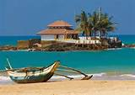
Home work
Fill in each gap with a suitable word of your own based on the information from the text.
Partha Pratim Majumder is the first (a) ……… to take up mime as a profession. He staged (b) ……… performances in different places. Various channels of Bangladesh aired his performances too. In 1979 he staged a solo performance (c) ……… Bangladesh Shilpakala Academy. French ambassador Loic Moreau was (d) ……… there. He was very much charmed at the spotless performance of Partha Pratim Majumder. He helped Majumder get a French scholarship so that he could receive (e) ………
training in mime.
Bangladeshi
solo
in
present
professional

