Slide 1
Welcome
Notes:
Welcome slide.

Slide 2
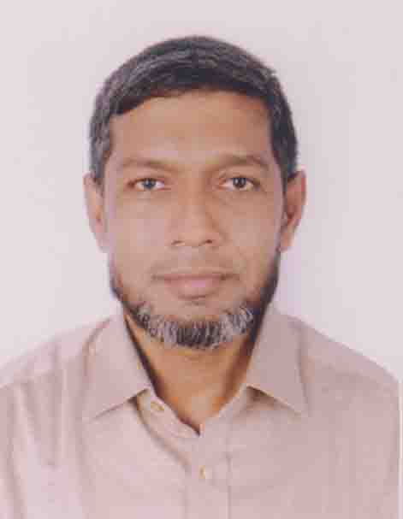
Identity
Md. Abdul Motalab
ENGLISH
Police Lines School and College, Rangpur

Slide 3
WHAT ARE THE STUDENTS DOING HERE?

Slide 4
Our Topic is
Exercise on Substitution table

Slide 5
Learning outcomes
After completing this lesson, we will be able to –
prepare for the S.S.C examination
Notes:
Aim of this lesson.

Slide 6
1. Make five sentences using parts of sentences from each column of the table below. 1 x 5 = 5
Many students | Do not know can not write out cannot understand beat lengthen | that writing answers to the point and neatly brings good marks
They |  | their answers sometimes unnecessarily
So, they |  | their examination papers fairly
 |  | the questions properly
 |  | about the bush

Slide 7
Answer: 1
i) Many students do not know that writing answer is to the point and neatly brings good marks.
ii) So, they lengthen their answers sometimes unnecessarily.
iii) They cannot write out their examination papers fairly.
iv) They cannot understand the questions properly.
v) So they beat about the bush.

Slide 8
2. Make five sentences using parts of sentences from each column of the table below. 1 x 5 = 5
Sincerely | are is works | properly
A sincere man |  | also sincere to their works
The great people |  | not aware of its importance
The people of our country |  | indifferent to the work
They |  | importance of sincerity
 |  | a great virtue

Slide 9
Answer: 2
i) Sincerity is a great virtue.
ii) A sincere man works properly.
iii) The great people are also sincere to their works.
iv) The people of our country are not aware of its importance.
v) They are indifferent to the work.

Slide 10
3. Make five sentences using parts of sentences from each column of the table below. 1 x 5 = 5
 | needs can | remain only a dream
One |  | never be successful in life if one sits idly
One’s ambition |  | to work hard to materialize any ambition
Sometimes it |  | to be competitive too
 |  | materialize one’s desired ambition only by working hard

Slide 11
Answer: 3
i) One can materialize one’s desired ambition only by working hard.
ii) One needs to work hard to materialize any ambition.
iii) One can never be successful in life if one sits idly.
iv) One’s ambition needs to be competitive too.
v) Sometimes it can remain only a dream.

Slide 12
4. Make five sentences using parts of sentences from each column of the table below. 1 x 5 = 5
Culture | is includes shake | badly influenced by dish antenna and so on
Hospitality |  | hands at greetings only with males and not with females
Our culture |  | a term used for a way of life
It |  | a society’s beliefs, custom. language and so on
We |  | a part of Bangladeshi culture

Slide 13
Answer: 4
i) Culture is a term used for a way of life.
ii) It includes a society’s beliefs, custom, language and so on.
iii) Hospitality is a part of Bangladeshi culture
iv) We shake hands at greetings only with males and not with females.
v) Our culture is badly influenced by dish antenna and so on.

Slide 14
5. Make five sentences using parts of sentences from each column of the table below. 1 x 5 = 5
Character | means be hates | the combination of some virtues
It |  | the crown of life
Character of a person |  | a man without character.
It also |  | the mental or moral qualities of a person, a community, a race etc
Everybody |  | a mental or moral nature

Slide 15
Answer: 5
i) Character is the mental or moral qualities of a person, a community, a race etc.
ii) It means the combination of some virtues.
iii) Character of a person is the crown of life.
iv) It also is a mental or moral nature.
v) Everybody hates a man without character.

Slide 16
6. Make five sentences using parts of sentences from each column of the table below. 1 x 5 = 5
 | will remain will always inspire is | us
The 21st February |  | the National Martyrs Day
The 26th March |  | the Independence Day
Our nation |  | indebted to the martyrs of our country
These days |  | now international Mother Language Day

Slide 17
Answer: 6
i) The 21 February is the National Martyrs day.
ii) The 21 February is now International Mother Language Day.
iii) The 26th March is the Independence Day.
iv) These days will always inspire us.
v) Our nation will remain indebted to the martyrs of our country.

Slide 18
7. Make five sentences using parts of sentences from each column of the table below. 1 x 5 = 5
 | is achieved has | one of the main impediments
Bangladesh |  | some impediments to be developed
It |  | a developing country of South Asia
Corruption |  | freedom in 1971
 |  | an independent country

Slide 19
Answer: 7
i) Bangladesh is a developing country of South Asia.
ii) It is an independent country.
iii) It achieved freedom in 1971.
iv) It has some impediments to be developed.
v) corruption is one of the main impediments.

Slide 20
8. Make five sentences using parts of sentences from each column of the table below. 1 x 5 = 5
Mount Everest | is might be has fascinated looks | difficult and dangerous because of snow
It |  | exciting and challenging to them
But climbing the Everest |  | the climbers always
There |  | in the Himalayan mountains
 |  | snow slides and cracks under ice

Slide 21
Answer: 8
i) Mount Everest is in the Himalayan mountains.
ii) It fascinated the climbers always.
iii) It looks exciting and challenging to them.
iv) But climbing the Everest might be difficult and dangerous because of snow.
v) There has snow slides and cracks under ice.

Slide 22
9. Make five sentences using parts of sentences from each column of the table below. 1 x 5 = 5
Education | is can prosper ennobles | the training for proper growth
It |  | the liberation from prejudice
Nobody |  | our mind and refines our sensibility
The purpose of education |  | in life without education
 |  | the process by which our mind develops through formal learning

Slide 23
Answer: 9
i) Education is the process by which our mind develops through formal learning.
ii) It ennobles our mind and refines our sensibility.
iii) The purpose of education is the liberation from prejudice.
iv) It is the training for proper growth.
v) Nobody can prosper in life without education.

Slide 24
10. Make five sentences using parts of sentences from each column of the table below. 1 x 5 = 5
Self confidence | helps should exercise is leads | a man to reach the goal of life.
It |  | one to lose his self-confidence.
The lack of determination |  | not enjoyable.
Success without self-confidence |  | one of the invaluable human qualities.
One |  | it in order to overcome the problems of life.

Slide 25
Answer: 10
i) Self-confidence is one of the invaluable human qualities.
ii) It helps a man to reach the goal of life.
iii) The lack of determination leads one to lose his self-confidence.
iv) Success without self-confidence is not enjoyable.
v) One should exercise it in order to overcome the problems of life.

Slide 26
Thank You
Notes:
Ending slide.

