Slide 1
Welcome
Parvin Akter, Lecturer, English, Rampur Ideal Alim Madrasah, Sadar, Chandpur.

Slide 2
Introduction
Parvin Akter
Lecturer in English
Rampur Ideal Alim Madrasah, Kamranga, Sadar, Chandpur.
Phone:01718295712
email:parvinakter1335@gmail.com
Class: Alim 1st & 2nd
Year
Subject: English
First Paper
Unit: 09
Lesson: 4: Hercules
Time: 45 mins
Parvin Akter, Lecturer, English, Rampur Ideal Alim Madrasah, Sadar, Chandpur.

Slide 3
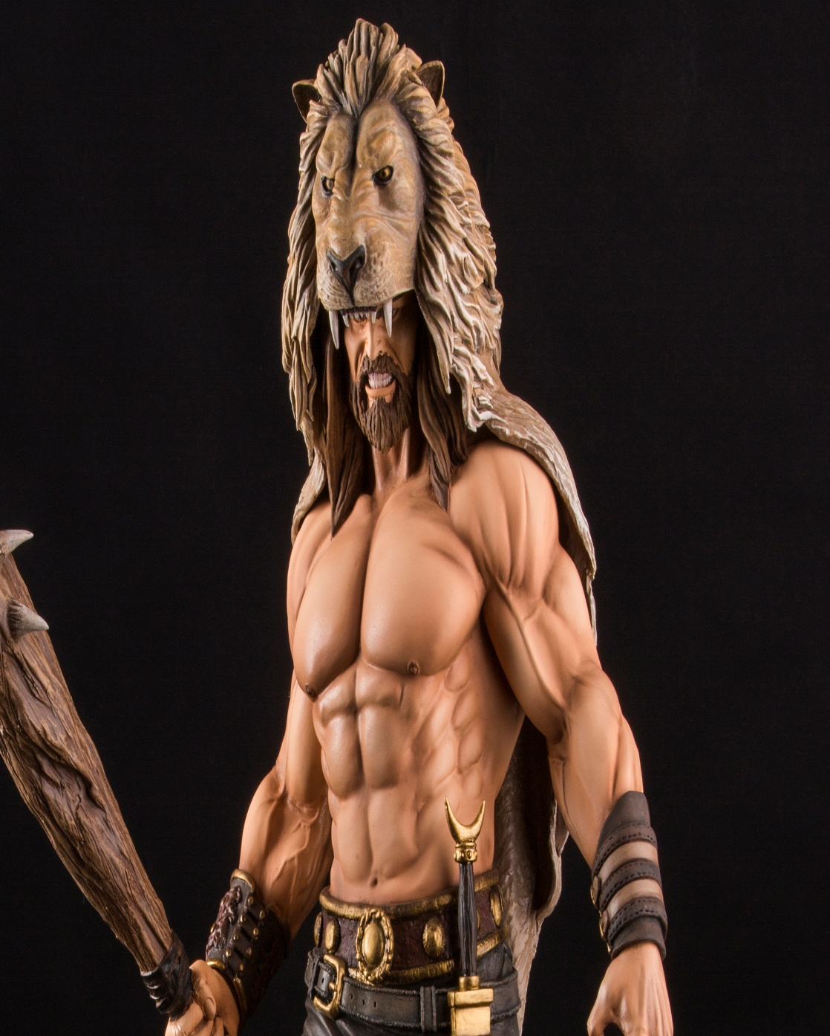
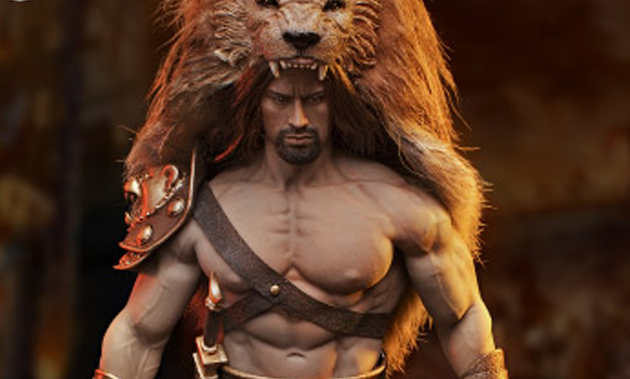
Look at the following pictures
Parvin Akter, Lecturer, English, Rampur Ideal Alim Madrasah, Sadar, Chandpur.

Slide 4
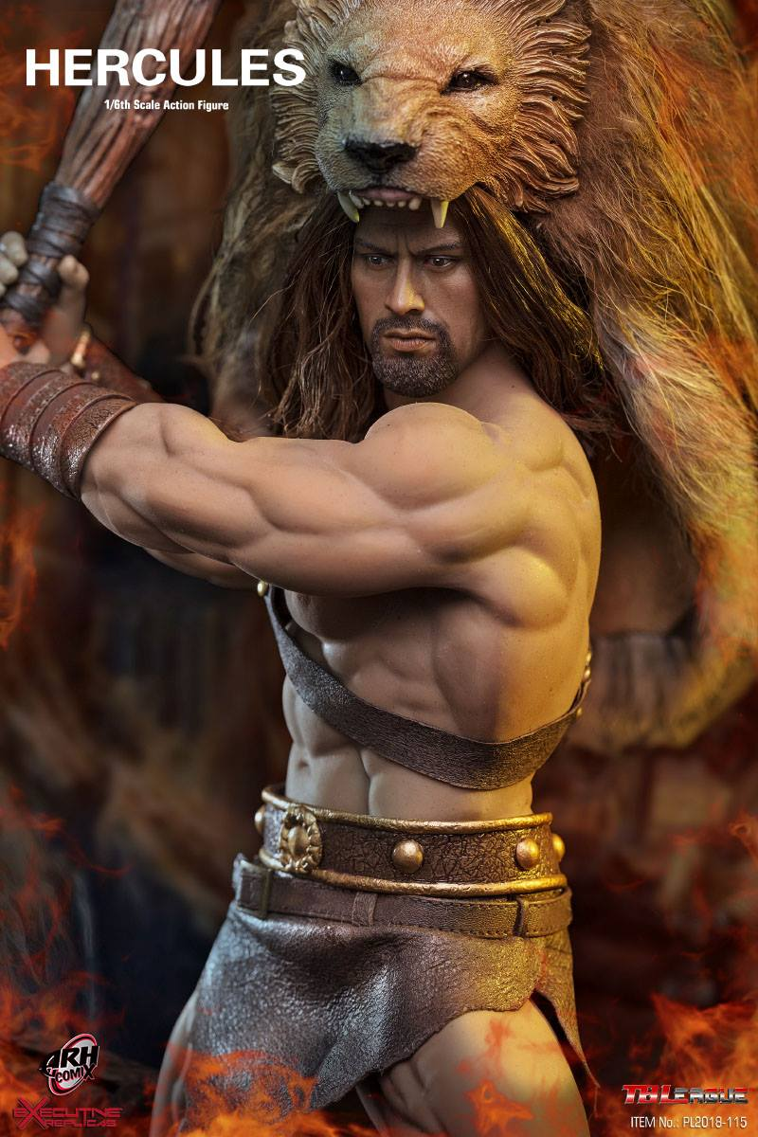
Today’s Lesson?
Hercules
Unit: 14
Lesson: Four
Parvin Akter, Lecturer, English, Rampur Ideal Alim Madrasah, Sadar, Chandpur.

Slide 5
Learning outcome
tell about myth
understand the text.
learn about Hercules
learn some new words .
write summary.
After this lesson Students will be able to
Parvin Akter, Lecturer, English, Rampur Ideal Alim Madrasah, Sadar, Chandpur.

Slide 6
What is myth ?
Myth is a folklore genre consisting of narratives or stories that play a fundamental role in a society. The main characters in myths are usually gods demigods and supernatural humans
Parvin Akter, Lecturer, English, Rampur Ideal Alim Madrasah, Sadar, Chandpur.

Slide 7
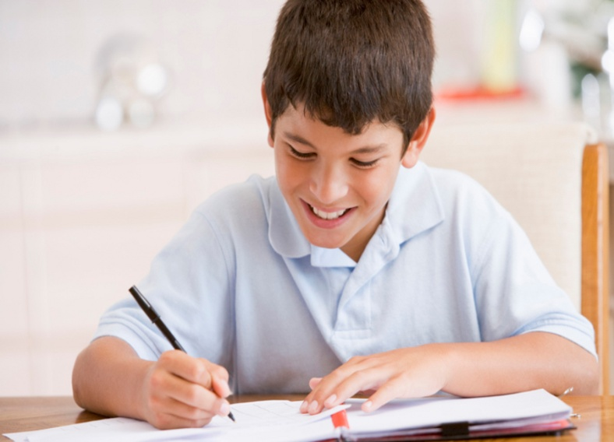
Time: 5min
Individual work
What do you know about Myth? Write in one or two sentence.
Parvin Akter, Lecturer, English, Rampur Ideal Alim Madrasah, Sadar, Chandpur.

Slide 8
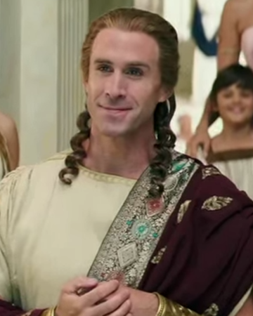
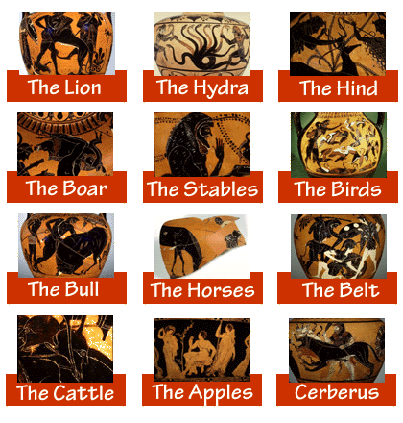
Silent Reading
Text: Hercules was the son of Jupiter and Alcmena. Eurystheus, the King of Mycenae and his cousin, made him undergo some difficult tasks, which are known in Greek myths as the twelve labours of Hercules’.
Eurystheus, the King of Mycenae
Twelve labours of Hercules
Parvin Akter, Lecturer, English, Rampur Ideal Alim Madrasah, Sadar, Chandpur.

Slide 9
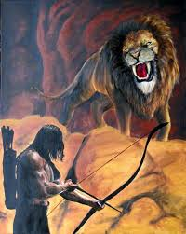
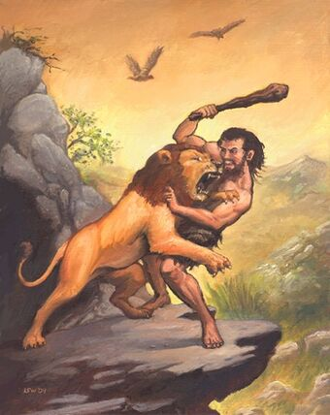
The first involved a fight with a lion. The valley of Nemea was being disturbed by a terrible lion and so Eurystheus ordered Hercules to slay the beast and bring him his skin. At first, Hercules tried to fight the lion with his clubs and arrows but this took him nowhere.
Fight with arrows
Fight with Club
Parvin Akter, Lecturer, English, Rampur Ideal Alim Madrasah, Sadar, Chandpur.

Slide 10
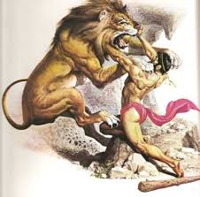
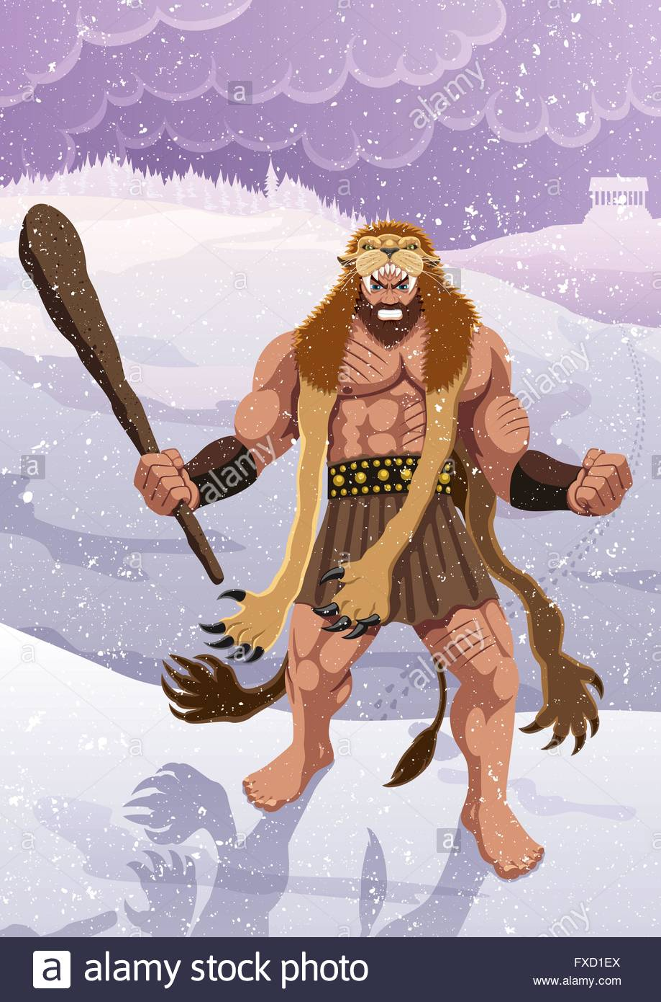
Then Hercules attempted
a different tactic: he
decided he would
use his hands .He
thus managed to
slay the animal on
his own, relying
entirely on his
immense strength.
Victorious, he returned
to Mycenae carrying the
dead lion on his shoulders
a sight that terrified the King.
Fight with bare hands
Lion skin on his shoulders
Parvin Akter, Lecturer, English, Rampur Ideal Alim Madrasah, Sadar, Chandpur.

Slide 11
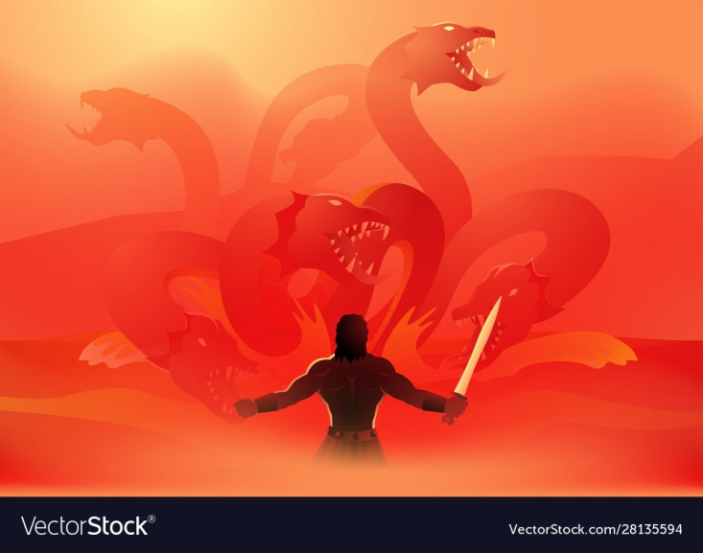
His next task was
to slay a monster
called Hydra that
was ravaging the
country of Argos.
The hydra had nine
heads, of which the
middle one was
said to be immortal.
Fight with Hydra
Parvin Akter, Lecturer, English, Rampur Ideal Alim Madrasah, Sadar, Chandpur.

Slide 12
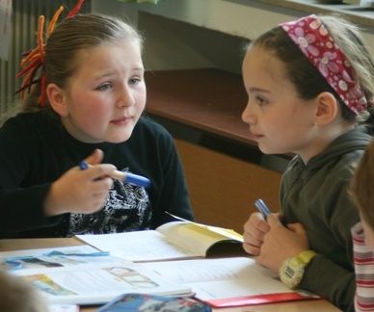
Pair Work
Time: 5 min
Write the twelve labours of Hercules.
Parvin Akter, Lecturer, English, Rampur Ideal Alim Madrasah, Sadar, Chandpur.

Slide 13
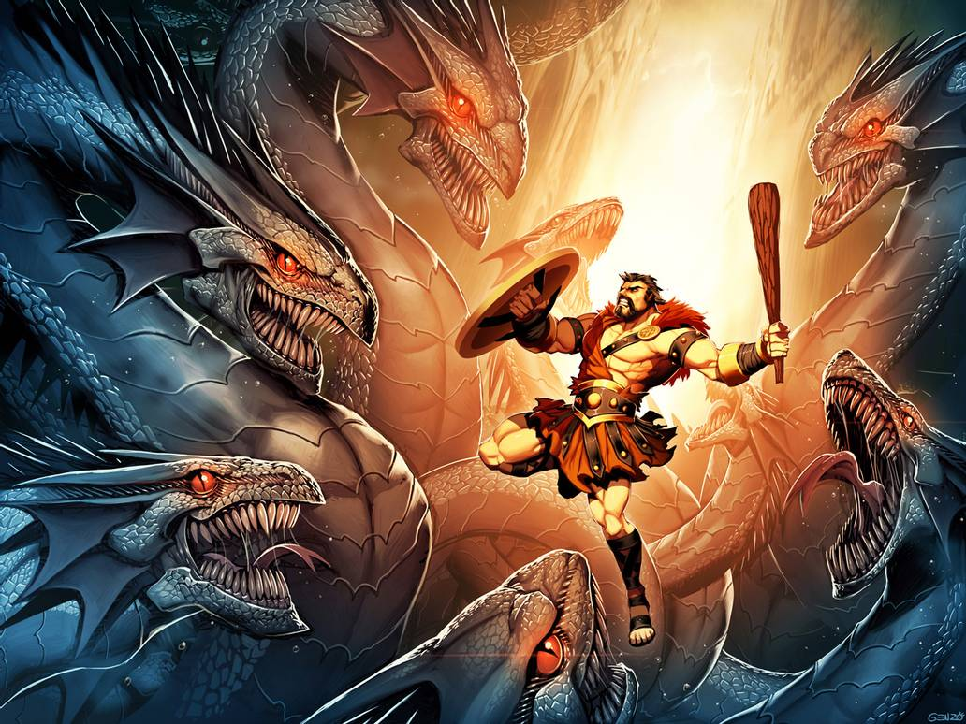
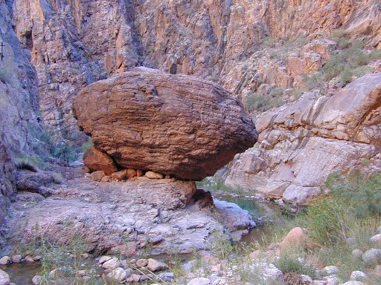
Our hero struck off its heads with his club but whenever he knocked off a head , two new ones erupted in its place. Eventually with the help of his devoted servant Iolaus, Hercules succeeded in burning all the heads of Hydra except the ninth or immortal one, which he decided to burry under a huge rock.
Burnt the Hydra’s heads
Buried the Hydra’s immortal
head Under a huge rock.
Parvin Akter, Lecturer, English, Rampur Ideal Alim Madrasah, Sadar, Chandpur.

Slide 14
In other words , Hercules triumphed again ,as he would every time he was given an impossible task by Eutystheus ! And this is how he began to acquire the reputation of a hero possessing immense strength throughout the world.
Parvin Akter, Lecturer, English, Rampur Ideal Alim Madrasah, Sadar, Chandpur.

Slide 15
Word Meaning
Attempt | Endeavour labour physical work
Arrow | Cursor ,dart Terrible awful
Devoted | Loyal entirely completely
Erupt | Burst out, break out Triumph conquer
Immense | Huge immortal deathless
Impressed | Touch reputation fame
Monster | Giant involve connect
Ravaging | Destroy victorious successful
Slay | Kill eventually finally
Struck | Beaten strike off hit
Tactic | Strategy knock off beat
Club | Baton task work
Undergo | Suffer valley lowland
Bury | Entomb acquire gain
Parvin Akter, Lecturer, English, Rampur Ideal Alim Madrasah, Sadar, Chandpur.

Slide 16
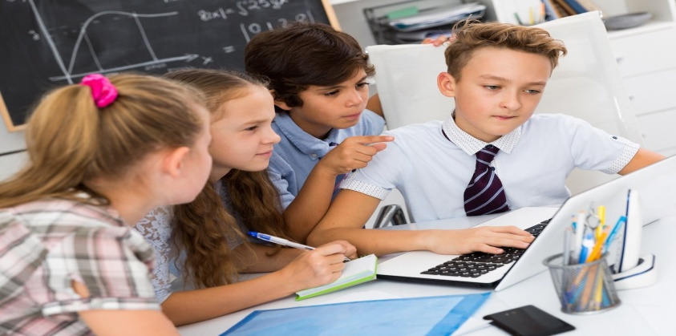
Time: 10 min
Group Work
Discuss in groups and answer the following questions:
How were the difficult tasks termed?
Why did Eurystheus order Hercules to slay a lion?
What was the speciality of the ninth head of Hydra?
How did Hercules kill the Hydra?
Did Hercules alone destroy Hydra? If yes/no , write I favour of the passage.
Parvin Akter, Lecturer, English, Rampur Ideal Alim Madrasah, Sadar, Chandpur.

Slide 17
Home work
Make a flow chart showing the bravery of Hercules . One is given for you.
1. fighting with a terrible lion
Parvin Akter, Lecturer, English, Rampur Ideal Alim Madrasah, Sadar, Chandpur.

Slide 18
Thanks to all
Parvin Akter, Lecturer, English, Rampur Ideal Alim Madrasah, Sadar, Chandpur.

