Slide 1
To Today’s Online Class

Slide 2
Introduction
Teacher’s Introduction
Md. Hamid Ullah
34th BCS (Non Cadre)
Assistant Teacher (English)
Daulatkhan Govt. High School
Bhola
parvezdk2@gmail.com
Lesson Introduction
English 1st Paper
Class: 9-10
Unit- 3
Lesson- 2

Slide 3
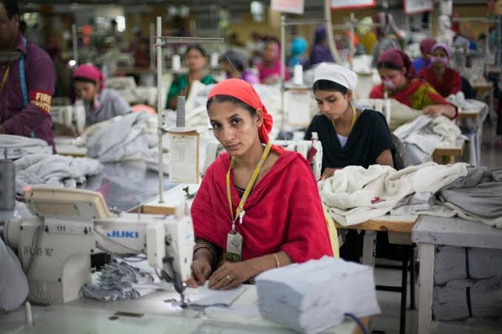
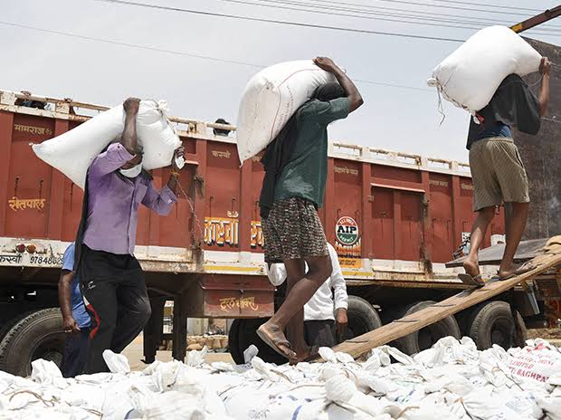
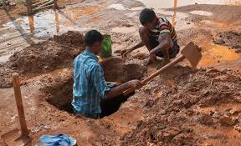
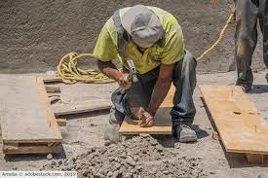
What can you see in the pictures?
The workers are working. They are laborers.

Slide 4
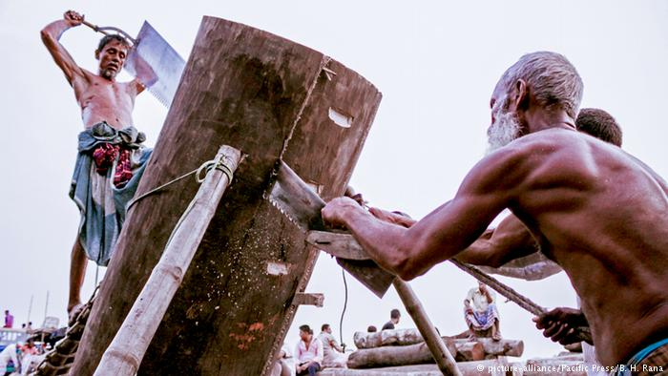
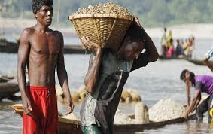
Two laborers are sawing wood.
Day Labourers are working hard.

Slide 5
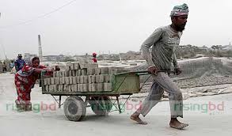
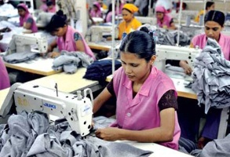
Two workers are working in a brick field.
Garment workers are working in a garment.

Slide 6
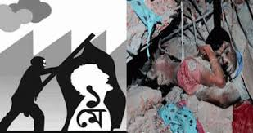
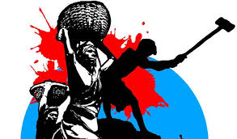
Our Today’s Topic is..
International Workers’ Day-MAY DAY

Slide 7
Learning Outcomes
After this lesson the students will be able to-
1. Learn new vocabulary
2. read and understand the text.
3. ask and answer questions.
4. talk about May Day.

Slide 8
Vocabulary
Word
Meaning
Instantly -immediately
Wound- To be injured in any part of the body
Injure -To harm somebody physically
Exploit -To treat somebody unfairly
Demand -To ask for something very firmly

Slide 9
Vocabulary
Word
Meaning
Commemorate - Recall and show respect somebody or something
Historical -Connected with the past
Establish -To start or create a system, an organization etc
Address -To make a formal speech to a group of people
Suddenly -Quickly or unexpectedly

Slide 10
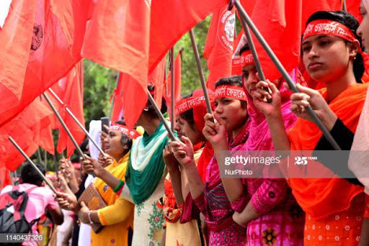
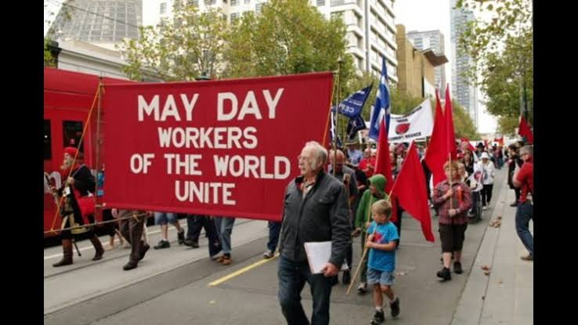
Section: A

Slide 11
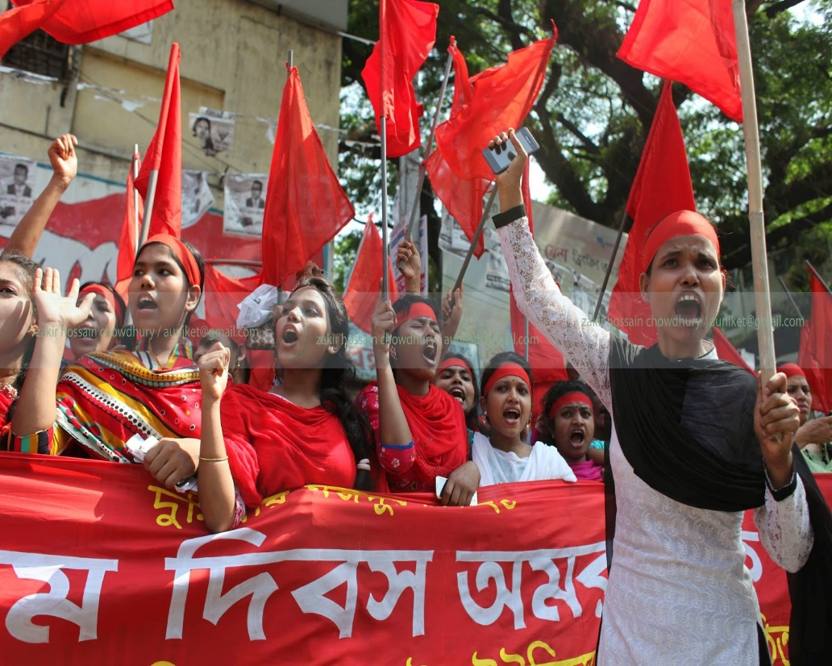
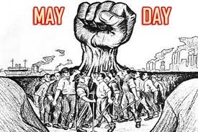
Section-B Read the text.
May day or International Worker’s Day is observed on May 1 all over the world today to commemorate the historical struggle and sacrifices of the working people to establish an eight-hour workday. It is a public holiday in almost all the countries of the world

Slide 12
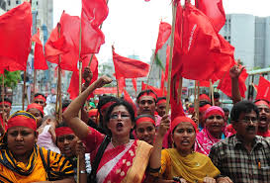
Since the industrial Revolution in the 18th and 19th centuries in Europe and the US, the workers in mills and factories had been working a long shift fourteen or even more hours a day On May 1st in 1886, inspired by the trade unions, half of the workers at the McComick Harvesting Machine Company in Chicago went on strike demanding an eight –hour workday.

Slide 13
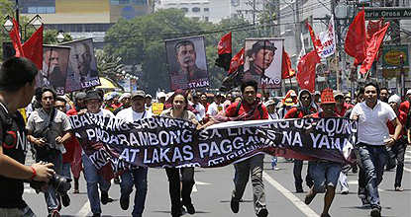
Two days later, a workers’ rally was held near the McComic Harvesting Machine Company and about 6000 workers joined it. The rally was addressed by the labour leaders.They urged the workers to stand together, to go on with their bosses. At one point of the rally, some strikebreakers started leaving the meeting place.

Slide 14
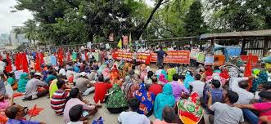
The strikers went down the street to bring them back. Suddenly about 200 policemen attracted them with clubs and revolvers. One sticker was killed instantly, five or six others were seriously wounded and many others were badly injured.

Slide 15
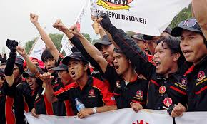
The events of May 1, 1886 are a reminder that workers will continue to be exploited until they stand up and speak out to gain better working conditions, better pay and better lives.

Slide 16
Individual Work
Fill in the gaps from the text.
throughout
May Day is observed a) __________ the world. It is a b)____________ day specially for the workers. Many workers went on c)________to gain an eight hour workday. They d)_________ for a better working condition with better wages. At last the workers e)_________ their rights.
red letter day
strike
demanded
gained

Slide 17
Pair Work
Write short answer to the following questions
What is May Day?
May Day is an International Workers’ Day.
How is May Day observed
May Day is observed as an international workers’ day.
When is May Day celebrated ?
May Day is celebrated on May 1st.

Slide 18
Choose the correct answer from the alternatives
What was workers prime demand_____
Better working condition b) better pay c) yearly increment d) Eight –hour workday
2. What does the phrase mean_____
a) Fight b) argue c) surrender d) admit
3. The word ‘strike’ means_____
a) refuse b) attack c) assault d) walkout
4. The word ‘exploit’ means_____
a) employ b) apply c) abuse d) handle

Slide 19
Evaluation
Answer the question:
1. Why do we observe May day? 2. Where was the place the strike held? 3. How many worker/workers was/were killed instantly on spot?

Slide 20
Home Work
Write a short paragraph on
“May Day”

Slide 21
Stay Safe-Keep yourself on Study

