Slide 1
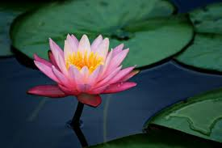
WELCOME

Slide 2
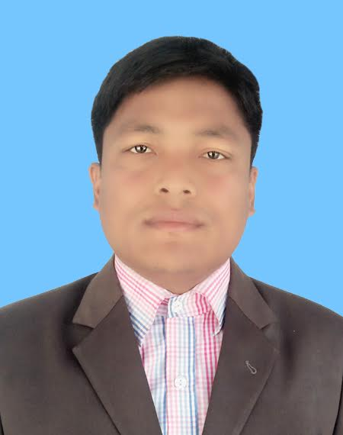
Introducing
Krishno Chandra Barman
Assistant teacher (English )
Kachari Bazar High School
Barogram ,Thakurgaon
25/7/2020
25/7/2020
Class : Nine
Sub :English 1st paper
Unit :Three
Lesson : Three
Time : 50 minutes

Slide 3
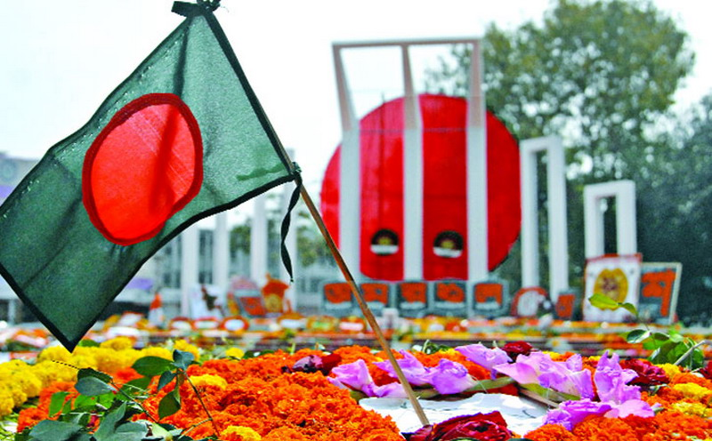
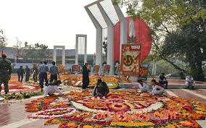
Look at the picture and talk about it .

Slide 4
Learning outcomes
After we have studied this lesson , we will be able to
write about the event.
complete the chart.
match the words with their meaning.
answer the questions.

Slide 5
1.What’s the picture about?
2.Where do you think it is?
3. Why was it built?

Slide 6
Our today’s lesson “International mother language day-1”

Slide 7
Learning outcomes
After we have studied this lesson , we will be able to
write about the event.
complete the chart.
match the words with their meaning.
answer the questions.

Slide 8
Vocabulary test
Memorable | Worth remembering
Tribute | expression of gratitude or praise.
Martyr | who makes sacrifices.
Enkindle | burn with
Movement | way of moving.
Climax | key moment
Admiration | respect, esteem.

Slide 9
Reading test
10 minutes

Slide 10
Single work
Complete the chart
Time | What happen
1947
1948
1952

Slide 11
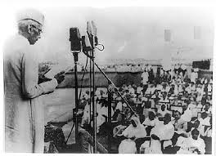
21 March 1948 Mohammad Ali Zinnah declared Urdu would be the only official language of Pakistan.

Slide 12
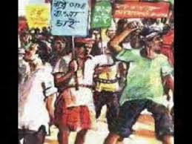
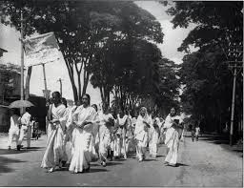
The declaration raised a storm of East Pakistan

Slide 13
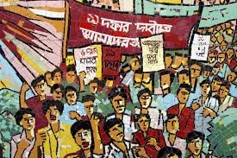
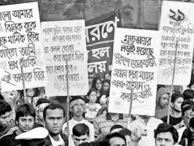
The student of Dhaka university defied the law

Slide 14
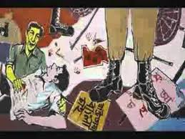
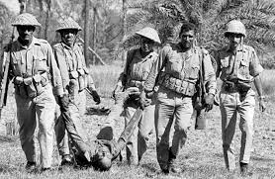
The police opened fire on the students

Slide 15
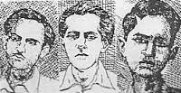
Killing Salam, Rafiq, Barkat & Jabbar

Slide 16
Pair work
Match the words with their meanings.
Words | Meanings
tributes | to have a particular effect
climax | to refuse to obey
outlaw | to give in
defy | The ability to keep increasing or developing
provoke | an act to show respect or admiration
relent | the most exciting point in time
momentum | to ban

Slide 17
Group work
Answers these questions
Why do we observe 21Februaryas the International Mother Language day?
What happened when Urdu was declared as the only official language of Pakistan?
“ The seed of independence was sown on 21 February 1952” .Do you agree with the comment? Why?

Slide 18
Evaluation
21 February is a -----------day in our national history.
On this day, we pay ----- to the martyrs.
The seed of the Language Movement was sown on ---------March----------.
This kindled the sparks of independence----------- of Bangladesh.

Slide 19
Home task
Write a short paragraph about “International Mother Language Day” which you observed in your school.

Slide 20
No more today

