Slide 1
Welcome

Slide 2
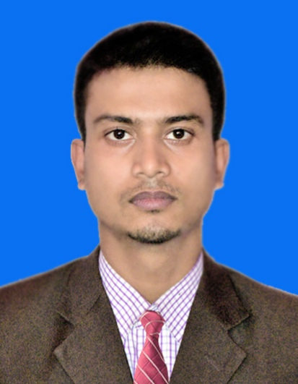
Sabuj Kumar Das
Assistant Teacher, English
Attaka K. Ali Pilot High School
Fakirhat, Bagerhat
E-mail: sabujeti2000@gmail.com

Slide 3
Learning Outcomes
After this lesson the students will be able to-
1. read and understand text through silent reading.
2. choose the best answer from the alternatives.
3. ask and answer questions.

Slide 4
Look the picture & try to guess our today’s topic

Slide 5
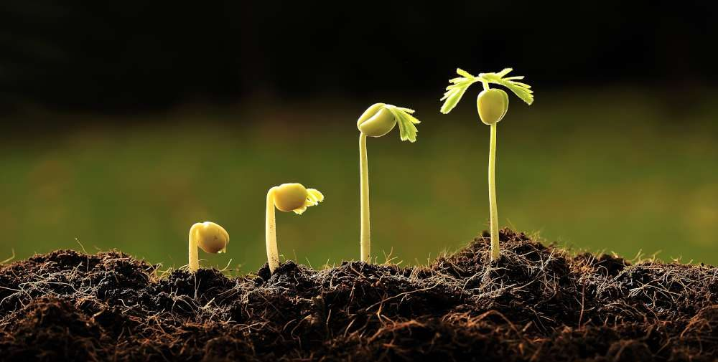
The beginning
&
Flash back
Unit-5, Lesson-1 & 2
Our today’s lesson is…

Slide 6
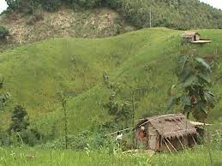
Vocabulary
Usual
Typical

Slide 7
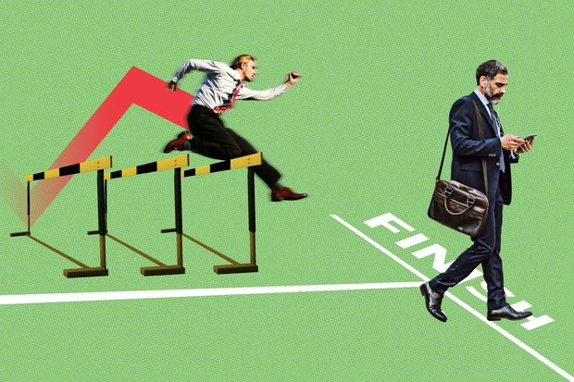
Disobey
Defying

Slide 8
Ego/Life force
Spirit

Slide 9
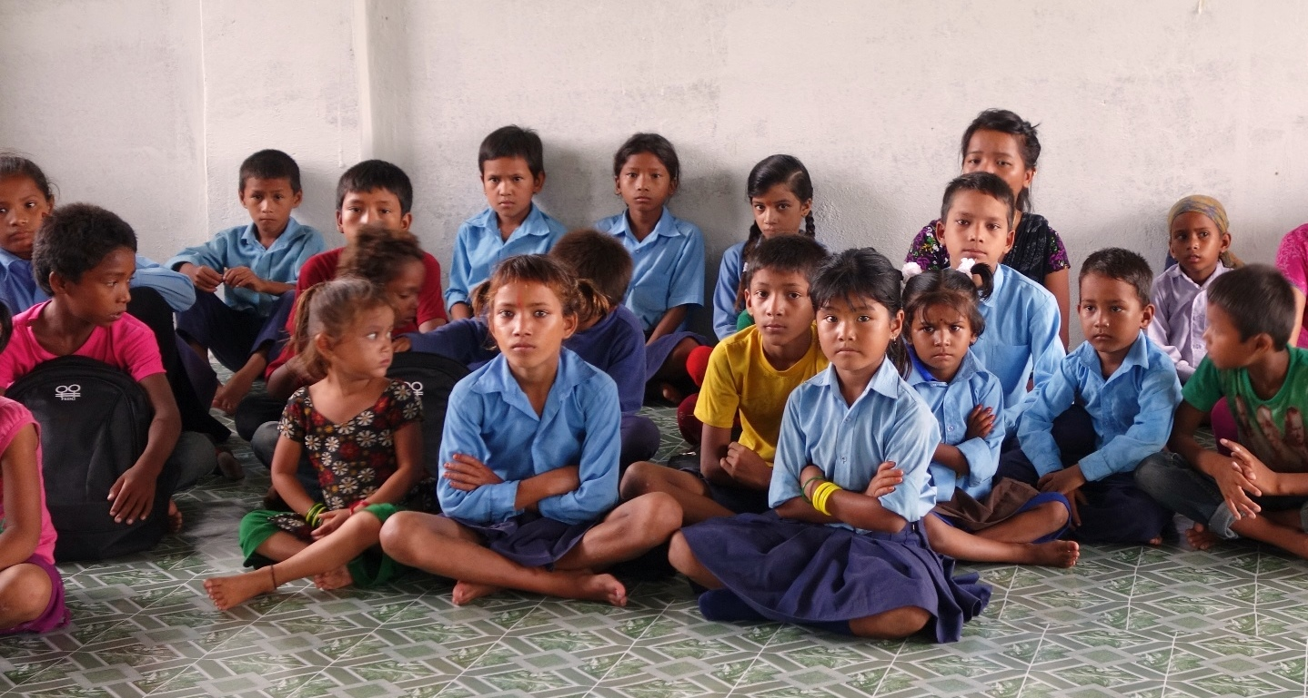
Juvenile
Adolescents

Slide 10
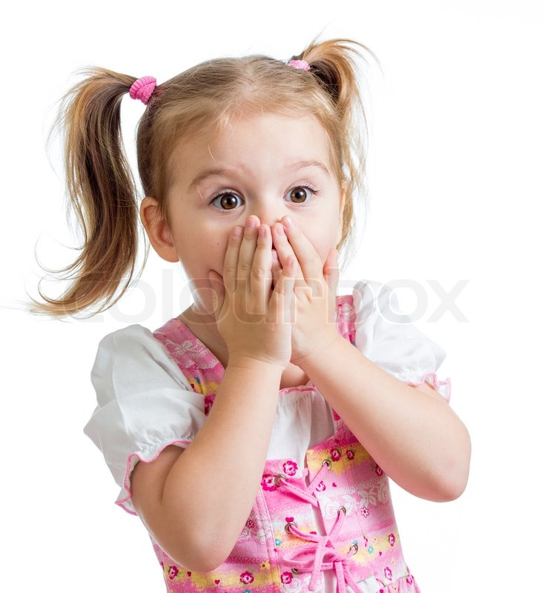
Shocked
Stunned

Slide 11
Unusual/ Uncommon
Extra ordinary

Slide 12
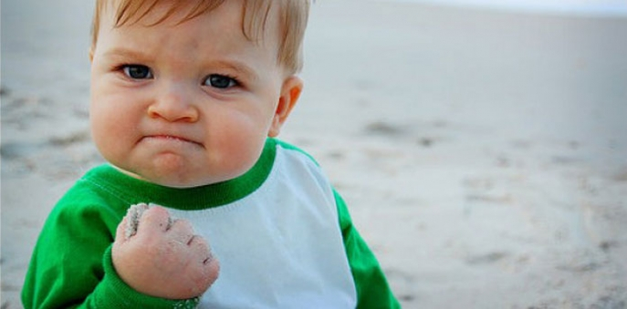
Power of mind
Determination

Slide 13
Let’s read the text

Slide 14
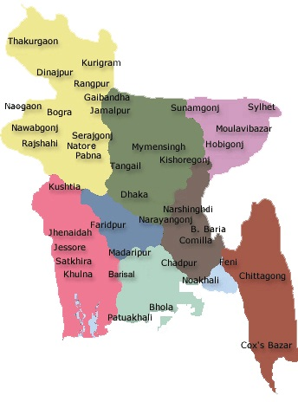
Khulna Division

Slide 15
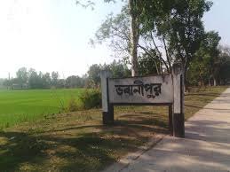
There is a small village called Bhabanipur in Jhenaidah.

Slide 16
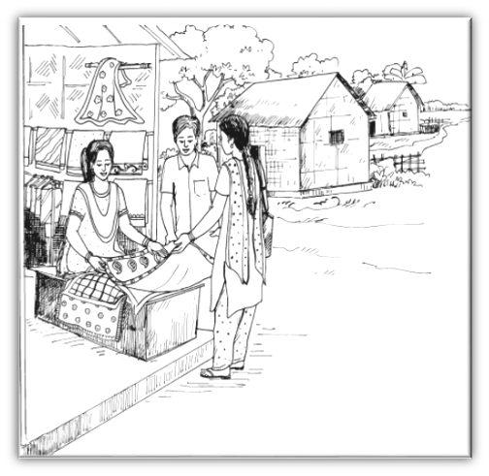
An extra ordinary woman
In this ordinary village, there lives an extraordinary woman named Shamima Akhter Maya. Shamima’s willpower and determination have made her extraordinary.

Slide 17
She has seen the most cruel aspect of life. But the cruelty could not defeat her spirit. She has come out as a winner, defying all the odds of life.

Slide 18
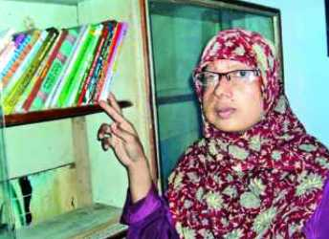
ঐক্য নারী কল্যাণ সংস্থা
Shamima is now 32 years old. She has only one son named Ashikur Rahman Kanok. She runs a small boutique called ‘Oikko Nari Kollyan Shangstha’ in her village.

Slide 19
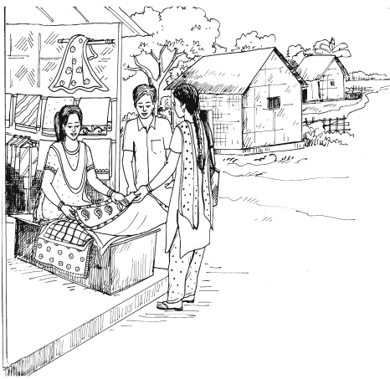
Let’s hear from Shamima, how she succeeded in setting up her boutique.

Slide 20
Shamima started to tell us her story. Listening to her, we were stunned and at the same time our hearts were filled with admiration for her.

Slide 21
GROUP WORK
Answer the following questions.
1. What type of village does Shamima live in?
2. What do the people of ‘Bhabanipur’ village usually do?
3. How long ago did Shamima begin to tell her story?
4. What has Shamima done to make herself extraordinary?
5. What did Shamima dream of?

Slide 22
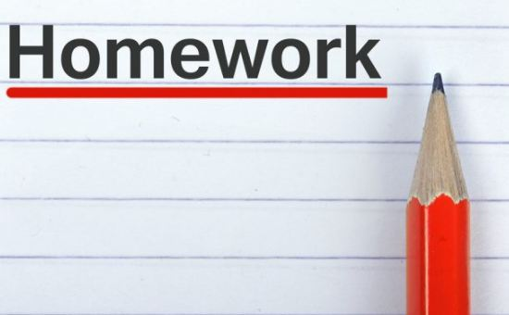
Write a paragraph about Shamima from your imagination. In your paragraph write “What Shamima should do for the good of her own family as well as the other families in the village”.
Write fifteen sentences about Shamima’s struggles.

Slide 23
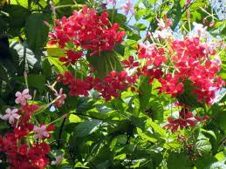
Thanks

