Slide 1
Welcome to my class

Slide 2
INTRODUCTION
Class : Eight-Twelve
Subject: English (Grammar)
(Transformation of Sentence)
Part-1
( Affirmative to Negative & vice versa)
Parvin Akter
Lecturer, English
Rampur Ideal Alim Madrasah,
Kamranga, Sadar, Chandpur.
Cell: 01718295712
Email:parvinakter1335@gmail.com

Slide 3
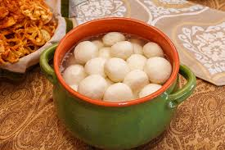
Notice these sentences…
The boy is sincere to his studies
The boy is not insincere to his studies.
I like Bangladeshi dessert.
I do not dislike Bangladeshi dessert
Do you find any change between first two and last two sentences............?
Yes
NO

Slide 4
Our Today’s Topic
Transformation Of Sentence
(Affirmative to Negative & vice versa)

Slide 5
Learning Outcomes:
After the end of the lesson the learners will be able to ---
write the definition of transformation of sentences
Identify the rules of transformation of sentences
Transform sentences (affirmative to Negative)

Slide 6
Definition
Transformation is a process of changing a sentence without changing its real meaning.
Example:
She is a good student. (Affirmative)
She is not a bad student. (Negative)
Both sentences have the same meaning

Slide 7
The rules of transformation of sentence
Part -1
Affirmative to Negative & vice versa :

Slide 8
Rule-1. Only replaced with none but ( person)
nothing but ( things)
not more/not less than (number/age)
Example:
Affirmative: Only the graduate can apply.
Negative: None but the graduate can apply
Affirmative: She likes only sweets.
Negative: She likes nothing but sweets.
Affirmative : He is only 22.
Negative: He is not more than 22

Slide 9
Rule-2: Must replaced with ‘can not but/can not help’
Example:
Affirmative : We must love our motherland
Negative : We can not but love our motherland.
Or, We can not help loving our motherland.
Vice versa
Negative: He cannot but go there.
Or: He cannot help going there.
Affirmative: He must go there.

Slide 10
Rule-3: Both ------and
Both replaced with Not only
and replaced with but also
Example:
Affirmative: Both Rana and his brother were present.
Negative: Not only Rana but also his brother were present.
Vice versa
Negative: He has not only money but also talent.
Affirmative: He has money and talent.

Slide 11
Rule-4: And ( if join two words replaced by not only….but also
Affirmative: He was obedient and gentle.
Negative: He was not only obedient but also gentle.
Vice versa
Negative: Jonny is not only punctual but also honest.
Affirmative: Jonny is punctual and honest.

Slide 12
Time: 5 min
Individual work
Transform the following sentences into negative
Only he can help you in this regard.
Jara took a bag only with her.
We must respect our parents.
She is both a singer and a dancer.
Both Sumi and her sister are beautiful.

Slide 13
Match the answers
Ans:None but he can help you in this regard
Ans: Jara took nothing but a bag with her.
Ans: We can not but respect our parents.
Ans: She is not only a singer but also a dancer.
Ans: Not only Sumi but also her sister are beautiful.

Slide 14
Rule-5: Everyone/everybody/every person (every + common noun) all replaced by there is no+ attached word+ but
Example :
Affirmative : Every mother loves her child.
Negative : There is no mother but loves her child.
Vice versa
Negative : There is no king but has a crown.
Affirmative : Every king has a crown.

Slide 15
Rule-6: Always replaced by Never
Affirmative word replaced by Antonym
Example :
Affirmative : He is always punctual.
Negative : He is never late.
Vice versa
Negative : I never forget you.
Affirmative : I always remember you.

Slide 16
As soon as replaced by No sooner had
Comma (,) replaced by than
Rule-7:
Example:
Affirmative: As soon as we reached the station, the train left.
Negative: No sooner had we reached the station than the train left.
Vice versa
Negative: No sooner had she seen her mother than she ran away to her .
Affirmative: As soon as she saw her mother, she ran away to her.

Slide 17
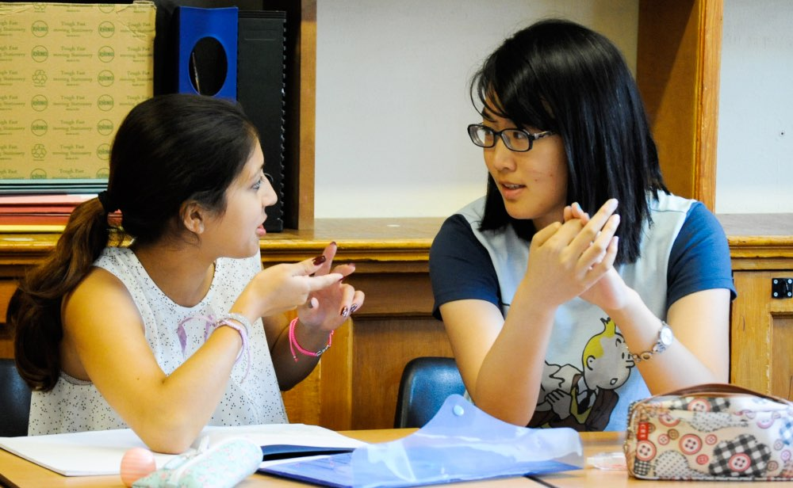
Pair Work
Transform the following sentences according to the instructions of the brackets.
Every body loves an honest man. ( Nega)
She is always attentive to her studies. (Nega)
No sooner had the thief seen the police than he ran away. (Affir)
He never tells a lie. (Affir)
As soon as I reached home, my little son ran to me. (Nega)

Slide 18
Rule-8:
Auxiliary verb replaced by not+ Auxiliary verb
Affirmative word replaced by Antonym
Example:
Affirmative: He is an attentive student.
Negative: He is not an inattentive student
Vice versa
Negative: He was not a honest man.
Affirmative: He was an dishonest man

Slide 19
Rule-9: Superlative degree replaced by no other
Affirmative: January is the coldest month of the year.
Negative: No other month of the year is as cold as January.
Vice versa
Negative: No other animal is as faithful as dog.
Affirmative: Dog is the most faithful animal.

Slide 20
Rule-10: as………as replaced by not less……….than
Affirmative: Shimi is as wise as Rimi.
Negative: Shimi is not less wise than Rimi.
Vice versa
Negative: Rani is not less tall than her sister.
Affirmative: Rani is as tall as her sister.

Slide 21
Rule-11: too…..to replaced by so……..that
Affirmative: She is too sick to attend the meeting.
Negative: She is so sick that she cannot attend the meeting
Vice versa
Negative: He is so weak that he can not walk.
Affirmative: He is too weak to walk.

Slide 22
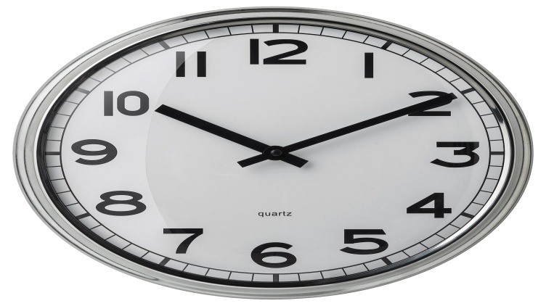
Group Work
Transform the following sentences according to the instructions of the bracket..
His work is liked by all. ( Negative)
Raju was the tallest boy in the class. ( Negative)
They were not less brilliant than we. ( Affirmative)
I was too weak to move. (Negative)
The sum was so difficult that I could not solve it. (Affirmative)

Slide 23
Rule-12: Universal truths replaced by negative & interrogative sentence
Affirmative: The sun sets in the west.
Negative: Does not the sun set in the west?
Vice versa
Negative: Does not the earth moves round the sun?
Affirmative: The earth moves round the sun.

Slide 24
Rule-13: Sometimes replaced by not always
Affirmative: Rahim sometimes visits me.
Negative:Rahim does not always visit me.
Vice versa
Negative: I do not always go my village home.
Affirmative: I sometimes go my village home.

Slide 25
Rule-13: a little replaced by not much
Affirmative: He has a little riches.
Negative: He does not have much riches.
Vice versa
Negative: She does not have much knowledge.
Affirmative: She has a little knowledge.

Slide 26
Home work
Transform the following sentences according to the instructions of the bracket
1. She alone lives in this building. (Negative)
2. There is no one bur hates a liar. (Affirmative)
3. Jim was only twenty two. (Negative)
4. Travelling is never unwelcome. (Affirmative)
5. You must obey your parents. (Negative)
6. He is as wise as his father. ( Negative)
7. Mr. Rashid is too brilliant to understand everything. ( Affirmative)
8. As soon as the rain stopped, I went out. (Negative)
9. Not only he but also his sister will come. ( Affirmative)
10. The sun rises in the east. ( Negative)

Slide 27
Thanks to all

