Slide 1
Welcome
English 2nd paper

Slide 2
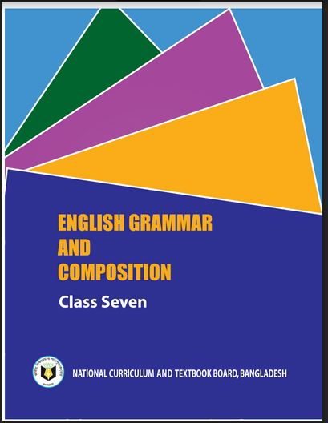
Identity
Class : Seven.
Lesson-13
Time- 50 Minutes
Date-20/03/2020
Md. Shariful Islam
M.A(Double), B.ED.
Asst. Teacher
Balakhal Chandraban Girls’ High School
Hajigonj, Chandpur.
Mobile no- 01736337531
E-mail-saharatanha@gmail.com

Slide 3
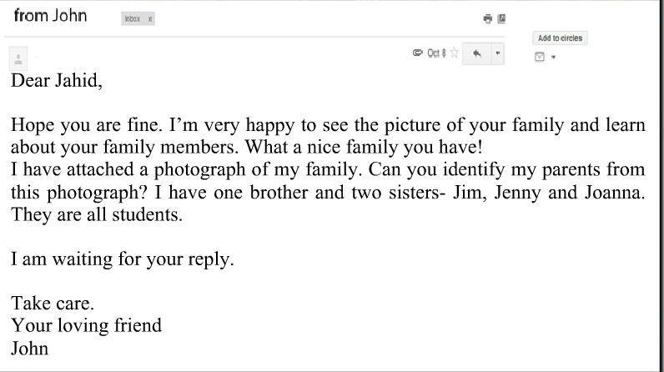
Look at the letter and the sentences.
What signs and marks are used in this letter?
What are they called in English?
Notes:
Showing the picture teacher can ask the question to the whole class.

Slide 4
Today’s topic
Punctuation Marks

Slide 5
Learning outcomes
After completing the lesson students will be
able to –
Learn the usage of different punctuation marks;
Use punctuation marks correctly.

Slide 6
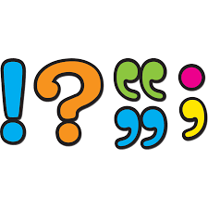
What is punctuation mark ?
Punctuation are marks used in printing and writing to separate sentences and clauses and to help make the meaning of sentences more clear. Commas, periods and question marks are examples of punctuation.

Slide 7
Why do we use them?

Slide 8
Some punctuation marks are given below

Slide 9
What’s the name of sign?

Slide 12
What’s the name of sign?

Slide 14
What’s the name of sign?

Slide 16
What’s the name of sign?

Slide 19
What’s the name of sign?

Slide 21
What’s the name of sign?

Slide 23
What’s the name of sign?
The semicolon (;) is used to connect independent clauses. It shows a closer relationship between the clauses than a period would show.

Slide 26
Home work

Slide 27
Thank you

