Slide 3
Identity
Mahfuja Khatun
Head Teacher
6 no Sujanagor Govt Primary School
Pangsha, Rajbari.
Class: two
Subject: English
Unit: 29
Lesson: 4-6 (A poor farmer …….... the egg.)

Slide 4
Learning outcomes
Students will be able to
1.1.1 repeat after the teacher simple words and phrases with proper sounds and stress.
4.2.1 enjoy simple stories.

Slide 5
Let’s watch a video

Slide 6
Story
The Golden Goose

Slide 7
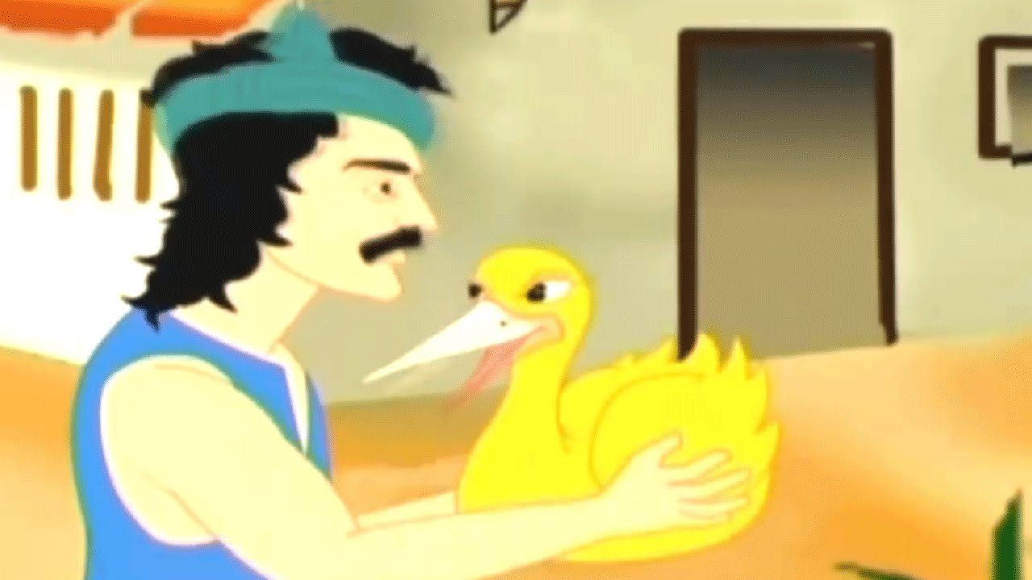
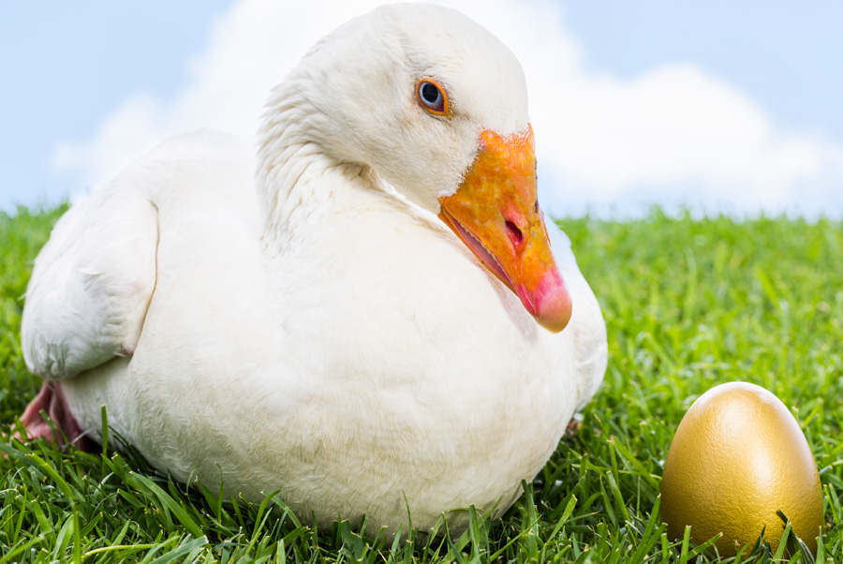
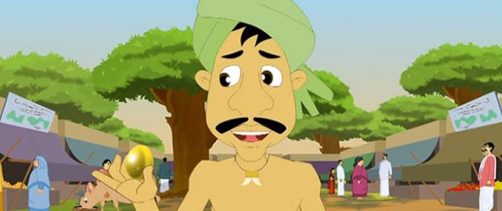
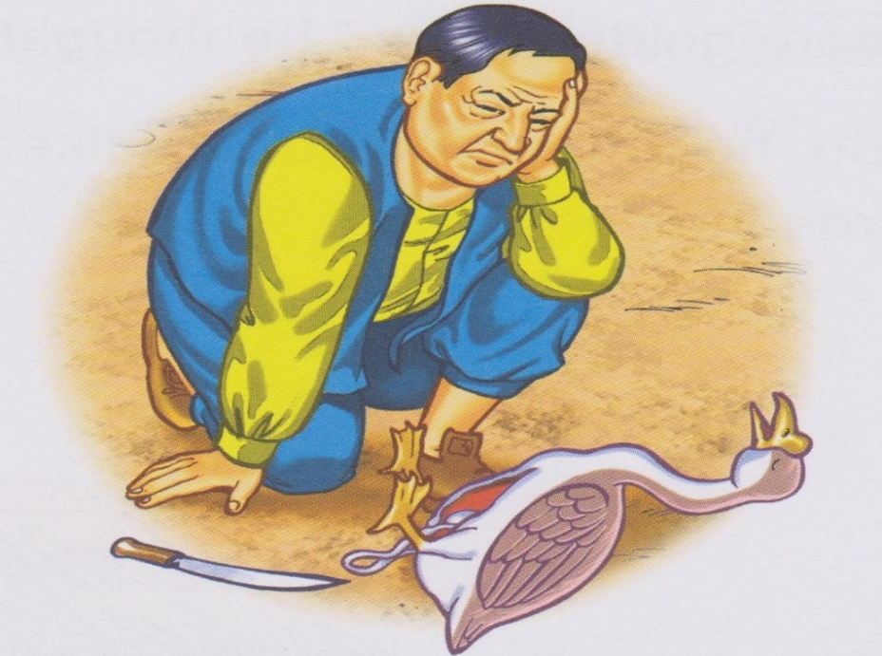

Slide 8
A poor farmer has a goose.

Slide 9
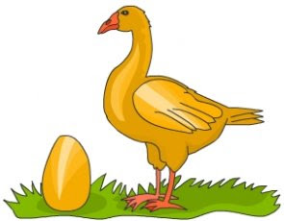
Everyday, the goose lays an egg.

Slide 10
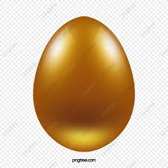
It’s a golden egg.

Slide 11
Everyday, the farmer sells the egg.

Slide 12
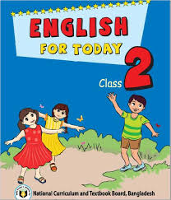
Open your book at page 59

Slide 13
Teacher’s loud reading

Slide 14
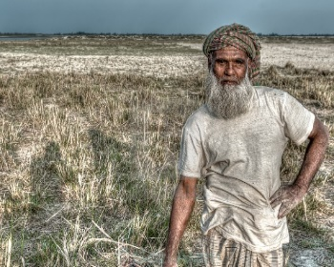
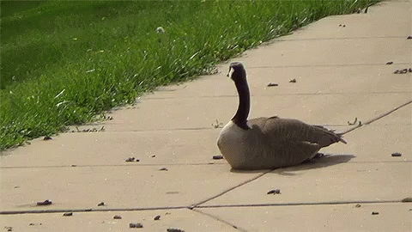
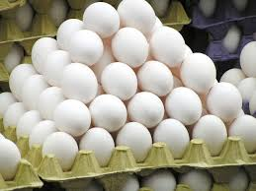
New words
Farmer
Goose
Egg
Golden

Slide 15
Group reading

Slide 16
Individual reading
By students

Slide 17
Evaluation
Pronunce and say the meaning the words:
Everyday
Goose
Lay

Slide 18
Home Work
Write two sentences about your pet bird.

Slide 19
THANK YOU

