Slide 1
Welcome to my Class

Slide 2
IDENTITY
PARVIN AKTER
Lecturer, English
Rampur Ideal
Alim Madrasah
Sadar, Chandpur
Mobile : 01718295712
E-mail: parvinakter1335@gmail.com
Class: Eight
Subject: English
Topic: Transformation of Sentence Part-2 ( Assertive to Interrogative & vice versa)
Time: 45 minutes

Slide 3
Let’s see the following sentences
i)
He is a good student.
Isn’t he a good student?
ii)
Nothing is impossible in this world.
Is anything impossible in this world?
iii)
Everybody wants to be happy in life.
Who does not want to be happy in life?

Slide 4
Lesson Declaration
Our today’s lesson is transformation of sentence ( Assertive to Interrogative and vice versa)
[ vice versa means opposite]

Slide 5
Learning outcomes
At the end the lesson , students will be able to……
1. Define Assertive and Interrogative sentence
2 . Identify assertive and interrogative sentence
3. Know auxiliary verb
4. Change assertive to interrogative and vice versa
Notes:
Parvin Akter, Lecturer, English, Rampur Ideal Alim Madrasah, Kamranga, Sadar, Chandpur.

Slide 6
Definition of Assertive and Interrogative Sentences
Definition of Assertive/Declarative Sentence:
The sentence which declares or asserts a statement, feeling, opinion, incident, event, history, or anything is called an assertive sentence.

Slide 7
How to identify Assertive and Interrogative Sentences
An assertive sentence ends with a p full stop (.). Assertive sentences can be either affirmative or negative.

Slide 8
Individual Work
What is Assertive Sentence? How do you identify it?

Slide 9
Let’s know auxiliary verbs
Auxiliary /helping verbs are two types:
1.Primary Auxiliary:
a) Be verb: am, is are present
was, were past
b) Have verb: have, has present
had past
c) Do verb: do, does present
did past
2. Model Auxiliary: will, would, shall. should. can. could, may, might, need, must. used to, ought to, dare

Slide 10
Pair Work
What is auxiliary verb?
How many auxiliary verbs?
What are they?

Slide 11
Assertive to interrogative
1. [Assertive sentence with Auxiliary/Model Affirmative]
Structure: Aux/model verb+ not+ sub+ rest part of the sentence
Example:
Ass: He is a good teacher.
Int: Isn’t he a good teacher?
Ass: The girl was very intelligent.
Int: Wasn’t the girl very intelligent?

Slide 12
More examples
Asser: It may rain today.
Inte: Mayn’t it rain today?
Vice Versa
Inte: Do they play in the afternoon?
Asser: They do not play in the afternoon.

Slide 13
2. Assertive sentence with Auxiliary/Model verb negative
Structure: Aux/Model verb+ sub+ rest part of the sentence+ question mark
Example:
Ass: They were not good players.
Int: Were they good players?
Ass: I am not a rich man
Int: Am I a rich man?

Slide 14
More examples
Ass: He cannot swim.
Int: Can he swim?
Vice Versa
Inte: Is she a writer?
Asser: She is not a writer.
Inte: Should we go?
Asser: We should not go.

Slide 15
3. Assertive sentence with action verb (affirmative)
Structure: Don’t / doesn’t / didn’t+ sub+ base form of verb + the rest part of sentence + question mark
Example:
Ass: She teaches us English.
Int: Doesn’t she teach us English?
Ass: Two brothers help each other.
Int: Don’t two brothers help each other?
Notes:
Parvin Akter, Lecturer, English, Rampur Ideal Alim Madrasah, Kamranga, Sadar, Chandpur.

Slide 16
More examples
Ass: They enjoyed the football match.
Int: Didn’t they enjoy the football match?
Asser: He went to village home.
Inte: Didn’t he go to village home?
Vice Versa
Inte: Didn’t Rana finish his homework?
Asser: Rana finished his homework.
Notes:
Parvin Akter, Lecturer, English, Rampur Ideal Alim Madrasah, Kamranga, Sadar, Chandpur.

Slide 17
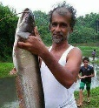
4. Assertive sentence with action verb (negative)
Structure: Do / does / did+ sub+ base form of verb + the rest part of sentence + question mark
Example:
Ass: He doesn’t eat small fish.
Int: Does he eat small fish?
Ass: He didn’t have money to buy this fish.
Int: Did he have money to buy this fish?

Slide 18
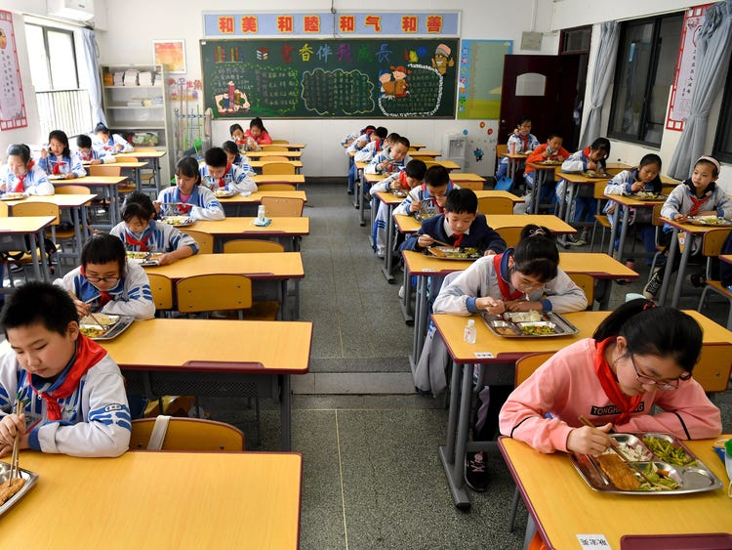
More examples
Ass: I shan’t go to school today.
Int: Shall I go to school today?
Vice Versa
Inte: Does Jahid go to office?
Asser: Jahid does not go to office.

Slide 19
5. Assertive with nobody / none / no one
Structure: who+ the rest part of sentence + question mark
Example:
Ass: None can do the work.
Int: Who can do the work?
Or: Can anyone do the work?
Notes:
Parvin Akter, Lecturer, English, Rampur Ideal Alim Madrasah, Kamranga, Sadar, Chandpur.

Slide 20
More examples
Ass: Nobody believes a dishonest man.
Int: Who believes a dishonest man?
Or: Does anyone believe a dishonest man?
Vice Versa
Inte: Who could ever count his love for us?
Asser: Nobody could ever count his love for us.
Notes:
Parvin Akter, Lecturer, English, Rampur Ideal Alim Madrasah, Kamranga, Sadar, Chandpur.

Slide 21
6. Assertive with everybody / everyone / all
Structure: who+ doesn’t / don’t / didn’t + base form of verb + the rest part of sentence + question mark
Example:
Ass: Everybody believes an honest man.
Int: Who doesn’t believe an honest man?

Slide 22
More examples
Ass: Every one loves flowers.
Int: Who doesn’t love flowers?
Vice Versa
Inte: Who were not present in the last meeting?
Asser: All were present in the last meeting.

Slide 23
7. Assertive with never
Structure: Auxiliary verb + sub + ever + main verb + rest part + question mark
Example:
Asser: I have never visited Thailand
Inter: Have I ever visited Thailand?
Asser: Jerry had never seen his mother.
Inter: Had Jerry ever seen his mother?
Notes:
Parvin Akter, Lecturer, English, Rampur Ideal Alim Madrasah, Kamranga, Sadar, Chandpur.

Slide 24
8. Assertive with nothing
Structure: Verb + sub + anything + rest part of the sentence + question mark
Example:
Asser: He had nothing to do in that situation.
Inter: Had he anything to do in that situation?
Vice Versa:)
Inter: Had she anything to eat?
Asser: She had nothing to eat.

Slide 25
9. Assertive with introductory ‘there’
Put ‘what/who’ in the place of ‘there is no’ + the rest part of the sentence + question mark.
Examples:)
Assertive: There is no use of this law.
Interrogative: What is the use of this law?
ii) Assertive: There is no man happier than Jamil.
Interrogative: Who is happier than Jamil?
Note: If the word after ‘there is no’ is a person, you have to use ‘who’ and ‘what’ if it is something else. And, ‘is there any’ can also be used. ‘What isn’t’ can also be used instead of ‘what is’ while changing to Interrogative.

Slide 26
10. Assertive with ‘it is no use
Put ‘why’ in the place of ‘it is no use’ + base form of verb +the rest part of the sentence + question mark.
Asser: It is no use memorizing answer for any examination.
Inte: Why memorize answer for any examination?
Or: Is there any use of memorizing answer for any examination?
Vice Versa
Inte: Why go to beach in this cold weather?
Asser: It is no use going to beach in this cold weather.
Notes:
Parvin Akter, Lecturer, English, Rampur Ideal Alim Madrasah, Kamranga, Sadar, Chandpur.

Slide 27
11. Assertive with ‘ it does not matter’
Put ‘what enough’ in the place of ‘it does not matter’ + the rest part of the sentence + question mark.
Asser: It does not matter if we lose the game.
Inte: What though if we lose the game?
Vice Versa
Inte: What though if they do not help us?
Asser: I does not matter if they do not help us.

Slide 28
Change the following sentences according to the instruction of the bracket:
I shall never forget your advice. ( Interrogative)
What is life but full of actions? (Assertive)
Prevention is better than cure. ( Interrogative)
Everybody loves a patriot. ( Interrogative)
Could they drink salty sea water? (Assertive)
Nobody trusts a liar. ( Interrogative)
Who can do this? ( Assertive)
She loved her father deeply. ( Interrogative)
There is no use of this law. ( Interrogative)
Who does not wish to be happy? ( Assertive)

Slide 29
Thanks to all

