Slide 1
Welcome to my class
Md. Saiful Islam, Assistant teacher (English), Bagbari Chowbaria High School, Tangail Sadar Tangail

Slide 2
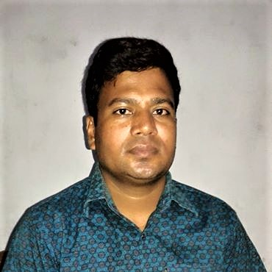
Introducing
Md. Saiful Islam
Assistant teacher (English)
Bagbari Chowbaria High School,
Tangail Sadar Tangail
Class: Eight
Subject: English 2nd paper
Unit: 06
Topic: Verb
Date: 16-09-2020-20
Md. Saiful Islam, Assistant teacher (English), Bagbari Chowbaria High School, Tangail Sadar Tangail

Slide 3
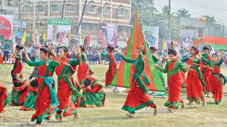
Look at the following Examples.
We like to enjoy display.
Do not take junk food.
Md. Saiful Islam, Assistant teacher (English), Bagbari Chowbaria High School, Tangail Sadar Tangail

Slide 4
This is Sabina’s family.
She likes to read books.
What are the underlined words in the above slides?
In the above slides, the underlined words are verbs.
Md. Saiful Islam, Assistant teacher (English), Bagbari Chowbaria High School, Tangail Sadar Tangail

Slide 5
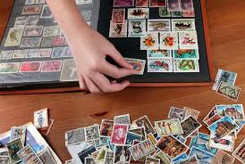
What is called verb?
The word that denotes to do any kind of work or action is called verb.
(a) They go to school. (b) I eat rice. (c) They are climbing trees. (d) Stamp collecting is my hobby.
Md. Saiful Islam, Assistant teacher (English), Bagbari Chowbaria High School, Tangail Sadar Tangail

Slide 6
Lesson declaration
Verbs
Md. Saiful Islam, Assistant teacher (English), Bagbari Chowbaria High School, Tangail Sadar Tangail

Slide 7
Learning outcomes:
After finishing the lessons, learners will be able to -------
define verbs.
classify the verbs
fill in the gaps with verbs.
differentiate between participle and gerund.
Md. Saiful Islam, Assistant teacher (English), Bagbari Chowbaria High School, Tangail Sadar Tangail

Slide 8
Kinds of verb
There are two kinds of verb. They are:
Verb
Non-finite
Finite
Md. Saiful Islam, Assistant teacher (English), Bagbari Chowbaria High School, Tangail Sadar Tangail

Slide 9
Finite verb
The verb that follows its subject and tense is called Finite Verb.
(a) We all live in a family. (b) None can live alone.
Md. Saiful Islam, Assistant teacher (English), Bagbari Chowbaria High School, Tangail Sadar Tangail

Slide 10
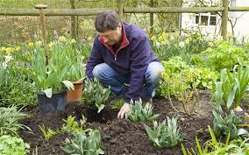
Non-finite verb
The verb that does not follow its subject and tense is called Non-finite Verb.
(a) Swimming is my hobby. (b) He likes to make a garden.
Md. Saiful Islam, Assistant teacher (English), Bagbari Chowbaria High School, Tangail Sadar Tangail

Slide 11
Kinds of Finite Verb
There are two kinds of finite verb. They are:
Finite verb
Auxiliary verb
Principal verb
Md. Saiful Islam, Assistant teacher (English), Bagbari Chowbaria High School, Tangail Sadar Tangail

Slide 12
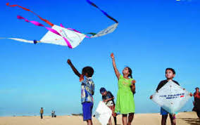
Principal Verb
The verb that can express its meaning without the help of other verbs is called principal verb.
(a) They are flying kites. (b) Karim goes to school.
Md. Saiful Islam, Assistant teacher (English), Bagbari Chowbaria High School, Tangail Sadar Tangail

Slide 13
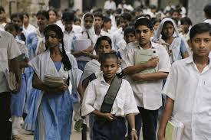
Auxiliary Verb
The verb that can not express its meaning without the help of principal verbs is called Auxiliary verb.
(a) The baby can not walk alone. (b) You must go to school regularly.
Md. Saiful Islam, Assistant teacher (English), Bagbari Chowbaria High School, Tangail Sadar Tangail

Slide 14
Kinds of Principal Verb
There are two kinds of finite verb. They are:
Principal verb
Intransitive verb
Transitive verb
Md. Saiful Islam, Assistant teacher (English), Bagbari Chowbaria High School, Tangail Sadar Tangail

Slide 15
Transitive verb
The verb that can not complete its meaning without the help of other words is called Transitive verb.
(a) The boy reads a book. (b) He catches fish.
Md. Saiful Islam, Assistant teacher (English), Bagbari Chowbaria High School, Tangail Sadar Tangail

Slide 16
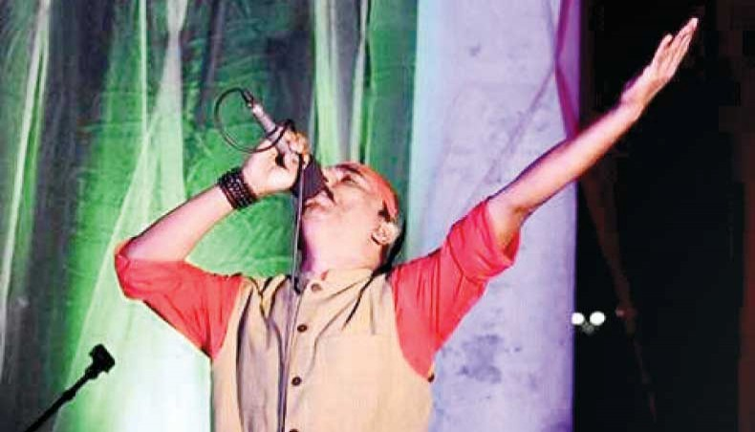
Intransitive verb
The verb that can complete its meaning without the help of other words is called Intransitive verb.
(a) Birds fly. (b) The man sings.
Md. Saiful Islam, Assistant teacher (English), Bagbari Chowbaria High School, Tangail Sadar Tangail

Slide 17
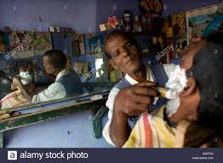
Causative Verb
The verb that doesn’t work itself but gets the work done by other is called Causative Verb.
(a) I make the barber cut my hair. (b) They raised their hands.
Md. Saiful Islam, Assistant teacher (English), Bagbari Chowbaria High School, Tangail Sadar Tangail

Slide 18
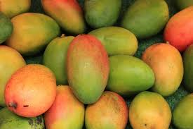
Copulative Verb
When the intransitive verb can not complete the meaning of the sentence without the help of other words then it is called Copulative Verb.
(a) The mangoes are tasty. (b) They look happy.
Md. Saiful Islam, Assistant teacher (English), Bagbari Chowbaria High School, Tangail Sadar Tangail

Slide 19
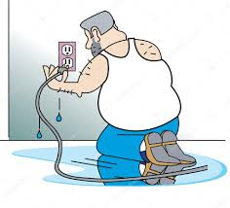
Factitive Verb
When the transitive verb with its object can not complete the meaning of the sentence without the help of other words then it is called Factitive Verb.
(a) We made him captain. (b) They call him a fool.
Md. Saiful Islam, Assistant teacher (English), Bagbari Chowbaria High School, Tangail Sadar Tangail

Slide 20
Reflexive Verb
When the subject and object of an intransitive verb indicates the same person or thing then it is called Reflexive Verb.
(a) They fed themselves. (b) The girls fans herself.
Md. Saiful Islam, Assistant teacher (English), Bagbari Chowbaria High School, Tangail Sadar Tangail

Slide 21
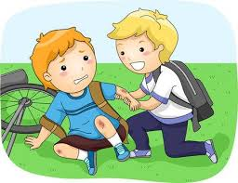
Reciprocal Verb
The transitive verb that express the action or reaction between subject and object in a sentence is called a Reciprocal Verb.
(a) They help one another. (b) The two boys hated each other.
Md. Saiful Islam, Assistant teacher (English), Bagbari Chowbaria High School, Tangail Sadar Tangail

Slide 22
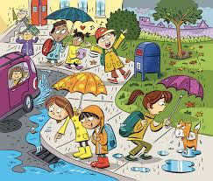
Impersonal Verb
When the impersonal ‘it’ is used as a subject of a verb then it is called Impersonal Verb.
(a) It has been raining since morning. (b) It dews in winter.
Md. Saiful Islam, Assistant teacher (English), Bagbari Chowbaria High School, Tangail Sadar Tangail

Slide 23
Cognate Verb
When an intransitive verb takes the similar noun as an object and acts as a transitive verb then it is called Cognate Verb.
(a) They fought a fight. (b) The man sings a song
Md. Saiful Islam, Assistant teacher (English), Bagbari Chowbaria High School, Tangail Sadar Tangail

Slide 24
Kinds of Non-finite Verb
There are three kinds of finite verb. They are:
Non-finite verb
Participle
Infinitives
Gerund
Md. Saiful Islam, Assistant teacher (English), Bagbari Chowbaria High School, Tangail Sadar Tangail

Slide 25
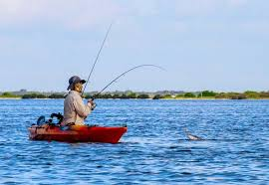
Gerund:
The form of verb which does the function of both verb and noun is called gerund.
(a) Walking is a good form of exercise.
(b) Fishing is very enjoyable.
[In the above sentences, the underlined words are gerund because they do the function of both verb and noun.]
Md. Saiful Islam, Assistant teacher (English), Bagbari Chowbaria High School, Tangail Sadar Tangail

Slide 26
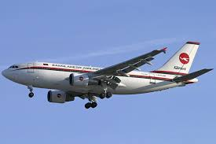
Participle:
The form of verb which does the function of both verb and adjective is called participle.
Closing the door, Karim went to the field.
Having taken the passengers, the plane flew away.
[ In the above sentences, the underlined words are participle because they do the functions of both verb and adjective.]
Md. Saiful Islam, Assistant teacher (English), Bagbari Chowbaria High School, Tangail Sadar Tangail

Slide 27
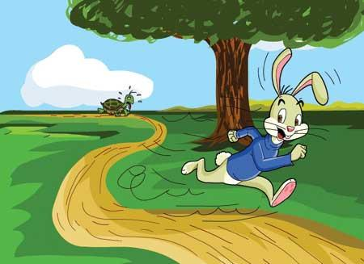
Infinitives:
If there is ‘to’ before the base form of verb and does the function of both verb and noun is called infinitive.
(a) It is our duty to respect our teacher.
(b) The hare ran fast to win the race.
[ In the above sentences, the underlined words are infinitives because they do the functions of both verb and noun.]
Md. Saiful Islam, Assistant teacher (English), Bagbari Chowbaria High School, Tangail Sadar Tangail

Slide 28
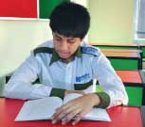
Individual work
What is called verb? How many kinds of verb are there? Write their names.
Answer:
The word that denotes to do any work or action is called verb. There are two kinds of verb. They are: (1) Finite verb (2) Non-finite verb.
Md. Saiful Islam, Assistant teacher (English), Bagbari Chowbaria High School, Tangail Sadar Tangail

Slide 29
Pair work
What is the difference between Gerund and Participle?
Answer: The difference between gerund and participle are given below
Gerund1 | Participle
1. A gerund is a verbal noun. | 1. A participle is a verbal adjective.
2. A gerund is a verbal that functions as a noun. | 2. A participle is a verbal that functions as an adjective.
3. Verb and noun combined is a gerund. | 3. Verb and adjective combined is a participle.
Md. Saiful Islam, Assistant teacher (English), Bagbari Chowbaria High School, Tangail Sadar Tangail

Slide 30
Group work
Run | print | change | fly | shine | love | go | work
Read the following text and fill in the gaps using present participle. Pick the suitable words from the above box.
Uncle Tom had a printing press. It was the first press in the city. He was very proud of his machines. When he died, his son, Rod, became the owner of the (a) ------------business. Initially he was doing fine. After few months his university (b)--------- brother came home. He was a kind of (c) ---------- bird and didn’t have any interest in business. Yet one day he came to the press and told Rod to replace the old machines with digital ones. He also expressed his desire to be his (d) ------------- partner. Tom agreed. Later he took him to London to show modern (e) ----------- machines with digital technology. But Rod had limited ideas about them. So he took time to think. His (f) ---------- brother was not happy to see the big brother’s (g) -------- -----mind.
running
going
flying
working
printing
loving
changing
Md. Saiful Islam, Assistant teacher (English), Bagbari Chowbaria High School, Tangail Sadar Tangail

Slide 31
Evaluation
Choose the best answer from the alternatives:
Hasan reads a book. The underlined verb is---
(i) impersonal (ii) cognate (iii) Reflexive (iv) transitive
(b) He killed himself. The underlined verb is---
(i) causative (ii) factitive (iii) cognate (iv) reflexive
(c) Mother feeds the baby. The underlined verb is ------
(i) reflexive (ii) factitive (iii) causative (iv) factitive
(d) We made him captain. The underlined verb is -----
(i) cognate (ii) reflexive (iii) factitive (iv) causative
(e) The man sings a song. The underlined verb is -----
(i) Cognate (ii) factitive (iii) reflexive (iv) causative
Md. Saiful Islam, Assistant teacher (English), Bagbari Chowbaria High School, Tangail Sadar Tangail

Slide 32
Home work
Write a paragraph about ‘’Your mother’’ using transitive, cognate, factitive and causative verbs.
Md. Saiful Islam, Assistant teacher (English), Bagbari Chowbaria High School, Tangail Sadar Tangail

Slide 33
Allah Hafez
Md. Saiful Islam, Assistant teacher (English), Bagbari Chowbaria High School, Tangail Sadar Tangail

