Slide 1
Welcome to the class

Slide 2
IDENTITY
MD. AFSAR ALI
SENIOR ASSISTANT TEACHER Majhira Model High School
Shajahanpur, Bogra
Mob: 0171549949
E-mail: afsar0903@gmail.com
English for today
Class: Nine-Ten
Unit: Three (Events and festivals)
Lesson : International Mother Language Day-2

Slide 3
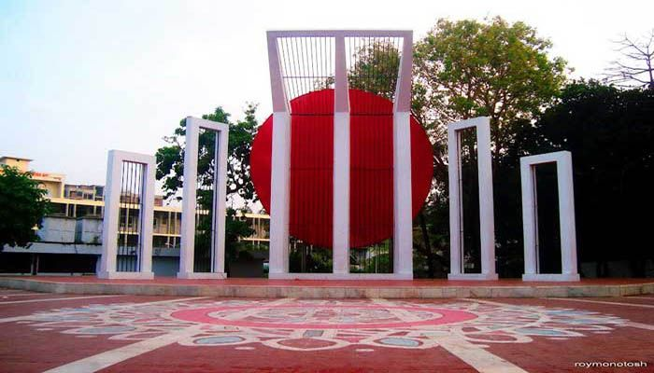
Look at the picture and talk about it
The other name of shahid Dibosh is International Mother Language Day.
What is the other name of shahid Dibosh?
I can see a shahid minar in the picture
What can you see in the picture?

Slide 4
Our Today’s Lesson is-
International Mother Language Day -2
Unit-3, Lesson-4 Page No:

Slide 5
Learning outcomes
After we have studied this lesson. we will be able to---
talk about events and festivals
ask and answer questions and give opinions in a logical sequence
infer meanings from the context

Slide 6
Key words
Word | Meaning
Observe | To celebrate or acknowledge
Throughout | In every part of
Remembrance | the ability to recall past occurrence
Mourning | The expression of sorrow for someone’s death
Recall | To remember something
Supreme | Highest in rank or position
Sacrifice | The fact of giving up something important or valuable
Barefoot | Without shoes on
Procession | A number of person, vehicles etc. moving in an orderly fashion

Slide 7
Key words
Word | Meaning
Wreath | An arrangement of flowers and leaves in a circular shape
Proclaim | To publicly or officially tell people about something important
Recognition | Identification of a thing or person from previous encounters or knowledge
Rightful | That is correct, legal
Promote | To help something to happen or develop
Linguistic | Relating to languages or the affinities of languages
Diversity | A range of different things
Multilingualism | The use of two or more language/multilingual

Slide 8
Let’s enjoy a video

Slide 9
B Read more about International Mother Language Day.
Observed: (v) উদযাপন করেছিল, পালন করেছিল
To celebrate, acknowledge, commemorate
Commemoration: স্মৃতি রক্ষা করা
Processions: মিছিল pomp, parade
Recognition: স্বীকৃতি gratitude, acknowledgment
Multilingualism: বহুভাষাবাদ the use of two or more language
Linguistic: ভাষা সম্বন্ধীয় verbal, lexical
Proclaim: ঘোষণা করা announce, declare
Mourning: শোক grieving, sorrowing
Scarifies: ত্যাগ abandonment
Barefoot: খালি পায়ে wearing nothing on the feet
Diversity: বৈচিত্র variety, multiplicity
Wreaths: পুষ্পস্তবক laurels, bay
observed
21 February is observed as Shaheed Dibosh every year throughout the country in remembrance of the martyrs of language movement of 1952. The comme­moration begins at the early hours of the day with mourning songs that recall the supreme sacrifices of our language martyrs. People wear black badges and go to the Shaheed Minar in barefoot processions, singing mourning songs. They place wreaths at the Minar. Many of them visit the graves of the martyrs at Azimpur graveyard and pray for them. They also attend various programmes organised in remembrance of the language martyrs.
The UNESCO (United Nations Educational, Scientific and Cultural Organisation) on 17 November in 1999 proclaimed February 21 as the International Mother Language Day in recognition of the sacrifices of the martyrs for the rightful place of Bangla. The day is now annually observed worldwide to promote awareness of linguistic and cultural diversity and multilingualism.
commemoration
mourning
sacrifices
barefoot
processions
wreaths
proclaimed
recognition
linguistic
diversity
multilingualism

Slide 10
A. DISCUSS THESE QUESTIONS.
When did the International Mother Language Day celebration begin?
Answer: 21st February was declared as the International Mother Language Day by UNESCO in 1999. From next year 2000 is the begging of it’s celebration.
What does the abbreviation UNESCO stand for?
Answer: UNESCO stand for United Nations Education, Scientific and Cultural Organization.
What is the other name of 21 February?
Answer: The other name of 21 February is Shaheed Day.

Slide 11
Match the words/phrases in the table with their meanings
Words/phrases
Meanings
1. wreath
2. in remembrance of
3. proclaim
4. promote
5. diversity
6. multilingualism
7. in recognition of
encourage
in appreciation of
practice of using several languages
an arrangement of flowers in the shape of a circle
declare
in memory of
variety

Slide 12
D. Read the text in B again and answer these questions.
1. Why is 21 February called Shaheed Dibosh?
Answer: It is called Shaheed Dibosh as our martyrs sacrificed their lives on this day for our language.
2. Why do people go to the Shaheed Minar? How do they go there?
Answer: People go to Shaheed Minar to show their respect to the martyrs. They go there barefooted.
Why is 21 February now observed throughout the world every year?
Answer: Now 21 February observed throughout the world every year as on 17 November 1999 UNESCO has declared it as International Mother Language Day .

Slide 13
E. Complete the passage with suitable words.
blood
On 21 February 1952……….....was shed at a place between Dhaka Medical College and Dhaka University……………..to establish Bangla as a state …………….. of Pakistan. All subsequent movements ………………...to struggles for independence had their origin in the historic language ………………. Shaheed Minar is the………………..of die supreme sacrifice ………..the mother tongue.
in order
language
contributed
movement
symbol
for

Slide 14
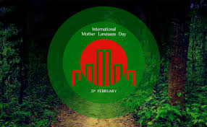
Home Work
Write briefly how you observed this year’s 21 February at your school.

Slide 15
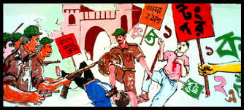
Good bye
See you again

