Slide 1
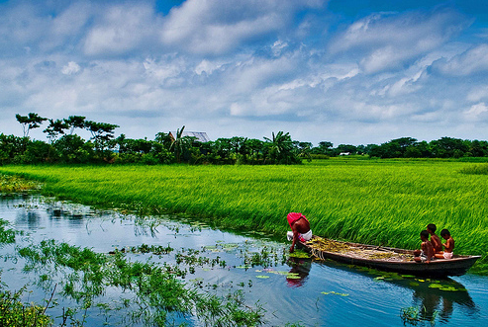
Welcome to English Class

Slide 2
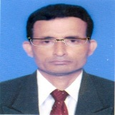
Identity
Manik Chandra Majumder
Senior Teacher
Gazirhat High School
Senbag, Noakhali
Mobile No: 01717155169
Email: manikmajumder01@gmail.com
Class : Nine-Ten
Subject : English 1st paper

Slide 3
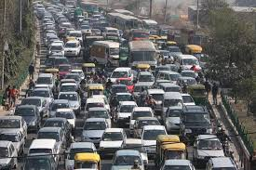
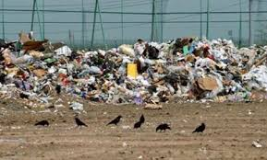
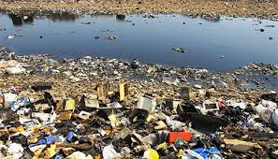
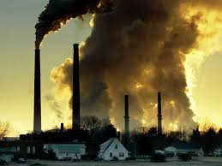
Can you guess about our today’s topic ?
Look at the pictures and talk about them.

Slide 4
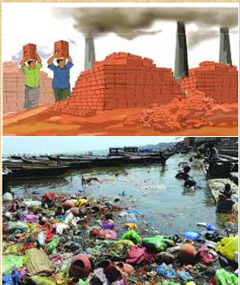
Our today’s topic is….
Environmental Pollution
Unit : Five
Lesson : Two
Page : 69

Slide 5
Learning Outcomes
After we have studied the lesson, we will be able to :
a) ask and answer questions,
b) comprehend and summerise texts
c) tell about the causes of environmental
pollution,
d) suggest for solution,
e) Write paragraph on causes and effects.’

Slide 6
Let’s watch the video
https://www.youtube.com/watch?v=PYmDdJwb6Y4

Slide 7
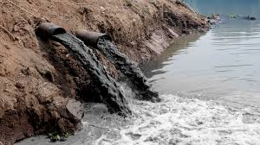
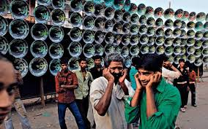
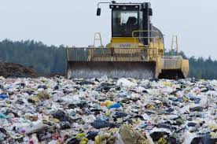
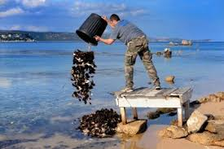
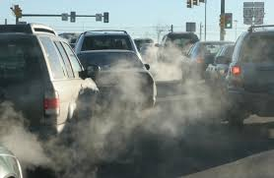
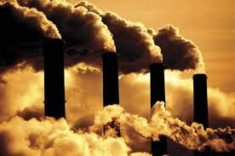
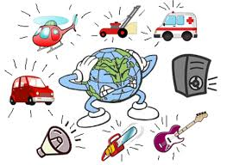
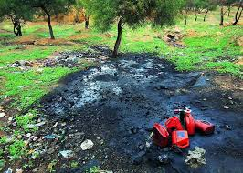
Look at the pictures and think about them.
A model of sound pollution……
Soil is also being polluted by……
Water is also being polluted by……
Air is being polluted by…..

Slide 8
Individual work
a) What are the common sources of
environmental pollution ?
b) What is environmental pollution ?
Match your Answer
a) What are the common sources of environmental
pollution ?
Ans : The common sources of environmental pollution
are air pollution, water pollution, soil pollution and
sound pollution.
What is environmental pollution ?
Ans: Environment refers to air, water, soil, in which man, animals and plants live. These are the main elements of the environment. So environmental pollution means polluting the elements of the environment.

Slide 9
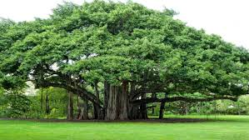
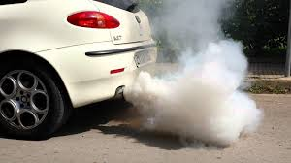
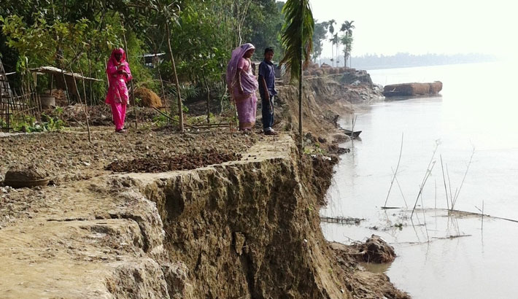
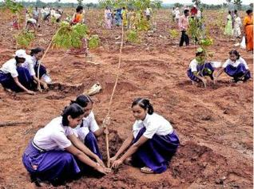
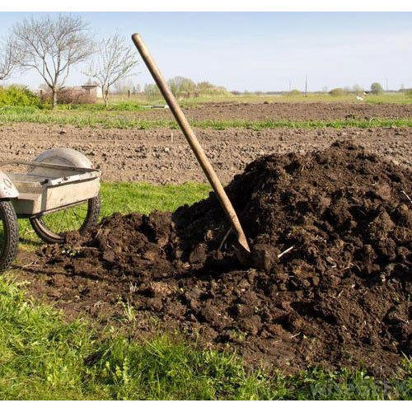
Vocabulary and sentence making
Meaning : Huge size, Immense ,Gigantic, Colossal
Meaning : Decay, Wasting, Degradation
Meaning : Reuse, reprocess, Recover
Meaning : Transport, Carrier, Conveyance
Meaning : Natural manure, Rotten manure
Meaning : Tree plantation, Afforestation
Click word
Vehicle
Re-forestation
Recycle
Erosion
Compost
Enormous
Meaning : The earth has an enormous molten core that contains vast amounts of energy.
Sentence : Planting trees and re-forestation help to prevent soil erosion and pollution.
Sentence : Deforestation is one of the causes of pollution and soil erosion.
Sentence : Farmer should use compost instead of chemical fertilizer.
Sentence : Motor vehicles emit huge amount of smoke.
Sentence : Recycle and reuse can reduce pollution.

Slide 10
Now read the following passage to know more about environmental pollution in Bangladesh.
Bangladesh in now in the grip of all sorts of pollution like air pollution, soil pollution and water pollution. The dwellers of the urban areas are the worst sufferers of such pollution. The indiscriminate industrialisation process in Bangladesh over the past decades has created significant environmental problems. We will now read about some of the most common types of environmental pollutions and ways of coping with them.

Slide 11
Air pollution :
Air pollution comes from a wide variety of sources. In Bangladesh poisonous exhausts from industrial plant, brick kiln, old or poorly-serviced vehicles and dust from roads and construction sites are some of the major sources of air pollution.
We can minimise this type of pollution by making less use of motor vehicles and avoiding the use of vehicles older than 20 years. We may also use proper lubricants to lessen the level of emission and pollutants. We can encourage people to use Compressed Natural Gas (CNG) or Liquid Petroleum Gas (LPG) for fuelling their cars. The government may relocate hazardous industries like brick kilns to areas away from human habitations.

Slide 12
Water pollution :
Water pollution can occur in oceans, rivers, lakes, ponds and underground reservoirs. As different water sources flow together, the pollution can spread easily and quickly. Causes of water pollution include:
• increased sediment from soil
• erosion
• improper waste disposal and littering
• leakage of soil pollution into water supplies
• organic materials that decay in water supplies .

Slide 13
In fact polluting the land means polluting the water. Throwing away a toxic substance on the ground near a water source means it eventually reaches the body of water. As a result, the water is polluted. Industrial wastes must not be disposed in rivers or lakes. We need to be more careful about disposing household wastes too. Use of pesticides means that when it rains, chemicals used in the lawn or garden wash into the water bodies. Therefore, we must be aware of the dangers of using pesticides as they may pollute our rivers, canals and lakes.

Slide 14
Soil pollution
Among the most significant causes of soil pollution is the enormous volume of industrial waste which is being produced every day but not disposed properly. The mismanagement of household wastes, particularly the polythene shopping bags, has caused serious threat to the soil and the drainage system. Another cause for soil pollution is the use of agricultural pesticides, fertilizers, etc. Sometimes fuel leakages from automobiles may get washed away by rain and seep into the nearby soil.

Slide 15
Pesticides and fertilizers are useful for plant growth but their overuse has led to soil pollution. Natural fertilizers and compost can be used instead of their chemical alternatives. Recycling is another way to reduce and control soil pollution. Recycling papers, plastics and other materials reduces the volume of refuse in landfills. De-forestation also causes erosion, pollution and the loss of fertility in the topsoil. Planting trees and re-forestation help prevent soil erosion and pollution.

Slide 16
Group work
Now find out the causes of air pollution, water pollution and soil pollution and how can we get gid of these problems.

Slide 17
Match your Answer
We can minimise this type of problem:
Making less use of Motor vehicles,
Avoiding older vehicles,
Using proper lubricants,
Using CNG or LP gas as car fuel,
Relocating hazardous industries away from human habitation.
Causes of air pollution :
Poisonous exhausts from industrial plant,
Smoke from brick manufacturing field,
Old or poorly-serviced vehicles,
Dust from roads and construction sites are some of the major sources of air pollution.

Slide 18
We can minimise this type of problem:
Industrial waste must be deposed proper way ,
Farmers should be conscious of using pesticides and and chemical fertilizer,
Stop throwing industrial waste and domestic waste into water bodies,
Underground water pipes must be checked time to time.
Causes of water pollution :
increased sediment from soil erosion,
Using chemical fertilizer an insecticides,
improper waste disposal and littering,
leakage of soil pollution into water supplies
organic materials that decay in water supplies .

Slide 19
Causes of soil pollution:
Throwing industrial waste indiscriminately,
Mismanagement of household wastes,
Using and throwing polythene shopping bags,
Use of agricultural pesticides and chemical fertilizers,
Fuel leakages from automobiles may get washed away by rain and seep into the nearby soil.
We can minimise this type of problem:
Use compost instead of chemical fertilizer ,
Recycling and reuse can minimise soil pollution,
Plants more trees.

Slide 20
Individual work-2
Prepare a short lecture within 50 words on the topic below.
Topic : Polluting the land means polluting the water.

Slide 21
Match your Answer
Topic : Polluting the land means polluting the water.
It is very important to know about the dangers of pollutions around us. We know that air, water and soil are the most important elements of our environments. The elements are interrelated to each other. We cannot think of water without soil. When the soil of a particular place is polluted ultimately the nearby water gets polluted. We see soil getting polluted in various ways. Industrial waste, polythene bags untreated rubbish, ill drainage system, over use of pesticides and fertilizer often cause soil pollution. As the soil holds water, harmful poisonous mix with water and pollute it.

Slide 22
From your of the above text complete each blank space in the table with no more than two words or numbers,
Pollution | Causes | Suggestions
Air pollution | Toxic smoke from…….. Plant. Vehicles which are old and poorly…………… . Smoke from the………..fields. | Don't drive motorcars which are older than…………years. Use car lubricants of good quality to keep the ………. level minimum. Use CNG or LP gas as car………
Soil pollution | Industrial wastes not ……. ……..properly. Use of ………….,,,,shopping bags. Use of agricultural pesticides and…….. | Use of compost for …………purpose . ……………. paper, plastics and other materials . Plant more trees to help prevent loss of fertility in the……..

Slide 23
Now match with your partner
Pollution | Causes | Suggestions
Air pollution | Toxic smoke from------------------------Plant. Vehicles which are old and poorly…………… Smoke from the………..fields. | Don't drive motor cars which are older than…………years. Use car lubricants of good quality to keep the ………. level minimum. Use CNG or LP gas as car………
Soil pollution | Industrial wastes not ……. ………………properly. Use of ………….,,,,……shopping bags. Use of agricultural pesticides and…….. | Use of compost for ----------------------------------purpose . ……………. paper, plastics and other materials . Plant more trees to help prevent loss of fertility in the……..
industrial
twenty
serviced
emission
brick
fuels
disposed
agricultural
Recycling
polythene
fertilizer
top soil

Slide 24
Choose the best answer from the alternatives
Q : a) Increased sediment from soil causes………..
i. air pollution
ii. water pollution
Ans :
ii. water pollution
Ans :
iii. soil pollution
iv. environment pollution
Q : b) We……….industrial wastes in water bodies.
Ans:
ii. should accumulate
Ans:
i. must dispose
iii. should not dispose
iv. should throw
iii. should not dispose

Slide 25
Q : C) The ……. people are the worst victims of various pollutions.
i. rural
ii. urban
Ans :
ii. urban
Ans :
iii. unconscious
iv. conscious
Q : d) Use of ……. shopping bags is also responsible for environmental pollution.
ii. polythene
Ans:
i. paper
ii. polythene
Ans:
iii. cotton
iv. jute
Q : e) Recycling can be ……. to control or reduce soil pollution.
ii. helpful
Ans:
i. harmful
ii. helpful
Ans:
iii. useless
iv. dangerous

Slide 26
Q : f) Soil pollution is caused by the ------------ of pesticides and fertilizer.
ii. slight use
Ans:
i. Moderate use
Ans:
iv. indiscriminate use
iii. proper use
iv. indiscriminate use
Q : g) Natural fertilizer should be used ------------ chemical ones.
Ans:
i. in addition to
ii. in place to
Ans:
ii. in place to
iii. in favour of
iv. in case of

Slide 27
Evaluation
Why should we be aware of using pesticides?
Why is environmental pollution a major problem today ?
Which can be safe substitution of chemical fertilizer ?
How do polythene shopping bags cause serious threat to the soil and drainage system?
What s the most significant cause of soil pollution?
Answer-a) We should be aware of using pesticides because they may seriously pollute our rivers, canals ,lakes etc.
Answer-b) Environmental pollution is a major problem today because it has not only endangered plants and animals life but also affected the normal cycles in natures.
Answer-b) Environmental pollution is a major problem today because it has not only endangered plants and animals life but also affected the normal cycles in natures.
Answer-c) Natural fertilizers and compost can be safe substitution for chemical fertilizers.
Answer-e). The most significant cause of soil pollution is the mismanagement of huge volume of industrial waste which is produced every day.
Answer-d). As polythene shopping bags donot decay or decompose naturally, they remain unchanged. Thus they reduce the fertility of soil and obstructs drainage system.

Slide 28
Homework
Write a paragraph about ‘ Environmental pollution’ highlighting on its causes, effects and solution .

Slide 30
