Slide 1
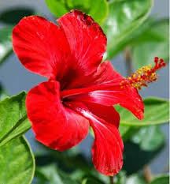
WELCOME
Companigonj Online School

Slide 2
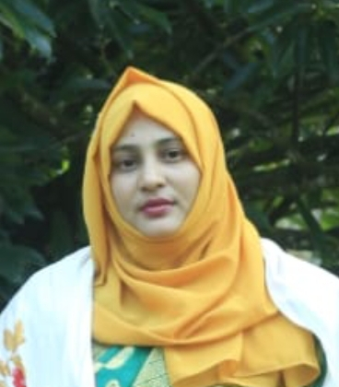
j
Jasmin Akter Jahan
Assistant Teacher
Dorakul Govt primary school,Companigonj,Sylhet.i

Slide 3
Let’s see some pictures
Doctor

Slide 4
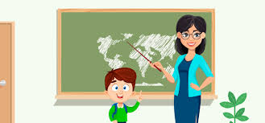
Teacher

Slide 5
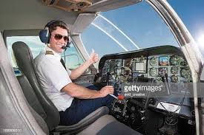
Pilot

Slide 6
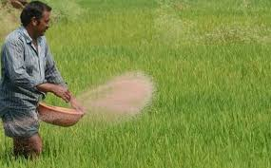
Farmer

Slide 7
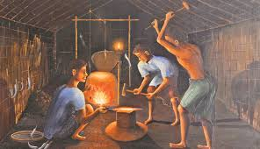
Blacksmith

Slide 8
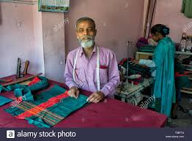
Tailor

Slide 9
What can you see in the pictures?
People of different occupations.

Slide 10
Today Lesson is----
Unit: 19, Lesson: 1-2, page no: 38

Slide 12
Let’s learn the word meanings
Farmer
কৃষক
Doctor
ডাক্তার
Pilot
বিমান চালক
Blacksmith
কামার

Slide 13
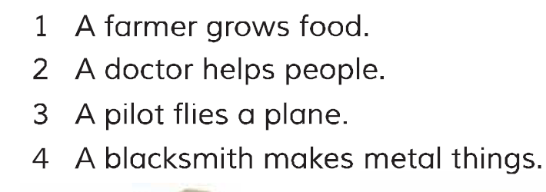
Listen attentively

Slide 14
Match the words with the sentences
Farmer
Doctor
Pilot
Blacksmith

Slide 15
Fill in the blanks
pilot
doctor
blacksmith
farmer
1. A …………. grows food.
2. A …………….. helps people.
3. A …………. flies a plane.
4. A ………………… makes metal things.

Slide 16
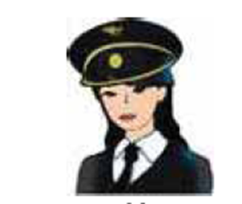
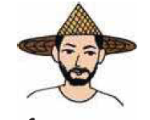
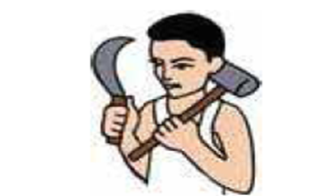
Match the photos with the sentences

Slide 17
Answer to the following questions
Who flies plane?
Ans: A pilot.
2. Who helps the pepole?
Ans: A doctor.
3. Who makes metal things?
Ans: A blacksmith.
4. Who grows crops?
Ans: A farmer.

Slide 18
One day one word
Blacksmith
কামার
Sentence making:
Rahim is a blacksmith.

Slide 19
Home Task
Write five occupations name.

Slide 20
GOOD BYE

