Slide 1
Welcome to our today's class

Slide 2
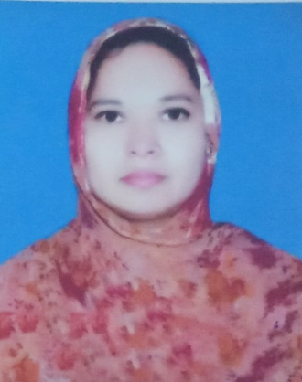
Introduction
Musa. Rahima Akther
Assistant teacher ,
Khulna Engineering University School
Kuet campus, Khulna
Class – Ten ,
Sub:- English 1st ,
Time – 50minutes ,
Date – 17-09-20

Slide 3
Look at the pictures and say what you see in them.
messenger
contact
text
chat
home
E-mail
Wi-Fi
conversation
Network
favourite
Internet
mobile
Some logos placed around the globe.
We find them while surfing the internet.

Slide 4
What are these?
Some pages of Internet version of daily newspaper & magazines.
The symbol is called 'at the rate of'. It is used in an e-mail address.

Slide 5
Can you guess, what we are going to discuss about?

Slide 6
OUR Today's lesson is-
Media and modes of e-communication
Unit: 13
Lesson: 01
Page No.: 154

Slide 7
Learning Outcomes
After completing the lesson students will be able to-
talk about media and e-communication .
read and write e-mails.
describe the benefits of e-communication.

Slide 8
Let's introduce with some new words.
Exchange
The act of giving something in return for something received, give and take.
Colleagues
An associate who works with, co-worker

Slide 9
Online
connected to a computer network
Facebook
A social media where people can share their opinion

Slide 10
Recipient
A person who receives something

Slide 11
B. Discuss which of the following words you are familiar with.
How they are related to e-communication?
facebook, e-mail, web site, blog, e-commerce, twitter,
e-learning, ipod, tablet pc, information super high way, social network, smart phone.

Slide 12
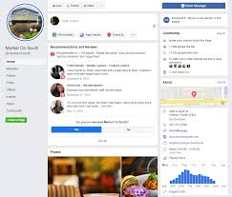
facebook
Facebook is a social network that allows users to interact with others, connect with friends and family, and share photos, video, and information.

Slide 13
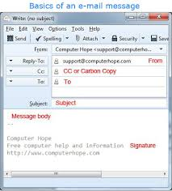
e-mail
Electronic mail (email or e-mail) is a method of exchanging messages ("mail") between people using electronic devices.

Slide 14
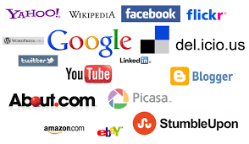
Web site
A collection of web pages which are grouped together and usually connected together in various ways. Often called a "web site" or simply a "site." ...such as google, you Tube, facebook, Wikipedia, Yahoo.com e.t.c.

Slide 15
Blog
A blog is an online diary or journal located on a website.

Slide 16
e-commerce
E-commerce (electronic commerce) is the activity of electronically buying or selling of products on online services or over the Internet.

Slide 17
twitter
Twitter is an American microblogging and social networking service on which users post and interact with messages known as "tweets".

Slide 18
e-learning
A learning system based on formalised teaching but with the help of electronic resources is known as E-learning.

Slide 19
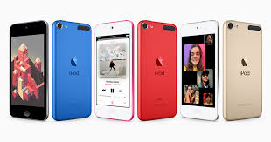
ipod
The iPod is a line of portable media players and multi-purpose pocket computers designed and marketed by Apple Inc.

Slide 20
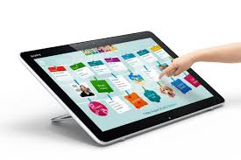
tablet pc
A tablet is a wireless, portable personal computer with a touchscreen interface.

Slide 21
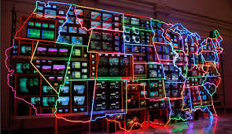
information super high way
a telecommunications infrastructure or system (as of television, telephony, or computer networks) used for widespread and usually rapid access to information especially : internet. — called also infobahn, information highway.

Slide 22
social network
A social networking service is an online platform which people use to build social networks or social relationships with other people.

Slide 23
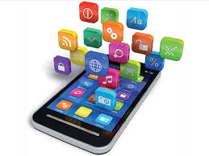
smart phone
A smartphone is a cell phone that allows you to do more than make phone calls and send text messages. Smartphones can browse the Internet and run software programs like a computer. Smartphones use a touch screen to allow users to interact with them.

Slide 24
C. Read the text and answer the questions that follow.
Let’s imagine a citizen’s ordinary day at work. The morning probably starts with a cup of coffee/tea, followed by greeting the colleagues. Then comes the inevitable, which is the logging in the computer. For many of us the third step has become an automatic behavior and it dominates the rest of our work day, receiving and sending dozens of emails.
An e-mail is an electronic mail. It is a computer-aided way of exchanging digital text messages from a sender to one or multiple recipient/s. Emails operate through a network of computers linked by the Internet. There are commercial server agencies such as Yahoo, Gmail, Ymail, Hotmail, etc. that accept the text message from the sender, forward it and deliver instantly to the digital mailbox of the recipient. If the recipient is not online, the message is stored and delivered later when the recipient is
online. It works instantly just with the click of your mouse. It has been a powerful
communication tool in modern life.

Slide 25
Answer the Questions
1. What is an email?
An e-mail is an electronic mail which is the way of exchanging digital text messages from a sender to one or multiple recipient/s. Internet connection is required to use it.

Slide 26
2. How do emails operate?
Emails operate through a network of computers linked by the Internet.

Slide 27
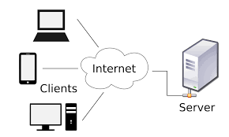
3. How do the commercial servers serve in the process of an email?
message of sender
digital mailbox of the recipient
server
Commercial servers serve by accepting the text message from the sender and then forwarding and delivering it instantly to the digital mailbox of the recipient.

Slide 28
4. ‘It has been a powerful communication tool in modern life.’ Explain the statement.
It is a reliable and speedy mode of communication in the modern world. Both personal and commercial communication greatly depend on it as it helps to exchange messages in the possible fastest way.

Slide 29
5. How do emails affect our daily work schedule?
Through e-mail, people of different corners of the world can come closer to one another within a fraction of time. it can lessen the workload of teachers, students, doctors and businessmen etc.

Slide 30
E. Read the following email exchanged between two friends. Like
an informal letter, an email to a close one is casually written. Identify the
mistakes in the main body of the message, discuss with your partner, and
correct them.
Subject: Details of Dhaka Tour
FROM: Alexa Dowson<alexa.dowson@yahoo.com>
TO: Moutushi Laboni<moutushi1997@ymail.com=
Monday, May 21, 2012 6:20 AM
Hi Moutushi!
Thanks for your mail. I’ll fly from Ottawa on 7:36 hours local time on 13 July with
Qatar Airlines via London-Doha and land Dhaka on 15 July around 13:41hours local
time. Wish to stay 2 days in the Cox’s Bazar and 1 day in khulna. Return flight on 21
july at 3:04 hours local time.
Keep fine and in touch. Hope to see you soon!
Alexa

Slide 31
Possible answer
1. the style of writing the mail is different. It is as if Alexa was talking to Moutushi face to face.
2. Here Alexa said that she'd fly from Ottawa; it is not clear what she meant here. Did she mean it literally? How can a man being fly?
3. The sentances don't follow standard syntax. Alexa didn't mention the subject 'I' in almost all sentences except the second sentence of the mail.

Slide 32
f. Pairwork. The email in section E is a reply by Alexa to Moutushi’s previous email. Imagine what Moutushi might have written to Alexa.Write that email.

Slide 33
G.Read the following text. It gives the information about the origin of the email. Choose the appropriate forms of the verbs from the box to complete the sentences. You can use a verb more than once.
send | say | use | remain | call | expand | allow | develop | spread
Sending text messages electronically could be ……………. to date back to the Morse code telegraph of the mid 1800s and the 1939 New York World’s Fair. In the fair, IBM ……………. a letter of congratulations from San Francisco to New York on an IBM radio-type, ……………. it a high-speed substitute for mail service in the world of tomorrow. Teleprinters were ……………. in Germany during World War II. The use ……………. until the late 1960s when there was a worldwide Telex network. Additionally, there was the similar American system ……………. TWX which ……………. important until the late 1980s.
With the introduction of MIT’s Compatible Time-Sharing System (CTSS) in 1961, for the first time multiple users were ……………. to log into a central system from remote dial-up terminals. They were also able to store and share files on the central disk. Informal methods of using this to pass messages ……………. and were ……………. to create the first true email system.

Slide 34
G.Read the following text. It gives the information about the origin of the email. Choose the appropriate forms of the verbs from the box to complete the sentences. You can use a verb more than once.
send | say | use | remain | call | expand | allow | develop | spread
Sending text messages electronically could be ……………. to date back to the Morse code telegraph of the mid 1800s and the 1939 New York World’s Fair. In the fair, IBM ……………. a letter of congratulations from San Francisco to New York on an IBM radio-type, ……………. it a high-speed substitute for mail service in the world of tomorrow. Teleprinters were...... ……………. in Germany during World War II. The use ……………....... until the late 1960s when there was a worldwide Telex network. Additionally, there was the similar American system ……………. TWX which ……………. important until the late 1980s.
With the introduction of MIT’s Compatible Time-Sharing System (CTSS) in 1961, for the first time multiple users were ……………. to log into a central system from remote dial-up terminals. They were also able to store and share files on the central disk. Informal methods of using this to pass messages ……………. and were ……………. to create the first true email system.
used
sent
developing
developed
remained
called
remained
allowed
spread
used

Slide 35
H. Read the following grid first. Then listen to the CD/teacher and tick the right box in the following grid.
Comparison between emails, phone conversations and face to face meetings
 | time-cnsuming |  | reliable |  | efficient
 | less | more | less | more | less | more
E-mails
Phone conservations
F to F meetings

Slide 36
Listen the text

Slide 37
H. Read the following grid first. Then listen to the CD/teacher and tick the right box in the following grid.
Comparison between emails, phone conversations and face to face meetings
 | time-cnsuming |  | reliable |  | efficient
 | less | more | less | more | less | more
E-mails |  |  |  |  |  | 
Phone conservations |  |  |  |  | 
F to F meetings |  |  |  |  | 



Slide 38
Home work
Write the steps of your normal days, weekends, etc.

Slide 39
Thanks to all

