Slide 1
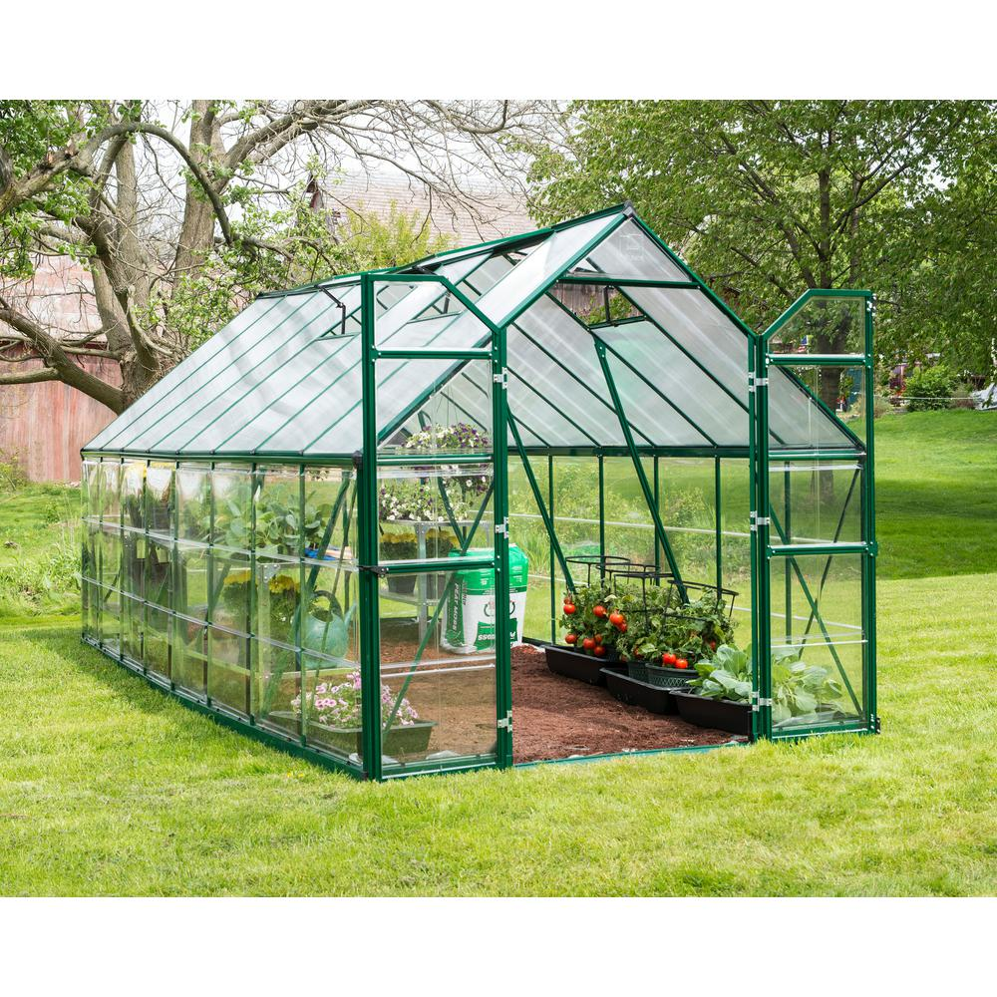
Welcome to online class

Slide 2
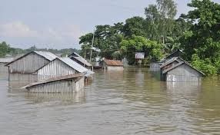
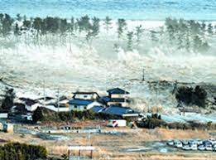
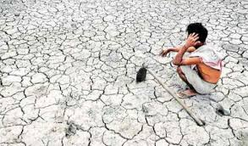
What are the pictures about?
Tsunami---সুনামি
Drought—- খরা
Flood----বন্যা
What are they called?
They are called natural calamity.
Why does natural calamity happen?
It happens because of the greenhouse effect.

Slide 3
Our today’s lesson is….
The greenhouse effect! Unit: 9 Lesson : 3 Page: 100

Slide 4
Learning outcomes………………..
After the end of the lesson, the students will be able to ……………
1. Get ideas about greenhouse
2.Explain the effect of greenhouse
3.Narrate the causes of the world warmer

Slide 5
Vocabulary
1.Trap-----------ফাদে ফেলা/আটকানো ---------------- Entrap/entangle
2.Planet----- -----গ্রহ -------------------------------Globe/world
3.Roof---- -----------------------ছাদ------------------Top
4.Greenhouse------------- কাচ নির্মিত ঘর-------------- Glasshouse
5.Release------- মুক্ত করা-------------------------------- Free/discharge
6.Atmosphere----------- বায়ুমন্ডল ------------ The surrounding area
7.Warm----------- উষ্ণ---------------------------------- hot
8.Power station----------------- বিদ্যুৎ কেন্দ্র ------------------------------ where electronic power is produced

Slide 6
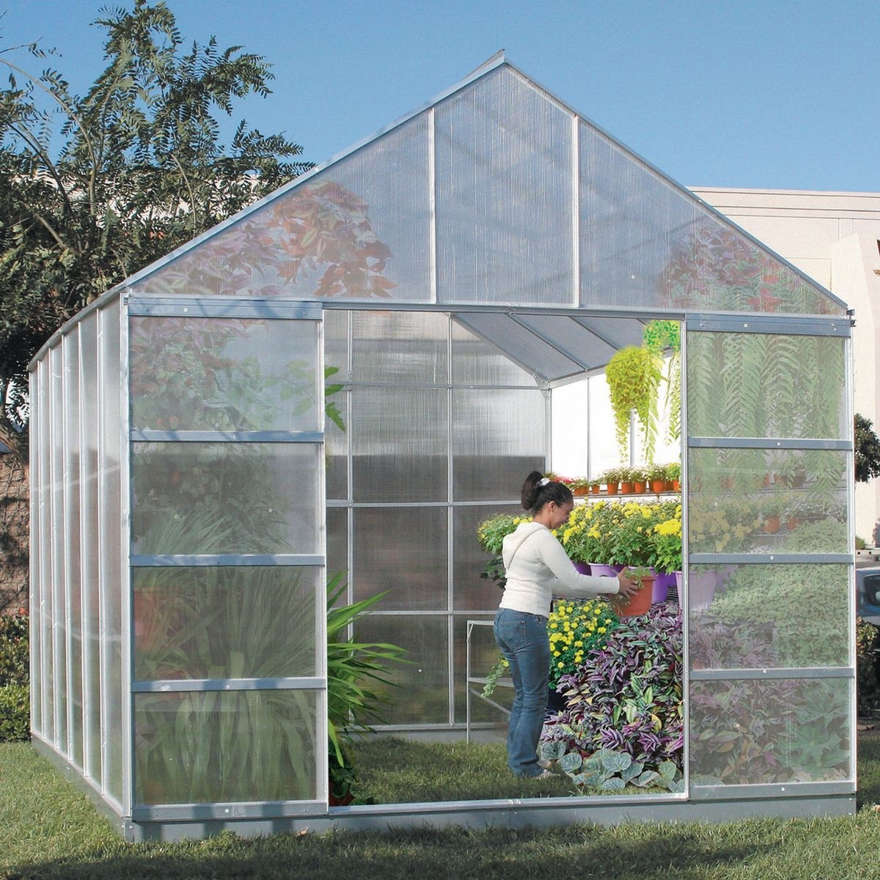
A greenhouse is a house made of glass. It has glass walls and a glass roof.

Slide 7
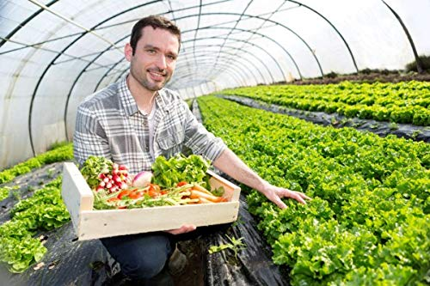
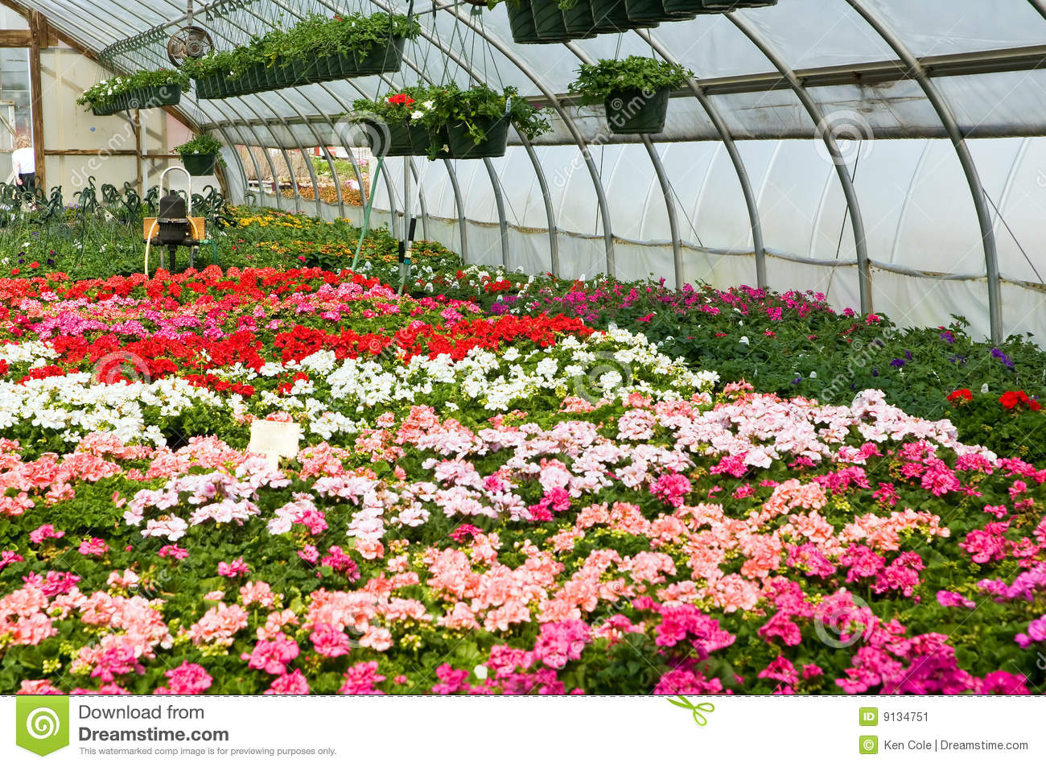
People grow vegetables, flower and plants in them. A greenhouse stays warm inside , even during winter. During the daylight hours, a greenhouse gets warmer and warmer and stays pretty warm at night too. This is because the heat received from the sun is trapped inside the greenhouse by the glass.

Slide 8
The Earth is also like a greenhouse. During the day Earth’s surface warms up in the sunlight. At night, the surface cools releasing the heat back into air. But some of the heat is trapped by gases like carbon dioxide in the atmosphere.

Slide 9
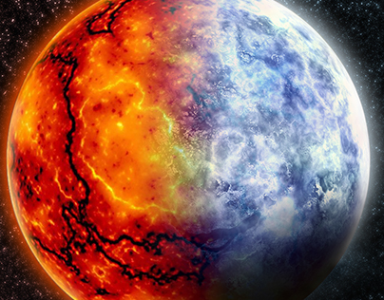
These gases are called greenhouse gases, work like the glass wall and roof and keep the earth warm. This is global warming and it makes the earth a dangerous planet.

Slide 10
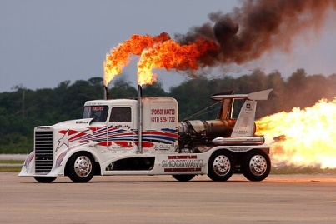
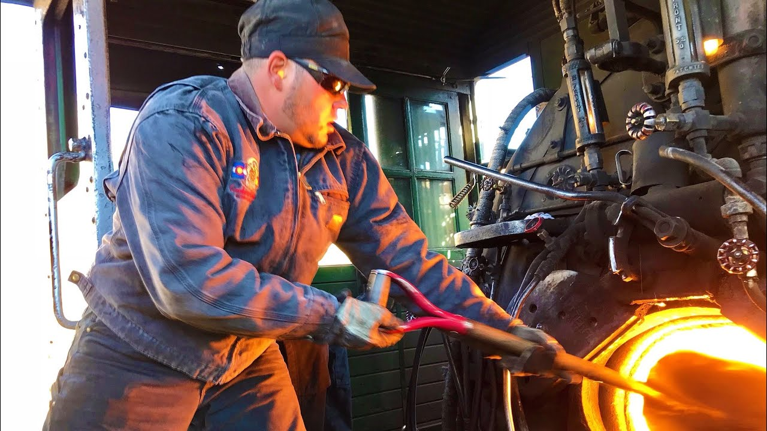
Unfortunately, we are making the earth too hot. We are using oil, gas, and coal for running cars, buses, trains, planes, power stations and so on.

Slide 11
These fuels have carbon in them. This carbon and other gases trap the heat in the atmosphere and do not allow the earth to cool down.
As a result, the earth gets hotter.

Slide 12
Question no. 1:Choose the best answer.
I)The Earth is like a greenhouse. What does ‘greenhouse’ mean?
a)green house b) glass house c)block house d)brick-built house
II) Which information is correct about carbon dioxide ?
a)wind b)water c) air d)gas
III)A greenhouse can…………….. the heat.
a)release b) cool c) free d)snare
IV) The Earth is getting hotter ……………………………..
a) for cooking b)for making excessive fire
c)because of trapped carbon dioxide d)because of cutting trees
V) People make greenhouse for……………………………..
a)poultry b)decoration c) growing vegetables , flowers and plants d)water

Slide 13
2. Answer the following questions
a)What is a greenhouse?
Ans-A greenhouse is a house made of glass
b) How does the greenhouse work?
Ans-It works by trapping the heat of the sun inside.
c) Why does the inside of the greenhouse stay warm?
Ans-Because the heat received from the sun is trapped inside the greenhouse by the glass.
d)Why does the Earth’s surface become cool at night?
Ans-The Earth’s surface become cool at night by releasing the heat back into the air.
e) What makes the Earth a dangerous planet?
Ans-Global warming makes the Earth a dangerous planet.

Slide 14
Thanks

