Slide 1
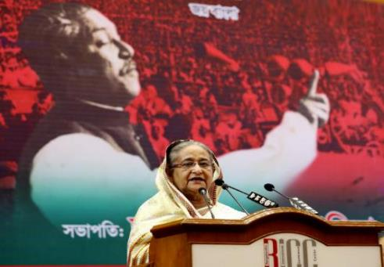
Welcome to my class

Slide 2
SPEECH / NARRATIVE STYLE
Introduction
MD. ABDUR RAZZAK
Head Teacher
Dhalahara westpara Secondary Girls’ School
E-mail: abdurrazzakmt@gmail.com
Phone number: 01721588402
Class:9 & 10
U-13, L-1
Time: 50 min

Slide 3
Let’s enjoy a video clip

Slide 4
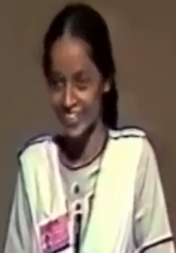
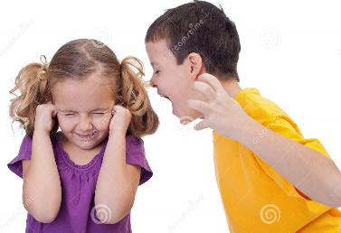
Observe, think and say
The boy said to the girl,ʽʽWhy are you crying?”
Mr. Bin said to me,
ʽʽThe girl delivered a devastating speech.”
What type of narrative style is it?
Direct speech
Mr. Bin told me that the girl had delivered a devastating speech.
The boy asked the girl why she was crying.
What type of narrative style is it?
Indirect speech

Slide 5
Could you guise what is today’s lesson?
Lesson declaration
SPEECH / NARRATIVE STYLE

Slide 6
Learning outcomes
After the end of the lesson the learners will be able to---
1.
define indirect form of speech.
2.
change person, verb and adverb in indirect form.
3.
use correct form of speech in their real life.
Md. Abdur Razzak, Head teacher, Dhalhara Poshcimpara Secondary Girls’ School, Sadar, Magura, phone number: 01721588402

Slide 7
Observe the sentences below
Mita says, “I am ill today.”
Direct speech
Reporting speech
Reported speech
Mita says that she is ill that day.
Indirect speech
Verb of the reported speech
Reporting verb
kinds of speech
Direct speech
Indirect speech
Speech spoken
by the speaker
Speech spoken
by another one

Slide 8
Observe changing option
How to change ‘adverb’ from Direct to Indirect speech.
How to change ‘verbs’ from Direct to Indirect speech.
How to change ‘person’ from Direct to Indirect speech.
Direct | Indirect
am/is/are | Was/were
was/were | Had been
have/has/did | Had+pp form of verb
shall/will/can/may | Should/would/could/might
must/have to/has to/ought to | Had to
Present indefinite | Past indefinite
Past indefinite | Past perfect
Reporting speech | Reported speech
I | He/she
We | they
You | I/we/me/us
my | His/her
our | their
your | My/our
He/She/they(3rd party) | no chance
Karim/Rina/Karim and Rina | He/She/they
DIRECT | INDIRECT
Now | then
tomorrow | the next day
tonight | That night
today | That day
yesterday | the previous day
last night | the previous night
last week | the previous week
Mita said to me, “I am ill today.”
Direct speech
DIRECT | INDIRECT
here | there
this | that
these | those
Mita told me that she was ill that day.
indirect speech
If there object
person
verb
adverb

Slide 9
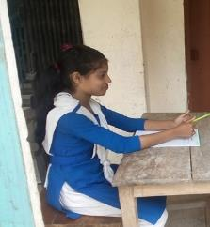
Individual Work 2 min.
Answer the following questions.
What is indirect form of speech?
speech spoken by another one
How many kinds of speech are there?
2
Which form are changed in indirect form of speech?
person, verb and adverb

Slide 10
Indirect speech of assertive sentence
direct: Monika said to me, “You are my best friend”.
Indirect: Monika told me that I was her best friend.
connector
verb
If there object
person
person
Similarly
direct: Mina says to me, “The earth moves round the sun”.
direct: Mina says to me, “You are my best friend”.
Indirect: Mina says to me that I am her best friend.
Indirect: Mina says to me that the earth moves round the sun.
direct: Hamid said to Rimi, “You were my best friend”.
no changing potation in universal truth
Indirect: Hamid told Rimi that she had been his best friend.

Slide 11
Indirect speech of interrogative sentence
direct (int): Monika said to me, “Are you my best friend?”
direct (ass): Monika said to me, “You are my best friend.”
Indirect (int): Monika asked me If I was her best friend.
direct: Mina says to me, “Will you be my best friend?”
Indirect: Mina asks me if I would be her best friend.
direct: Hamid said to me, “What are you doing now?”
Indirect: Hamid asked me what I was doing then.
direct: Hamid said to Mina, “What’s your name?”
Indirect: Hamid asked Mina what her name was.

Slide 12
Click
Pair work 3 min
Change the following direct speech into indirect speech.
1. Tama said, “I myself did the work.”
2. The man said to me, “What’s your name?”
3. Kona said to Rahat, “ Why are you late?”

Slide 13
Changing option of imperative sentence (forbid)
Indirect speech of imperative sentence
Changing option of imperative sentence (request)
Changing option of imperative sentence (order)
direct: Teacher said to me, “Don’t disturb me”.
direct: Fahad said to me, “Please lend me your pen”.
direct: Teacher said to me, “Do the sum”.
Indirect: Teacher ordered me to do the sum.
Indirect: Teacher forbade me to disturb him.
Indirect: Fahad requested me to lend him my pen.
Reporting verb
connector
reporting verb
reporting verb
Changing option of imperative sentence (advice)
Changing option of imperative sentence (propose)
direct: Fahad said to Ruma, “Let’s go out”.
direct: Fahad said to me, “Let’s go out”.
direct: Father said to me, “Don’t waste your time”.
Indirect: Father advised me not to waste my time.
Indirect: Fahad proposed Ruma that they should go out.
Indirect: Fahad proposed me that we should go out.
reporting verb
reporting verb
reporting verb
1st person
3rd person

Slide 14
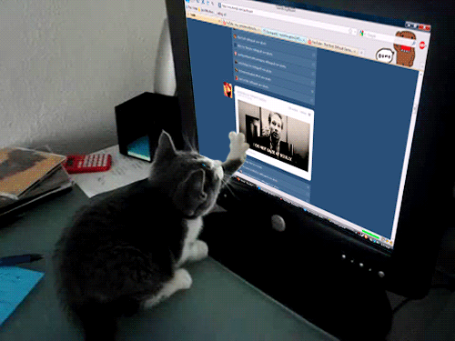
Indirect speech of exclamatory sentence
direct :Mina said, “What an unlucky girl I am !”
Indirect:Mina exclaimed with sorrow that she was a very unlucky girl.
reporting verb
direct :Mina said, “What a funny cat it is!”
direct :Mina said, “Hurrah! We have won the game
direct(ass):Mina said, “It is a very funny cat.”
Indirect(ex):Mina exclaimed with joy that it was a very funny cat.
Indirect:Mina exclaimed with joy that they had won the game..
reporting verb
connector
reporting verb

Slide 15
Indirect speech of optative sentence
direct : Mom said to me, “May God bless you.”
Indirect: Mom prayed me that God might bless me.
reporting verb
direct : Mina said to me, “Good bye.”
direct : Mina said , “If were a child again.”
Indirect: Mina wished me good bye.
Indirect: Mina wished that if she had been a child again.
reporting verb
reporting verb

Slide 16
Group work 8 min
Change the following direct speech into indirect speech.
1. Teacher said to Rimi, “Follow my instruction.”
2. Father said to me, “Never tell a lie.”
3. Mom said to her son, “ Please give me a glass of water.”
4. Lipi said, “What a clever girl she is!”
5. People said, “Live long our PM.”
Click

Slide 17
Evaluation
Tick ($√$) the correct form from the alternatives.
1. Indirect form ‘ now ’.
(b) then
(a) for ever
$√100$%
$$×$$
(d) this time
(c) never
$$×$$
$$×$$
2. Direct form of ‘ me’.
(a) she
(b) they
$$×$$
$$×$$
(c) I
(d) you
$√$100%
$$×$$

Slide 18
3. Indirect form of verb (go). (past indefinite)
(a) gone
(b) went
$$×$$
$√100$%
(c) had gone
(d) going
$$×$$
$$×$$
4. Mina said----- she was ill that day. What would be in the blank?
(a) to
(b) if
$$×$$
$$×$$
(c) that
(d) what
$√$100%
$$×$$
5. Teacher ordered the student --- do the sum.----?
(a) that
(b) what
$$×$$
$$×$$
(c) to
(d) and
$√$100%
$$×$$

Slide 19
Home work
Change the following speech into indirect.
She said to me , “I like you very much.”
I said to her, “Why do you like me ?”
Kinjal said to her father, “ Bring me a car.”
She said, “ What a tall boy you are !”
The students said, “ Alas ! We are fail again.”

Slide 20
See you next class

