Slide 1
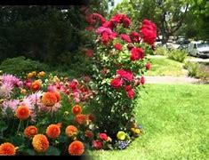
WELCOME TO ENGLISH 2ND PAPER CLASS

Slide 2
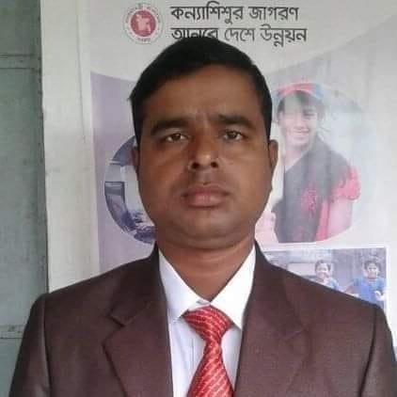
TEACHER IDENTY
BENOY BHUSHAN SINGHA ASSIT. TEACHER ENGLISH CELL NO:-01741-337217 SANNYASI SECONDARY GIRLS SCHOOL, MORRELGONJ,BAGERHAT

Slide 3
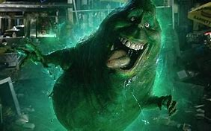
Lesson title
CONJUGATION
OF
VERB
THIS IS AN ACTIVITY OF VERB

Slide 4
Learning outcome
AFTER COMPLETING THE LESSON THE SS WILL BE ABLE TO…...
KNOW THE FORMATION OF VERB.
KNOW THE THREE CHANGE OF VERB
REACEIVE FULL CLARAFICATION OF VERB

Slide 5
STRONG VERB
PRESENT -- PAST -- PAST PARTICIPLE
BREAK -- BROKE -- BROKEN
DRINK --DRANK -- DRUNK
EAT -- ATE -- EATEN
COME—CAME-- COME
GO --WENT --GONE
FIGHT -- FOUGHT -- FOUGHT

Slide 6
WEAK VERB
CALL----CALLED---CALLED
AGREE----AGREED-----AGREED
BOIL-----BOILED---BOILED
CARRY----CARRIED----CARRIED
WEEP---WEPT---WEPT
SMELL---SMELT---SMELT
TEACH---TAUGHT--TAUGHT

Slide 7
SAME FORMATION OF VERB
PRESENE----PAST---PAST PARTICIPLE
PUT---PUT----PUT
CUT----CUT----CUT
SET----SET----SET
LET----LET-----LET
HIT----HIT---HIT
RID----RID---RID

Slide 8
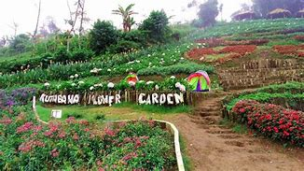
Home work
Practise exercise on your text book.

Slide 10
TANKS
FOR
PARTICIPIATING
US.

Slide 11
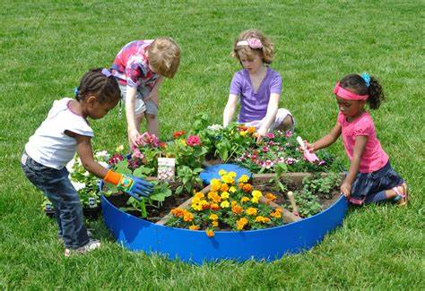
SEE YOU……

