Slide 1
Welcome to my session

Slide 2
TEACHER’S INTRODUCTION
Mst:fatama begum Head teacher
Chalarchor Govt.Primary School.
Chatak, Sunamgong…

Slide 3
Lesson introduction:
Subject: English
Class: iv , Unit 32, Lesson:1-2
Lesson Title: Months of the year.
Time: 40 minutes

Slide 4
Learning Outcomes
Writing :
Students will able to
7.1.1 - write names of the days of the months and Months of the year.

Slide 5
There are thirty days
in September,
April, June and November.
All the rest have thirty-one,
Except February,
which has twenty-eight days clear,
And twenty-nine in each leap year.

Slide 6
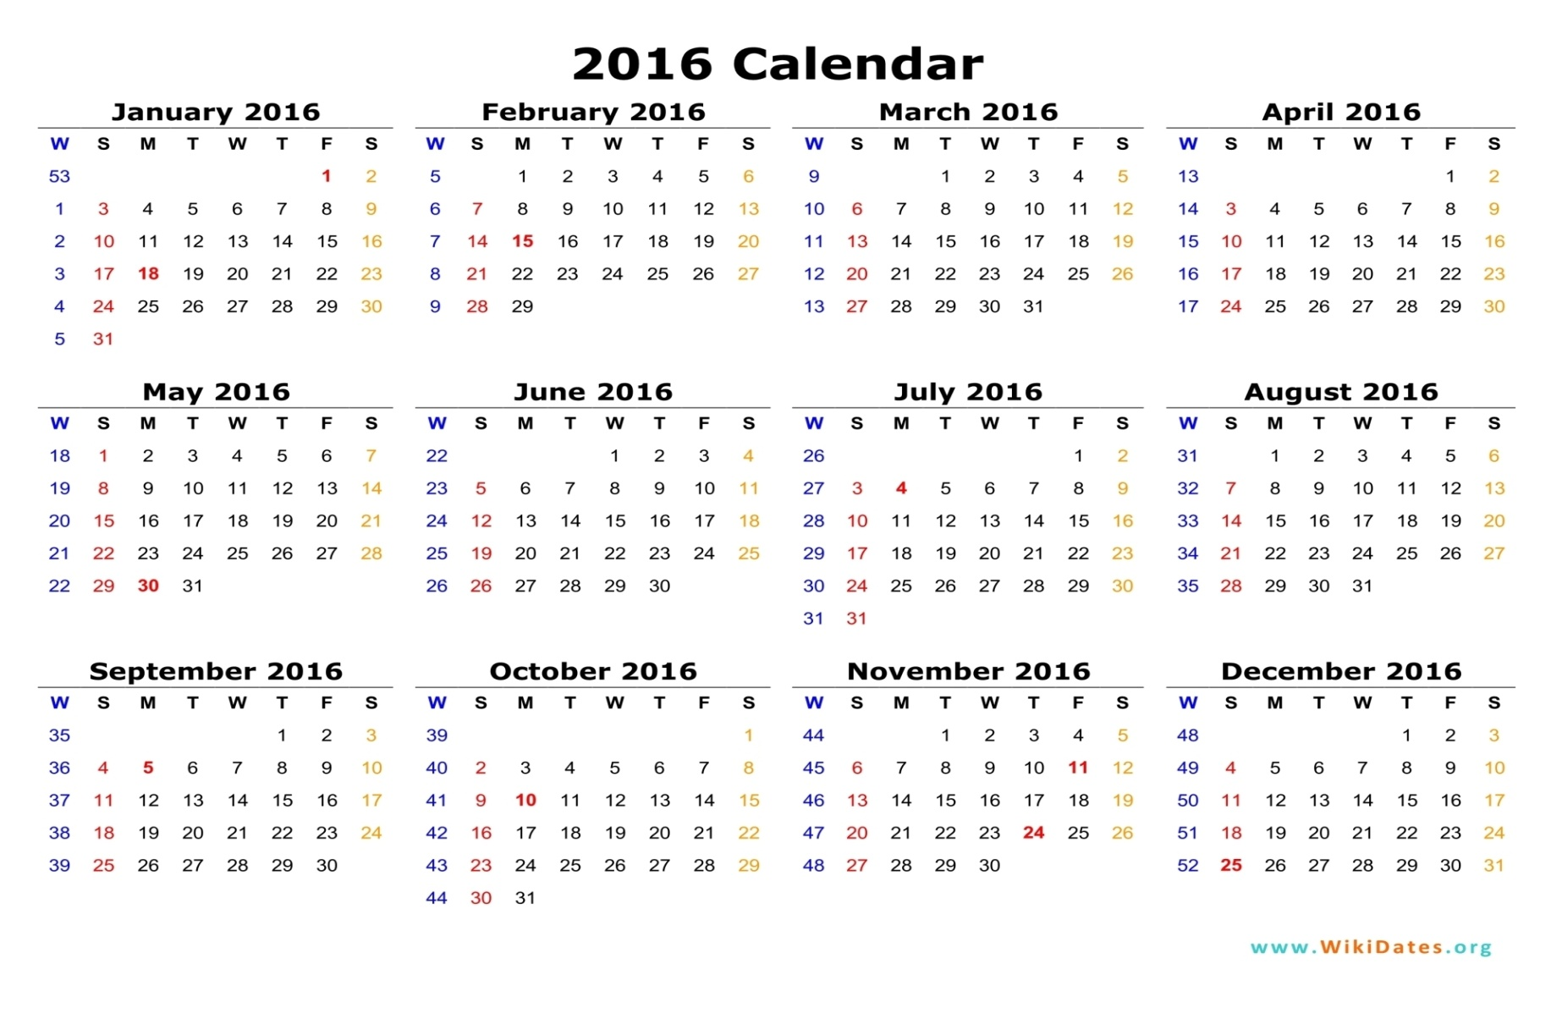

Slide 7
Show the picture

Slide 8
Look at the picture

Slide 9
Think about the picture

Slide 10
Today is my birthday!
I’m four years old !

Slide 11
Four? you’ re not four.
You’re in class 4 !

Slide 12
Oh! You ‘re right .
I’m in class 4 .But I’m in 9 years old .

Slide 13
Group work

Slide 14
s
What is your birthday ?How old are you ?

Slide 15
s
Practice

Slide 16
W
Write the missing months

Slide 17
s
January……………..March………………..May………….July……………….
October…………December.

Slide 18
Home work

Slide 19
1.When is your birthday ?
2.How old are you?

Slide 20
Many Many Thanks

