Slide 1
Wellcome to
everybody

Slide 2
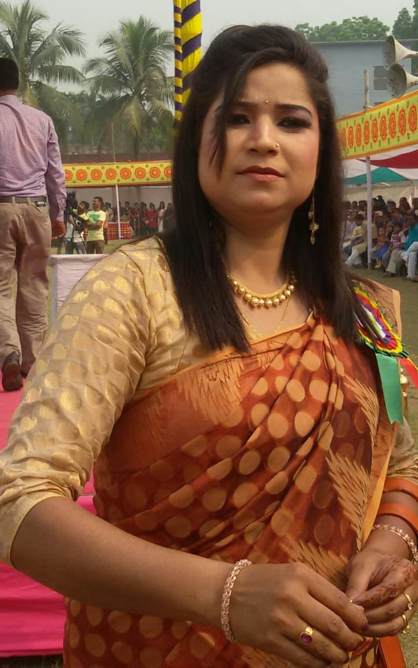
Introducing
Class : Three
Subject: English
Unit-19
Lesson :1-2
Time: 40 minutes
Nasima Akter
Assistant teacher
Chatia Chala Gov:
Primary School
Sakhipur,Tangail.

Slide 3
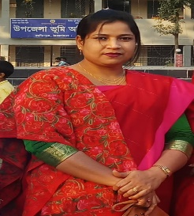
Good morning, students.
Good morning, teacher.
How are you today?
Fine. and you?
Fine, thank you.

Slide 4
Let’s enjoy a video

Slide 5
Today's lesson
Occupations

Slide 6
Learning outcomes
1.3.1 recognize which words in a sentence are stressed.
1.1.3 repeat words, phrases and sentences after the teacher with proper sounds and stress.
1.1.4 say words, phrases and sentences with proper sounds and stress.
Students will be able to

Slide 7
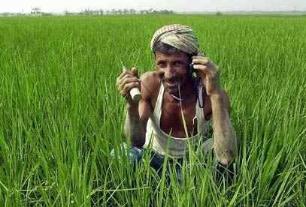
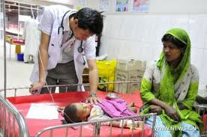
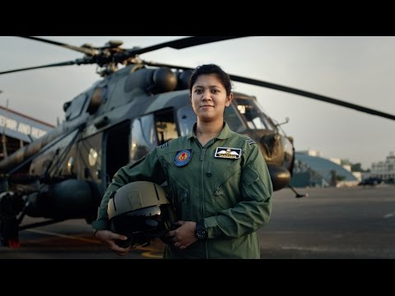
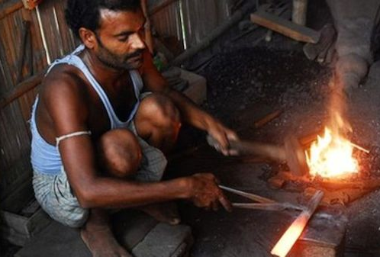
What do you see in the pictures?
Farmer
Doctor
Pilot
Blacksmith

Slide 8
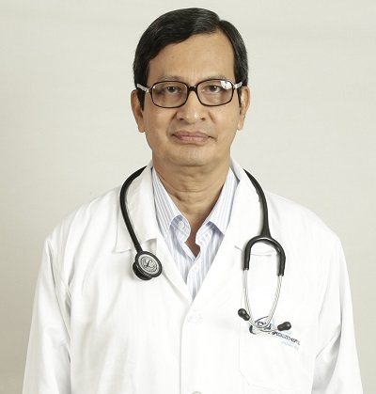
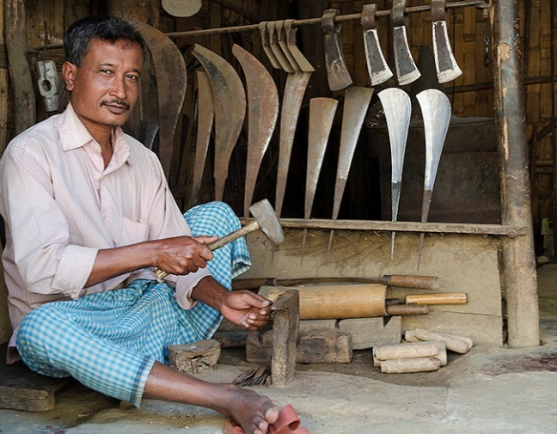
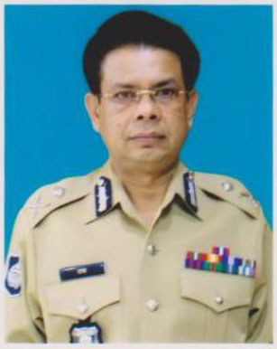
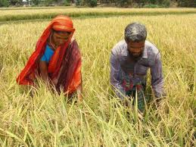
Look and say
A doctor
A blacksmith
A police man
Two farmers

Slide 9
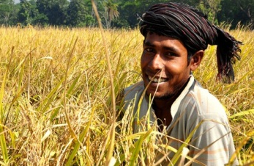
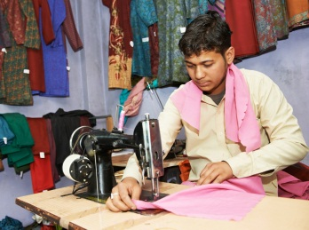
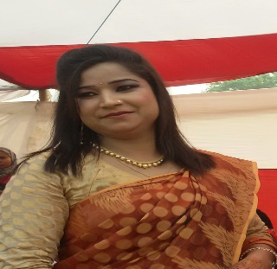
Everybody look, listen and say after me.
Farmer
Tailor
Teacher
Doctor

Slide 10
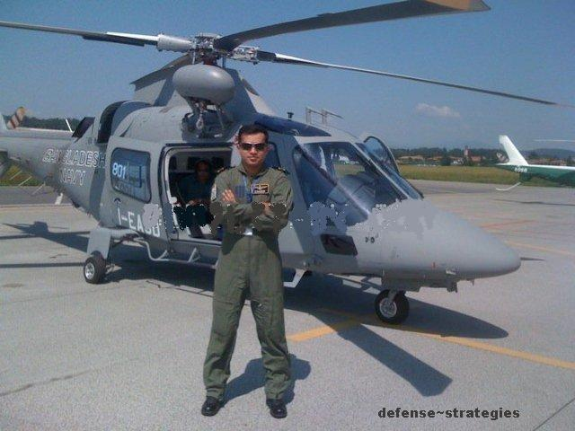
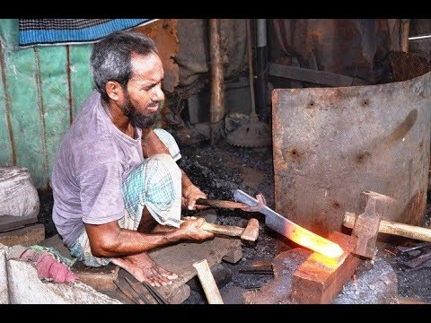
Everybody look, listen and say after me.
A farmer grows food.
A pilot flies a plane.
A doctor helps people.
A blacksmith makes metal things.

Slide 11
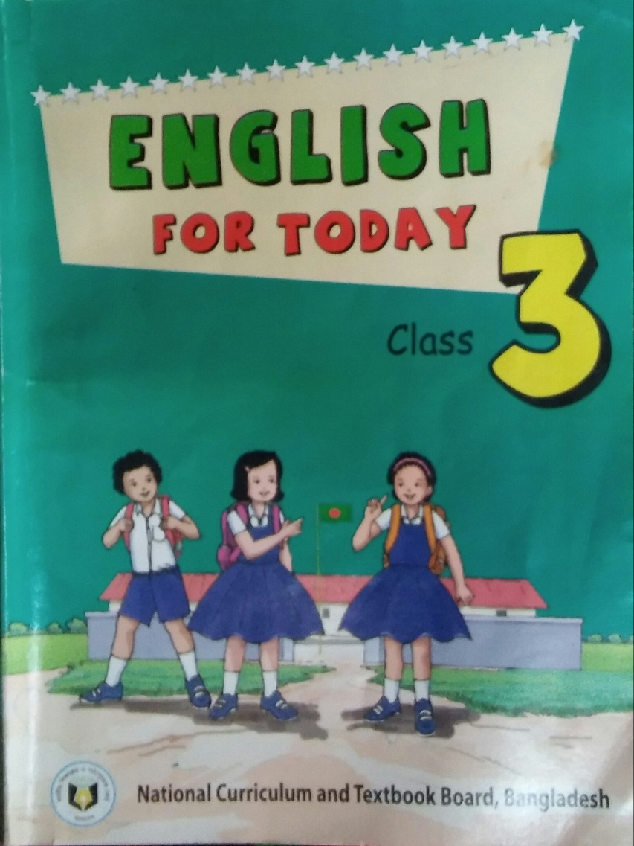
Open your book at page 38.

Slide 12
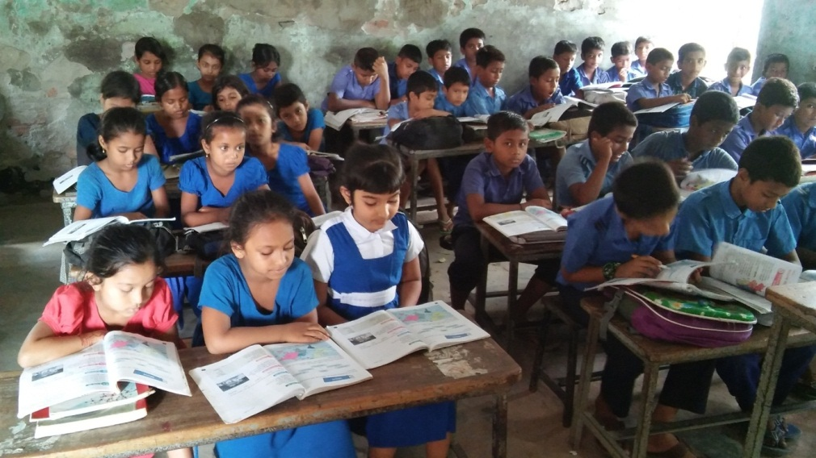
Student’s reading silently
farmer
A farmer grows food.
doctor
A doctor helps people.
pilot
A pilot flies plane.
blacksmith
A blacksmith makes metal things.

Slide 13
Let’s play a Kim’s game.
farmer
Occupation
blacksmith
doctor
pilot

Slide 14
Group work
Group A
Who grows foods and crops?
Group B
Who teaches students?
Group C
Who makes metal things?
Group D
Who helps people?
Group E
Who drives a bus?

Slide 15
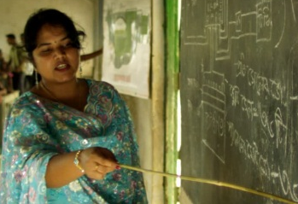
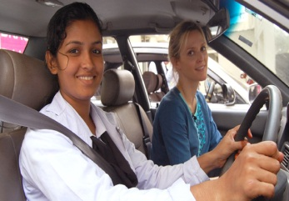
Pair work
Read and match with the picture.
Tailor
Farmer
Teacher
Driver
Doctor

Slide 16
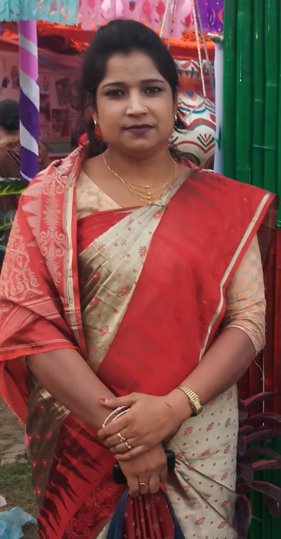
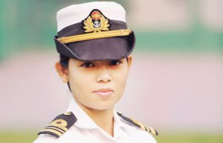
Individual work
See the pictures and say about these
blacksmith
pilot
teacher
farmer
tailor
doctor

Slide 17
Evaluation
1. Who grows food?
2. Who helps people?
3. Who flies a plane?
5. Who makes clothes?
4. Who Teaches at school?

Slide 18
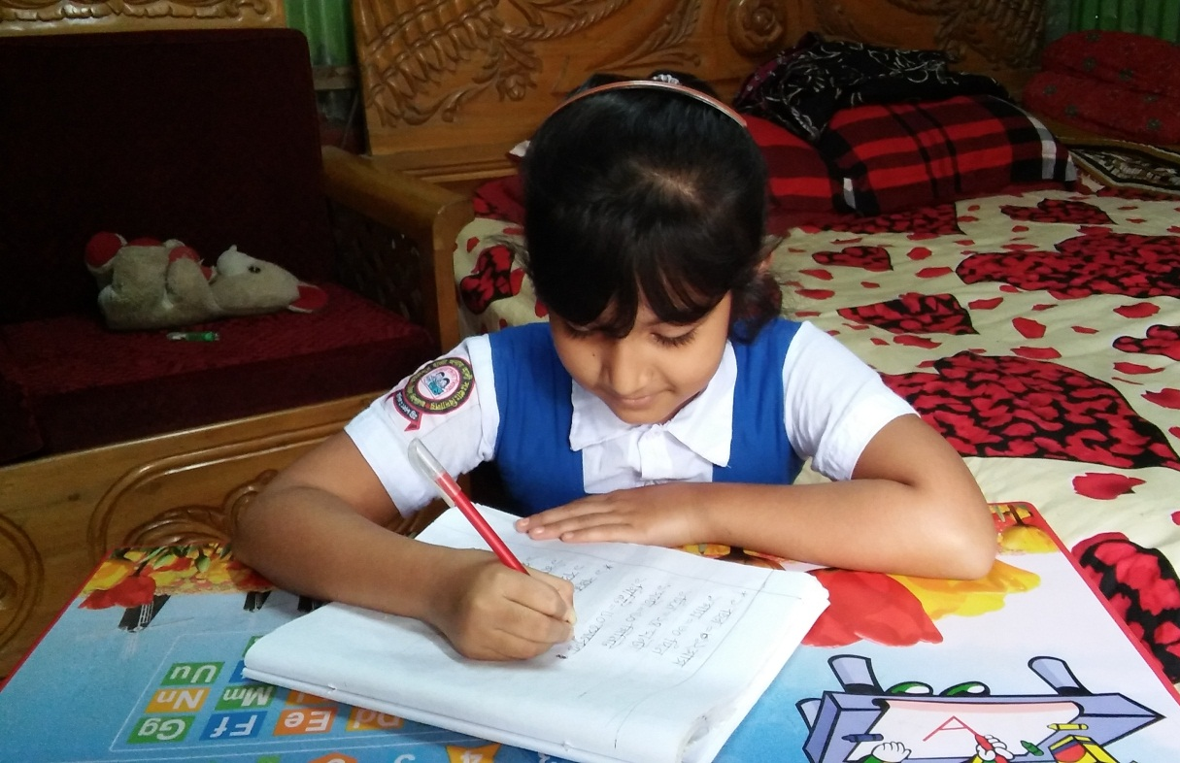
Home work
Make a list of different occupation people who live in your area.

