Slide 1

WEL COME

Slide 2
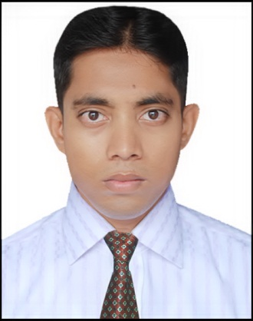
PERSONAL INFORMATION
Abul Hashem Md. NurUddin
Assistant Teacher, Computer
Dudmukha High School
Dagonbhuiyan, Feni
hashem.akt@gmail.com

Slide 3
Class Nine
SUBJECT:
ENGLISH FOR TODAY

Slide 4
Learning Outcomes
 What is The Land of Everest
 Describe Everest Nation & Languages
 Identity Land of Nepal
 Explain Religion of Nepal

Slide 5
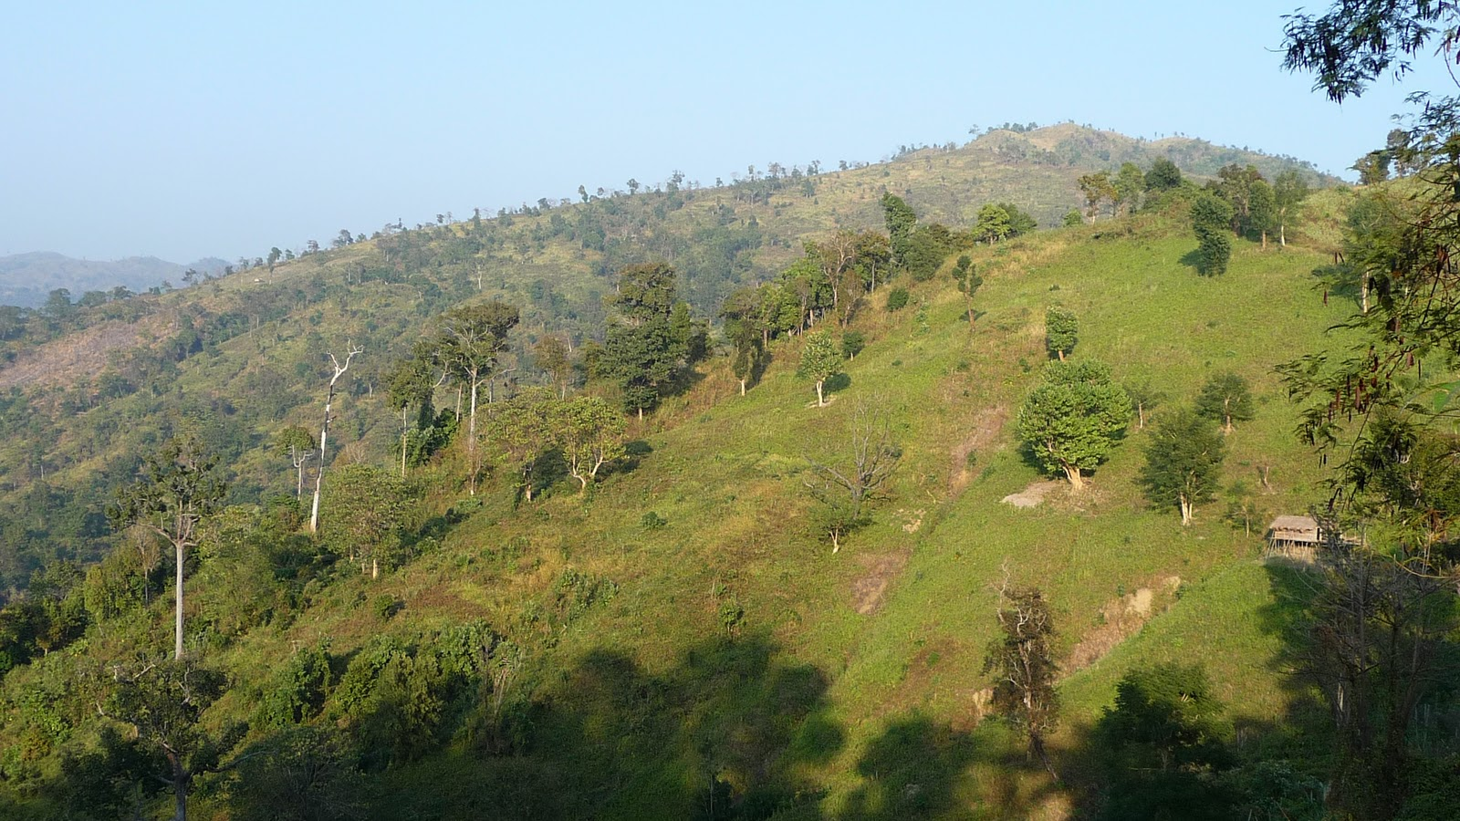
Hill
Tajingdong Hill

Slide 6
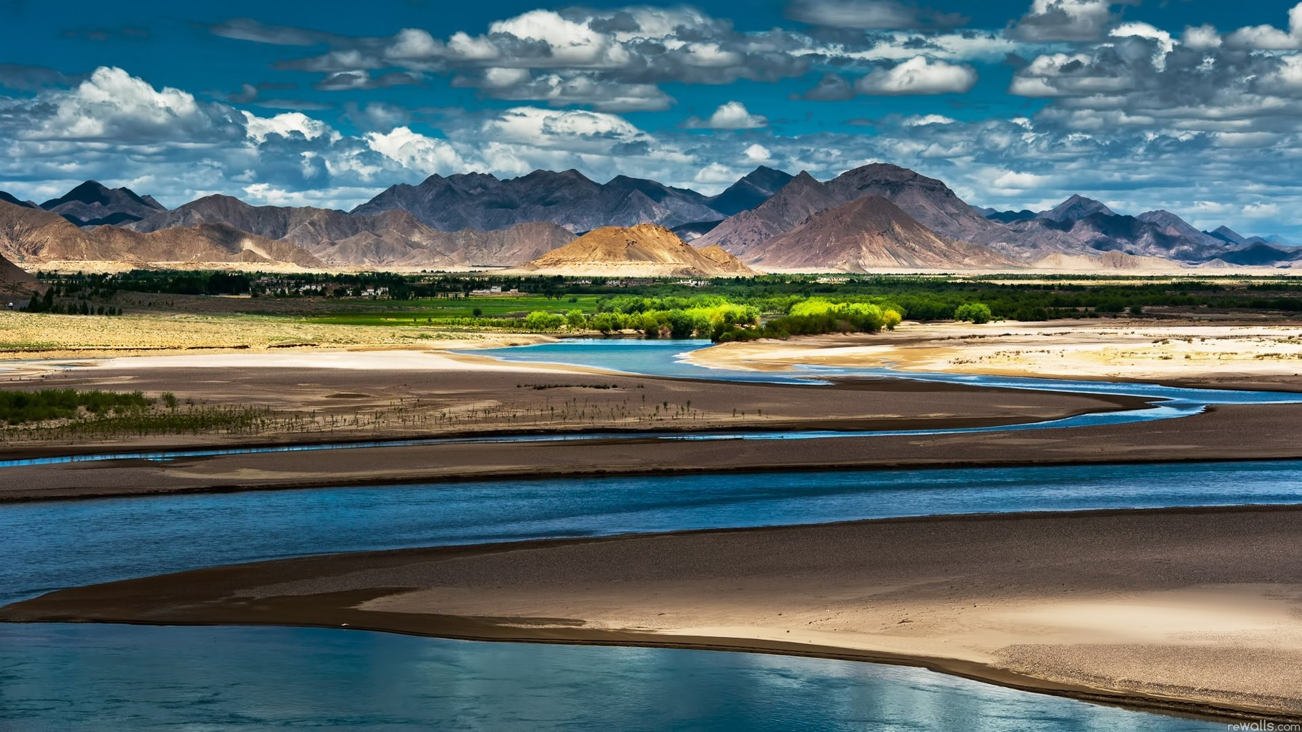
Lesson
Nepal: The Land of Everest

Slide 7
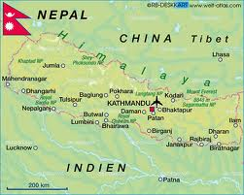
Map
Nepal Map

Slide 8

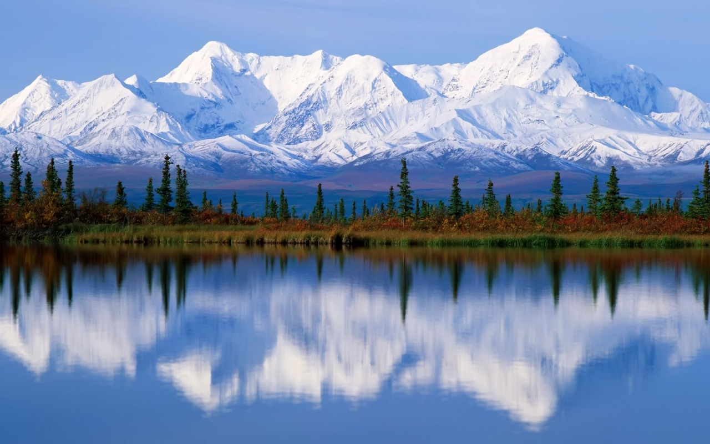

Everest
Himalaya from china view

Slide 9
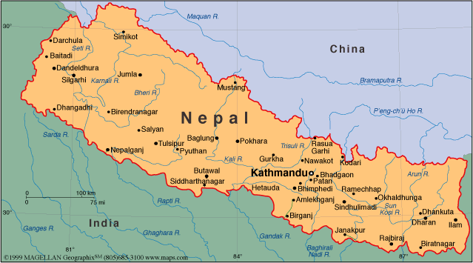
Known as the land of Everest, Nepal is one of the most charming countries in Asia. It is also known as the only Hindu kingdom in the world. The Kingdom of Nepal is a small land of sublime beauty.

Slide 10
Nepal lies between India and the Tibetan part of china.
Nepal Lies
This small country has an area of 147,181 square kilometers.
Area
Nepal is home to nearly 29,000,000 people.
People
Kathmandu, the capital city of Nepal.
Capital

Slide 11
Southern Nepal is tropical lowland known as the part of Nepal has not summers and warm winters. Here the Temperatures reach up to 40º C in April and May and monsoon rains drench this region from June to September. This part of Nepal has some of the highest peaks of the world including Everest.
Weather

Slide 12
In total, there are 103 castes and ethnic groups living in this small country. Two largest known as Chetri and Bahun
Castes & Ethnic
About 48% of the people speak Nepali. Among other languages spoken are Maithali, Bhojpuri, Tharu and Tamang.
Languages

Slide 13
Nepal is the holy land of Lord Pashupatinath and Gautam Buddha were the Hindu and Buddhists have lived togather in harmony for centuries
Holy Land
The seven monuments zones situated within the Valley have been named as World Heritage Sites by UNESCO
Heritage

Slide 14
Pair Work
Say Some castes and ethnic groups of Nepal.
Nepal is Holy Land But Why?
What is Nepal Another Name

Slide 15
Team Work
Rose
Why Nepal is Famous?
Lily
Describe in brife of Everest

Slide 16
Test
 What does Nepal lie?
 What is its area?
 What is the capital of Nepal?
 How Many People live in Nepal?

Slide 17
Home Work
Shortly Describe of Nepal Castes & Ethnic


Slide 18

Thanks
Thanks to All

