Slide 1
Good morning!
How are you students?

Slide 2
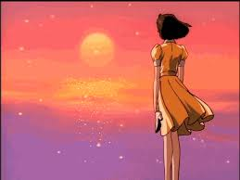
Welcome to
Multimedia Class

Slide 3
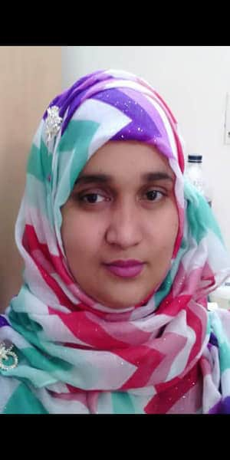
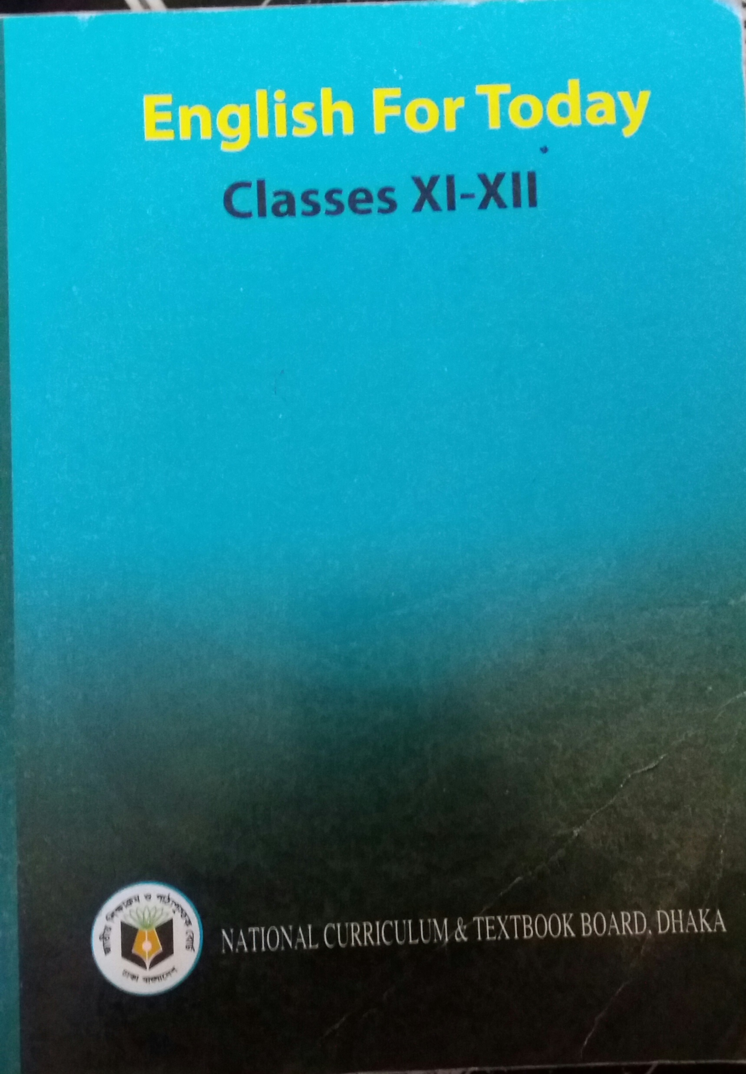
Identity
Mosammat Nelufa Afrose
Lecturer in English
Khilbaisa Rahmania Fazil Madrasah
Khailbaisa, Sadar, Lakshmipur
E-mail:nelufa.afrose@gmail.com
Class: Eleven/Twelve/Alim
Subject: English 1st paper
Unit-Five : Adolescence
Lesson-4, The story of Shilpi
Subject- English 1st paper

Slide 4
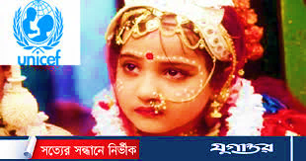
Look at the picture below -
Is there any girl in your text like her?
She is victim of early marriage.
A girl child who is going to be bride.
What do you see in the picture?

Slide 5
The topics of our today class is-
Yes, you are right..
The story of Shilpi

Slide 6
By the end of the lesson students will able to know-
About the early marriage & risk of early pregnancy through the story of Shilpi.
About the causes of early marriage.
About how to convince others to have children later..
Some new vocabulary from the text.

Slide 7
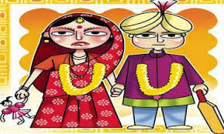
Let’s know the story of Shilpi with the picture
Shilpi was only 15 years old when she married Rashid in 2008.

Slide 8
Marrying off daughters at an early age is a standard practice for many families living in rural Bangladesh.

Slide 9
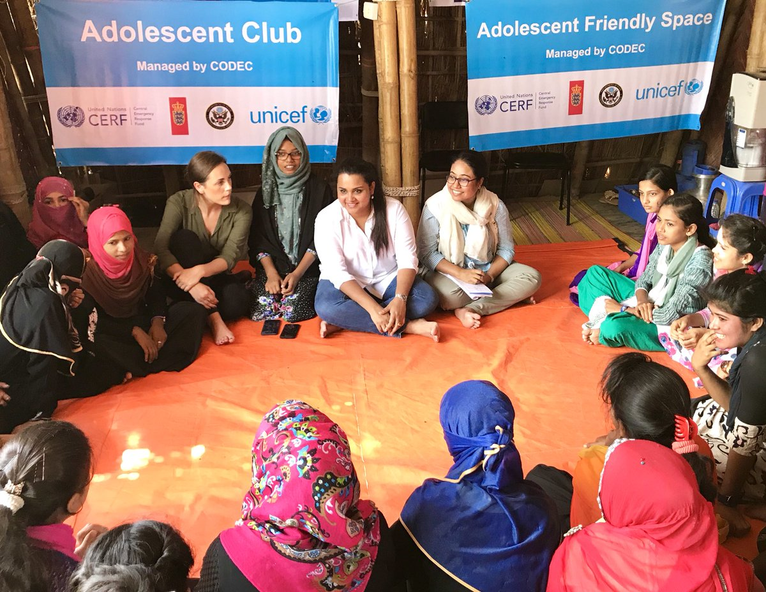
It also offers peer-to-peer support and life training that help adolescent say no to early marriage.
These NGOs work through Canada’s Adolescent Reproductive Health project.
The group’s activities include discussions on how to most effectively change behaviour related to reproductive health as well as one-on-one counselling.
After her wedding Shilpi joined a local empowerment group that provides adolescent girls with the tools needed to change practices, particularly those pertaining to early marriage and pregnancy.

Slide 10
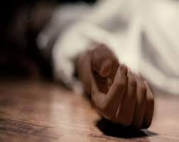
While maternal morality in Bangladesh has declined by nearly 40 percent since 2001, the rate remain high with 194 maternal deaths per 100000, live birth in 2010- dropping from 322 in 2001 with a project decrease to 143 by 2015.

Slide 11
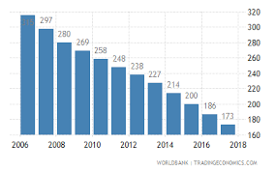
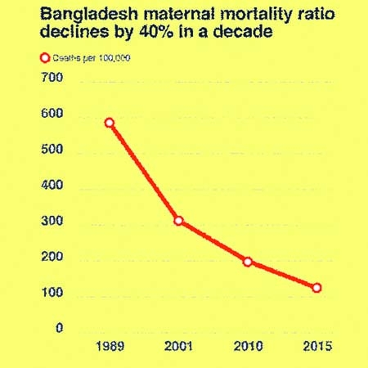
Maternal morality rate in Bangladesh on graph.
2OO1-2015 According to text.
Maternal mortality ratio declines
2006-2018 maternal mortality
Collected from internet

Slide 12
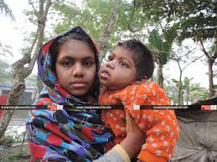
Girls who get pregnant are at risk of serious health complications.
These include:
Dangerous hemorrhage and fistula
A painful internal injury caused by obstructed childbirth.
that commonly leads to serious maternal morbidities and social exclusion.

Slide 13
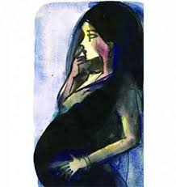
Together , the couple met with a female health care provider who informed them about the various family planning options available.
When Shilpi heard those risks she invited her husband, Rashid , to discuss pregnancy with a counsellor. After hearing about the risks, Rashid agreed to delay having children for five years despite pressures from his parents and neighbours to produce an off spring.

Slide 14
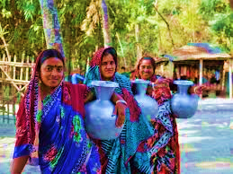
Today, the village no longer pressurizes the couple; their parents and neighbours now support them and speak out against early marriage and pregnancy.
Shilpi’s mother-in-law and neighbours eventually came to understand the harmful effects of early pregnancy on mother and child.
Shilpi’s mother-in- law and neighbours continued to pressurize the newlyweds. Unable to convince their close relatives of risks, Shilpi and Rashid returned to the counsellor.

Slide 15
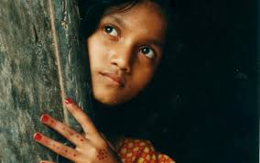
The causes of early marriage
Ignorance
Superstitions
Poverty
Standard practice etc. .

Slide 16
Creating social awareness
Discuss with partner.
How to convince others to have children later
Make understand the elder the harmful effect
Taking the help of parent peer

Slide 17
Let’s learn some Vocabulary from the text
Empowerment (noun):
Meaning : Authority or power given to someone to do something.
Counselling(noun):
Meaning : The provision of professional assistance and guidance.
Morbidity(noun):
Meaning: The condition of being diseased.
Obstructed:(adjective):
Meaning : The state of being blocked.

Slide 18
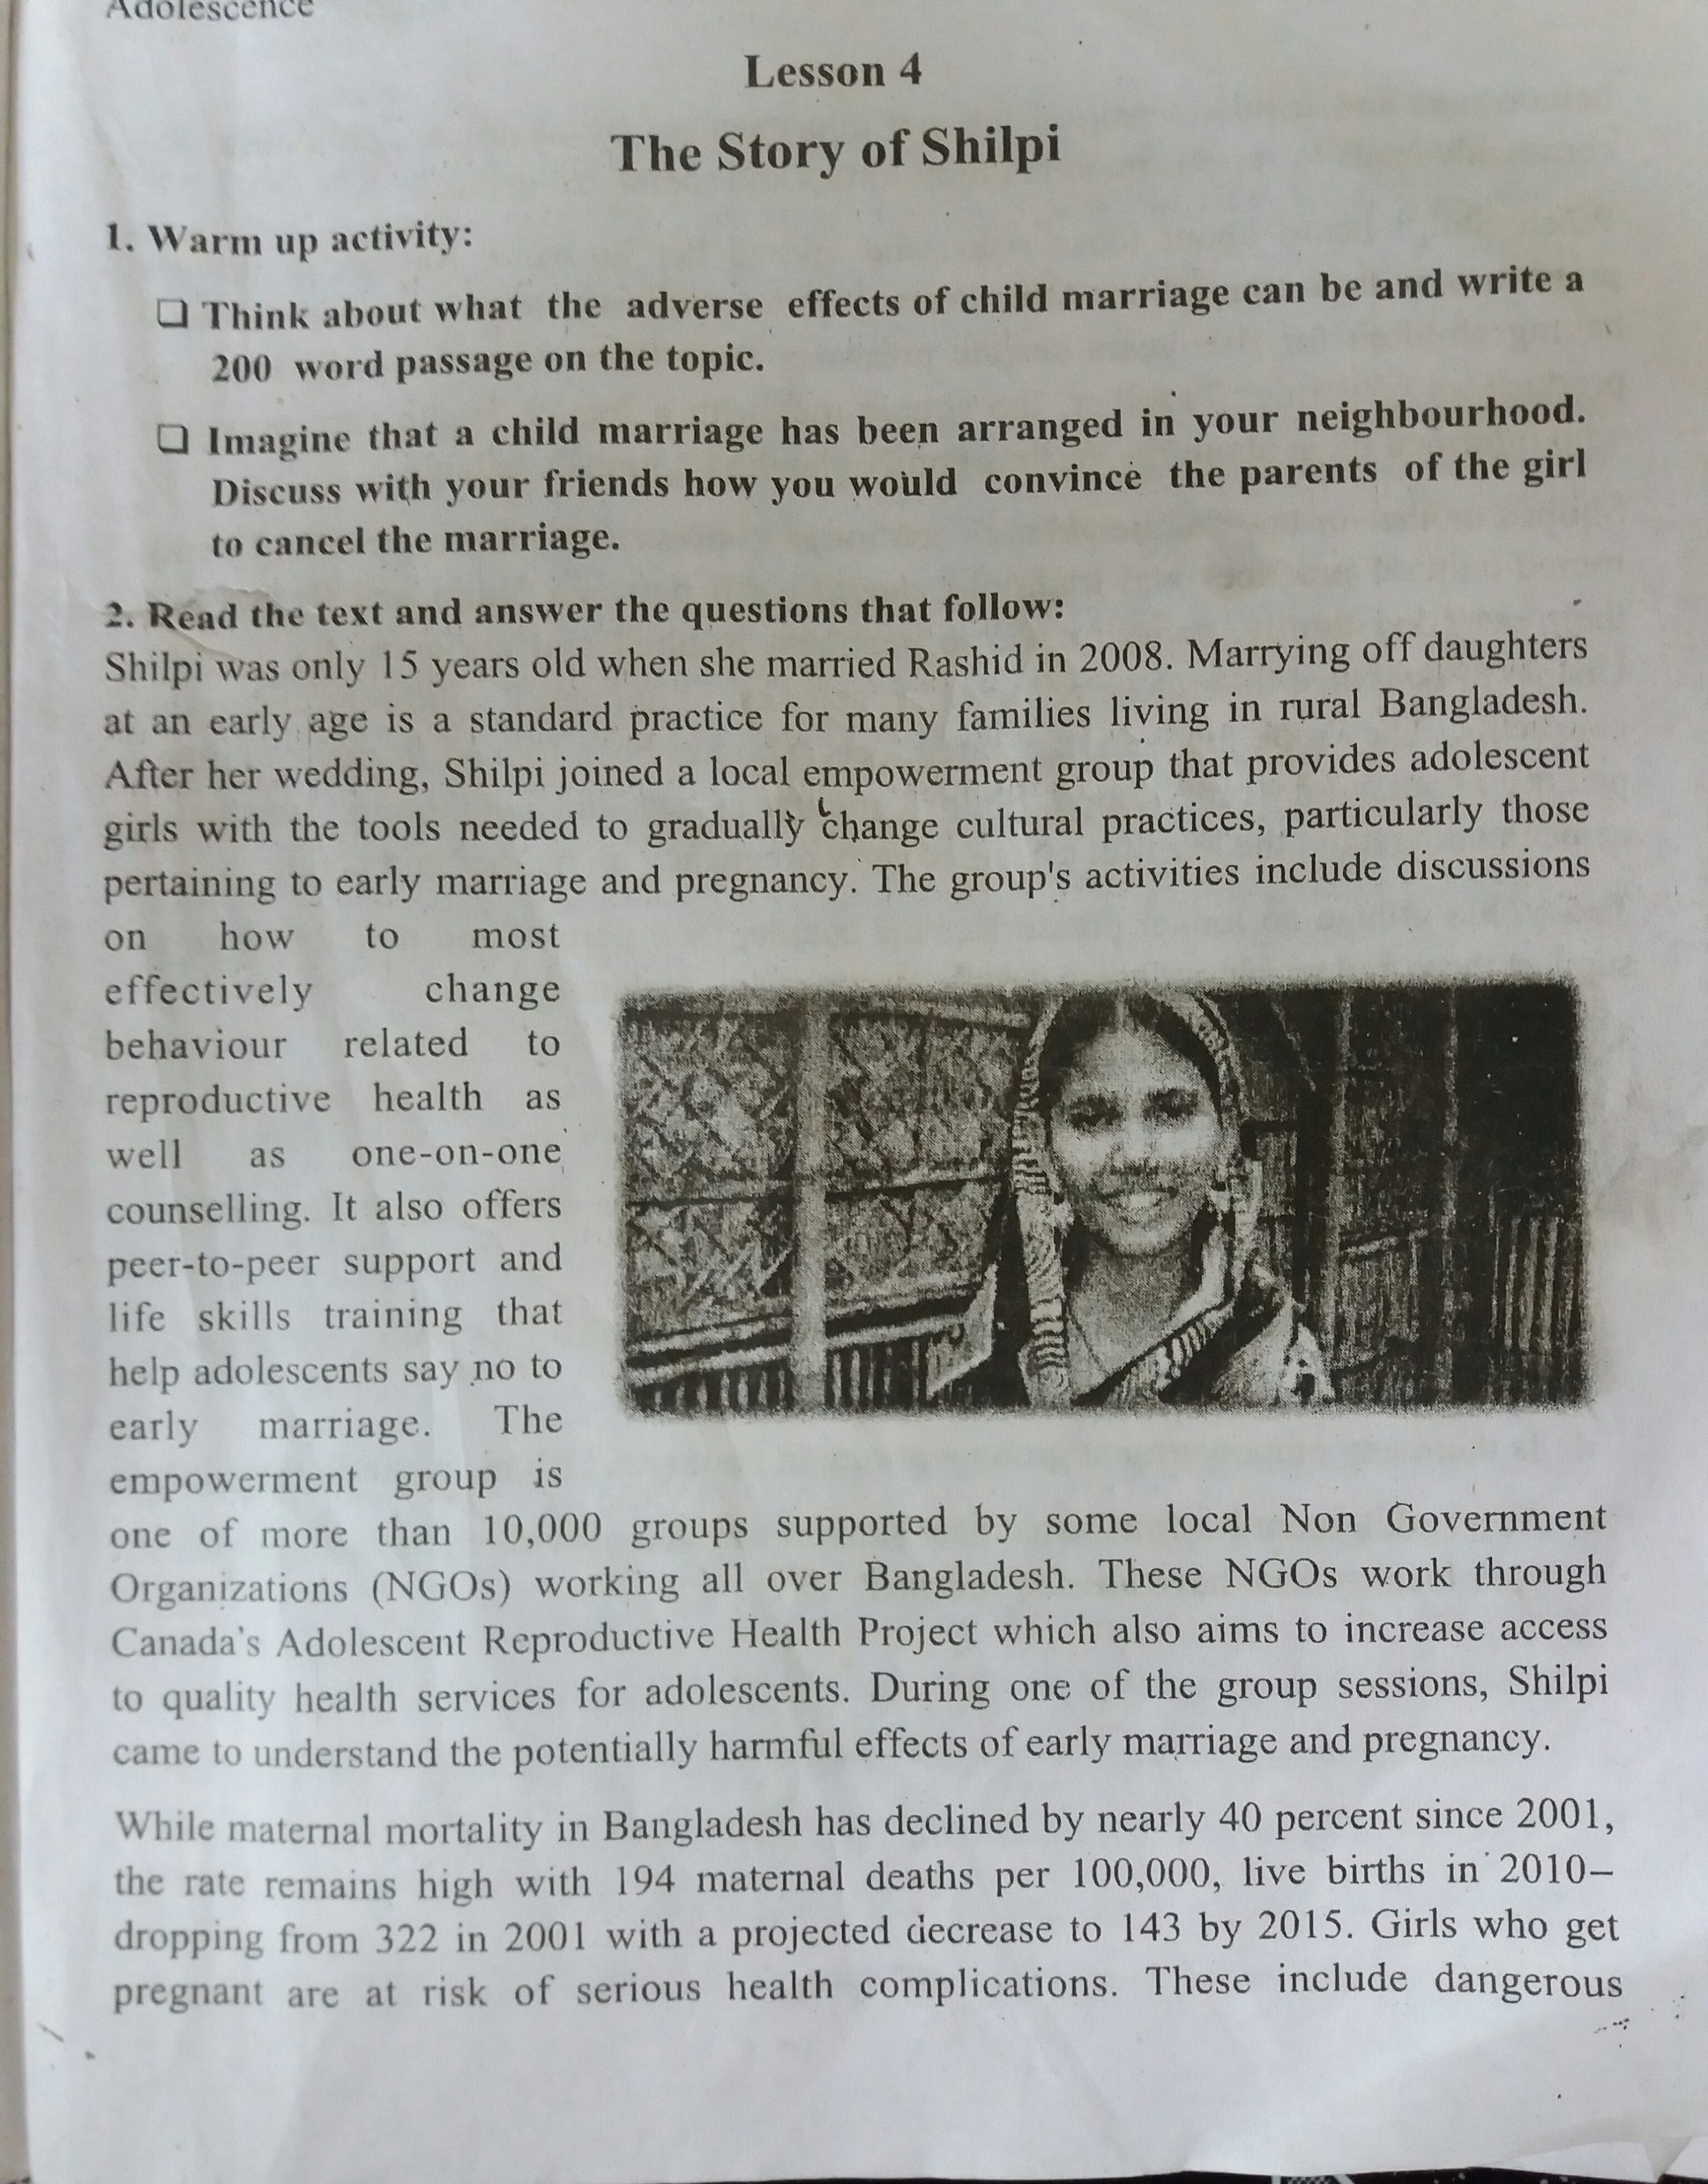
Open at page-59 &
Read silently

Slide 19
How can we solve early marriage and early pregnancy?
*Ensure mass education.
*Create social awareness
*Persist to abide by law.
*Ensure the fixed age limit of marriage.

Slide 20
Individual Work
Adolescent health quiz
Tick each item that is true for you. Each tick march is worth 1 point. Add up the point and check your score.
Life at home
You have the opportunity to make decisions that are important to you.
You can talk to caring and responsible adults about important things.
You feel safe at home.
You understand and follow the rules your parents have set for you.
Life at college
You do well in college and ask for help when you need it.
You plan to do well in your HSC examination.
You can complete your home work /college tasks on your own.
Making good choices
Your friends do not use or offer you cigarettes, alcohol or drugs.
You have friends who are trustworthy.
You are active in sports, cultural clubs and voluntary organizations
Healthy lifestyle
You have 3 healthy meals each day including breakfast.
You take 3 calcium rich food items , such as milk or yogurt everyday.
You eat enough fruit and vegetables daily.
You avoid eating food high in fat, sugar and salt most days of the week.
You watch 2 hours of tv or less everyday.
You exercise or play sports daily.
Bonus point
You volunteer in your community to help others.
You do things to help out at home.
Your total score is………
If your total score is 6 or less, you really need to think about changing yourself
If your score is 7-10 you still need to work toward a healthier you.
If your total score is 11+ you have a heathy life. Keep it up.

Slide 21
Pair work
Answer the questions
Why did Shilpi decided to delay her pregnancy?
How were Shilpi and her husband able to handle the pressure for having children ?
What are the various health-related services that couples like Shilpi and Rashid need?

Slide 22
Evaluation
What does the word adolescent mean in?
i. grow-up ii. infant iii .teenage iv. adult
What leads to serious maternal morbidities and social exclusion?
i. obstructed childbirth ii. blind childbirth iii. illegal intercourse iv. injury
In the passage, the word ‘aim’ is a/an –
i. noun ii. adjective iii. Verb iv. adverb
In the passage ‘life skills training’ refers to-
i. training to develop skills of life ii. training to get a good job
iii. training on how to live well iv. training on reproductive health.

Slide 23
Home Work
Write the adverse effects of child marriage in about 200 words.

Slide 24
t
Thanks to all.

