Slide 1
WELCOME

Slide 2
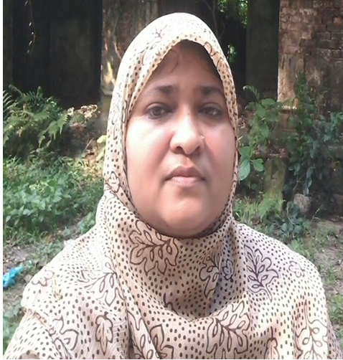
Teacher’s Introduction
Zannaton Nahar
Head Teacher
Teknogopara Govt. Primary School
Gazipur citycorporation, Gazipur.

Slide 3
Subject identity: English
Class: two
Time: 40 minutes

Slide 4
Let’s see a picture

Slide 6
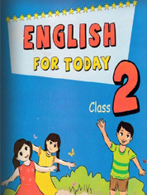
Unit 16
Lesson: 4-6
Topic:Colours
Page no : 33

Slide 7
Learning outcomes:
Students will be able to:
4.1.1 Repeat rhymes after teachers.
4.1.2 Recite the rhyme independently.

Slide 8
What’s the pictur name?

Slide 9
Teachers recite the rhyme loudly.
Rainbow, rainbow
I see you!
Red and orange,
Yellow, green and blue,
Indigo and violet, too!

Slide 10
Students repeat after teachers.
Rainbow, rainbow
I see you!
Red and orange,
Yellow, green and blue,
Indigo and violet, too!

Slide 11
Recite the rhyme in pair.
Rainbow, rainbow
I see you!
Red and orange,
Yellow, green and blue,
Indigo and violet, too!

Slide 12
Recite the rhyme with clap
Rainbow, rainbow
I see you!
Red and orange,
Yellow, green and blue,
Indigo and violet, too!

Slide 13
Evaluation
I will ask some students to recite the rhyme individually.

Slide 14
Home work
Write the rhyme ‘Rainbow,rainbow’.

