Slide 1
Welcome to
our today’s English Class

Slide 2
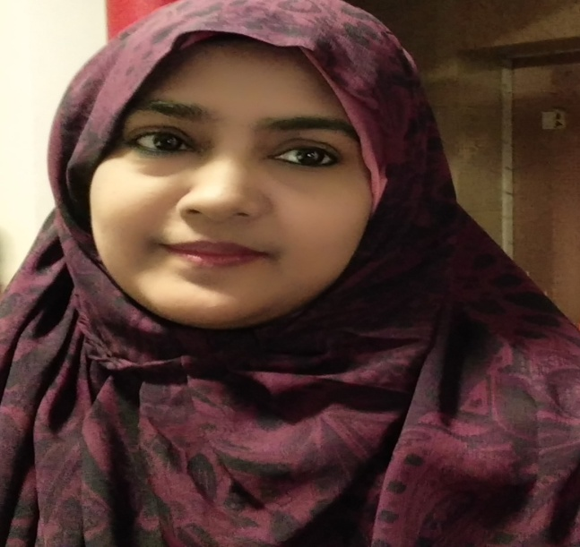
IDENTITY
Syeda Shahinur parvin
Asst. Teacher
Hasne Hena Girls’ High School
Bakalia,Chattogram.
Contact: 01819858004
Email:syedashahinurparvin @gmail.com
Class: Six
English First Paper
Lesson-5

Slide 3
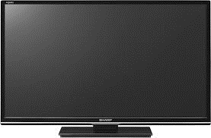
Let’s enjoy a video clip
They are collecting rubbish.
What are they doing?
Because they keep the society neat and clean.
Why is their work important for the society?

Slide 4
Our Topic is….
Thanks for your work
Lesson-5,Page-13

Slide 5
Learning outcomes
After completing the lesson students will be able to
• talk about people, places and familiar objects in short and simple sentences
• ask and answer questions
• participate in short dialogues and conversations on familiar topics
. read and understand texts
• write short paragraphs.

Slide 6
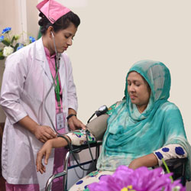
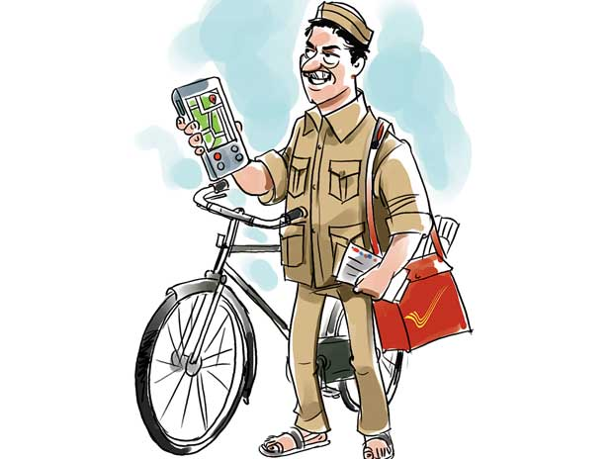
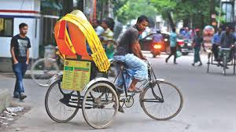
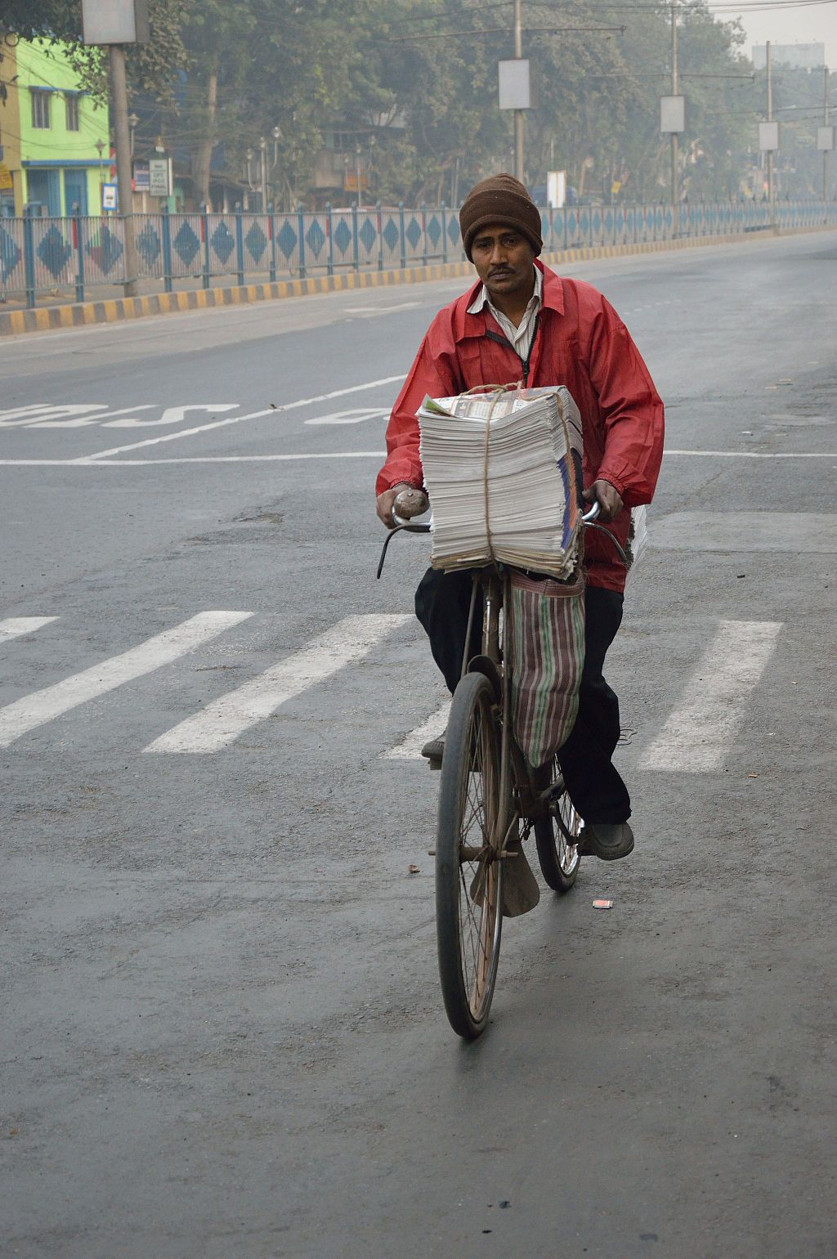
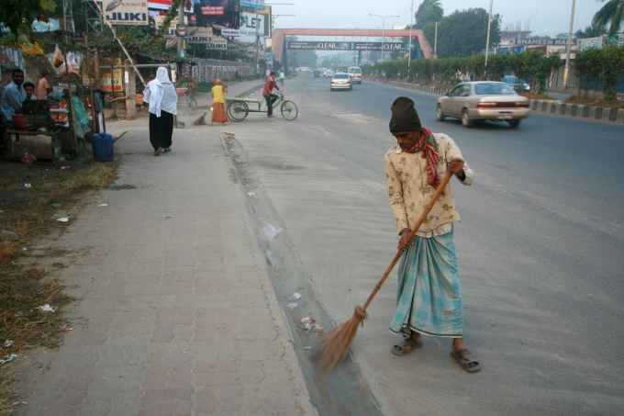
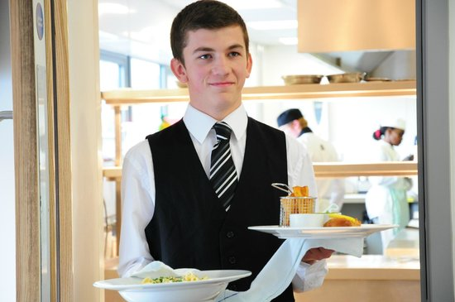
A Look and say. Use suitable words from the box to describe the occupation of each person below.
Newspaper hawker
nurse
cleaner
Rickshaw-puller
waiter
postman

Slide 7
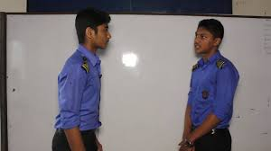
A1 Choose appropriate words from the box to complete the dialogue below. Then act out the dialogue in pairs.
Letters restaurant streets place morning
A1 Now act out the dialogue in pairs.
A waiter serves food at the restaurant.
A postman delivers letters and other items to us.
A rickshaw puller takes us from one place to another.
What does a newspaper hawker do?
A cleaner cleans our houses,office and streets etc.
What does a cleaner do?
A hawker gives us newspapers every morning.
What does a waiter do?
What does a postman do?
What does a rickshaw puller do?

Slide 8
B Read the text about Bulbul and answer the questions below.
Bulbul collects rubbish from the Sankar area in Dhaka. Every morning, he wakes up at 5 o'clock and walks along the streets of Sankar to collect rubbish. People of Sankar put their rubbish in plastic bins and leave them in front of their houses. Bulbul walks from door to door to collect them. Sometimes the bins are very dirty and they smell bad. But Bulbul does not mind. He takes out everything from the bins and puts them in his van. He believes that all jobs are important. He works hard every day to keep this area clean.

Slide 9
Last month Bulbul was sick for two days. So, he could not come to collect the rubbish. The people of Sankar were in great trouble. They got piles of rubbish waiting in front of their houses. The whole area became dirty and unhygienic. When Bulbul got well, he came back to Sanker. He collected everything from all the bins. Bulbul does not want to fall sick again. He realises, if he stops working even for a few days only, the whole area will turn into a big dustbin.

Slide 10
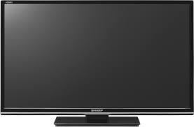
Let’s enjoy a video clip

Slide 11
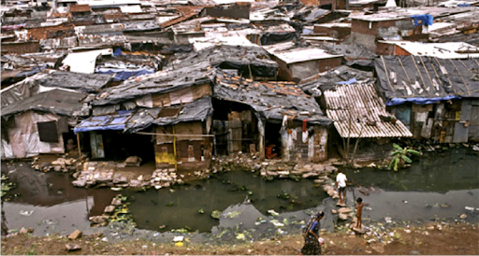
Guess the meaning of the word and make sentence with them
Unhygienic
Unhealthy
The slum area is very unhygienic

Slide 12
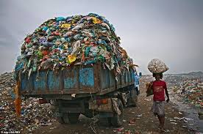
Guess the meaning of the word and make sentence with them
Rubbish
Garbage
Bulbul collects rubbish everyday.

Slide 13
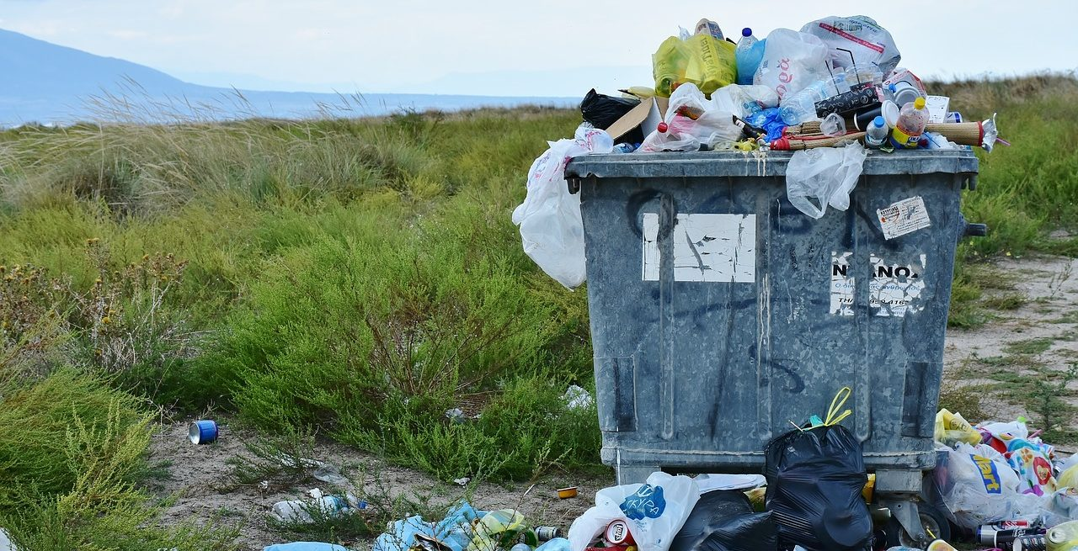
Guess the meaning of the word and make sentence with them
Bins
Containers
Put your rubbish in plastic bin.

Slide 14
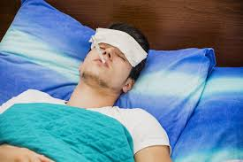
Guess the meaning of the word and make sentence with them
Sick
Ill
The man feels sick.

Slide 15
Guess the meaning of the word and make sentence with them
Profession
Occupation
There are people of different professions in our society.

Slide 16
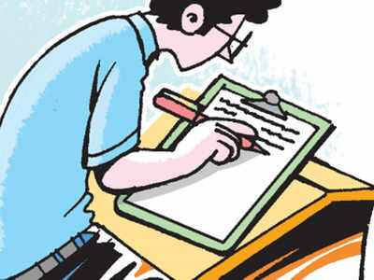
Individual Task
B2
Think of a person who helps you live well. Write a composition on this person. Now answer the following questions.
a) What does he/she do?
b) What time does he/she start his/her work?
c) How does he/she do the work?
d) Does he/she like the job? Why/why not?
e) What will happen if he/she stops working?
f) What do you think about his/her job?

Slide 17
Evaluation
More multiple choice for practice
(a) Bulbul collects………….
(i) Money (ii) honey (iii) tickets (iv) rubbish
(b) He believes that all jobs are…………..
(i) worthless (ii) meaningless (iii) valueless (iv) significant

Slide 18
Evaluation
(c ) Bulbul was sick for…………………..
( i) one day (ii) two days (iii) three days (iv) four days
(d) Sometimes the bins are………………
( i) empty (ii) clean (iii) dirty (iv ) full
(e) He removes rubbish…………………………..
( i ) in time (ii ) untimely (iii ) occasionally (iv ) at time

Slide 19
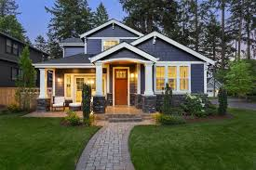
Home Task
Write a paragraph on “ A Cleaner ”.

Slide 20
Thank you

