Slide 2
Identity
English Grammar
Class:- Eight
KHITISH SARKER
ASSISTANT TEACHER
KRISHNAGOBINDA HIGH SCHOOL, BANGLA, NETRAKONA.

Slide 3
How about this?
There is some milk ……… the fridge.
He sat ………..the chair.
She lost her ring ………. the beach.
in
on
at

Slide 4
Preposition

Slide 5
Learning outcomes
After completing the lesson students will be able to…
Define preposition.
Use preposition In, On and At properly.

Slide 6
A preposition is a word placed or positioned before a noun or a pronoun or noun equivalent to show the relationship between a noun or pronoun and other words in a sentence.
Preposition

Slide 7
For describing Time & Place,
the prepositions In, On and At go from GENERAL to SPECIFIC

Slide 8
TIME
GENERAL
IN
PLACE
Centuries--… the 1990’s …… France—Countries
Decades --….. The 90’s ……-Paris—Cities.
Year--….The 1990, 2000 Manhattan—Neghborhood
Months--….. May, June. …. A car—Enclosed space
Weeks--….. 5 weeks.
Seasons--….. Spring.
Period of time … the future
Holidays…. The Easter Holiday
Parts of the day… The morning
Bigger
Time---…..The weekend. …… Columbus Street—Street.
Day--………. Mondays. …….. Seventh Avenue– Avenues.
Dates--…… April 3rd. ………The floor----Surfaces.
Day+ Part of the day– Sunday, Morning. ……. A bus --Means of transport
Holidays with Day– Easter Day. ……..The Radio—Communications.
More specific
ON
(Smaller)

Slide 9
TIME
Very specific
At
(Smallest)
PLACE
Hour’s--………. 9am/pm …….. 7/A State
Parts of the Day– Midnight. ……….street – Address.
Time– The moment. ….. The station –Specific locations.
Holidays without ‘Day’-- …Easter.

Slide 10
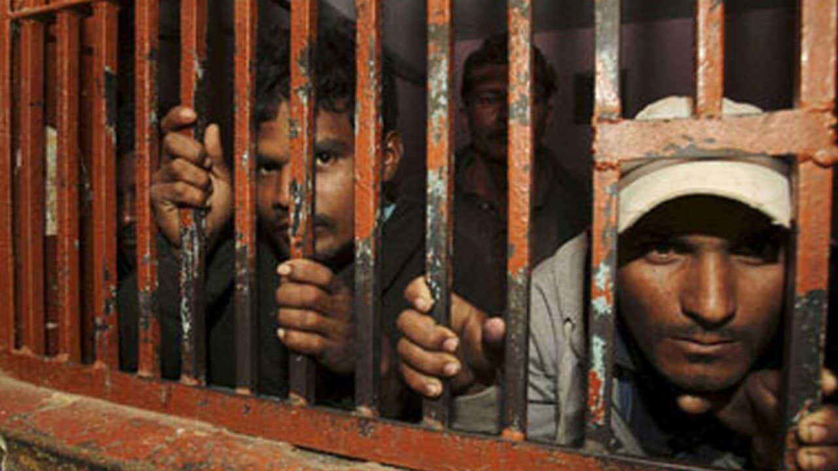
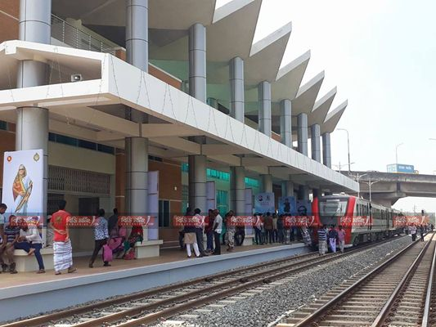
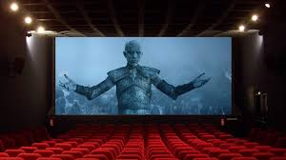
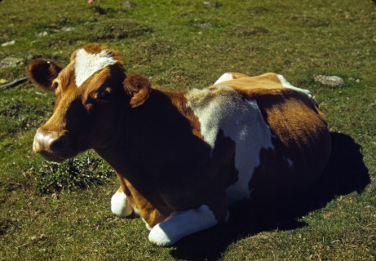
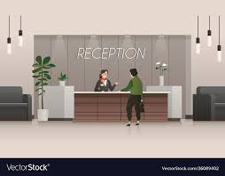
Preposition of Place: At, In, On
At the office | In prison | On the Internet
At the station | In the cinema | On the ground
At reception | In a raw | On the left
At
In
On

Slide 11
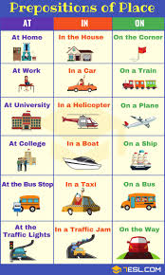

Slide 12
Activities
Orally
&
individually
Notes:
Practicing option.

Slide 13
- Rifat lives…………Dhaka. - Place the book………. the table. - Look ……… the sky clearly
in
on
at

Slide 14
Evaluation
Fill in the blanks with appropriate preposition-
……………the room. …………..the window.
………….. the office.
……………the table.
……….June,
……… 2010,
……… the morning/evening/afternoon. ……….. Sunday.
Notes:
Teacher may evaluate the students through this option.

Slide 15
May Allah bless you all.
Notes:
Ending slide.

