Slide 1
Welcome to our online class

Slide 2
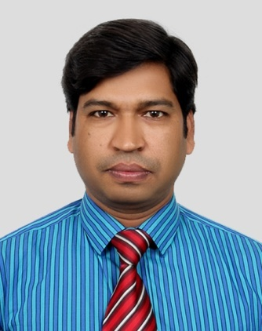
INTRODUCTION
Mohammad Jashim Uddin
Assistant teacher
K.B.A.H.Dovash City Corporation Girls’ High School
Agrabad, Doublmooring, Chattogram
E-mail:jashim580@gmail.com
Sub: English 2nd paper
Class: IX/X
Total student: ----
Time: --------
Date: --------

Slide 3
Notice these sentences…
We eat to live.
We eat so that we may live.
We eat and we may live.
Do you find any change between three sentences............?
Yes
NO

Slide 4
Our Today’s Topic
Transformation Of Sentence
(Simple to Complex
Simple to compound

Slide 5
Learning Outcomes:
After the end of the lesson the students will be able to --
Identify the key word of transformation sentence.
transform simple to complex sentence.
transform simple to compound sentence

Slide 7
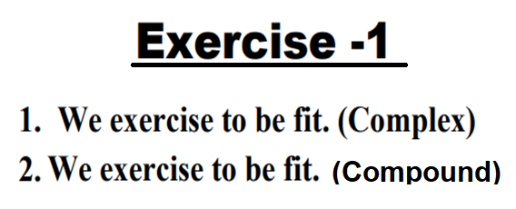
1. We exercise so that we can be fit.
2. We exercise and we can be fit.

Slide 9
1. Though he is poor, he is honest.
2. He is rich but he leads a poor life.

Slide 11
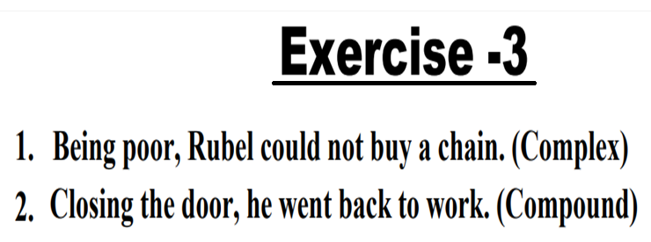
1. Since Rubel was poor, he could not buy a chain.
2. He closed the door and so he went back to work.

Slide 13
Complex : Sohel was so honest that he could not show excuse.
Compound: He is very weak and he can not carry the load.

Slide 14
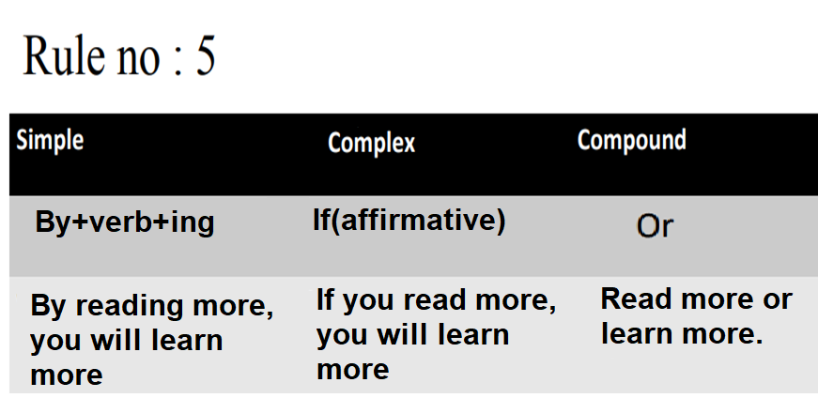

Slide 15
Complex: If you work hard, you can prosper in life.
Compound : Practice math and solve any problem.

Slide 16
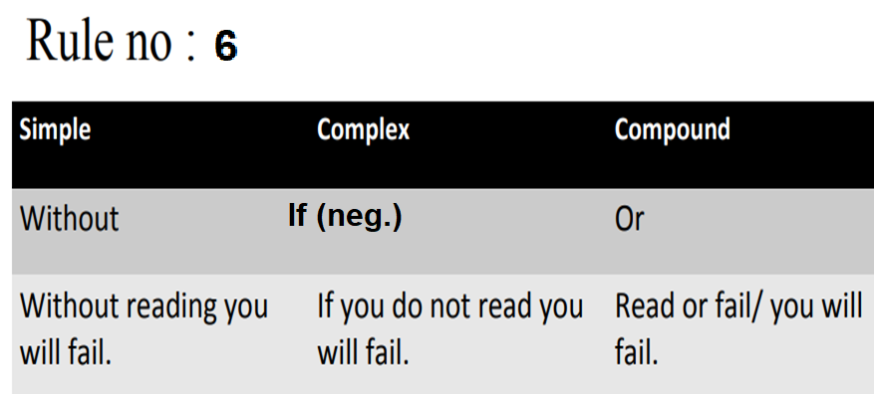

Slide 17
If you do not work hard, you can’t success in life.
2. Work hard or you will not prosper in life.

Slide 18
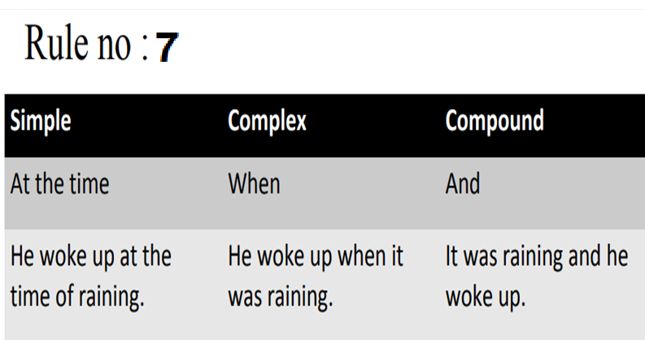

Slide 19
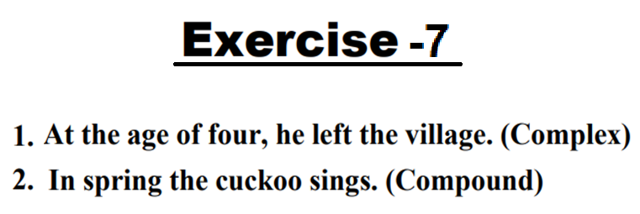
Complex: When he was four, he left the village.
Compound : It is spring and the cuckoo sings.

Slide 20
Home work
Transform the following sentences into
complex and compound.
1. We write to learn.
2. In spite of his being wealthy, he is miser,
3. Being intelligent, he got the job.
4. He is too short to touch the fan.
5. By reading paper, you will get daily news.
6. Without reading paper, you will not get daily news.
7. In winter, the poor suffer a lot.

Slide 21
THANK YOU ALL
Stay home
Stay safe

