Slide 1
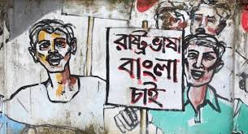
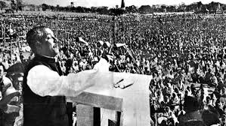
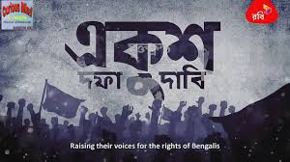
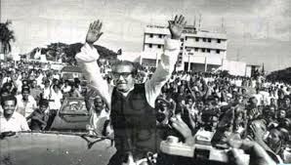
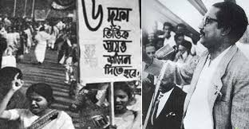
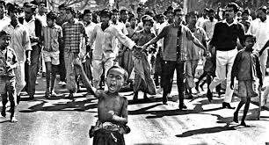
to multimedia class
Notes:
Say greeting to the students.

Slide 2
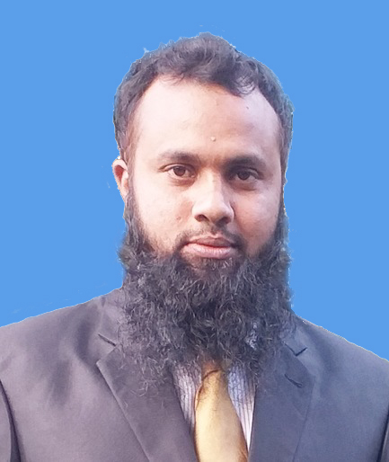
Identity
Md. Jakirul Islam
BA (Hons’), MA in English, B.Ed, LL.B
Lecturer of English
Shaitshala Adarsha High School & College
Brahmanpara, Cumilla.
Contact- jakir.oy@gmail.com (01811285175)
Notes:
Introduce yourself.

Slide 3
Class Identity
Class- XI-XII
Subject- English For Today
Unit- 01
Lesson- 02
Time- 45 min
Notes:
Introduce Subject & Unit-Lesson.

Slide 4
Let’s enjoy a video.
Notes:
Play a video of 7th March Speech fo Mujib for 3 or 4 minutes.

Slide 5
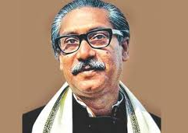
Who is the speaker you have seen in the video?
Bangabandhu Sheikh Mujibur Rahmab
What does he speak at the very beginning?
The unforgettable History of Bangladesh
just prior to Independence
Notes:
Ask the students some questions to infer today’s lesson.

Slide 6
Today’s lesson is on
The Unforgettable History
Notes:
Declare the lesson.

Slide 7
Learning Outcomes
By the end of the lesson,
students will be able
➔ To say meanings of difficult words.
➔ To give answer to some questions
about the pre-independence occurrences.
➔ To make some points of pre-independence occurrences.
Notes:
Proclaim the learning outcomes.

Slide 8
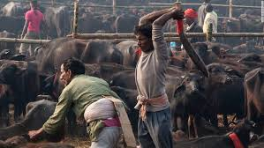
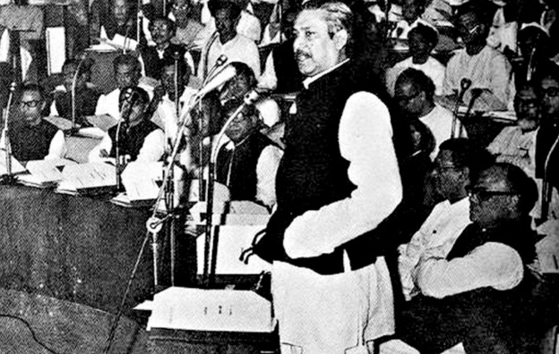
negotiations
Discussion aimed at reaching an agreement
slaughter
Kill, murder
Assembly
Meeting place, gathering
Notes:
Demonstrate several words along with showing pictures and tell students to infer meaning.

Slide 9
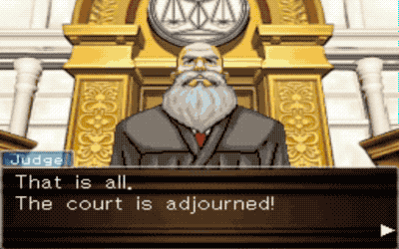
proceedings
A series of activities of a meeting
prorogue
Adjourn, discontinue
spontaneously
Easily, amicably
Notes:
Demonstrate several words along with showing pictures and tell students to infer meaning.

Slide 10
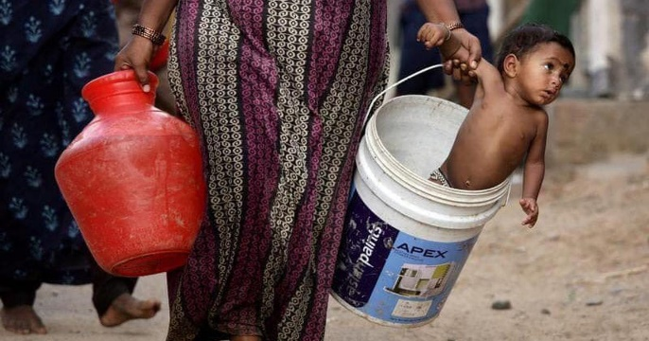
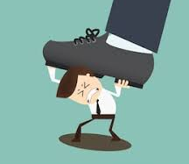
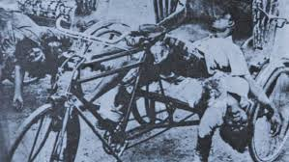
wretched
Unlucky, woeful
downtrodden
Oppressed, persecuted
massacre
Bloodshed, killing
Notes:
Demonstrate several words along with showing pictures and tell students to infer meaning.

Slide 11
Read the passage silently. 7 min
Notes:
Tell students to read the text silently.

Slide 12
Answer the following multiple questions. 4 min
1. What did Bangabandhu talk about with other leaders?
Handing over the administration iii. Creating a constitution
Carrying out discussion iv. boycotting the Assembly
2. What is meant by ‘slaughterhouse?
A house or place where massacre occurs iii. A location where people are adorned
A place where people are honored iv. a building where criminals stay
3. By whom the Assembly members were threatened to be killed?
Bangabandhu iii. Yahya Khan
Mr. Bhutto iv. None
4. The word ‘proceedings’ could be replaced by?
The official written records of a meeting iii. darkness
having fun iv. advancing
5. The poor people of the then …………………… are mowed down with bullets?
East Pakistan iii. Bangladesh
West Pakistan iv. India
Notes:
Tell students individually to answer the multiple questions.

Slide 13
Time
10 minutes
12
1
10
11
2
3
4
5
6
7
8
9
Group Work
Answer the following questions.
Why did Bhutto carry out discussion with Mujib?
According to the speech what is slaughterhouse? Why?
Has Bangabandhu in his speech declared the War of Liberation? How?
Who prorogued the Assembly’s session and why?
Whom did the president Yahya blame?
Notes:
Arrange a group work, monitor their work.

Slide 14
Question:
2. According to the speech what is slaughterhouse? Why?
4. Who prorogued the Assembly’s session and why?
Why did Bhutto carry out discussion with Mujib?
3. Has Bangabandhu in his speech declared the War of Liberation? How?
5. Whom did the president Yahya blame?
Answer:
Bhuto carried out discussions to create a constitution for the country.
The president Yahya Khan prorogued the Assembly’s session to deprive the power of Bengali leaders.
Yes, Bangabandhu in his speech has declared the war of liberation. He says in his speech that the struggle this time is a struggle for freedom- the struggle this time is a struggle for emancipation.
According to the speech, the Parliament would be a slaughterhouse if the West Pakistani members came here to join the Assembly.
The president Yahya blame both Sheikh Mujib and the Bengali people.
Notes:
Give feedback of the group work.

Slide 15
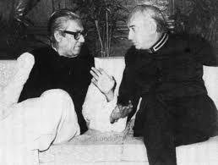
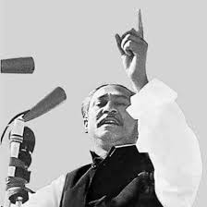
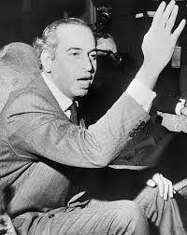
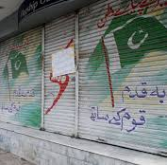
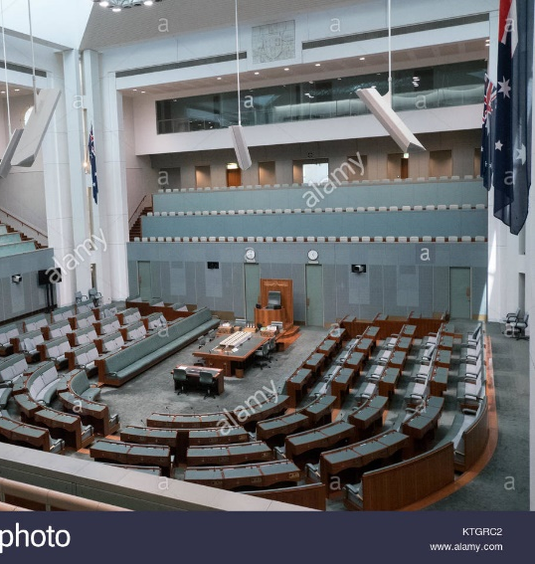
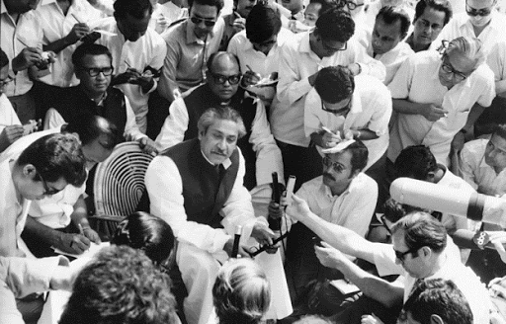
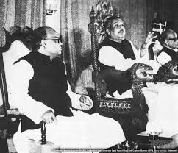
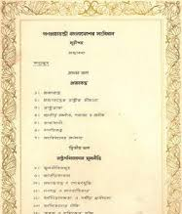
The significant incidents before the Assembly’s session prorogued.
1
Carrying out discussions by Bhutto
2
Talking with other leaders by Mujib
3. Mujib’s Proposal to create a constitution
4. Bhutto’s threat to the West Pakistani members not to join
5. Bhutto’s threat to shut down all shops from Peshwar to Karachi
6. Mujib’s declaration to continue the Assembly
Notes:
Give feedback of the group work.

Slide 16
Time
12
1
2
3
4
5
6
7
8
9
10
11
5 min
Pair Work
Make five points about the significant incidents before the Assembly’s session prorogued. One is done for you.
1
Carrying out discussions by Bhutto
Notes:
Arrange a pair work, monitor them and give feedback.

Slide 17
Evaluation
3 minutes
Who carried out discussions?
1. Bhutto
2. Who proposed to create a constitution?
2. Bangabandhu
3. How many West Pakistani members joined the Assembly?
3. 35
4. Who prorogued the Assembly?
4. Yahya
5. Who threatened West Pakistani members?
5. Bhutto
Notes:
Evaluate the students by asking some short questions.

Slide 18
Make short notes in each of the boxes in the flow-chart showing
the significant incidents before the Assembly’s session prorogued.
One is done for you.
1.
Fight against white minority rule
2.
3.
4.
5.
6.
Notes:
Give them Home Work.

Slide 19
Thank you all
for enjoying
the class.
Notes:
End the class with thanks-giving.

