Slide 1
Welcome to all

Slide 2
Identity
Teacher’s Identity
MD. Senamul Islam
Head Teacher
Malson govt. primary school
Adamdighi, Bogura.
Lesson Identity
English for today
Class: two
Unit: 11 lesason : 4
Time: 40 minutes

Slide 3
Learning outcomes: Student will be able to -
Listening: 1.1.1 - become familiar with English sounds by listening to common English word. 2.1.1 - follow simple command and instruction
Speaking: 1.1.2 - say simple words and phrases with proper sounds and stress.

Slide 4
Let’s enjoy a video:

Slide 5
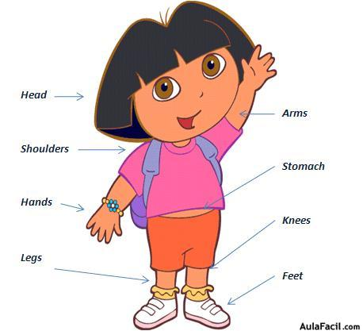
Today’s lesson: Parts of the body.

Slide 6
New words
Teeth
Leg
Hair
Hand
Finger

Slide 7
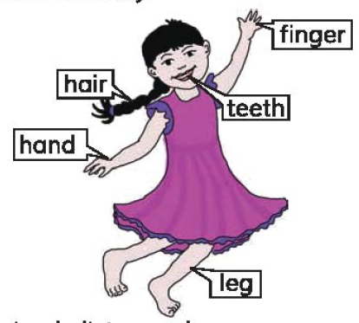
Students let’s introduce with parts of our body.

Slide 8
Students let’s introduce with parts of our body.

Slide 9
Now repeat after me -
Hair
Teeth
Hand
Finger
Leg

Slide 10
Pair work: Say the words in pairs -

Slide 11
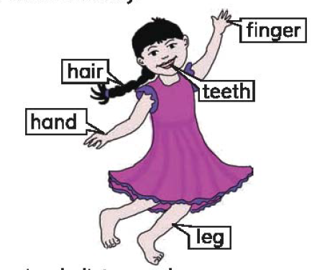
Evaluation: say the names of the parts of your body following numbers
3
1
4
2
5

Slide 12
Thanks

