Slide 1
WELCOME

Slide 2
MOHAMMAD ABUL MANSOOR Head Teacher Borumchora Jonotha GPS Anwara, Chattogram

Slide 3
TODAYS LESSON Class: Five Subject: English Sound practice-1 Lesson: 7 Unit: 2 Page: 9

Slide 4
Learning out comes
Students will be able to 1.1.1 Recognize sound differences in the context of words. Recognize and pronounce the sounds /f/ and /v/ correctly.

Slide 5
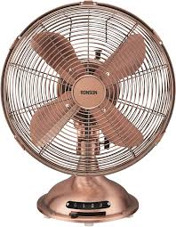
Repeat after me /f/, /f/, /f/ /f/ is for Fan. This is a Fan. This is a Fan.

Slide 6
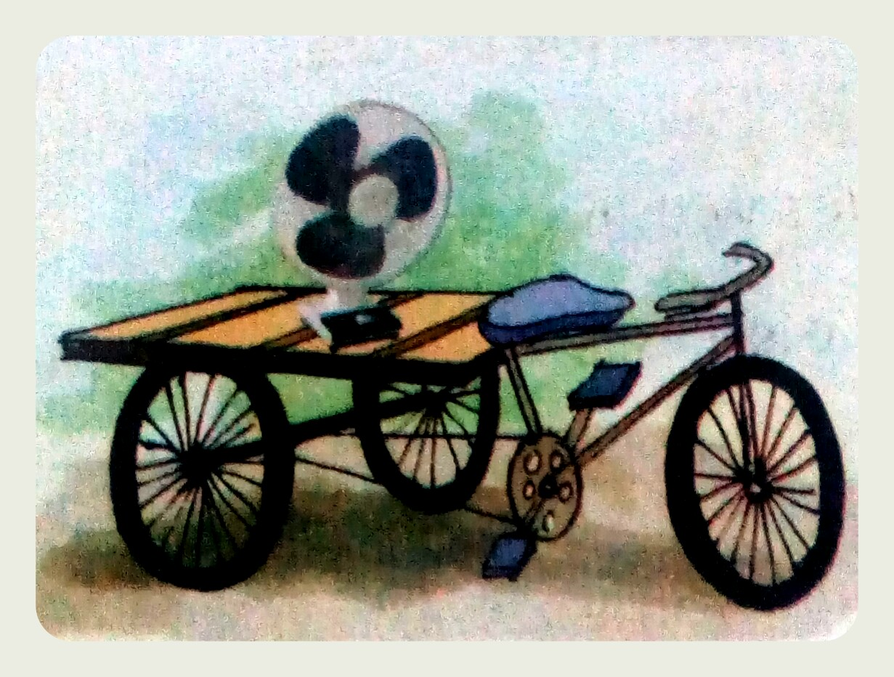
/v/, /v/, /v/ /v/ is for Van.
This is a Van.
This is a Van.

Slide 7
/f/, /f/, /f/ Fan, Fan, Fan. This is a Fan. /v/, /v/, /v/ Van, Van, Van. This is a Van. The Fan is on the Van. The Fan is on the Van.

Slide 8
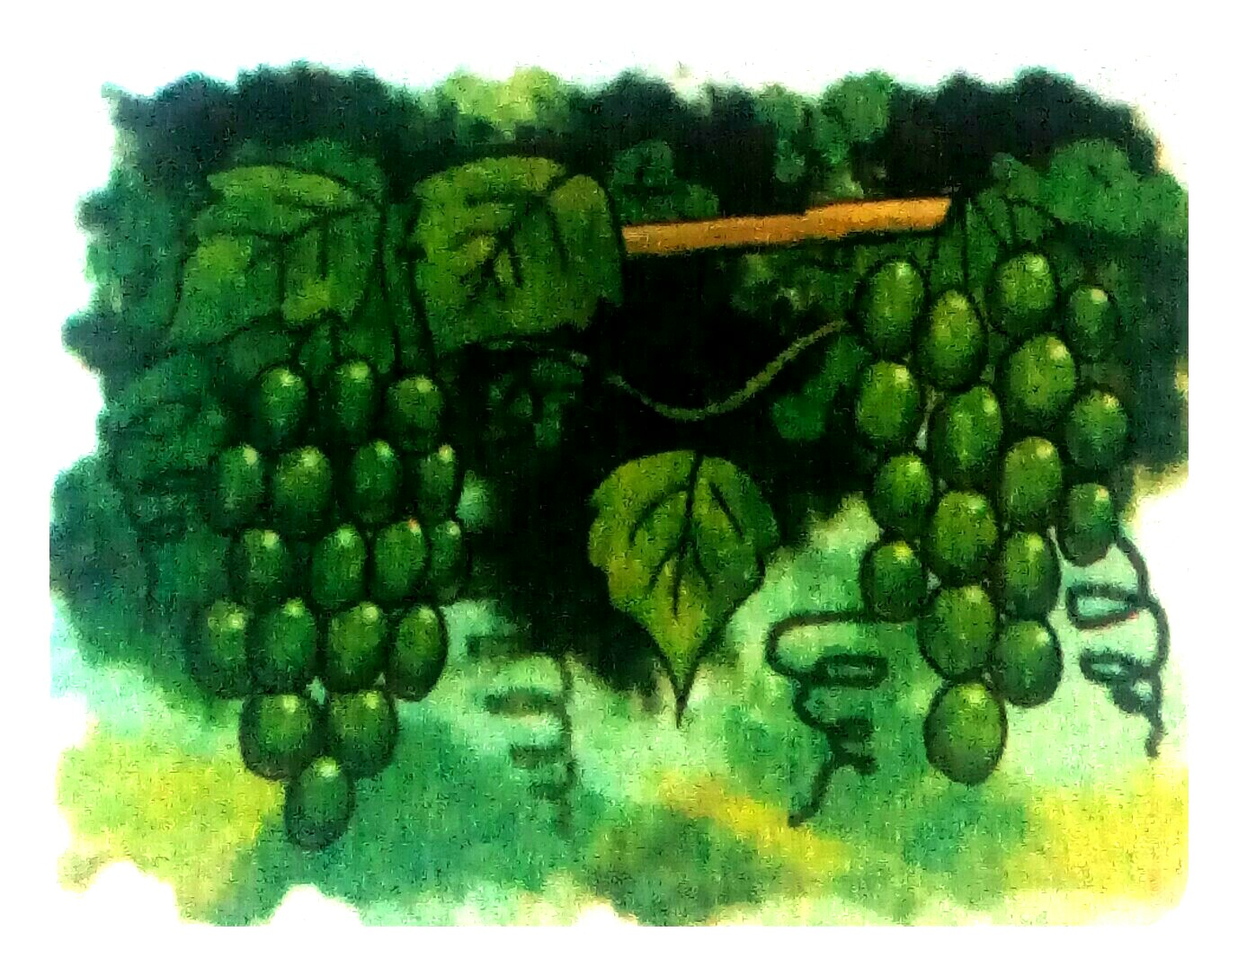
Vine, vine, vine
Grapes on a vine.

Slide 9
Fine, fine, fine I feel fine! I like grapes from the vine.

Slide 10
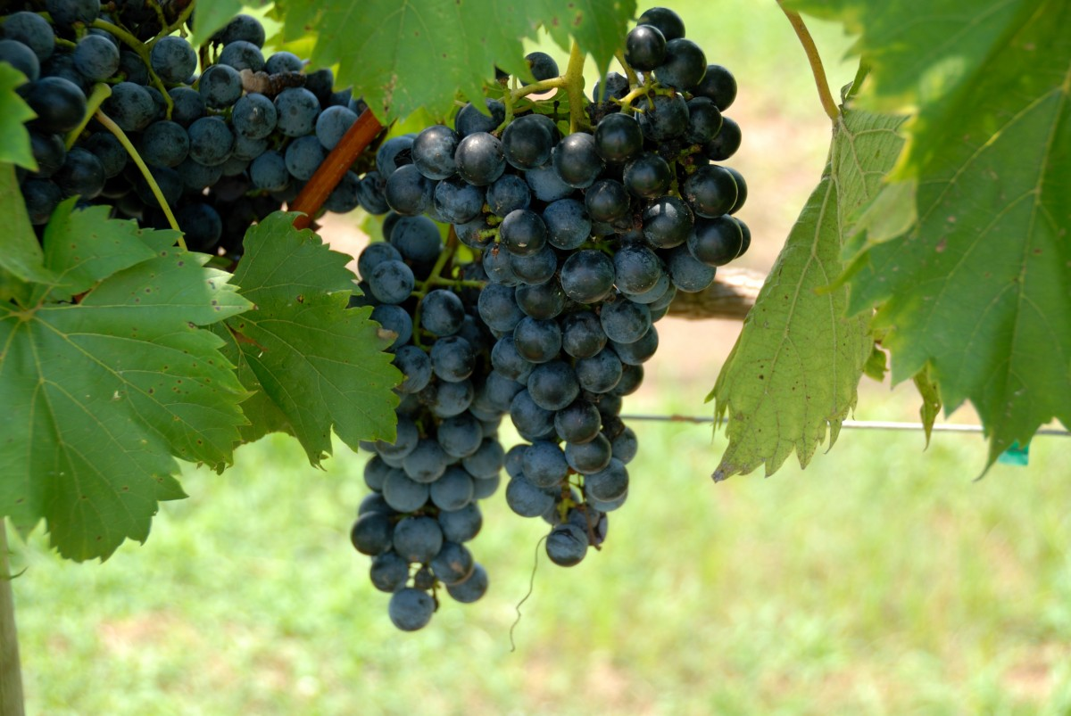
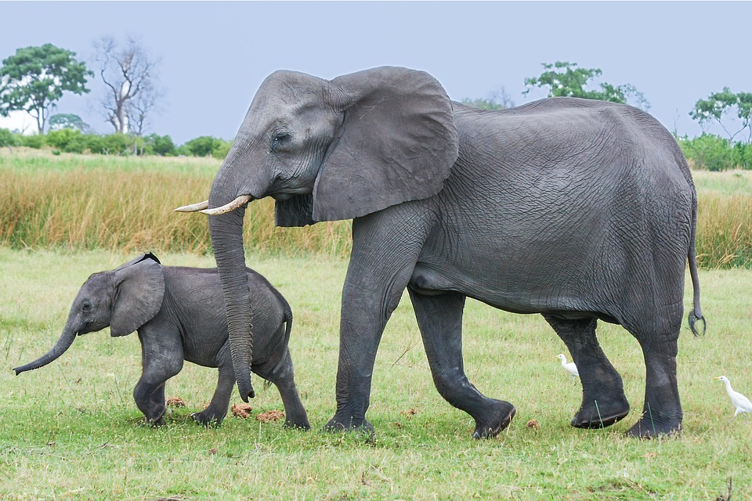
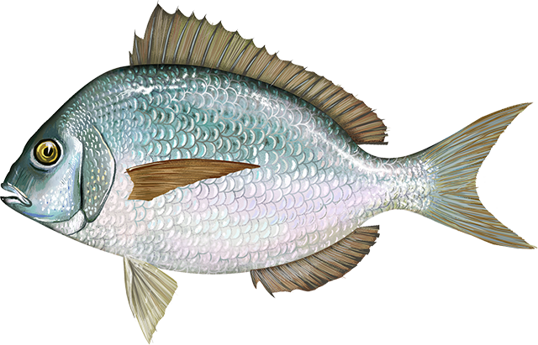
Circle the pictures that have sound /f/. Underline the pictures that have the sound /v/

Slide 11
Check your answer
/V/
/V/
/F/
/F/
This Photo by Unknown Author is licensed under CC BY-SA

Slide 12
Let’s sing the good bye song!
Good bye Goodbye
It’s time to go away
Goodbye Goodbye
I wish you a good day!!

Slide 13
Thank you so much for your active participation.

