Slide 1
Welcome

Slide 2
Introduction of the Teacher
Mst. Zakia Sultana
Head Teacher
Pouta Govt. Primary School
Adamdighi, Bogura

Slide 3
LESSON
CLASS: FIVE
UNIT : 10
LESSON’S Title: My home district.
TODAYS LESSON:A

Slide 5
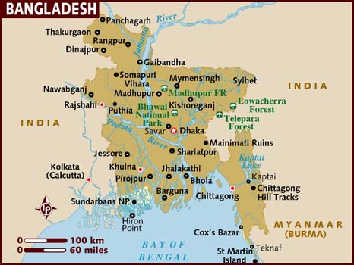
Look at the map of Bangladesh and find out Kishoreganj district.

Slide 6
Lesson declaration
My home district.

Slide 7
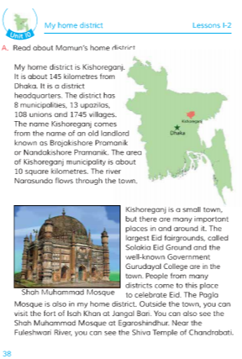
Open your book page at 38.

Slide 8
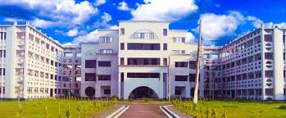
My home district is Kishoreganj.

Slide 9
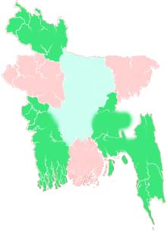
Kishoreganj is about 145 Kilometres from Dhaka.
kishoreganj
Dhaka
How far is Kishoreganj from Dhaka?

Slide 10
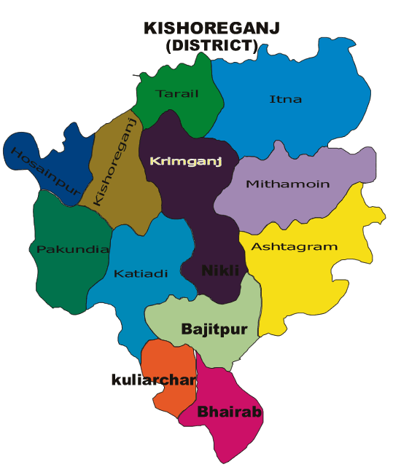
The district Kishoreganj has 8 municipalities, 13 upazilas, 108 unions and 1745 villages.
The area of Kishoreganj municipalities is about 10 square kilometres.
kishoreganj

Slide 11
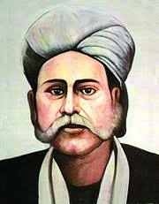
The name of Kishoreganj comes from the name of an old landlord known as Brojakishore Pramanik or Nandakishore Pramanik.

Slide 12
The river Narasunda flows through the town.
Which river flows through the town.

Slide 13
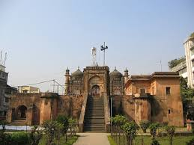
Shah Muhammad Mosque at Egaroshindhur

Slide 14
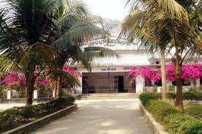
The well-known Government Gurudayal College in Kishoreganj.

Slide 15
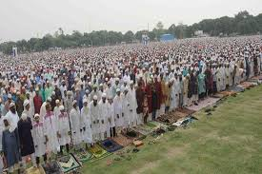
Solakia Eid Ground in Kishoreganj. People from many districts come to this place to celebrate Eid.
1.Why do people come to Solakia?

Slide 16
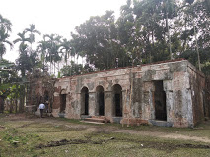
Outside the town, you can visit the fort of Isah Khan at Jangal Bari.

Slide 17
Near the Fuleshwari River, you can see the Shiva Temple of Chandrabati.
Where is the Shiva Temple of Chandrabati?

Slide 18
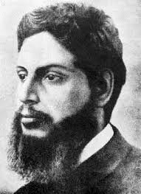
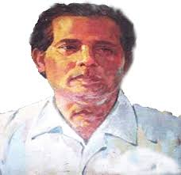
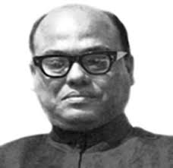
Chandrabati, Upendrakishore Roy Chowdhury, Sukumar Roy Chowdhury, Zainul Abedin, Syed Nuzrul Islam are the famous people in Kishoreganj.
Upendrakishore Roy Chowdhury
Zainul Abedin
Syed Nazrul Islam

Slide 19
Now we know some new words.
1.Eid fairground
2.Celebrate.
3.Temple.
4. visit.
5.Famous.

Slide 20
pairwork
Write 5 sentences about your home District.

Slide 21
Groupwork
1. Make a list of the important places in Kishoreganj. Which places do you think is the most interesting? Why? Discuss with your groupmates.

Slide 22
Homework
Write short composition on “ The Famous People of Kishoreganj”. In at least ten sentences.

Slide 23
Thanks dear students

