Slide 1
Welcome
Notes:
Welcome slide.

Slide 2
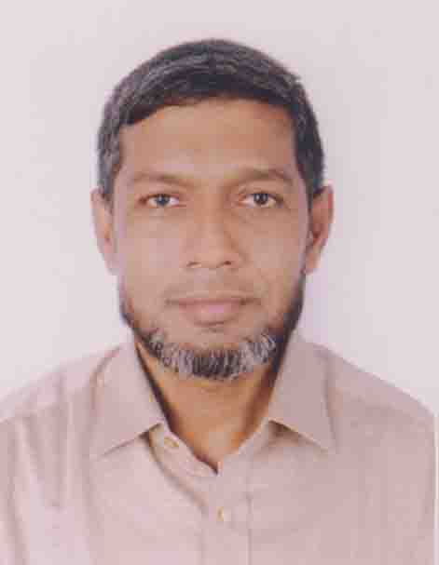
Identity
Md. Abdul Motalab
ENGLISH
Police Lines School and College, Rangpur

Slide 3
WHAT ARE THE STUDENTS DOING HERE?

Slide 4
Our Topic is
Exercise on Cloze test with clues

Slide 5
Learning outcomes
After completing this lesson, we will be able to –
prepare for the S.S.C examination
Notes:
Aim of this lesson.

Slide 6
sauce | manpower | explore | provide | employment | densely
recreation | necessary | different | across | solution | unemployment
1. Bangladesh is a (a) ----- populated country, but a large number of her people are (b) ----- It is not possible for her to ensure (c) ----- to the teeming millions. Self-employment is a possible (d) ---- to this problem. It means that people themselves should (e) ------ avenues for self-employment. Facilities for training in (f) ---- trades and vocations are available (g) ----- the country. The youths, in particular, can train themselves in any of these trades and turn into a useful (h) -----. The Govt. also (i) ------ easy loans and counseling with a view to helping them start are (f) ---- earning activity.

Slide 7
Answer-1
a) densely
b) unemployed
c) employment
d) solution
e) explore
f) different
g) across
h) manpower
i) Should provide
j) necessary

Slide 8
in | about | prosper | administer | of | the
in
2. Students’ politics hinders (a) ------ normal progress of a student. Students’ politics brings (b) ----- to a few but causes harm to many. Because (c) ----- students’ politics normal (d) ----- of a college or (e) ----- university is hampered. As (f) ----- result, it causes session jam. (g) ----- this problem of the campus students’ politics is mainly responsible. So we should think (h) ----- the necessity of student politics. Either we should advise students or we should bring (i) ----- a positive change (j) ------ this sector.

Slide 9
Answer-2
a) the
b) prosperity
c) of
d) administration
e) a
f) a
g) in
h) about
i) about
j) in

Slide 10
in | for | of | life | a | the
in | for | of | life
3. Youth is (a) ----- best time of (b) -----. This is the time (c) ----- it is most important (d) ------- one to remember the maxim, “As you (e) ------ , so shall you reap.” One must sow (f) ------ seeds of industry, truthfulness, honesty and other virtues (g) ------ this season to (h) ------- the harvest of prosperity and happiness. Whatever takes root in (i) ------ man at this time lasts throughout the rest (j) ------ his life and moulds his future.

Slide 11
Answer-3
a) the
b) life
c) when
d) for
e) sow
f) the
g) in
h) reap
i) a
j) of

Slide 12
to | a | wonder | without | the | communicate
to | a | wonder | without | the
4. Mobile phone is one of the (a) ------ of modem science. It has added (b) ------ new dimension (c) ------ our way (d) ------ life and to (e) ------ communication system. It is a telephone system that works (f) ------any wire. Obviously, mobile telecommunication has become (g) ------ part of modern life. Nowadays, (h) ------ a mobile phone is not a luxury (i) ------ a poor country like Bangladesh. People use mobile phones to do rapid (j) -----

Slide 13
Answer-4
a) wonders
b) a
c) to
d) of
e) the
f) without
g) a
h) keeping
i) in
j) communication

Slide 14
of | fear | with | a | in | get
of
5. A good man is (a)-------man of character. His polite behavior is (b)-------great asset because he can win the heart (c)-------other people around him, no matter whether he is rich or poor. He also (d)-------the admiration (e)-------all he deals with. He behaves well (f)-------even those who are rude towards him because he hates to behave rudely. One who pretends to be polite cannot be polite (g)-------all circumstances. But (h)-------man who is really polite does not (i)-------anybody whatever be (j)-------provocation.

Slide 15
Answer-5
a) a
b) a
c) of
d) gets
e) with
f) with
g) in
h) a
i) fear
j) the

Slide 16
give | a | symbol | to be | by | last
give | a | symbol | to be
6. A flower is (a)--------best gift of nature. It is a (b)--------of purity and beauty. It (c)--------us pleasure. There is nobody (d)--------loves a flower. But it is (e)--------matter of sorrow that a flower does not (f)--------long. It blooms (g)--------the morning and fades away very soon. Nowadays flowers (h)--------cultivated in our country. Many people earn their livelihood (i)--------flower (j)--------.

Slide 17
Answer-6
a) the
b) symbol
c) gives
d) but
e) a
f) last
g) in
h) are being
i) by
j) cultivation

Slide 18
up | an | and | useful | from | a
up | an
7. There is a close relationship between man (a)---------nature. Man has established (b)---------friendship with nature. It helps us (c)---------many ways. Similarly trees are closely related (d)---------our life. Trees play (e)---------important role in our life (f)---------economy. Trees are very (g)---------to us. We get oxygen (h)---------them. They are (i)---------great source of food and vitamin. They meet (j)---------our local demands.

Slide 19
Answer-7
a) and
b) a
c) in
d) to
e) an
f) and
g) useful
h) from
i) a
j) up

Slide 20
of | for | in | enquire | remember | a
the | about | freedom | forget | dying | supreme
8. Our freedom fighters are (a) ----- real heroes of our country. We should (b) ----- them as sacrificed their lives (c) ----- the greatest cause of the country. It is (d) ----- matter they of great sorrow that most (e) ----- them are forgotten. Our young generations do not know about their (f) ----- sacrifice. Now many real (g) ----- fighters are living (h) ----- hardship. Some of them are also (i) ----- pathetically. We should (j) ----- about them and give them honour

Slide 21
Answer-8
a) the
b) remember
c) for
d) a
e) of
f) supreme
g) freedom
h) in
i) dying
j) enquire

Slide 22
forward | at | up | in | move | a
forward | at
9. Traffic jam is (a) ------- problem in all towns and cities (b) ------- Bangladesh. It occurs where (c) ------- mass of vehicles crowd so close together that (d) ------- becomes impossible (e) ------- sometimes. It is more common where (f) ------- streets are narrow and have many bends. Weak traffic control system is also largely responsible (g) ------- it. Traffic jam is very vexatious and time killing. When caught in a traffic jam we simply get struck (h) ------- at one place. We cannot move (i) ------- we cannot move backward either. We have to wait and look repeatedly (j) ------- our watch.

Slide 23
Answer-9
a) a
b) in
c) the
d) movement
e) for
f) the
g) for
h) up
i) forward
j) at

Slide 24
in | the | preserve | a | grow | out
in | the | preserve
10. Students should observe (a) ------ laws of health. They should, rise (b) ----- the bed early (c) ----- the morning and go (d) ----- for (e) ----- walk. Besides these, they should take care to perform all these things which are useful for the (f) ----- of health. These are essential (g) ------ their physical and mental (h) ----- They should also follow (i) ------ rules of health because health is (j) ----- root of all happiness.

Slide 25
Answer-10
a) the
b) from
c) in
d) out
e) a
f) preservation
g) for
h) growth
i) the
j) the

Slide 26
Thank You
Notes:
Ending slide.

