Slide 1
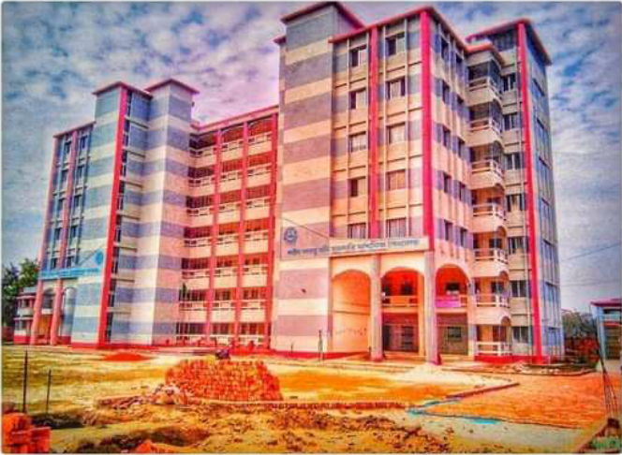
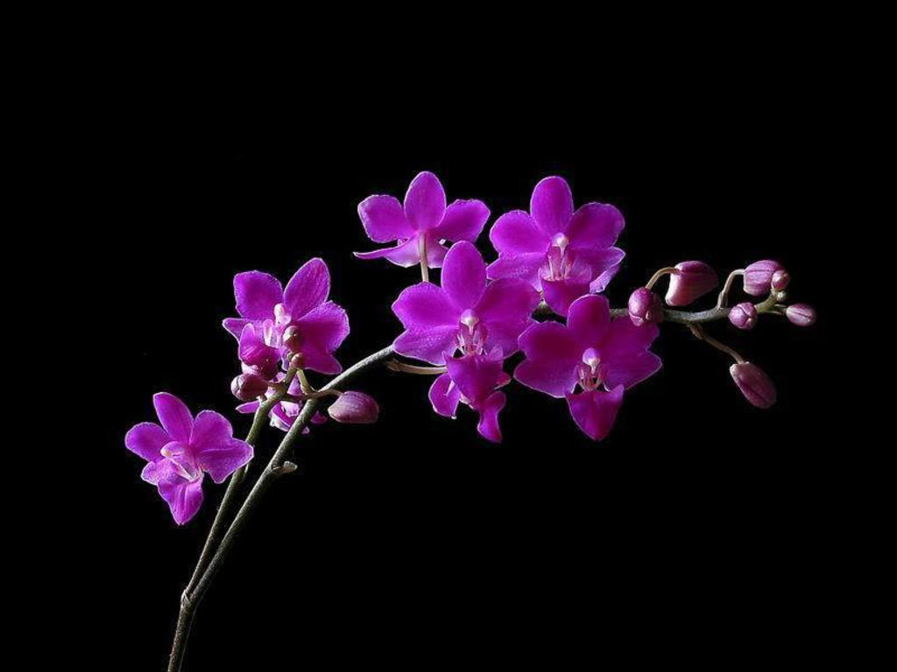
My dear
Students
Welcome
To TKS English Grammar Class

Slide 2
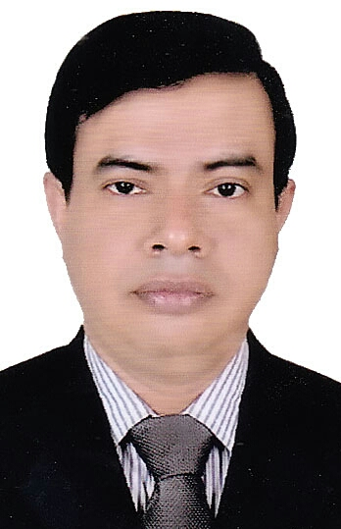
Introduction
Tapash Kumar Shil
English Teacher
Shahid Arju Moni Government Secondary School, Barishal.
Cell: 01733422388/01915017386
Email: teachertapash@gmail.com
YouTube channel: Tapash Kumar
Class-VIII
Subject: English 2nd Paper
Grammar Part: Transformations (Affirmative to Negative)
Lesson-03
Notes:
Introduction of the teacher and the class.

Slide 3
What we have already learnt
We have learnt –
1. About Transformation.
2. Types of Transformation
3. Details of Assertive, Interrogative, Imperative, Optative and Exclamatory Sentences.
4. We have also learnt 21 rules to transform the Affirmative Sentences to Negative.
I have told you-We will learn 40 rules.
So, what will we learn new today?

Slide 4
Today’s Lesson
Rules of transformations
Specifically, we will learn another 19 new rules to transform sentences into Negative from-
Affirmative Sentences with Very, greatly etc+ Adj.
Affirmative Sentences with Sub. + Fail/Failed to
Affirmative Sentences with Many/a few
Affirmative Sentences with A little/little/much/few
Affirmative Sentences with Last----at/on
Affirmative Sentences with By + Gerund
Affirmative Sentences with Last---ago

Slide 5
Rules Of Transforming sentences from Affirmative to Negative & vice-versa
Sl. | Affirmative | Negative
22 | very, greatly, highly, extremely etc. | Not at all

Slide 6
Rules Of Transforming sentences from Affirmative to Negative & vice-versa
Sl. | Affirmative | Negative
23 | Fail(s) to Failed to | Cannot/do not/does not Could not/did not

Slide 7
Rules Of Transforming sentences from Affirmative to Negative & vice-versa
Sl. | Affirmative | Negative
24 | Many A few | Not a few Not many

Slide 8
Rules Of Transforming sentences from Affirmative to Negative & vice-versa
Sl. | Affirmative | Negative
25 | A little | Not much
26 | Much | Not a little
27 | Little | No
28 | Few | No

Slide 10
Rules Of Transforming sentences from Affirmative to Negative & vice-versa
Sl. | Affirmative | Negative
29 | Normal Affirmative Sentence | It is not that + Sentence-Gi Negative

Slide 11
Rules Of Transforming sentences from Affirmative to Negative & vice-versa
Sl. | Affirmative | Negative
30 | Last—at/on + time | Present Perfect + Since

Slide 12
Rules Of Transforming sentences from Affirmative to Negative & vice-versa
Sl. | Affirmative | Negative
31 | Last---ago | Present Perfect----for

Slide 13
Rules Of Transforming sentences from Affirmative to Negative & vice-versa
Sl. | Affirmative | Negative
32 | Present Perfect-- forever/for good | Future Indefinite—never--again

Slide 14
Rules Of Transforming sentences from Affirmative to Negative & vice-versa
Sl. | Affirmative | Negative
33 | Past Indefinite –– for the last time | Past Indefinite/Present Perfect—never--again
Notes:
Note: Present Perfect Tense can be used in Negative Form.

Slide 15
Rules Of Transforming sentences from Affirmative to Negative & vice-versa
Sl. | Affirmative | Negative
34 | Both of | None of
35 | The last + Noun | No new

Slide 16
Rules Of Transforming sentences from Affirmative to Negative & vice-versa
Sl. | Affirmative | Negative
36 | Adjective/adverb | Opposite words

Slide 17
Rules Of Transforming sentences from Affirmative to Negative & vice-versa
Sl. | Affirmative | Negative
37 | By + Gerund | Without + Gerund

Slide 18
Rules Of Transforming sentences from Affirmative to Negative & vice-versa
Sl. | Affirmative | Negative
38 | If + Affirmative | If + Negative

Slide 19
Rules Of Transforming sentences from Affirmative to Negative & vice-versa
Sl. | Affirmative | Negative
39 | Or | If + Negative

Slide 20
Rules Of Transforming sentences from Affirmative to Negative & vice-versa
Sl. | Affirmative | Negative
40 | Some | Not many

Slide 21
Class work
Take your writing pad and transform the following Affirmative sentences into Negative:
01. He is greatly honorable to all.
02. He last came here on Monday.
03. He goes to school.
04. It is the last decision.
05. He has left Dhaka forever.

Slide 22
Class work
Now check your answers:
01. He is not at all unhonorable to anybody.
02. He has not come here since Monday.
03. It is not that he does not go to school.
04. No new decision will be taken.
05. He will never come to Dhaka again.

Slide 23
Home work
Write down the following and transform them into Negative:
01. They are greatly impressed.
02. He failed to complete the work.
03. There is little water in the pot.
04. She has gone there for ever.
05. Both of them are lazy.
06. By attending the classes, you will succeed.
07. If you study hard, you will get GPA-5.
08. Some people were present in the meeting.
09. Move or you will be punished.
10. He never came here again.

Slide 24
No more today
God bless you.

Slide 25
THE END

