Slide 1
WELCOME

Slide 2
Presented by –
Md. Arif Hossain
Assistant teacher
Tamai Bazar GPS
Belkuchi,Sirajgonj

Slide 3
Introduce lesson –
Class – Four
Subject – English For Today
Lesson – 11
Page - 37
Time - 45 minutes

Slide 4
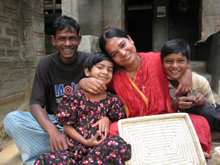
Previous knowledge test –

Slide 5
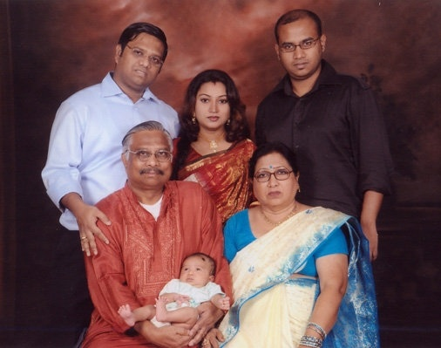

Slide 6
Topic of the lesson –
Sagar and His Family
Part of the lesson –Sagar is----------neighbourhood.

Slide 7
Learning outcomes –
By the end of the lesson students will be able to –
4.2.1 – enjoy and understand simple stories.
3.1.2 – ask and answer Wh questions.
1.4.1 – read words,phrases and sentences in the text.
8.1.1 – make sentences using words.

Slide 8
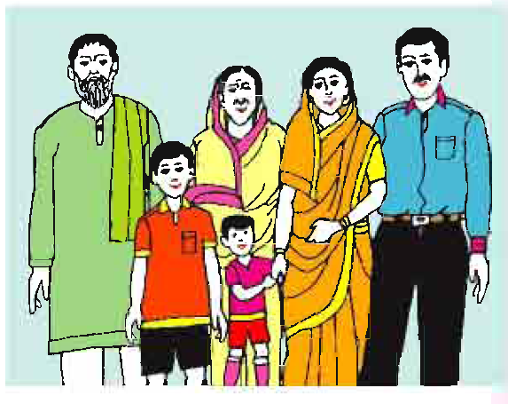
Sagar’s family

Slide 9
Father
Mother
Grandma
Grandpa
A Family
Brother
Housewife
Teacher
Sister

Slide 10
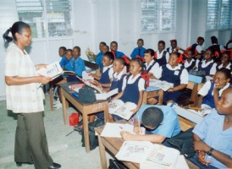
Teachers reading -

Slide 11
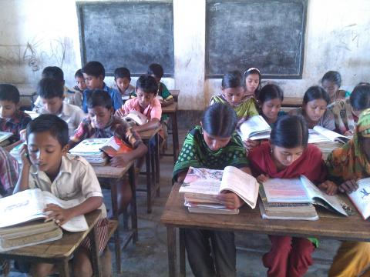
Student’s reading -

Slide 12
Find out new words -

Slide 13
Family
We live in a family

Slide 14
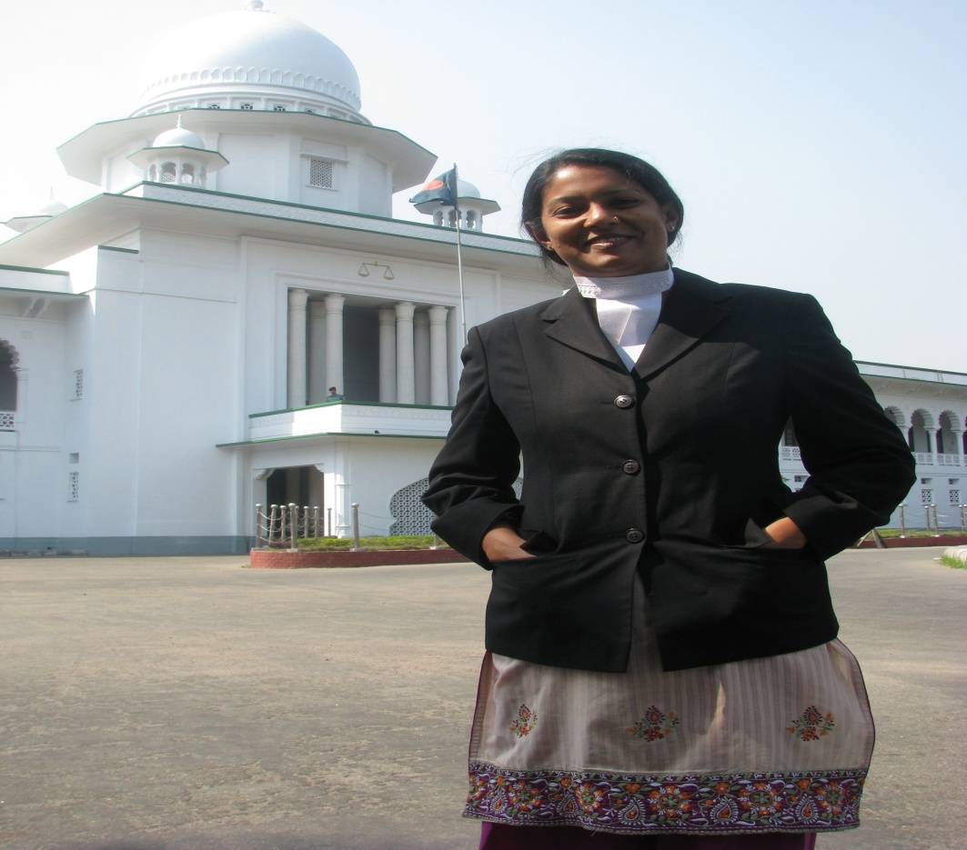
Lawyer
His mother is a lawyer.

Slide 15
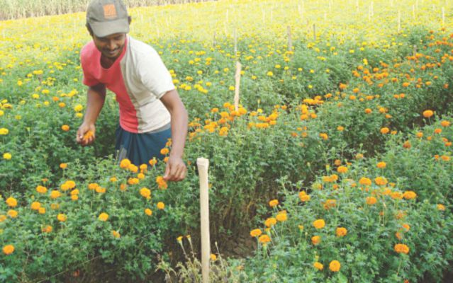
Garden
He makes a garden.

Slide 16
Individual work
Fill in the gaps –
Sagar is a------ of class four.
His father is a -------.
His grandfather was a --------.
student
lawyer
teacher

Slide 17
Pair work -
Answer the questions –
a)How old is Sagar ?
b) What is Sagar’s mother ?
c) Who is Keya ?

Slide 18
Group work -
Make five sentences about “Sagar’s Family.”

Slide 19
Evaluation –
Make 5 sentences about your family.

Slide 20
THANKS ALL

