Slide 1
Welcome to my session

Slide 2
TEACHER’S INTRODUCTION
Mst:fatama begum Head teagher
Chalarchor Govt.Primary School.
Chatak, Sunamgong…

Slide 3
Lesson introduction:
Subject: English
Class: iv , Unit 30, Lesson:1-2
Lesson Title: Months of the year.
Time: 40 minutes

Slide 4
Learning Outcomes
Reading :
Students will able to
3.1.1 - study the calendar
Writing :
Students will able to
7.1.1 - write names of the days of the months

Slide 5
Let’s sing a song
There are thirty days………..leap year.

Slide 6
There are thirty days
in September,
April, June and November.
All the rest have thirty-one,
Except February,
which has twenty-eight days clear,
And twenty-nine in each leap year.

Slide 7
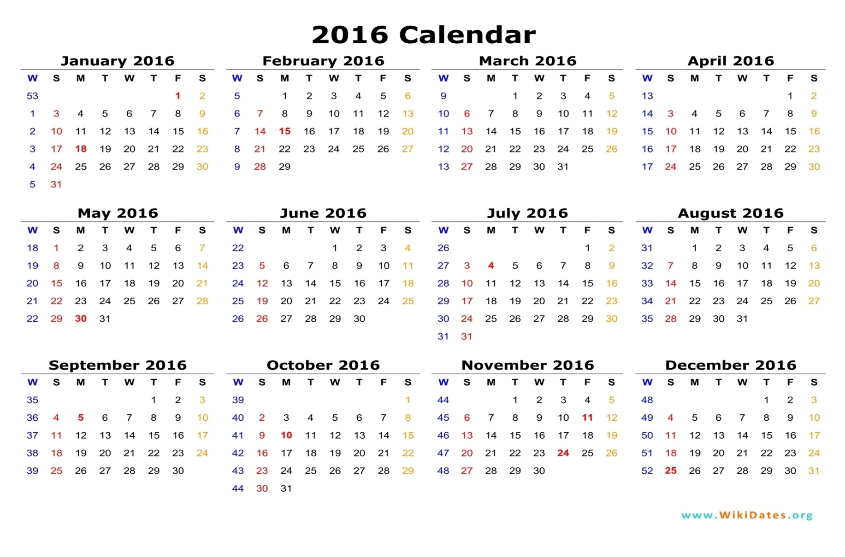
Months of the year 2016

Slide 8
2016
January
31 days
February
29 days
November
30 days
December
31 days
March
31 days
April
30 days
May
31 days
June
30 days
July
31 days
August
31 days
September
30 days
October
31 days

Slide 9
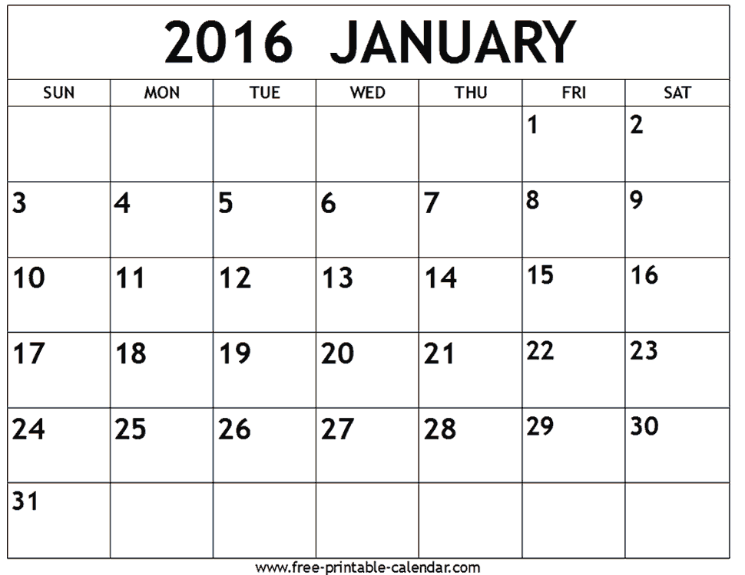
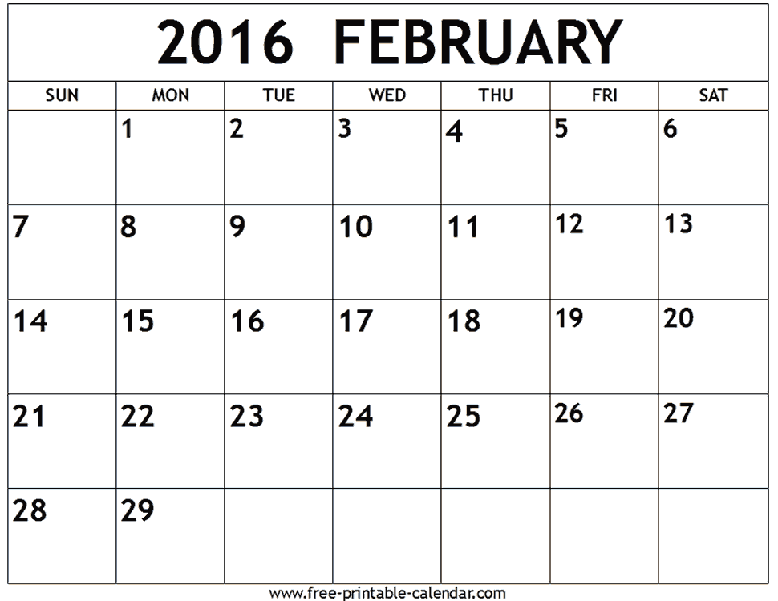

Slide 10
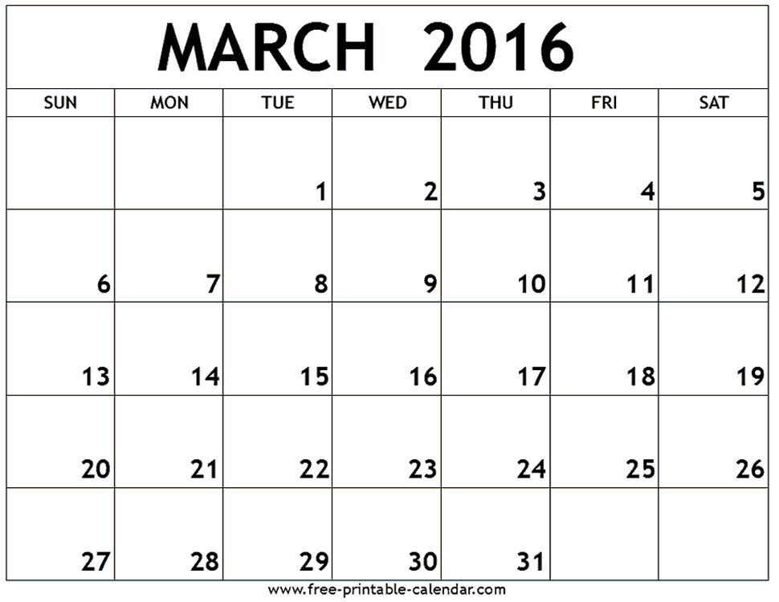
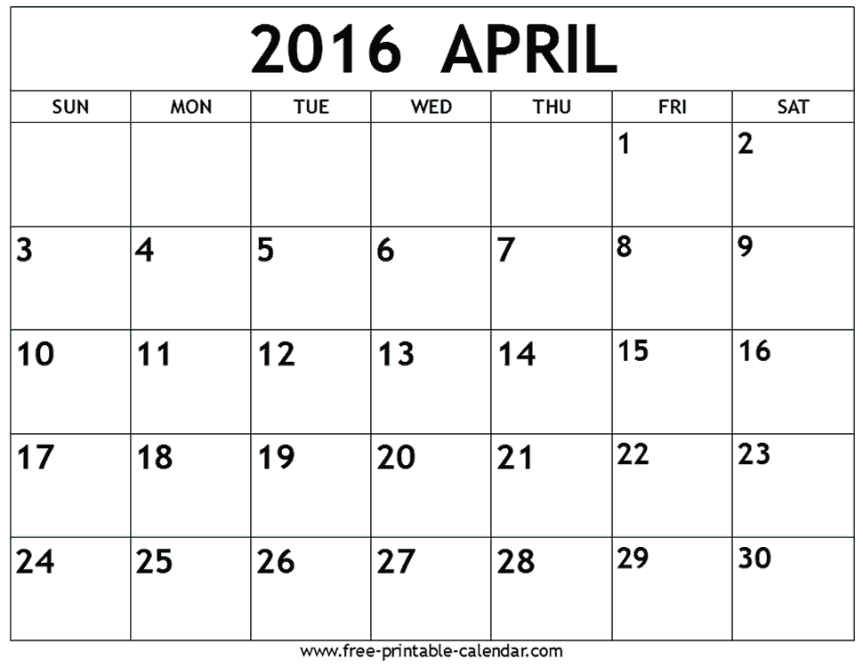

Slide 11
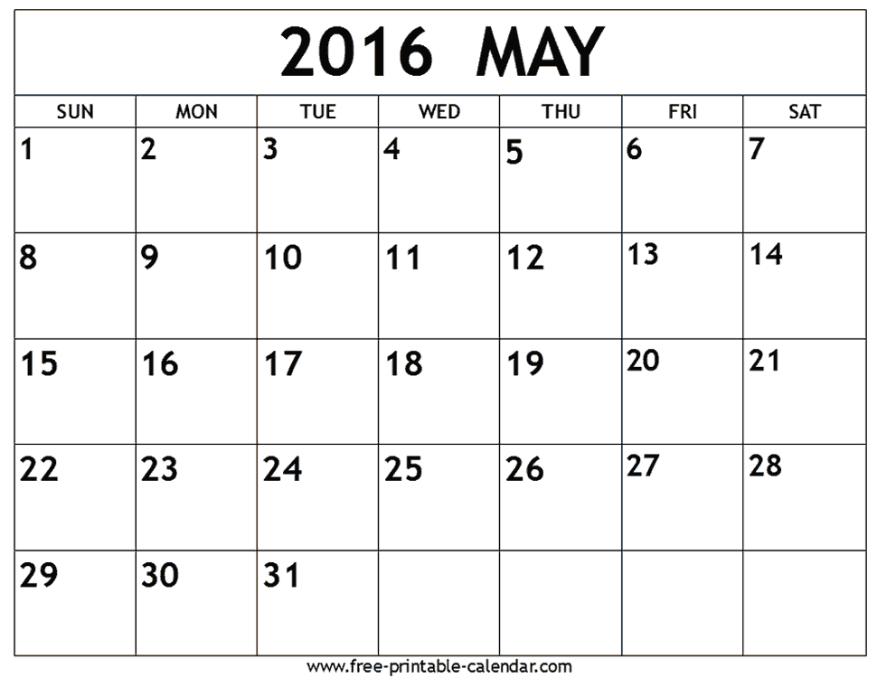
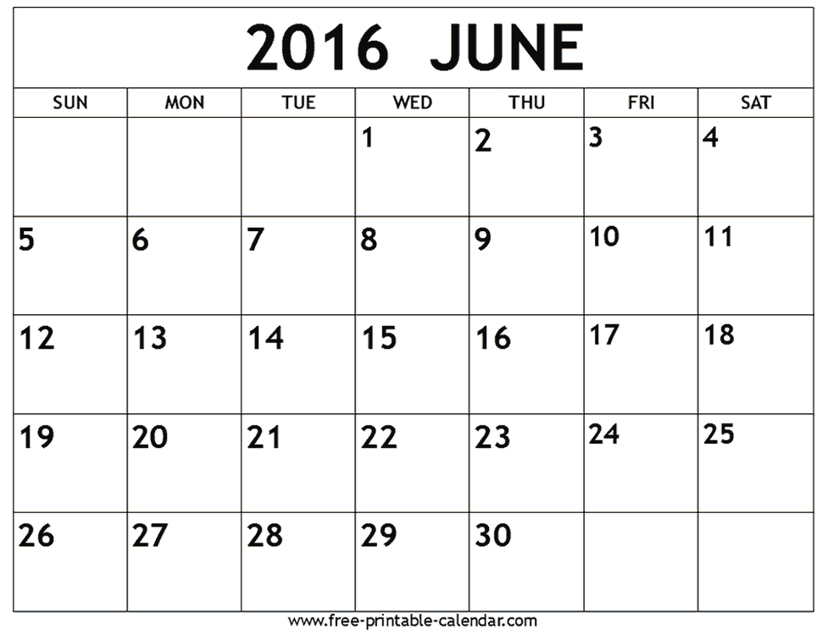

Slide 12
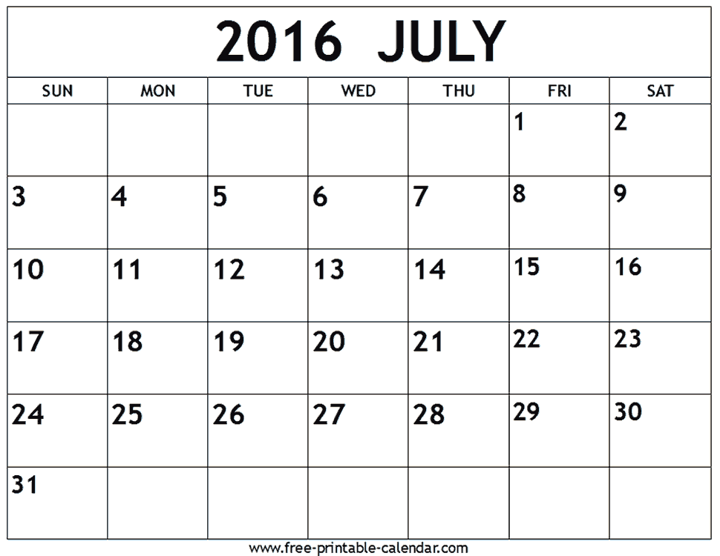
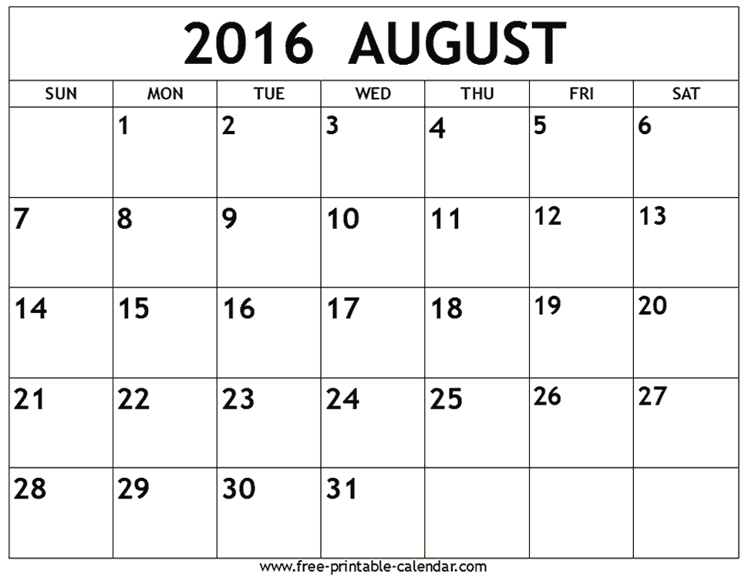

Slide 13
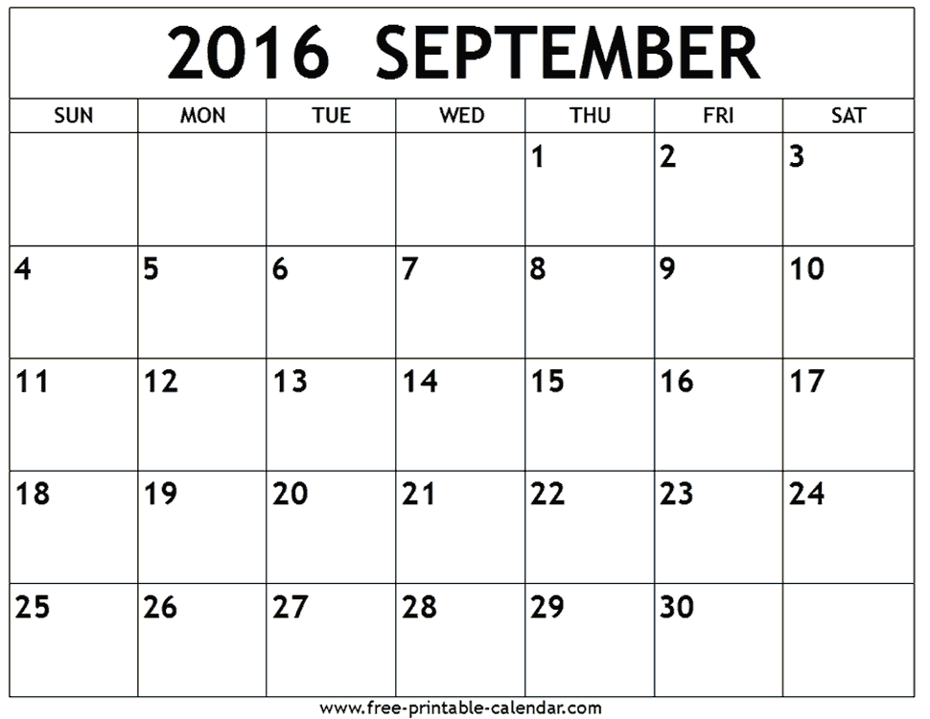
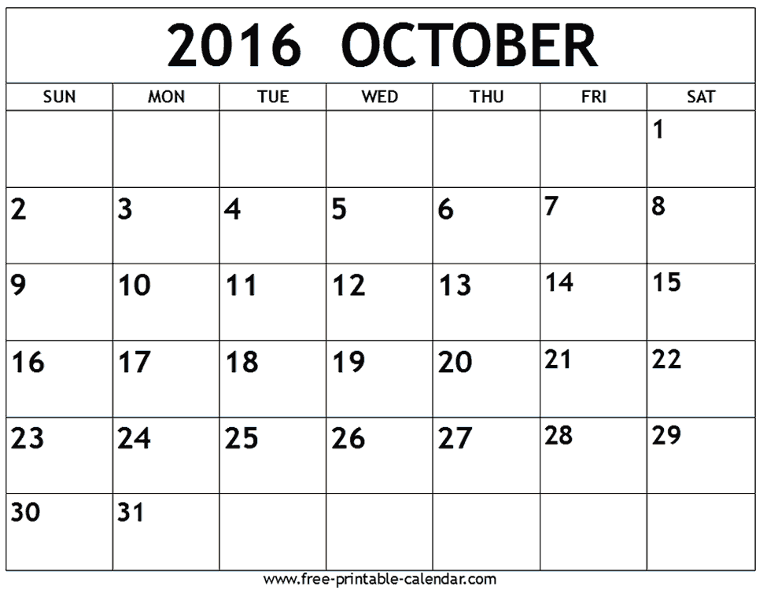

Slide 14
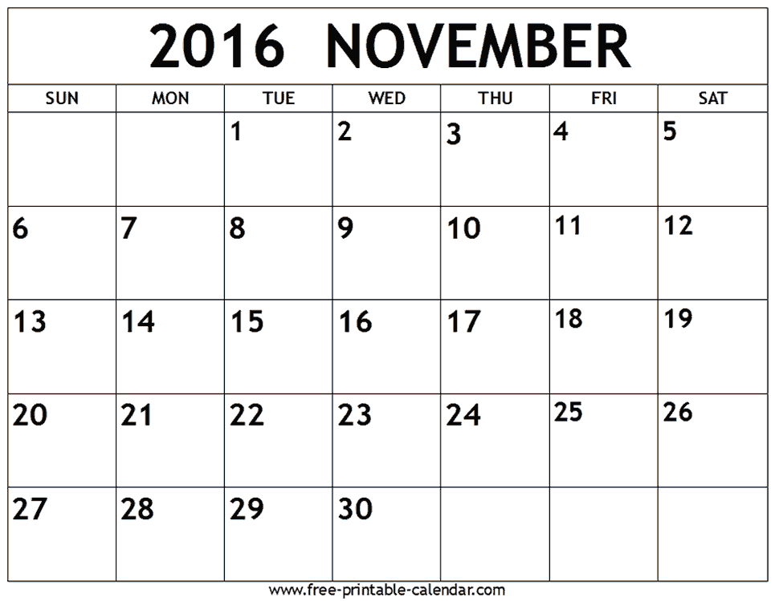
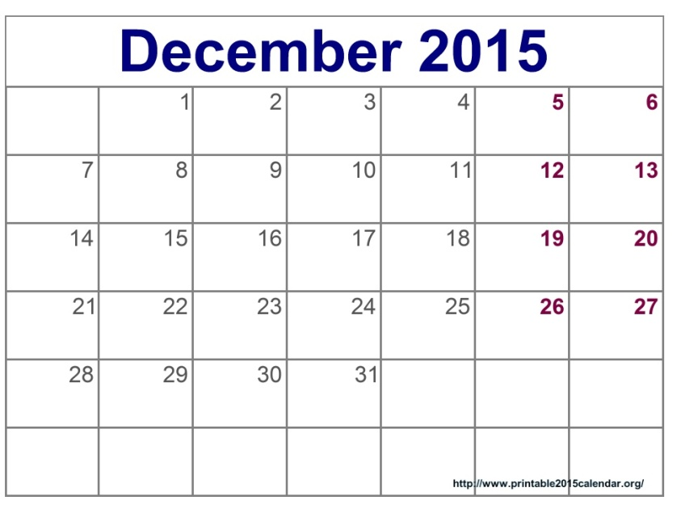

Slide 15
Let’s work in pair
1. How many months are there in a year ?
Answer : 12 months.
What month is it now ?
Answer : September.
What is the name of the next month?
Answer : October.

Slide 16
Group Work
Study the Calendar
Say the names of the months and their days

Slide 17
Group-1
January = 31days
February=28/29 days
March = 31days
April = 30 days

Slide 18
Group-2
May = 31days
June = 30 days
July = 31days
August = 31days

Slide 19
Group-3
September = 30 days
October = 31days
November = 30 days
December = 31days

Slide 20
Evaluation
1. How many months are there in a year ?
2. Say the name of the months of year ?
3. Say the name of the days of week ?

Slide 21
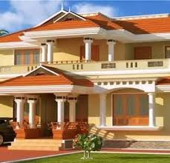
Home work
SSSSSSSSSSSSSSSSSs
Write the names of the months and their days

Slide 22
Many Many Thanks

