Slide 2
Presented By,
Md. Abdur Rouf
Lecturer in English
Khalna Islamia Fazil(Degree)Madrasah Patnitala,Naogaon. Email:rouf301285@gmail.com

Slide 3
Subject Introduction
Subject : English 1st paper
Unit : Five (Adolescence)
Lesson : 01 (The storm and stress of Adolescence)
Time : 50 Minutes

Slide 4
Learning Outcomes-
At the end of the lesson, you will be able to
Describe pictures of different ages and attitudes.
Explain the usual problems of adolescence.
Tell new words and their meanings.
Explain how to develop the attitudes of adolescents.

Slide 5
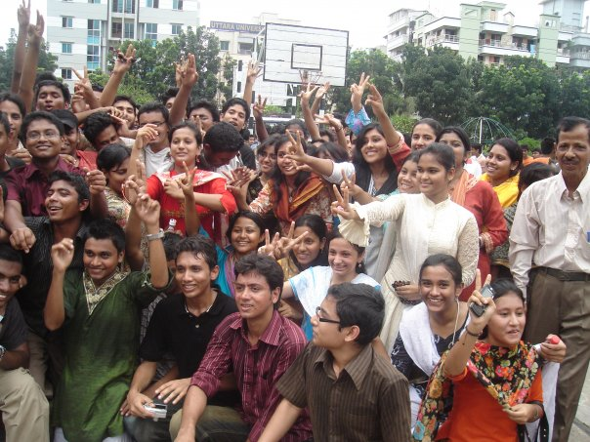
Cheering boys and girls …..……..

Slide 6
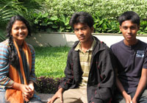
Gossiping boys and girls …..……..

Slide 7
Stressing ……………

Slide 8
Today’s Lesson?
[Adolescence]
(The storm and stress of Adolescence)

Slide 9
Guess the age of the infant ….
Birth to age 2
Birth to age 3
Birth to age 4

Slide 10
Birth to age 2 is called infancy.

Slide 11
Guess the age of the children ….
3 to 5 years
3 to 6 years
3 to 8 years

Slide 12
3 to 8 years is called childhood.

Slide 13
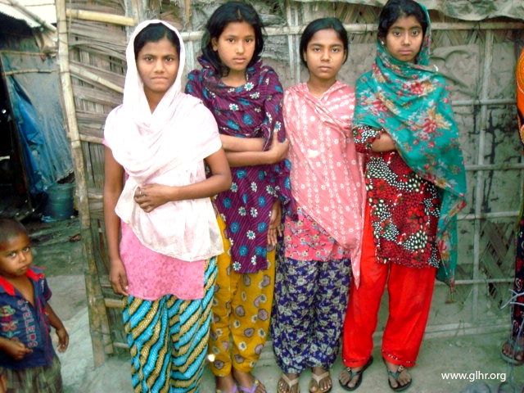
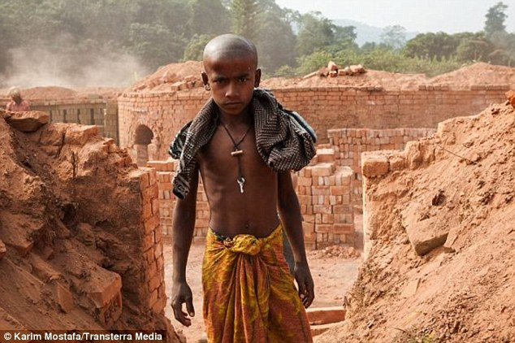
Guess the age of the children ….
9 to 15 years
9 to 12 years
9 to 10 years

Slide 14
9 to 12 years is called late childhood.

Slide 15
Guess the age of the boys & girls ….
12 to 13 years
11 to 14 years
13 to 18 years

Slide 16
13 to 18 years is called adolescence.

Slide 17
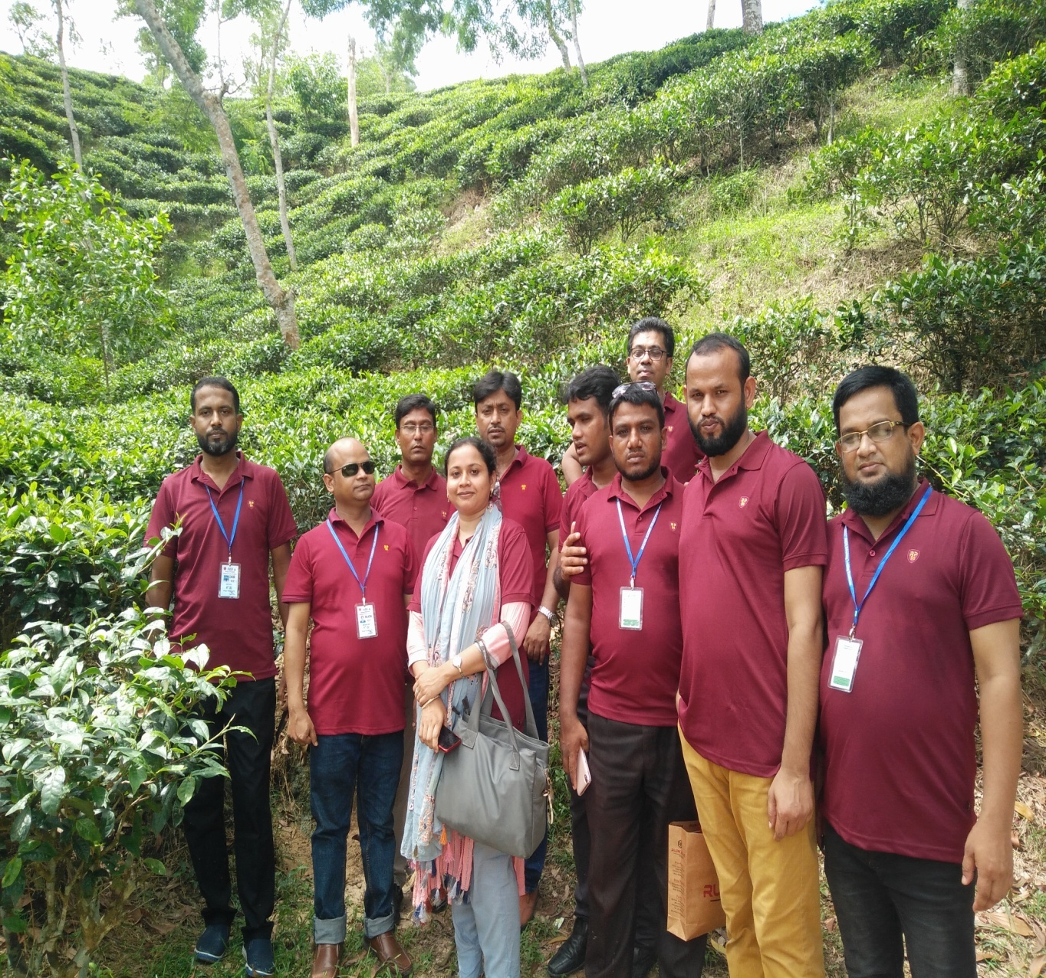
Guess the age of the persons…
12 to 13 years
15 to 18 years
18 and over years

Slide 18
Over 18 years is called adult.

Slide 19
Pair Work
Write synonyms & antonyms of the following words.

Slide 20
Now, match your answer …..
Words
Synonym
Antonym
Transition -
Change
preservation
Maturation -
Improvement
Decline
Intervene-
Interfere
Leave alone
Puberty -
Adolescence
Adult
Intentional -
Deliberate
Unintentional
Potential -
Capability
Inability

Slide 21
Home Work
Write a paragraph on how to develop the attitudes of the adolescents.

