Slide 1
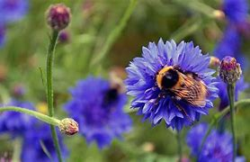
welcome

Slide 2
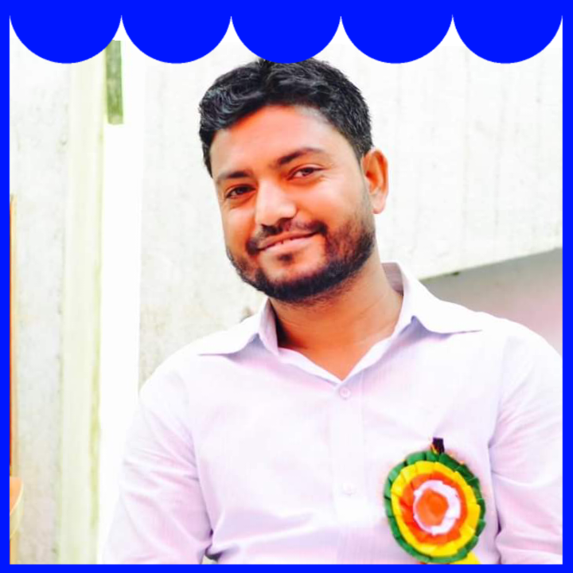
Teachers Identification
Md. Al Amin
Assistant Teacher
Kaitkuna Govt. Primary school
Alamin4bd@gmail.com

Slide 3
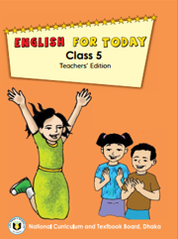
Lesson Identification
Class - 5
Sub – English
Unit – 5-6
Lesson – (H)
Activity -A

Slide 4
Try to Answer
Have any of you watched any international sports competition on television?
What is your favourite sports?
What do you know about international sports competition?
Have you heard of the Olympic Games?

Slide 5
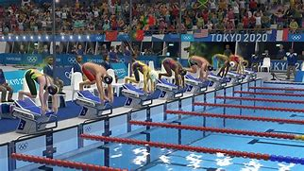
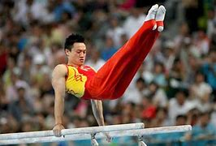
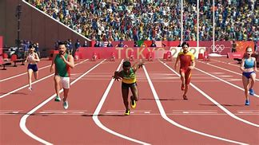
Let’s watch a video
https://youtu.be/EpeSSMuWqis

Slide 6
Olympic Games
Today’s Lesson is :

Slide 7
Learning Outcome
Students will be able to…
1
1.5.1 read words, phrases and sentences in the text
2
3
3.1.2 write, words, phrases and sentences using non-cursive small letters..
3.3.1understand questions about objects around them.

Slide 8
This flag is used in Olympic Games.
Circles mean everyone is organized.
The colors that are in the flag are taken from the color of the flag of the countries which participated in the first Olympic Games.
Have you seen this flag before?

Slide 9
Word | Meaning
Nation | Country
Participate | Take part
Competition | a contest for prize
Hold | Arrange
New Words

Slide 10
Please open page no 68 of textbook.
Connection with Textbook

Slide 11
The Olympic Games is the biggest sports competition in the world. The Olympics are held every four years in a different host city. More than 200 nations send a total of 13,000 athletes to compete in more than 30 different sports.
The first Olympic Games were held in Greece almost 3,000 years ago. The modern Olympic Games started in 1896, and there have been 31 Olympic competitions since then.
Teacher’s Reading

Slide 12
Students , please read
the text silently
and try to understand.
Silent Reading

Slide 13
Everyone practice reading in pair.
Pair Work

Slide 14
Participate
- I participated in our last annual sports Programme.
Pair Work
Compete
- He competed with many candidates.
Competition
Make sentences from the following words
-Yesterday I enjoyed a football competition.

Slide 15
What do we mean by Olympic Games?
Evaluation
Where were the first Olympic Games held?
How many Olympic Games have been held so far?

Slide 16
Home Work
Find the new words and make sentences with them.

Slide 17
Goodbye

