Slide 1
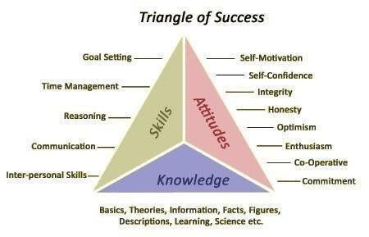
Welcome to the presentation
Knowledge , Skills and attitudes

Slide 2
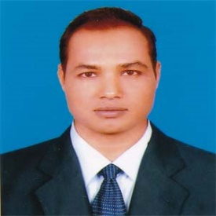
Introduction
Md. Mizanur Rahman
B.A.(Hons.), M.A. in English, B.Ed.
Assistant Teacher
Police Lines School and College, Pabna.
E-mail: mizanplsc@gmail.com
Phone No. 01737979719
Class: X
Subject: English 1st Paper
Unit: One (Good Citizens)
Lesson: Two
Lesson Title: Knowledge, Skills and attitudes
Class Duration: 40 minutes
Date: 07/09/2020

Slide 3
Discuss in groups the possible answers to the questions. Then read the text in B and answer the questions.
What else do you need in addition to food , shelter and company to become a good citizen?

Slide 4
Today’s Lesson
Knowledge, skills and attitudes

Slide 5
Learning Outcomes
At the end of the lesson, the students will be able to:
read and understand text .
write the answer of questions.
Choose the write answer.
write a short paragraph about how to make drinking water sage and its importance.

Slide 6
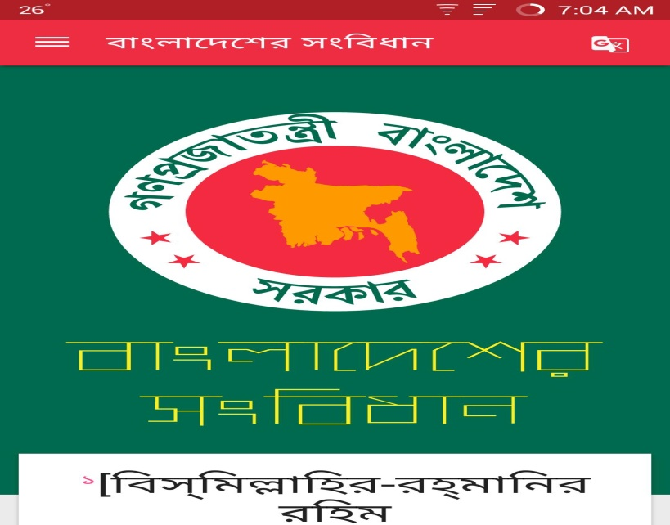
Key words presentation
Word: Constitution
Noun
Synonym: Code, legislation
Meaning: the system of laws and basic principles go govern a country.
Example: As a good citizen we have to know about the constitution of our country.

Slide 7
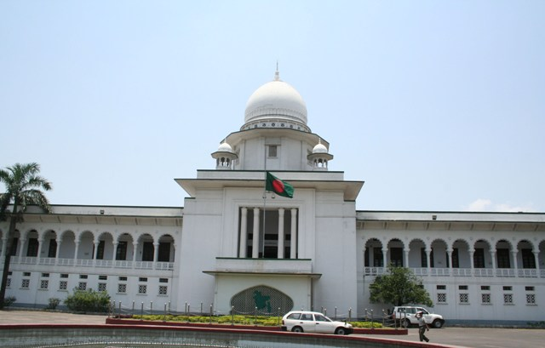
Word: Judicial
adjective
Synonym : legal, judiciary
Meaning: relating to the administration of justice
Example: It is also very essential to know about the judicial system of a country.

Slide 8
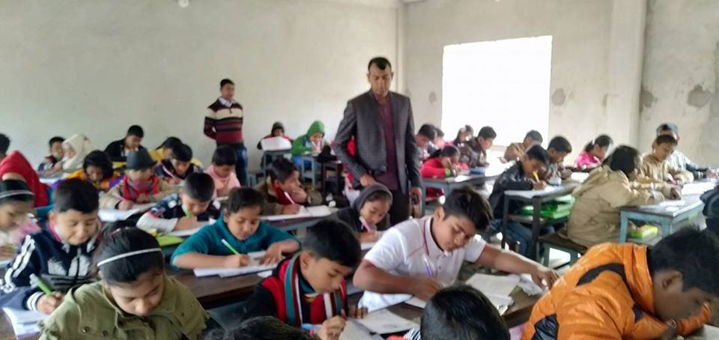
Word: Monitor
Verb
Meaning: to observe and check the progress of someone or something.
Example: Monitoring is very essential to make a fruitful class.

Slide 9
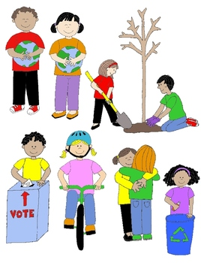
Read the text .
To be good citizen, you have to prepare yourself to do good work in society. Well , then how can you prepare yourself ?
First, you need knowledge. Today’s society is knowledge- based. Without having knowledge of modern sciences, technologies including ICT and other necessary subjects, you will have difficulty living a good life.

Slide 10
The other areas you, as a good citizen, should have knowledge about are:
Our country, its constitution, geography and people
Our state, its executive and legislative powers
Our judicial system
Our government and its structures and functions
Our history, cultures, traditions, literature, moral values and religions
Our socio- economic activities and educational system

Slide 11
Second, you need skills to do things. Knowledge is not enough. You must be able to apply your knowledge to do things practically.
Finally, knowing and doing things will bring about a change in your behaviour towards others. This behavioural change will show your attitudes towards others, that is , it will show how you think and feel about a person or thing.
.

Slide 12
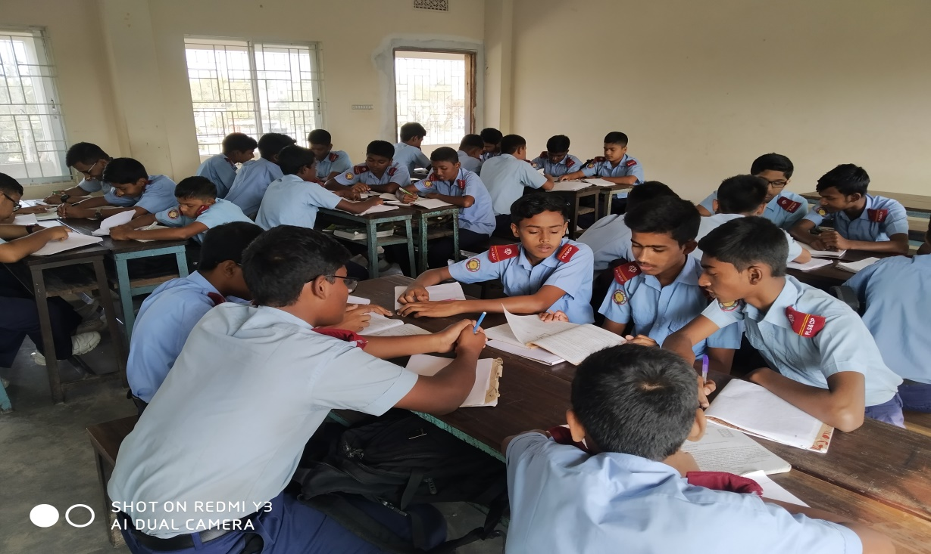
Then, you start working in groups. In each group, you take turns discussing points and answering questions. In this way, you can , actually , do the task. Your teacher may monitor and help you to do the work.

Slide 13
Let’s take an example, Suppose, you ,as a student, need to know about ‘group work’ in the classroom. So, you ask yourself or your teacher or anyone else, “What is group work?” Or you may find about it in a book. In this way, you may know, or you may have the knowledge about group work. To do group work, the class has to be divided into groups. Each group is to do some tasks given by the teacher or in the textbook. The group members will discuss and share ideas and points, and finally, one member will write the answers

Slide 14
Lastly, through regular group work it is expected that there will be noticeable changes in your behaviour. Possible changes are:
You will develop the skill of speaking freely in English with your classmates and teacher.
Your shyness will gradually disappear.
You will develop the attitude of helping and cooperating with each other.
You will learn to behave in a democratic way.
Most importantly, these behavioural changes taking place in you inside the classroom will be carried over outside the classroom in real- life situations.

Slide 15
Individual Work
Answer the following Questions
Knowledge is the first condition to be a good citizen” Do you agree? Why / Why not?
b. What do you mean by group work?
Ans. Today’s knowledge – based society demands only up – to – date persons. To be so, we need to know about science and technologies, politics, government, economics, history and so on. So, I do agree that to be a good citizen, knowledge is the first condition.
Ans. By group work, I mean doing a work not all by oneself but collectively.

Slide 16
Group Work
Discuss in groups. Write how K S A can be shown in the following topics:
K = knowledge, S = Skill and A = Attitude
Debate
Or saline
E- mail

Slide 17
Evaluation
Choose the best correct answer from the following alternatives.
1.What do you mean by ‘real – life situations’?
Empirical evidence b. practical necessity
c. Intrapersonal conflict d. fastidious attitude
2. What is attitude?
Feeling about others b. thinking about others
c. All types of changes in behaviour
d. feeling and thinking about others
3. To be a good citizen, you will have to prepare yourself to do good work in ----------------.
Classroom b. family c. School d. society

Slide 18
d. The opposite meaning of ‘democratic’ is-------------
self- governing ii. Independent
iii. Autonomous iv. Autocratic
e. What does the word ‘noticeable’ mean?
Hidden ii. Obvious iii. Manifest iv. Plain
f. At one point, a remarkable change will grow------.
In your mind ii. In your heart
iii. In your behaviour iv. In your brain
g. The word “practically’ refers to ----
Idealism ii. pragmatism
iii. Theism iv. atheism

Slide 19
Home Work:
Suppose, you have learned at school how to make your drinking water sage and when and how much you should drink it in a day. Now write a short paragraph about how to make drinking water sage and its importance.

Slide 20
Thanks to all
See you again in the next class.

