Slide 1
Welcome
Notes:
Welcome slide.

Slide 2
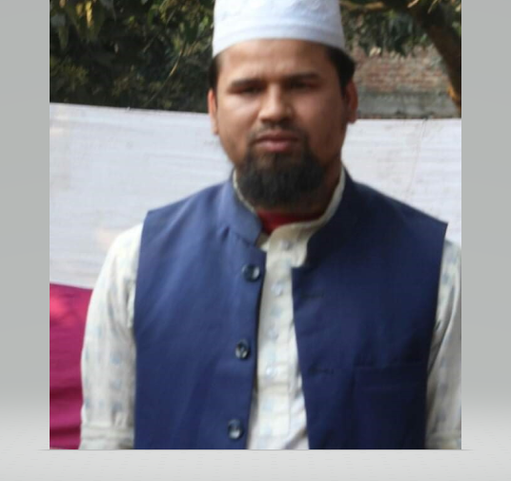
Identity
Md. Farid Uddin
Assistant Teacher
Dupchanchia D.S Fazil Madrasah
Subject : English 2nd Paper
Notes:
Identity of the teacher and class.

Slide 3
Let’s observe
Doctor’s technic
What have you observed?
No other doctor is as clever as he.
He is a clever doctor.
He is the cleverest doctor.
Notes:
1st Suspension to lead the lesson.

Slide 4
Very few doctors are as clever as he.
He is one of the cleverest doctors.
Notes:
2nd suspension to lead the lesson.

Slide 5
What is our today’s lesson?
Transformation of sentence
Positive to Superlative
Notes:
Lesson declaration.

Slide 6
Learning outcomes
At the end of this lesson, we will be able to—
identify the structure of changing positive into superlative
change positive to superlative.
Notes:
The target of this lesson is to achieve the experience of changing positive into superlative.

Slide 7
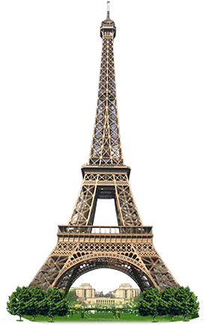
How to change simple positive into superlative.
Eiffel tower is a tall tower.
Eiffel tower is the tallest tower.
Subject +verb +the + superlative form +extension.
It is a long tower.
It is the longest tower.
Notes:
Basic structure to change from positive into superlative.

Slide 8
Cox’s Bazar is a beautiful sea beach.
Cox’s Bazar is the most beautiful sea beach.
Notes:
Changing from the normal structure of positive degree.

Slide 9
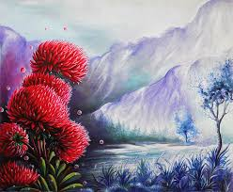
This is a charming scenery.
This is the most charming scenery.
Notes:
Changing from the normal structure of positive degree.

Slide 10
Class activities
Change the sentences into superlative.
Truthfulness is a noble virtue.
It is a valuable worldly wealth.
It is a nice possession to us.
Character is an actual glory also.
Notes:
Activities in the class for evaluation.

Slide 11
How to change positive (with ‘No other’ ) into superlative.
The Taj Mahal is the most attractive architecture.
No other architecture is as attractive as the Taj Mahal.
Sub(word after ‘as’) + verb + the +superlative form+ word after ‘No other’
Notes:
Teacher will help the students to understand the structure. Word after ‘as’ means last ‘as’ of the sentence.

Slide 12
Milk is the most nutritious food.
No other food is as nutritious as milk.
Notes:
Practice.

Slide 13
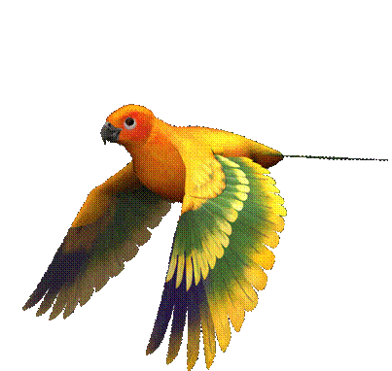
No other bird is as nice as the parrot.
The parrot is the nicest bird.
Notes:
Just for practice

Slide 14
Class activities
Change the sentences into superlative.
No other food is as harmful as junk food.
No other dish looks as attractive as it.
No other flower is as beautiful as the rose.
No other petal looks as pretty as it.
No other view is as charming as this flower.
Notes:
Activities to be done in the class as evaluation.

Slide 15
How to change positive (with ‘very few’ ) into superlative.
Very few devil’s seas are as dangerous as the Bermuda Triangle.
The Bermuda Triangle is one of the most dangerous devil’s seas.
Notes:
Plural noun and plural verb (are/were) is a must before ‘one of the’.

Slide 16
The dead sea is one of the most exceptional sea.
Very few seas are as exceptional as the dead sea.
This house is one of the most wonderful houses
Very few houses are as wonderful as this house
Notes:
Practice/feed back/evaluation

Slide 17
Home Work
Change the sentences into superlative degree
No other person is as noble as he.
Very few dramas are as popular as “Hamlet” in the world.
Very few kings of India were as great as Akbar.
No other boy is as young as Rubel in the class.
Very few people are as tall as Nasser Soomro.
Notes:
Students will solve it at home then show their teacher in the next class.

Slide 18
Thank
you
so
much

