Slide 1
Welcome TO all

Slide 2
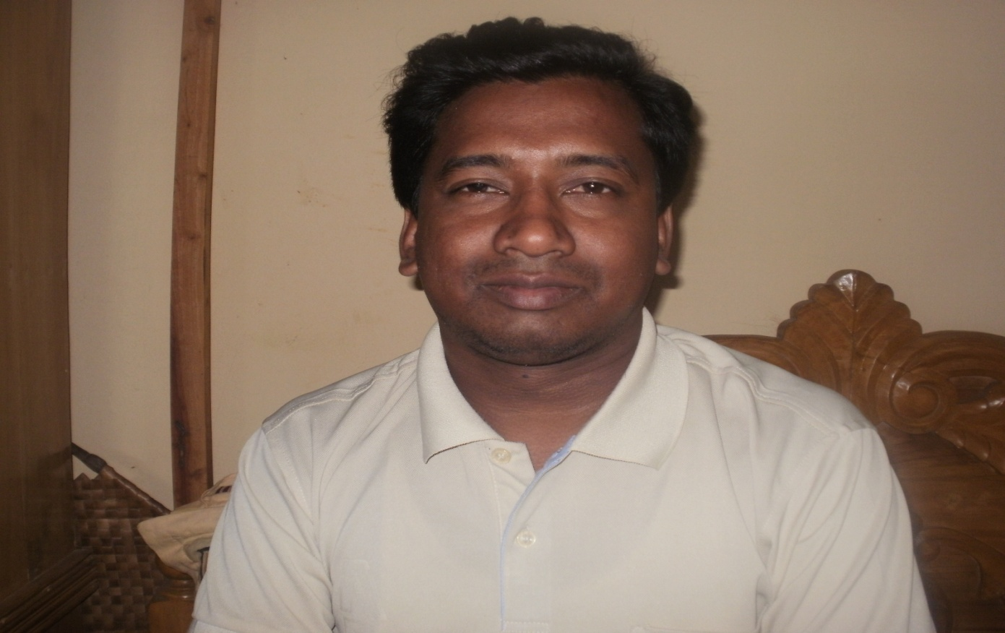
Teacher’s Identity
Rafiqul Islam
B.A (Hons), M.A (English)
Lecturer in Enghlish
Cell:01748906711
E-mail:
prof.rafiqulislam1981@gmial.com

Slide 3
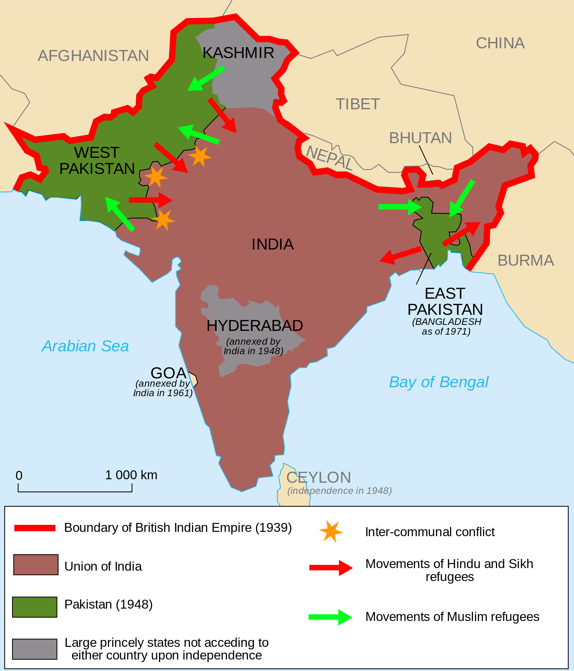
Map of divided Indian sub-continent

Slide 4
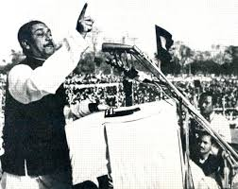
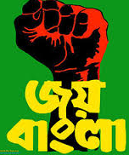
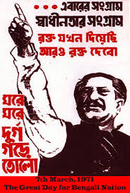
7th March 1971
Address of Sheikh Mujibur Rahman

Slide 5
The Unforgettable History

Slide 6
Learning Outcomes
After completing the text students will be able to ….
1.Identify vocabularies used in the passage
2.Comprehend the passage
3.Answer the questions after reading the passage
4.Make conversatation with fellow students on the history of Bangladesh

Slide 7
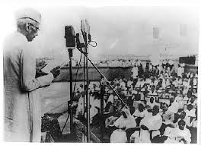
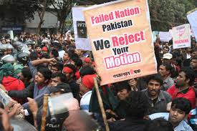
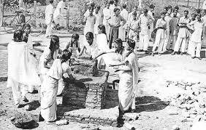
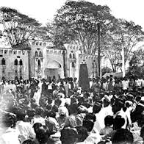
1947-1952
Mohammad Ali Jinnah declared that only Urdu will be the state language of Pakistan
Protest of Bangali people
Students are building temporary memorial
Procession of Aamtola to violate 144 act

Slide 8
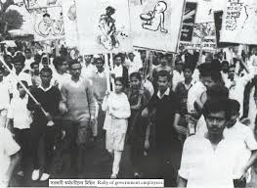
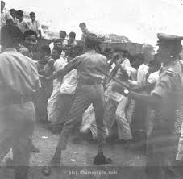
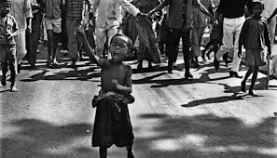
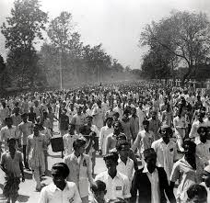
1962
Language Movement
Students’ protest
Laathi charge of Police on agitated people
A child is in front of a procession
People gathering at meeting

Slide 9
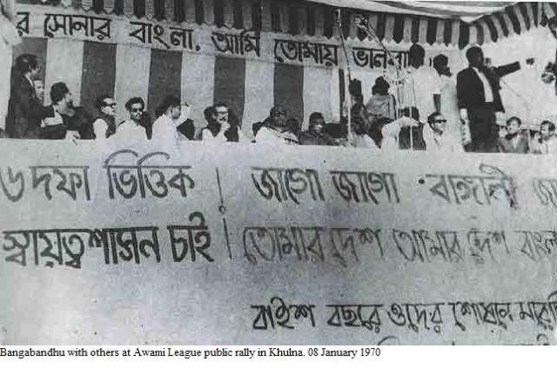
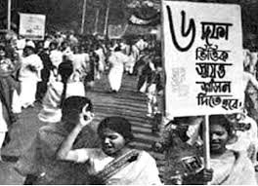
1966
6 points movement
Meeting is being held on 6 points movement
Students demanding the implementation of 6 points

Slide 10
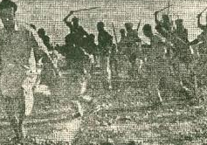
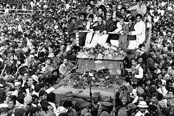
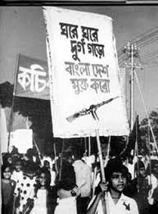
1969
Mass Movement
Procession
Laathi charge of police on mass people
Shikh Mujib,free from jail
Demonstration going on

Slide 11
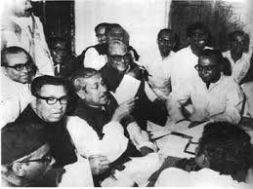
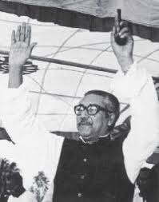
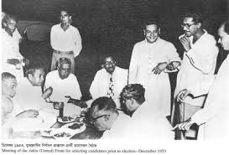
1970
National Election & victory of Awami League
Sheikh Mujib in pre-election meeting
Victory of Awami league in 1970 national Election
Sheikh Mujibur Rahman,counselling with co-workers

Slide 12
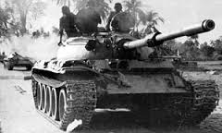
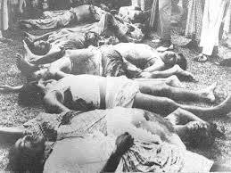
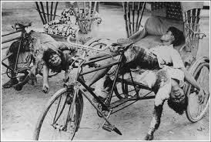
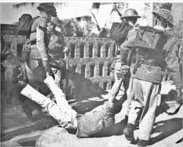
Atrocity of Pakistani army
Pakistani army deploying tank
Mass killing
Brutality of Pak army
Pak army capturing Bangalees

Slide 14
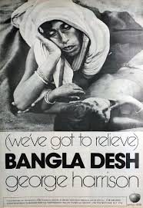
great sorrow, event causing great
sorrow
Import
We’ve understood the import of the incident
Significance, having importance of something
Vocabulary
Grief
The poor woman is grief-striken

Slide 15
Constitution
Set of laws and principles according to
which a country is governed
We must honour our constitution
Crimson
Deep red
Pak armies made our highways crimson with Bangalee’s blood

Slide 16
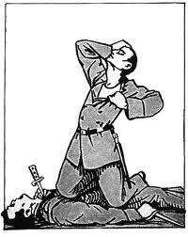
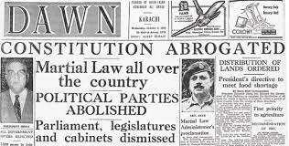
Regret
Sorrowness, be sad about something
Martial law
Military rule
Sheikh Mujib delivered the speech with regret
Ayub khan declared martial law

Slide 17
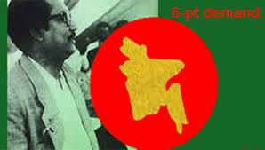
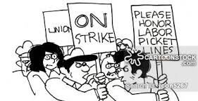
Six point movement
Six main demands of Bangali people which was proclaimed in 1966 by Seikh Mujibor Rahman
Proroughed
Assembly’s session was proroughed
postpone ; Stopping for the time being
Strike
Stopping of work as protest
Act of stopping work as protest
People welcomed 6 points movement

Slide 18
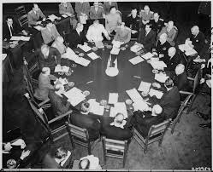
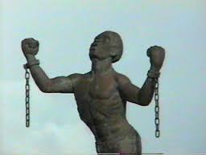
Round table conference
Conference where poitical parties’s leader meet and find a political solution through discussion
Emancipation
Economical independence

Slide 19
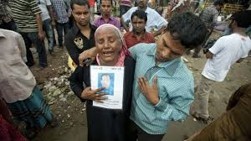
Agony
Great pain,afliction
Massacar
The woman is crying in agony
Pak army occurred massacar in1971
Mass killing

Slide 20
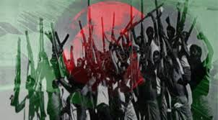
Repression
Our history with Pakistan was a history of repression
Torture
Struggle
This is the time of struggle,this is the time for freedom
Fight for achieving something

Slide 21
Individual Work
Students will read the passage silently

Slide 22
Pair Work
Students will answer the following questions after discussing with their pair:
1. Which features of the speech do you appreciate most?
2. What are the two main parts of the speech?
3.Why does Bangabandhu say that “the 23 years of our history with Pakistan is history of repression and bloodshed”?
4. How do you differentiate between ‘struggle for freedom’ and ‘struggle for emancipation’?

Slide 23
HomeTask
Directives
of
Sheikh Mujib

Slide 24
Evaluation
Who delivered the speech to Bangali nation on 7th March 1971?
Why did he address the nation?
What was Bangabandhu’s last directives in the speech?
Differenciate between “Freedom” and “Emancipation”?

Slide 25
Group Work
Read the speech again. The speech has references to some years and dates in our history. Find out their historical importance and complete the flow chart ending with 25thMarch 1971. You have to write down a paragraph on the major events leading to march 7.
25th March

Slide 26
Have a nice and successful day

