Slide 1
WELCOME

Slide 2
INTRODUCTION
Class : Three
Subject : English
Unit:35 , Lesson:1-3.
Date:
Time:
Suranjit Talukder
( BA, B-Ed; MSS, M-Ed; C-in-Ed )
Assistant teacher
Voishber Govt. Primary School.
Sunamgonj Sadar , Sunamgonj.

Slide 3
All of you are the students of class three. Please tell me, What is the relationship among yourselves with one another?
Thank you,
Classmates or friends.
Really! .
Today’s topic is “My Friend ” .

Slide 4
LEARNING OUTCOMES
Students will be able to………
Enjoy and understand simple stories.
Ask and answer simple WH and Yes/No questions.
To read silently with understanding simple sentences , paragraphs and other texts.
write short and simple paragraph by answering a set of questions.

Slide 5
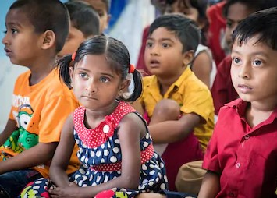
Please think about this picture and discuss in pairs.
What are the relationship between themselves?
They are friends.

Slide 6
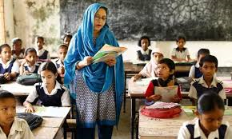
Please think about this picture and discuss in pairs.
What do you see in the picture?
Teacher and students in the classroom.

Slide 7
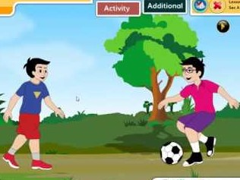
Please think about this picture and discuss in pairs.
What are they doing in the picture?
They are playing football.

Slide 8
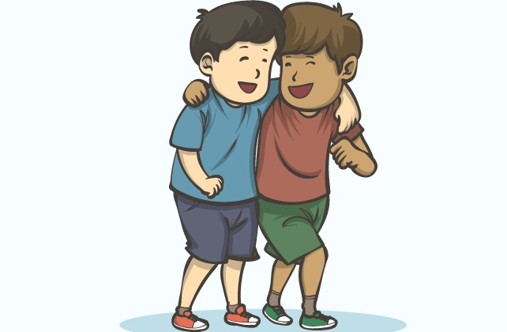
NEW WORDS MEANINGS
Friend : A good relationship.

Slide 9
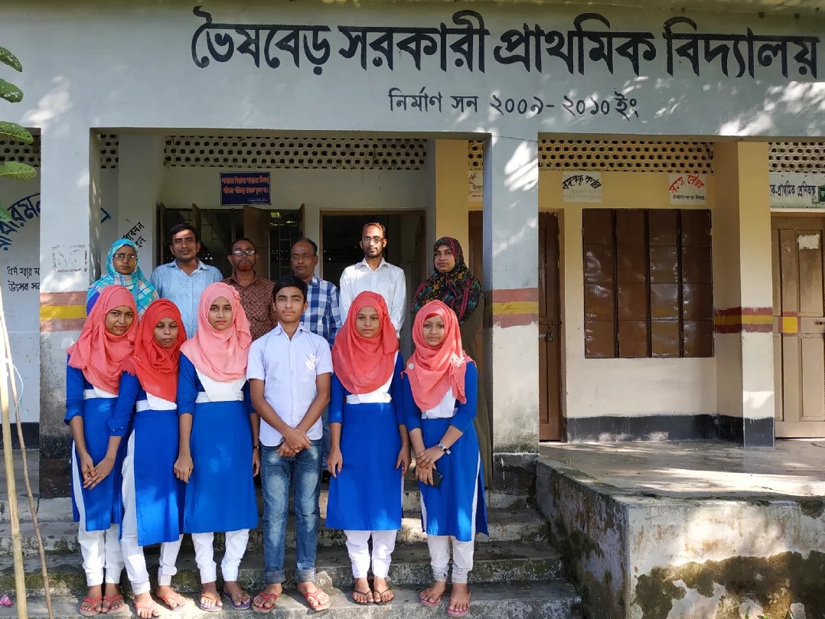
NEW WORDS MEANINGS
School : An educational institution

Slide 10
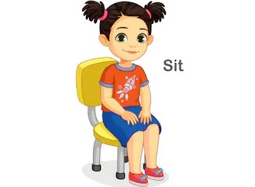
NEW WORDS MEANINGS
Seat

Slide 11
NEW WORDS MEANINGS
Friend : A good relationship.

Slide 12
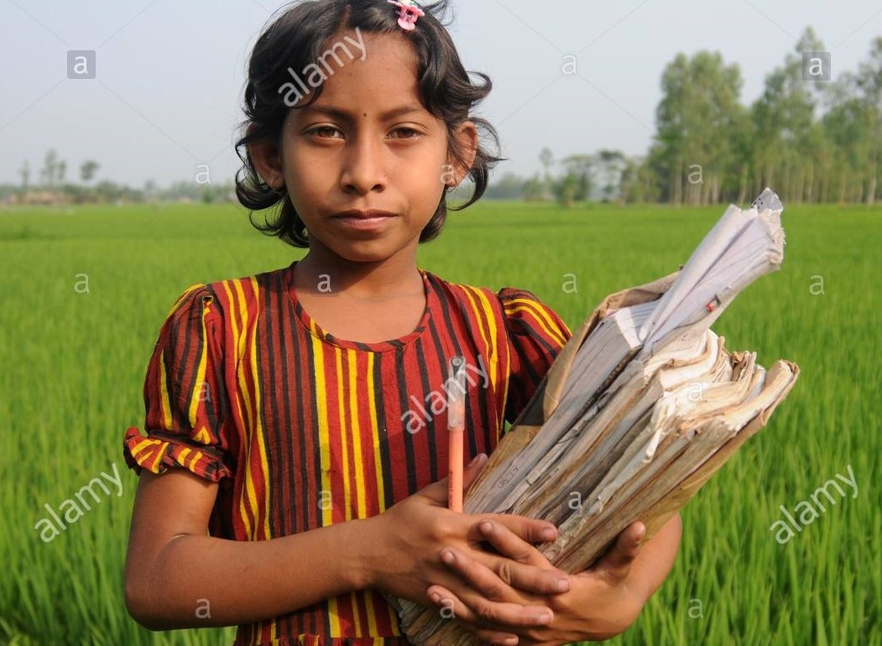
NEW WORDS MEANINGS
Student : Learner

Slide 13
Listen to the text with me and put your finger under the line.
I’m Radif. I’m eight years old. Anik is my friend. He’s eight years old, too. We go to Rajbari Primary School. We are in the same class. Anik sits next to me. In the afternoon , we play football.

Slide 14
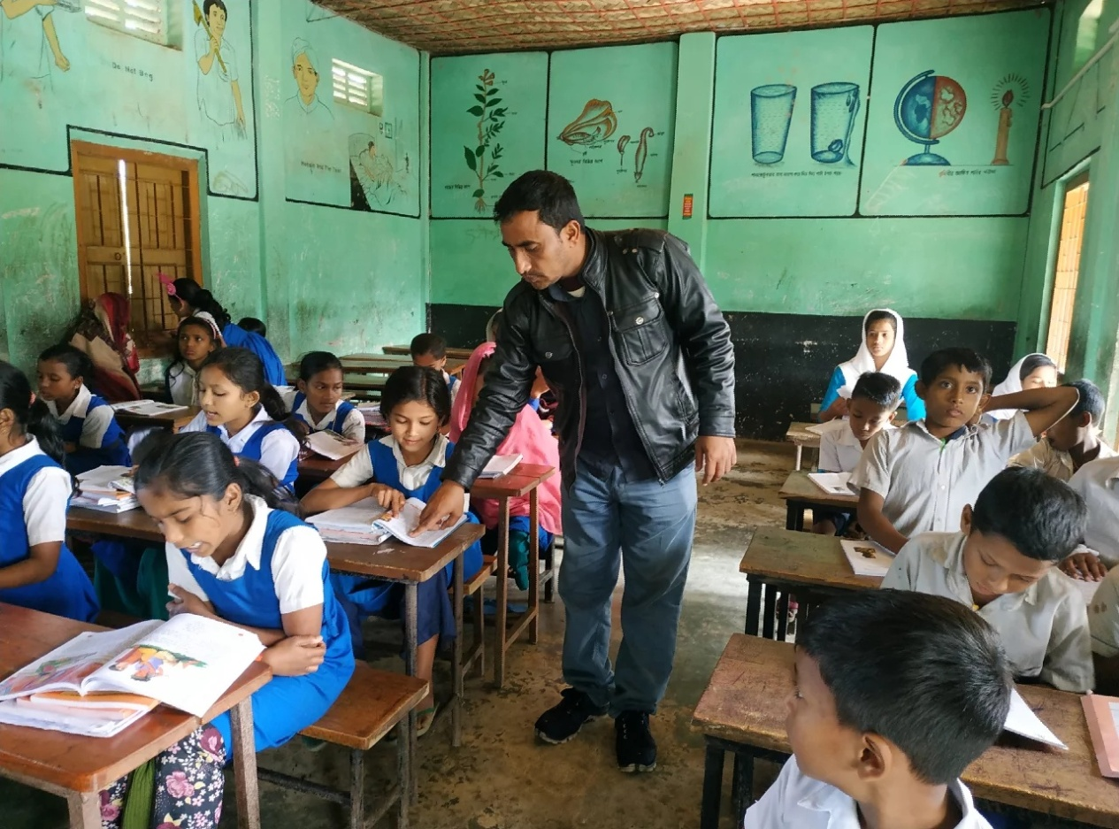
Now read loudly after me.

Slide 15
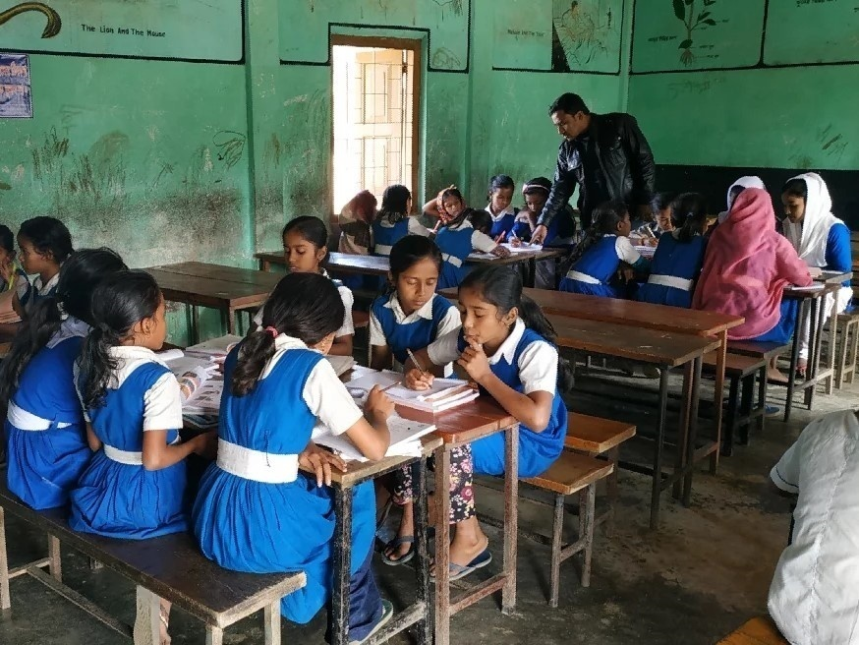
Now read the text in groups.

Slide 16
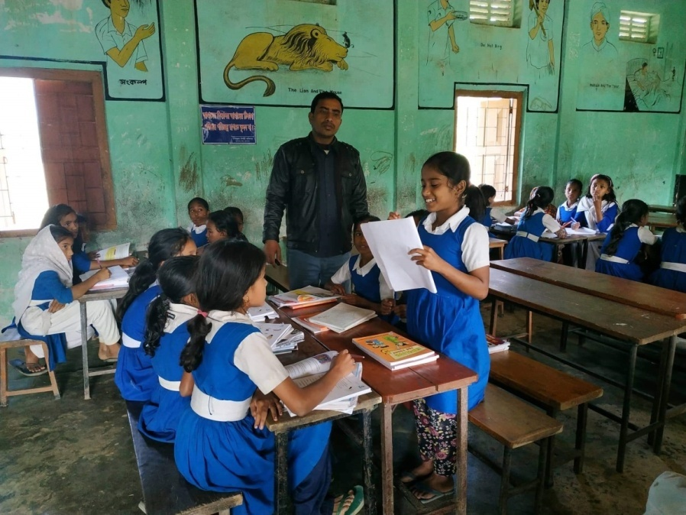
A student will be selected from every group to present their group work.

Slide 17
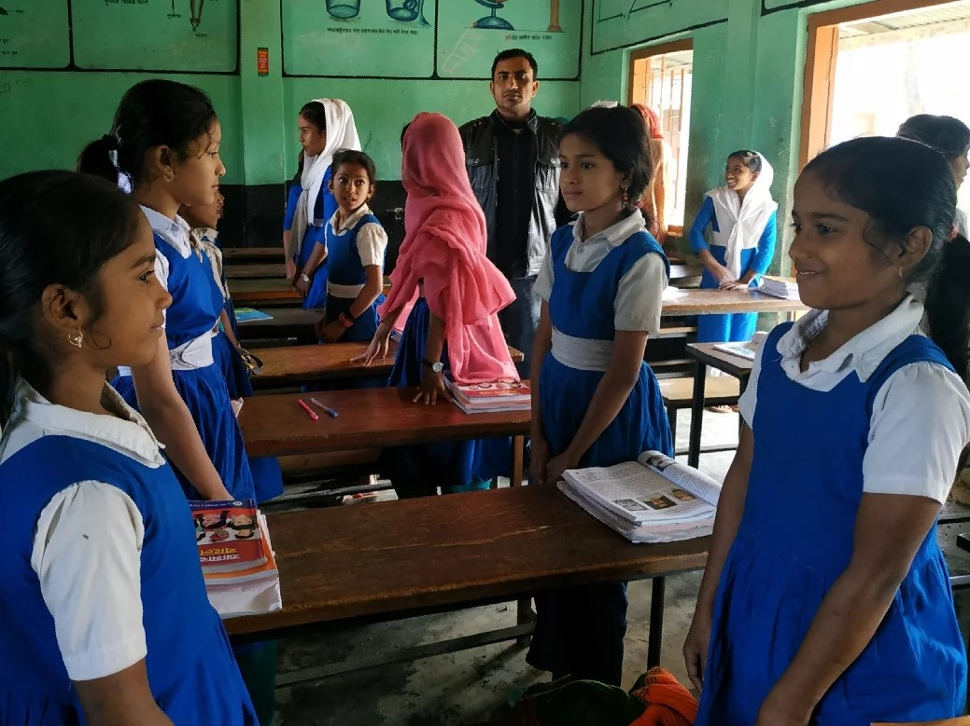
Pairwork.

Slide 18
Pairwork. Ask and answer.
1.How old is Radif ?
2.What is his friend’s name ?
3.How old is Radif’s friend ?
4.What school do they go to ?
5. Where does Radif sit in class ?
6.What do they do in the afternoon ?

Slide 19
Homework
Write a paragraph about “Your Friend” by using the following questions:
What is your friend’s name?
How old is your friend?
What school does your friend go to?
Where does your friend sit in class?
What do you do in the afternoon ?

Slide 20
GOODBYE

