Slide 1
Welcome To Multimedia Class.
Nelufa Afrose Bithi

Slide 2
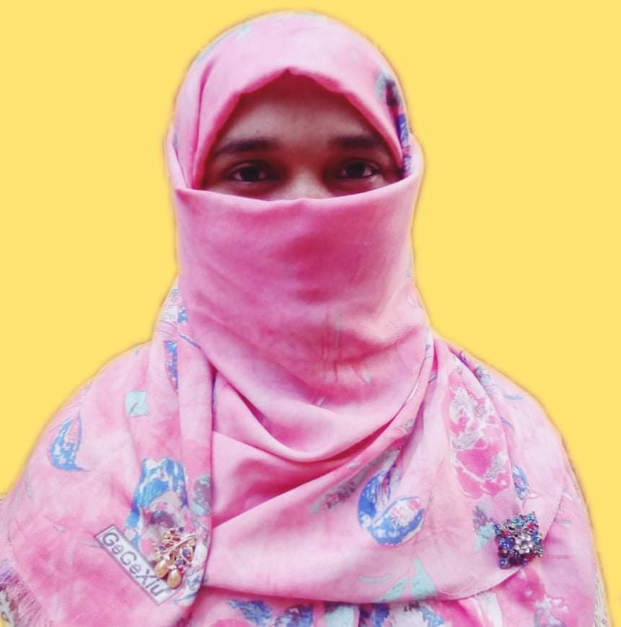
Identity
Mosammat Nelufa Afrose Bithi
Lecturer in English
Khilbaisa Rahmania Fazil Madrasah
Sadar, Lakshmipur
E-mail:nelufa.afrose@gmail.com
Nelufa Afrose Bithi

Slide 3
Lesson
Class- Alim/ xi/xii
Subject- English For Today
(English 1st paper)
Writing part.
Nelufa Afrose Bithi

Slide 4
Let’s watch a video -
https://www.youtube.com/watch?v=6QidTW0Ksgk
The video is about the early marriage..
What is the video about?
Nelufa Afrose Bithi

Slide 5
Our today’s Lesson is -
Paragraph on-
“Early marriage/Child marriage/Premature marriage”
According to U-5,L-4
Nelufa Afrose Bithi

Slide 6
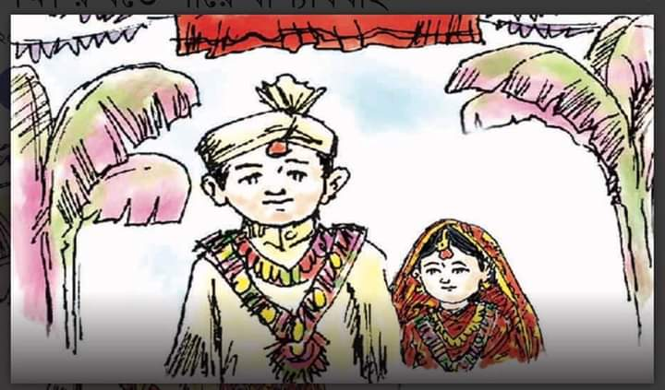
By the end of the lesson students will able to know-
The causes of early marriage.
Harmful consequence of early marriage.
Public awareness.
Nelufa Afrose Bithi

Slide 7
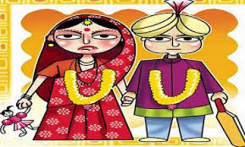
Paragraph on Early marriage-
Early marriage means a wedding of a young or girl before reaching puberty.
Nelufa Afrose Bithi

Slide 8
According to WHO, the age limit of marriage is 21 for males and 18 for females.
Any marriage before these figures of age is considered early marriage.
Nelufa Afrose Bithi

Slide 9
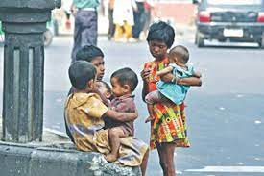
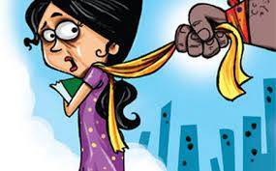
It is one of the social problems in Bangladesh. This problem is quite common everywhere in Bangladesh especially in rural areas. Various factors such as gender discrimination, poverty, ignorance, superstition , eve-teasing etc. are mainly responsible for early marriage.
Nelufa Afrose Bithi

Slide 10
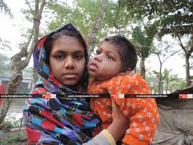
But it doesn’t bring any good to the society.
It leads to conjugal and family conflict, premature motherhood. Immature males and females cannot adjust themselves to their marital life.
Therefore quarrels and misunderstanding are inevitable. It spoils mental peace and physical fitness.
Besides, being a mother at an early age a female cannot play the role of a real mother.
Nelufa Afrose Bithi

Slide 11
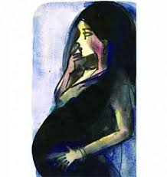
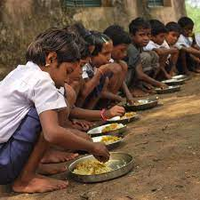
Moreover, she is attacked with various diseases. She faces the risk of her life.
Premature marriage is also responsible for population explosion.
Nelufa Afrose Bithi

Slide 12
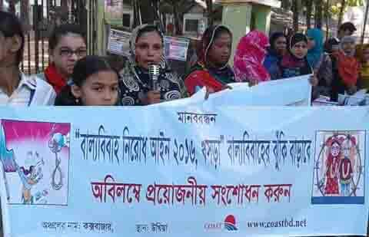
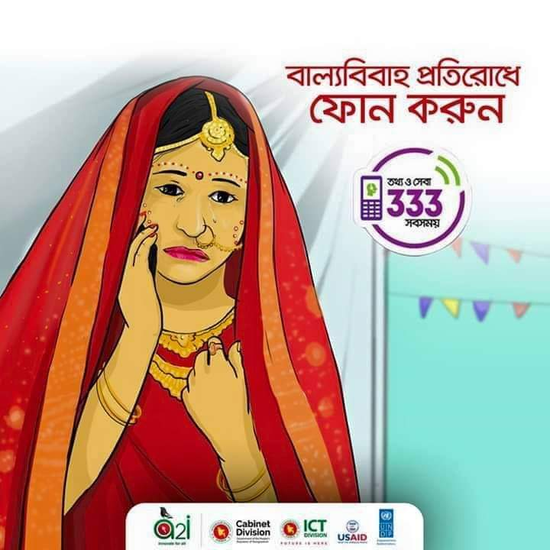
So, premature marriage should be stopped to save our future generation.
Government and non-government organisations should come forward to remove this problem from our country.
Nelufa Afrose Bithi

Slide 13
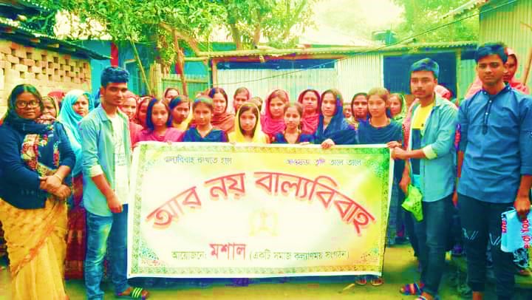
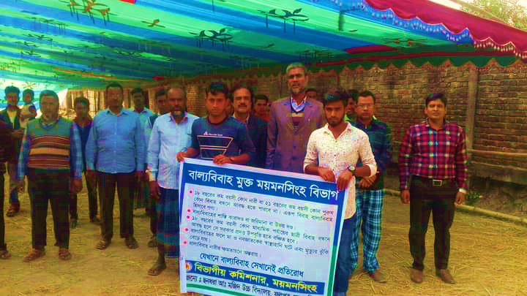
Mass education should be ensured.
Above all, social awareness must be developed.
Nelufa Afrose Bithi

Slide 14
Evaluation
Answer the following questions:
1.What are some the main causes of early marriage?
2.“Girl children are more victim of early marriage,” why? Mention 5 reasons of it.
3 Imagine, if an early marriage is arranged in your neighbourhood, what will you do?
Nelufa Afrose Bithi

Slide 15
Individual Work
Write 5 adverse effects of child marriage.
Nelufa Afrose Bithi

Slide 16
Pair work
How can we solve early marriage? Write 5 points.
Nelufa Afrose Bithi

Slide 17
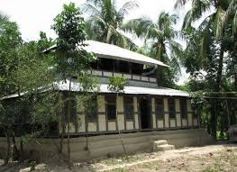
Home Work
Write a paragraph on “Early marriage”.
According to Board question no-7
Nelufa Afrose Bithi

Slide 18
Thank You
Nelufa Afrose Bithi

