Slide 1
Welcome to my class

Slide 2
Md . Saifuddin khan
Lecturer in English
Hajee Goyes Uddin Mohila Fajil Madrasah
Bhangura , Pabna .
Mobile: 01710449379 .
Email:skhan84bd@gmail.com
English for today
Class :xi&xii
Time ;40 minutes.

Slide 3
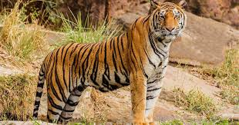
The Royal Bengal Tiger

Slide 4
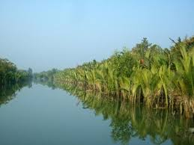
The Mangrove Forest

Slide 5
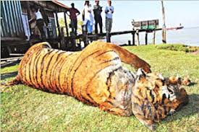
Today our topic is
Threats to Tigers of Mangrove Forest.
Unit : twelve
Lesson : four

Slide 6
Learning outcomes
After reading the text students will be able to
1.Tell the meaning of some new words .
2.Write about Mangrove Forest .
3.Tell the reasons of destroying tiger rapidly .
4.Write the view of Natalie Pettorelli on the sundarbans.

Slide 7
Key word
Meaning
Destroy (v)
Demolish
Erosion (n)
Decay
Coastline (n)
Sea side
Threat (n)
Risk
Evident (adj)
Explicit
Extend (v)
Amplify
Recede (v)
Retreat
Vanishing (adj)
Annihilating
Extreme (adj)
Excessive
Indicate (v)
Allude
Shield (v)
Defence

Slide 8
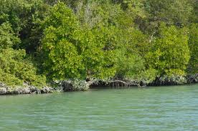
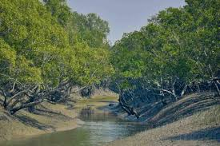
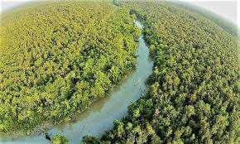
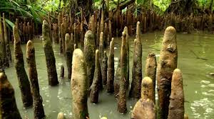
Images of Mangrove forest

Slide 9
Single Work
What do you mean by Mangrove Forest?

Slide 10
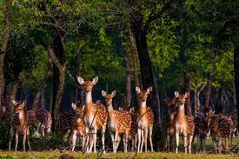
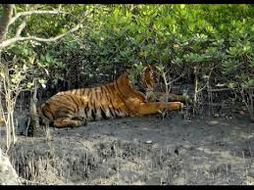
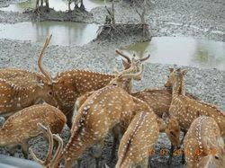
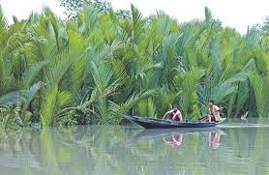
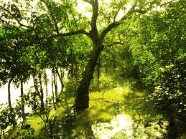
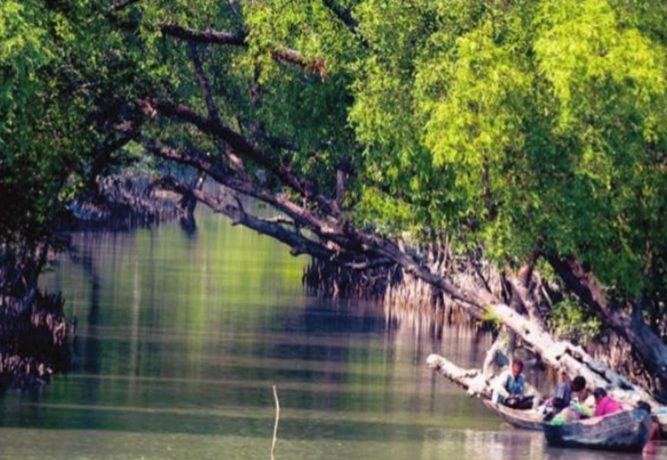
The Sundarbans ,natural shield of Bangladesh and India , but degradation is happening fast.

Slide 11
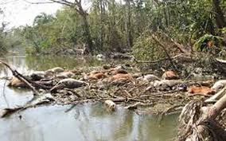
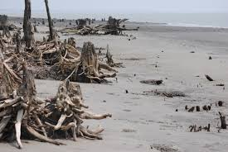
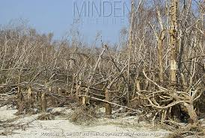
The Sundarbans forest took the brunt of super cyclone sidr in 2007.

Slide 12
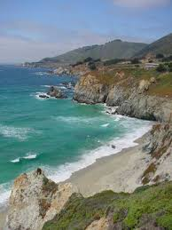
Erosion

Slide 13
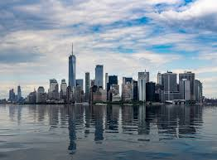
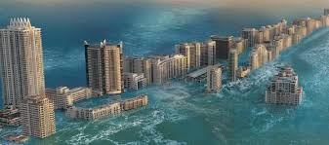
Rising of sea levels

Slide 14
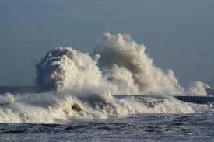
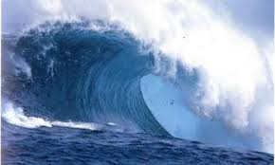
Storm surges

Slide 15
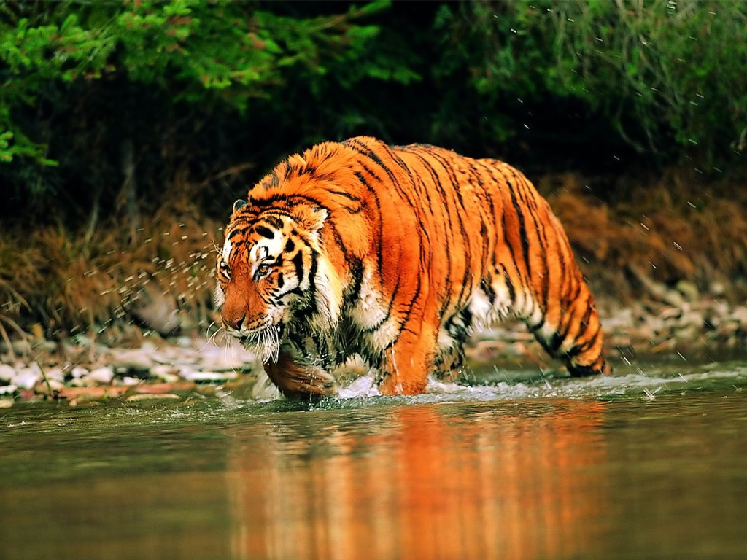
Pair work
Mention the reasons of destroying tigers in the Sundarbans.

Slide 16
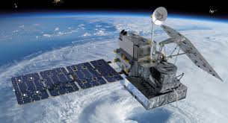
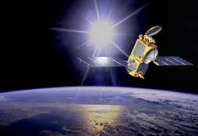
Satellite

Slide 17
Group work
1.What could be the closest meaning for ‘vast’.
(a)Important (b) ample (c) noteworthy (d) huge.
2.The sundarbans is home to possible …….. Royal Bengal tigers.
(a) 500 (b) 100 (c) 300 (d) 200
3.What is the correct meaning of the word ‘rising’.
(a) Repeatedly (b) continuously (c) increasing(d) retiring .

Slide 18
Evatuation
1.What will happen if we lose the Sundarbans ?
2.What is the view of Natalie Pettorelli on Bangladeshi part of Sundarbans ?
3.Why is the Sundarbans called a natural shield ?
4.What do you suggest to save the sundarbans?
5.What do you know about Satellite study on the Sundarbans.

Slide 19
Home work
Describe the causes of extinction of tigers in the Sundarbans.

Slide 20
Thank you all .

