Slide 1
Welcome dear students.

Slide 2
Introduction
Md. Mokhlesur Rahman
Head Teacher
Kadam Mobarak City Corp. High School,
Kotowali, Chattogram
English 2nd Paper , Class – IX-X
Grammar

Slide 3
Bag
Tag
A bag with a tag.
Tag means to add something with other thing .

Slide 4
Question Tag.
He is a student,
isn’t he?
What is this?

Slide 5
Our Today’s Class is on
Tag questions
English 2nd Paper (IX-X)
Unit-8, part-1

Slide 6
Learning Outcomes
After we have studied this lesson, we will be able to-
define question tag
identify tag operators
apply tag
different use of tag

Slide 7
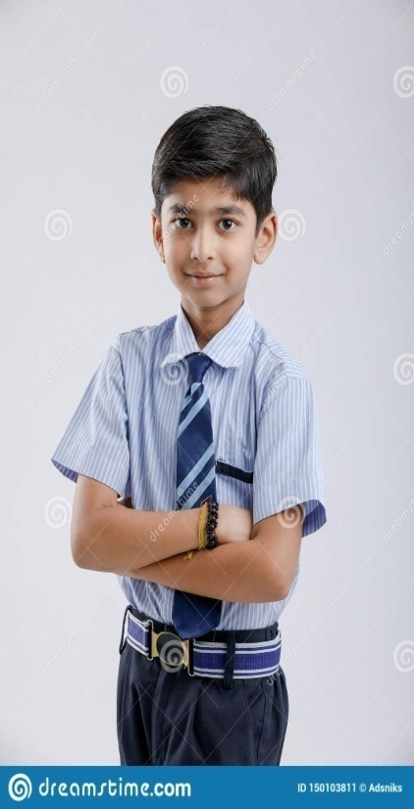
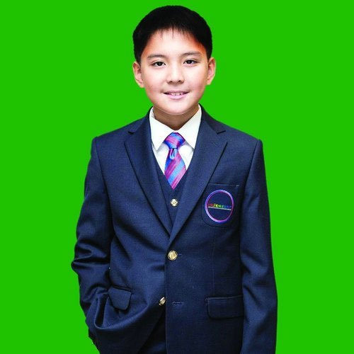
You are Jafar, aren’t you?
Tag
Adding something with other
A tag question is a question that is used at the end of a statement to get the support from the listener.

Slide 8
A computer operator.
Am, is, are, was, were
Tag question operators
shall, should, will , would, can, could, may, might, have, has, had, must, ought, dare, need.
Do, does & did (Used in action verbs)

Slide 9
Tag question basic/contraction form of the operators.
Am not = aren’t/ain’t
Is not = isn’t
Are not = aren’t
Was not = wasn’t
Were not = weren’t
Will not = won’t
Shall not = shan’t
Can not = can’t
Could not = couldn’t
May not = mayn’t
Might not = mightn’t
Must not = mustn’t
Has not = hasn’t
Have not = haven’t
Had not = hadn’t
Do not = don’t
Does not = doesn’t
Did not = didn’t
Ought not = oughtn’t
Dare not = daren’t
Need not = needn’t

Slide 10
How to form a tag question?
1. Structure in positive statement
isn’t he?
Habib is an honest boy,
Statement + , + operator +n’t+ subject (pronoun) +?
2. Structure in negative statement
is she?
She is not my mother,
Statement + , + operator + subject (pronoun) +?

Slide 11
Add tag to the following
1. Rubina was a brilliant student, __________?
wasn’t she
2. You were not a player,__________?
were you
3. They are our guests,_____________?
aren’t they
4. We cannot do this now,_________?
can we
5. He may come tomorrow,__________?
mayn’t he
6. We should not disobey our parents,___________?
should we
couldn’t you
7. You could do it easily,_____________?
8. They must not play bad,__________?
must they
9. I have a pen, _______?
don’t I
10. You had better go,_____________?
hadn’t you

Slide 12
How will you add tag, if there is no operator in the sentence?
My mother cooks very well,
doesn’t she?
don’t we?
We play football regularly,
He went to market yesterday,
didn’t he?
Notes
If there is V₁ with ‘s/es’, add tag with doesn’t/does,
2. If you find V₁ without ‘s/es’, add tag with ‘don’t/do’,
3. If you find V₂ , add tag with ‘didn’t/did’ as operator.

Slide 13
Exceptions
If you find ‘s/es after everybody, everyone, nobody, no one, somebody, some one, one, none, the above rules will not be effective. In that place you have to add ‘don’t they/do they’
Everyone respects him,
don’t they?
Nobody likes a man of bad temper,
do they?

Slide 14
No more today
Thank you all

