Slide 1
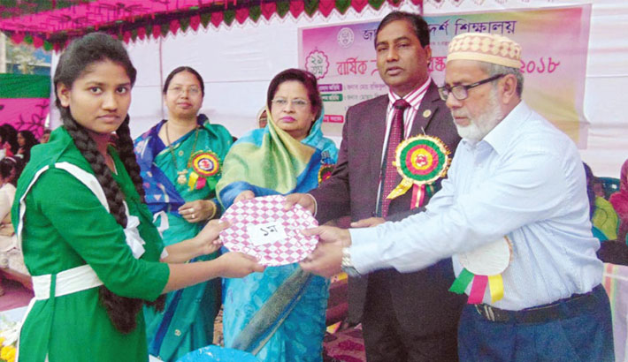
Welcome

Slide 2
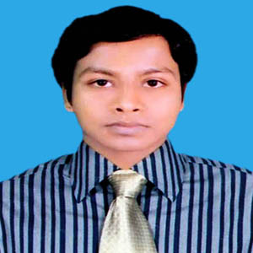
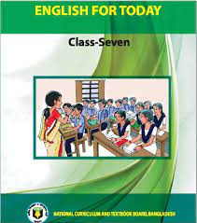
IDENTITY
Class: Seven
Subject: English First Paper
Unit: 3 Lesson: 1
Md. Shahinuzzaman
Assistant Teacher
Azampur Secondary School
Mirpur,Kushtia.
Mobaile No: 01737385556
e-mail: shahinuzzamanahs@gmail.com

Slide 3
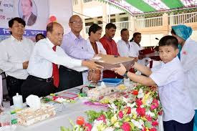
Look at the picture carefully:
What can you see in the picture?
Answer.
In the picture I can see
a boy is receiving prize
from the chief guest.

Slide 4
Prize giving day at school.

Slide 5
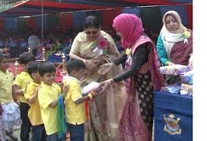
Look at the pictures and talk about discuss the following questions
Who can you see in the picture?
What are they doing?
Answer:
In the picture, I can see some boys standing in a queue
2. One of the boys is receiving prize from the chief gust

Slide 7
C. Match the words with their meanings.
visit----to go to see a person or place
ceremony----function
eminent---people having lots of power and influence
praise---speak highly of something or somebody
outstanding----extremely good
display---put something in a place where you can see it easily

Slide 8
D. Ask and answer in pairs. Make questions and then choose answers from this table.
How |  | the prize giving function.
What | was | the auditorium decorated?
Who |  | the chief guest at the function?
Where | did | the Head Teacher do at the beginning of the function?

Slide 9
Answer.
1. How was the auditorium decorated?
Ans. The auditorium was decorated brightly.
2. What did the Head Teacher do at the beginning of the function?
Ans. The Head teacher read out the annual report.
3. Who was the chief guest at the function?
Ans. The Principal of PN College was the chief guest at the function.
4. Where was the prize-giving function held?
Ans. The prize giving function was held in the school auditorium.

Slide 10
Home Task
Do you have a sports day at your school? First tell the class about it and then write about it in your note book.

