Slide 1
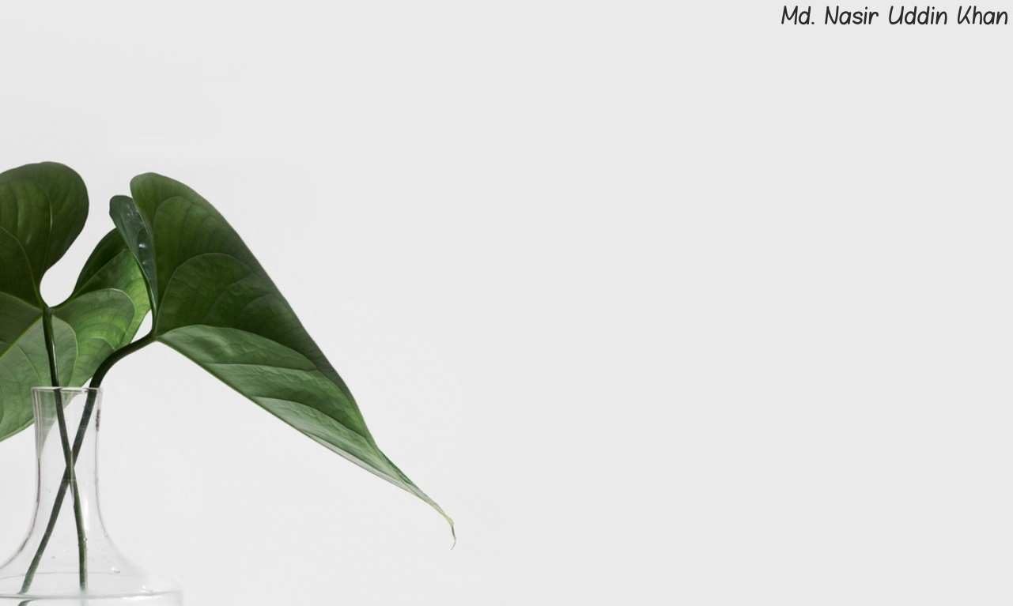
Welcome
To
English Class

Slide 2
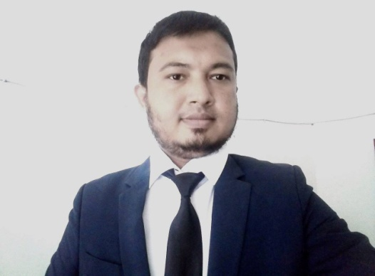
Teacher’s Identity
Md. Nasir Uddin Khan
Assistant Teacher
Gridakalindia GPS
Faridgonj, Chandpur
01687422109
nu01687@gmail.com

Slide 3
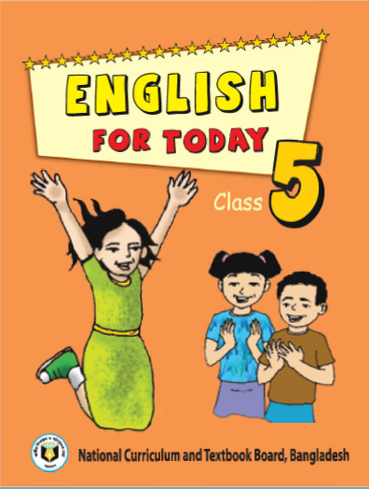
Lesson Identity
Class Five
Subject : English
Unit : 3
Lessons : 1-2
Topics :Saikat’s Family!

Slide 4
Learning Outcomes:
Students will be able to -

Slide 5
Good morning students . How are you?
I am fine Alhamdulillah
Let’s listen a greeting song together.

Slide 6
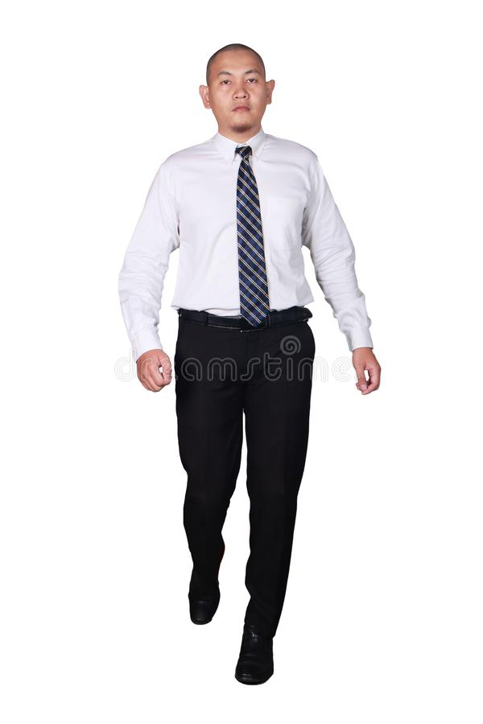
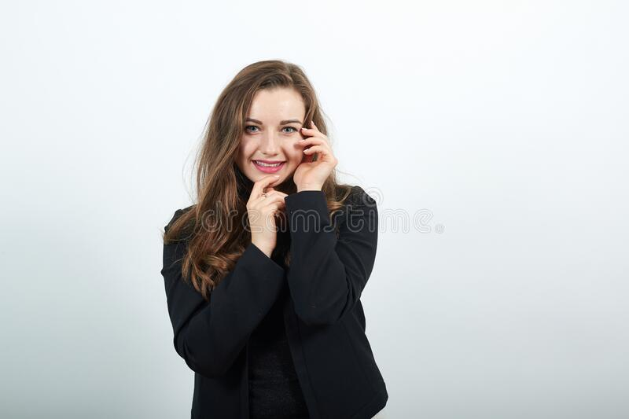
Lets remember our previous class topic.
Please think and answer correctly.
What title do we use to address a man?
Anwer: Mr.
What title do we use to address a married woman?
Answer: Mrs.
What title we use to address both married and unmarried woman?
Answer: Ms.

Slide 7
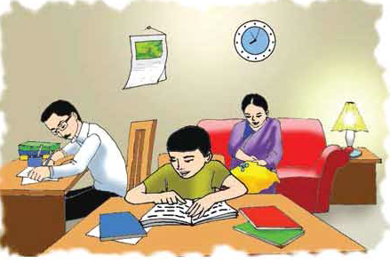
What do you see in the picture below? Think and say
Yes, the picture shows three person in a room. They are Saikat and his parents.

Slide 8
Dear Students, tell me what are they doing?
Yes, the woman sitting on the sofa and sewing . The man writing something and Saikat reading a book.

Slide 9
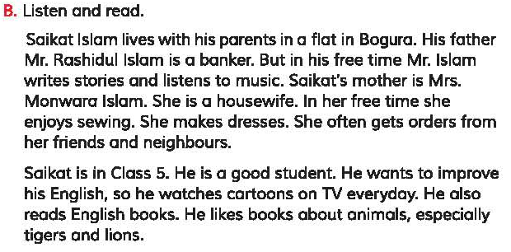
Now listen the text carefully and pronounce with me loudly.

Slide 10
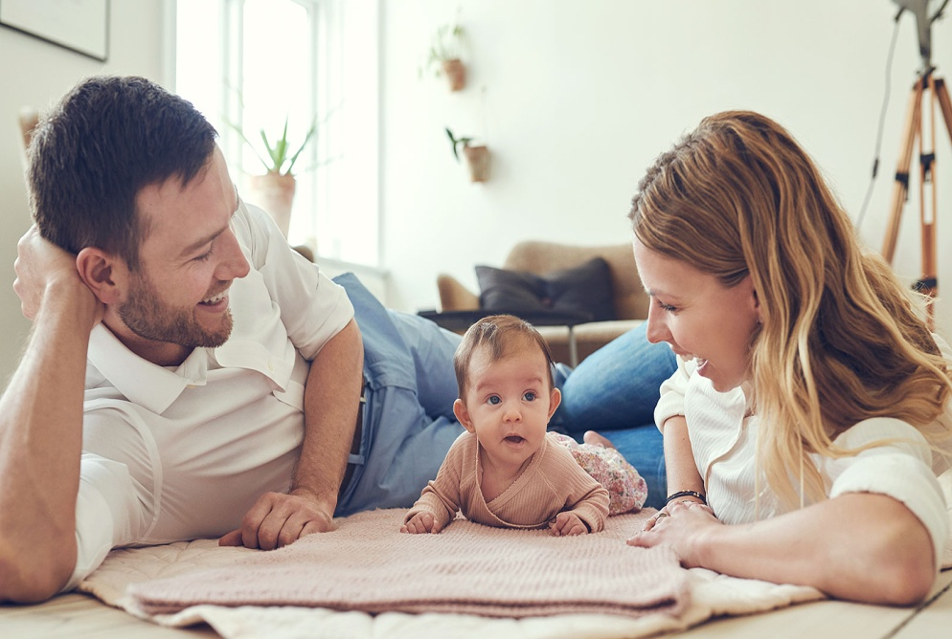
a person employed by a bank
Banker
ব্যাংকার
a person's father or mother.
Parents
মাতাপিতা

Slide 11
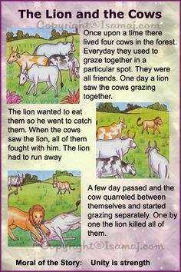
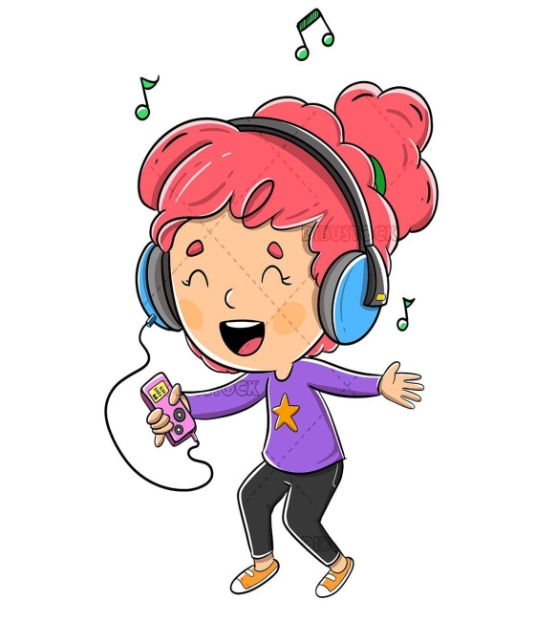
the facts about the present situation.
Stories
গল্প
a sound perceived as pleasingly harmonious.
Music
গান

Slide 12
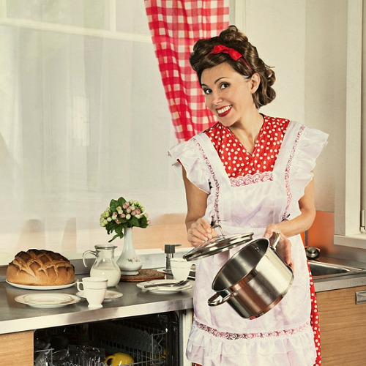
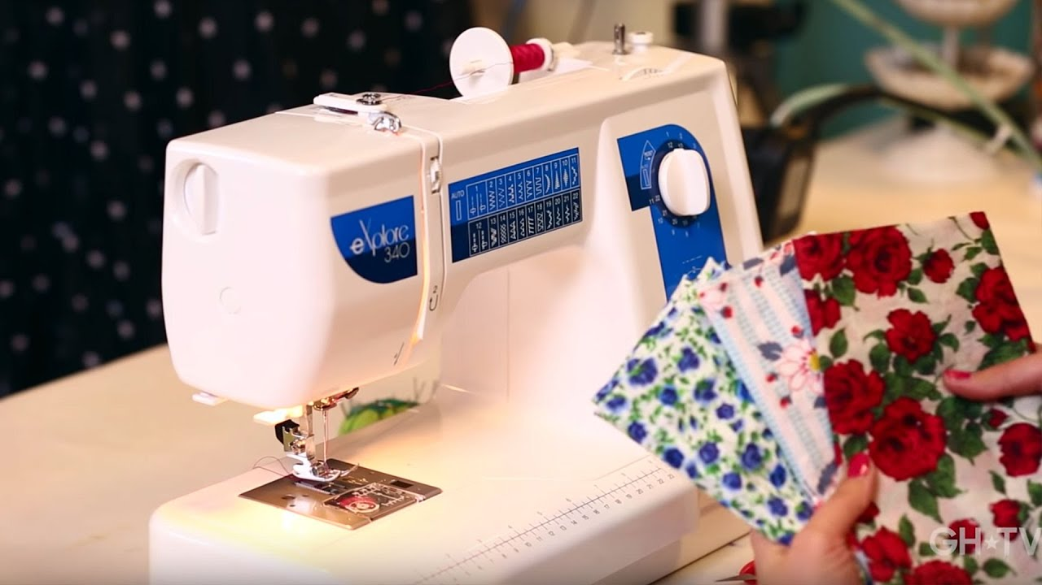
a woman whose main occupation is caring for her family
Housewife
গৃহিনী
the action or activity of sewing.
Sewing
সেলাই

Slide 13
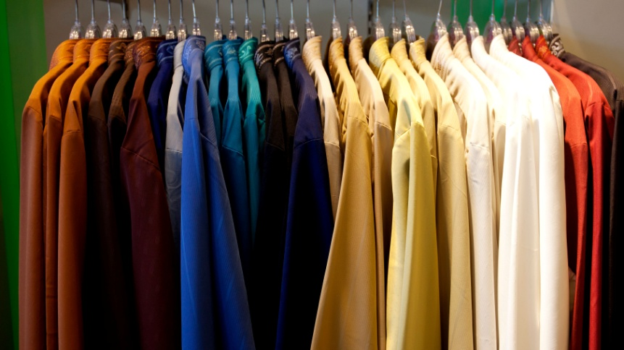
items worn to cover the body.
Cloths
জামাকাপড়
make or become better.
Improve
উন্নতি

Slide 14
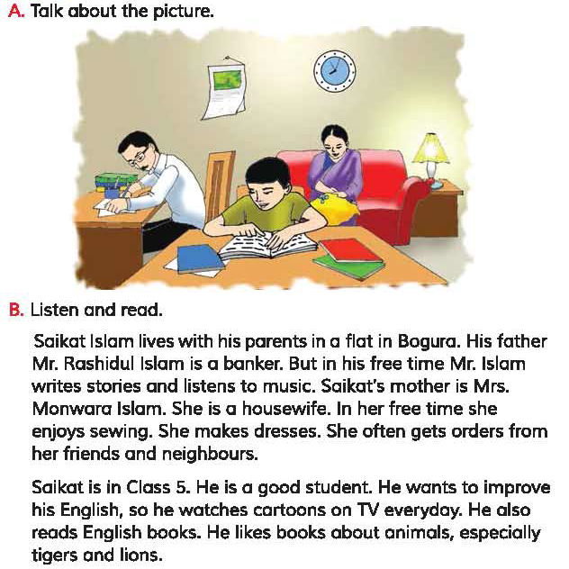
Silent reading

Slide 15
Individual work
What is saikat’s parents occupation?

Slide 16
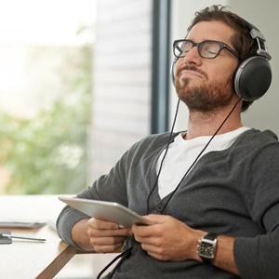
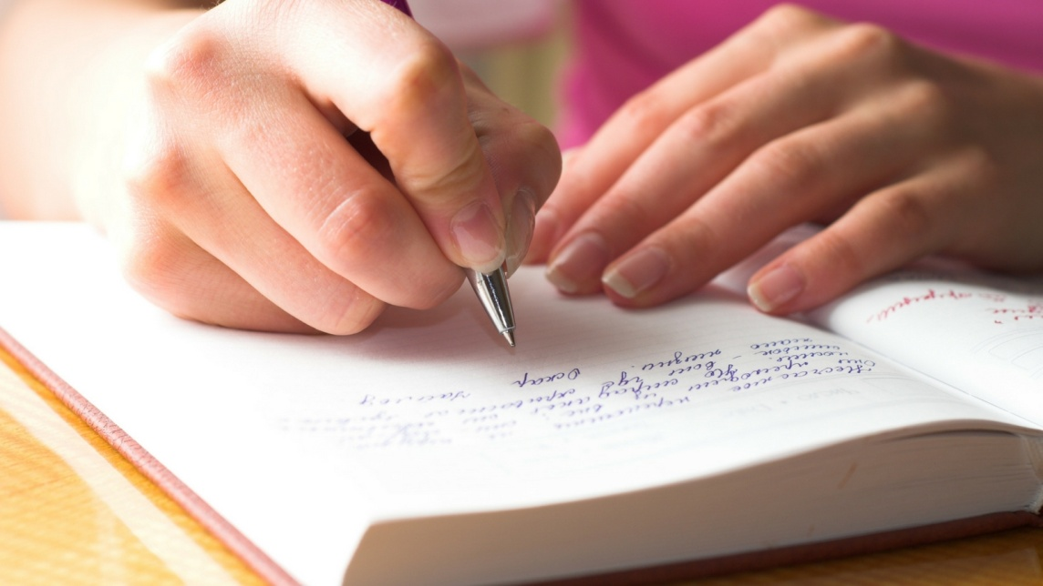
Individual work
What do his parents do in their free time?

Slide 17
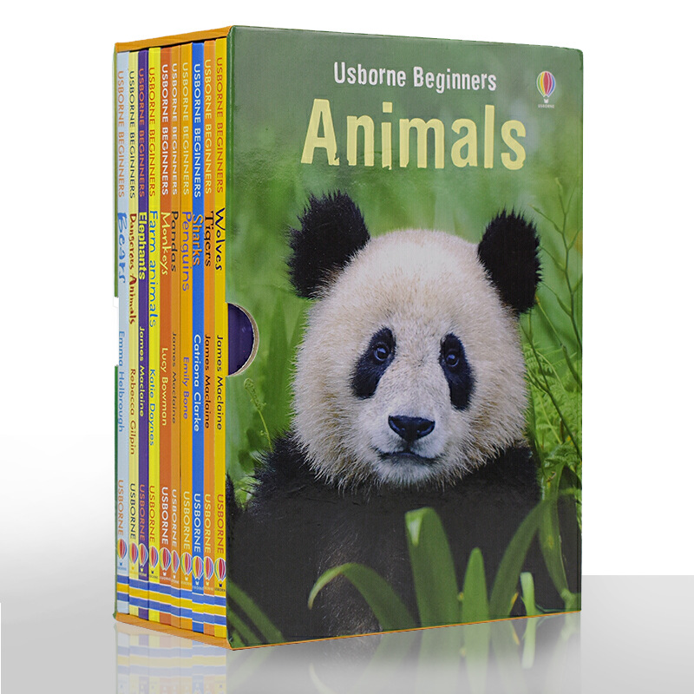
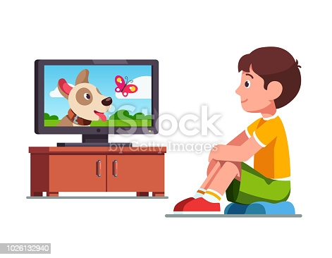
Individual work
What does Saikat do in his free time?

Slide 18
Pair Work
What is saikat’s father’s name?
What is saikat’s mother’s name?
What kind of books does like Saikat?

Slide 19
Checking learning
What have you learned from today's lesson?
Today, we have learnt what people do in their free time

Slide 20
Answer the following Questions
What is Mrs. Monwara Islam?
What does Saikat’s father do in his free time?
What does Saikat’s Mother do in her free time?
How can Saikat’s improve his English?
What kinds of book does Saikat’s like?

Slide 21
Home Work
Write a short composition about “Your Family”

Slide 22
One day one word
Occupation
পেশা
A job or profession.
Occupation

Slide 23
Thank you all.
Stay home , Stay safe

