Slide 2
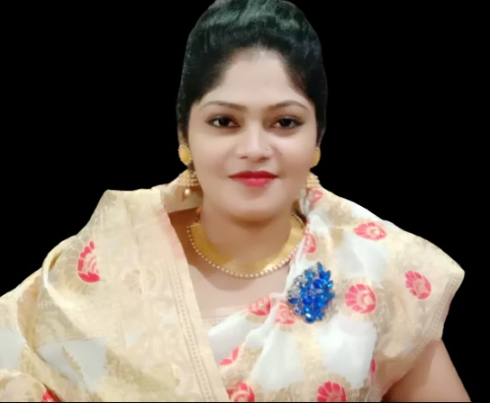
Presented by
Hafiza Khanam. Assistant teacher.
99 No. Nilokhi G.P.S.
Gopalganj Sadar,
Gopalganj.
khanamhafiza@gmail.com
Class: Five
Subject: English
Unite : 13.
Telling the time.
Lesson:2-3,
Page : 51

Slide 3
Let’s watch a video
We were watching a video.
Now tell me what about the video is?

Slide 4
Today’s lesson
Telling the time

Slide 5
LISTENING:
1.3.1 recognize which words in a sentence are stressed.
1
SPEAKING:
5.1.1 tell the time.(hours and minutes) and mention a.m./p.m, half past, quarter past, quarter to etc.
2
READING:
3.2.1 read the clock.(hours and minutes) and say a.m./p.m, half past, quarter past, quarter to etc.
3

Slide 6
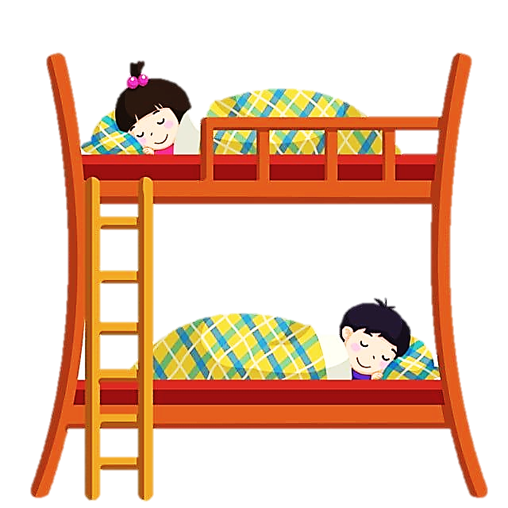
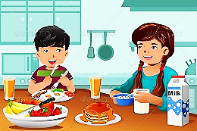
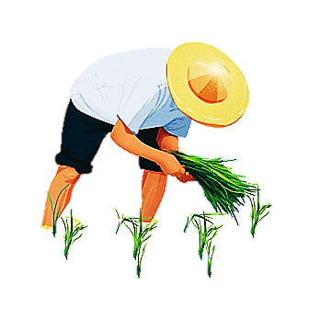
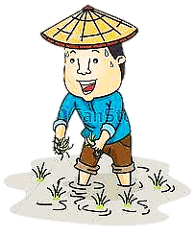
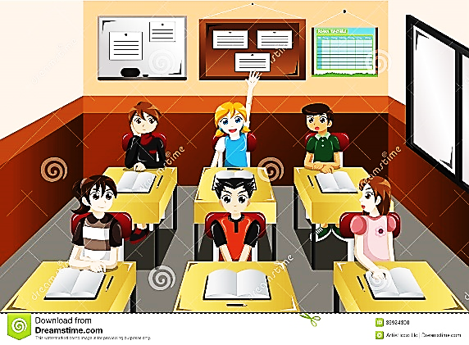
Open at page 51
What do you see in the pictures?
Notice some pictures
12
11
12
1
12
12
10
2
11
1
2
10
2
2
3
9
3
3
3
3
9
3
8
4
8
4
7
6
5
7
5
6
12
11
12
1
12
10
2
12
2
11
1
3
3
9
3
10
2
2
4
3
3
8
9
3
7
6
5
8
4
7
6
5

Slide 7
What do you see in the picture?
12
Look at the picture.
12
11
1
10
2
2
3
3
9
3
8
4
7
5
6
It’s midnight. It’s 12 o’clock. They’re sleeping.
What time is it according to the clock?

Slide 8
What do you see in the picture?
Look at the picture.
12
12
11
1
10
2
2
3
3
9
3
8
4
7
5
6
It’s 8 o’clock. They’re having breakfast.
What time is it according to the clock?

Slide 9
What do you see in the picture?
Look at the picture.
12
12
11
1
10
2
2
3
3
9
3
8
4
7
5
6
It’s 1 o’clock. They’re at school.
What time is it according to the clock?

Slide 10
What do you see in the picture?
Look at the picture.
12
12
11
1
10
2
2
3
3
9
3
8
4
7
5
6
It’s 6 o’clock. They’re helping their father.
What time is it according to the clock?

Slide 11
Group work
Make five groups. Read part B in a group. The group leader of each group came forward and read aloud the description below each picture.

Slide 12
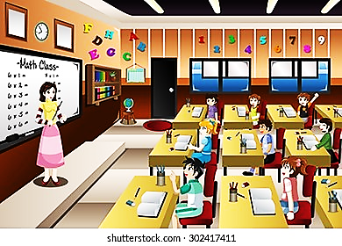
Read and discuss among yourself .
W.C.W
ENGLISH
12
11
12
1
10
2
2
3
9
3
3
8
4
7
6
5

Slide 13
Pair Work
Sit in pair and look at the time mentioned in the picture and discuss what you do at that time .

Slide 14
ONE DAY ONE WORD
Midnight =
Late night=
At midnight, I’m sleeping.

Slide 15
Homework
According to your English book at page 51 draw four clocks and write four sentences what you do at that time.

